Slide 1
GROUP17-CDBT
The second-hand car service!
Group Member:
Peng.Yu -- 46635884
Xuanche.Liu -- 46548304, Yuexiang.Zhao -- 45842452
Xuanru.Liu – 45663264

Slide 2
Part 1 -- Background & E-R map

Slide 3
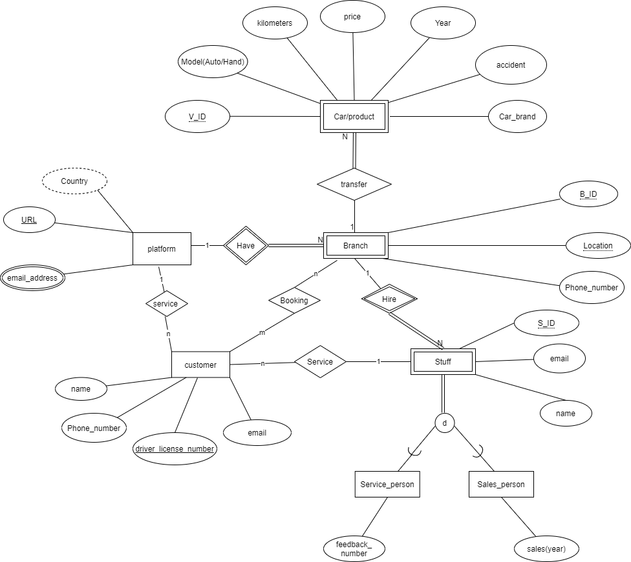
E-R map

Slide 4
Part 2 -- SQL code & Database

Slide 5
Part 3 -- Code & Web operation

Slide 6
Thanks for Listening !

