Slide 1
DATA7202 Tutorial 1
Date: 3/2/2021

Slide 2
Agenda
ECP introduce (10 min)
Lab 1 Q1-Q2 (60 min)
Assignment description (15 min)
Other questions

Slide 3
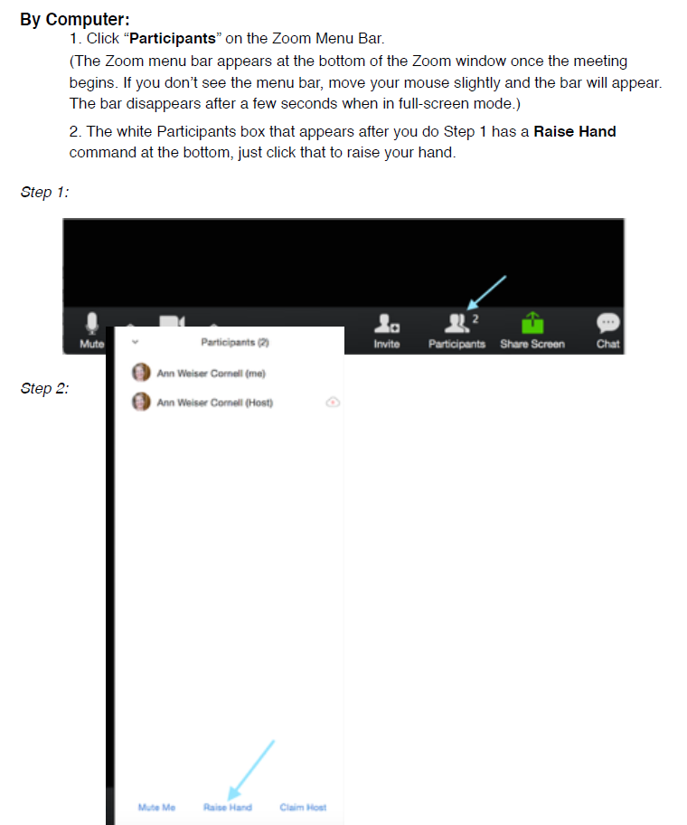
How to use Zoom for prac: * 20-30 mins for each part of question/each step; * Raise hand if you need help > breakout room one by one * Feel free to ask general questions or type the question in the chat

Slide 4

1. Install python
https://www.python.org/downloads/

Slide 5
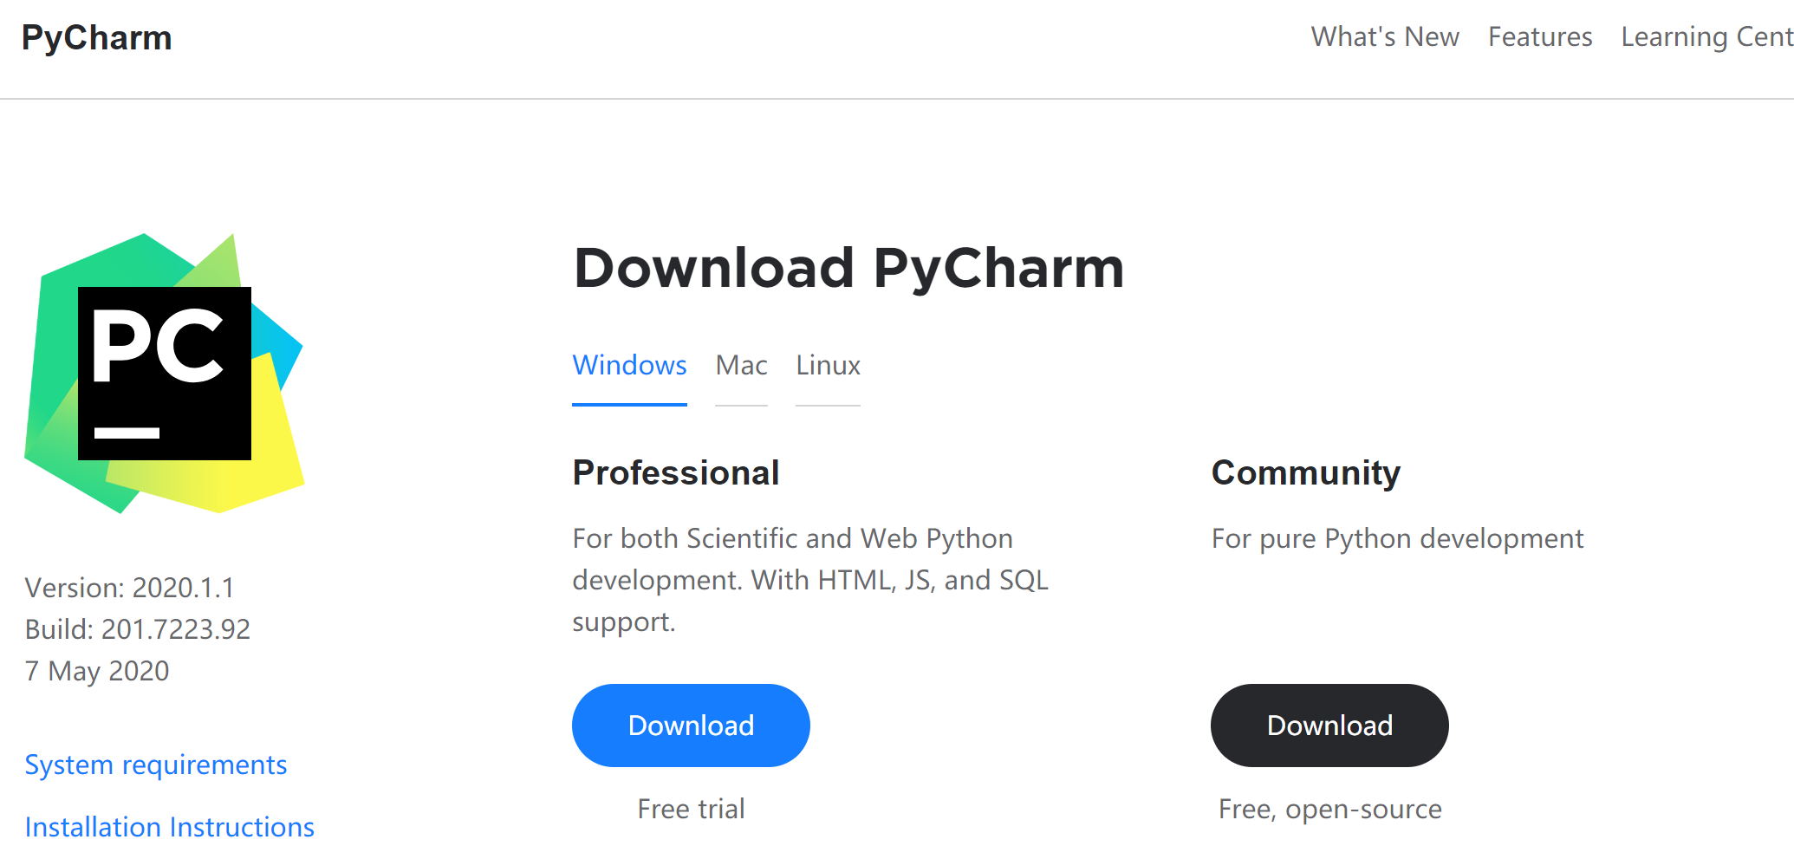
Install pycharm
https://www.jetbrains.com/pycharm/download/#section=windows

Slide 6
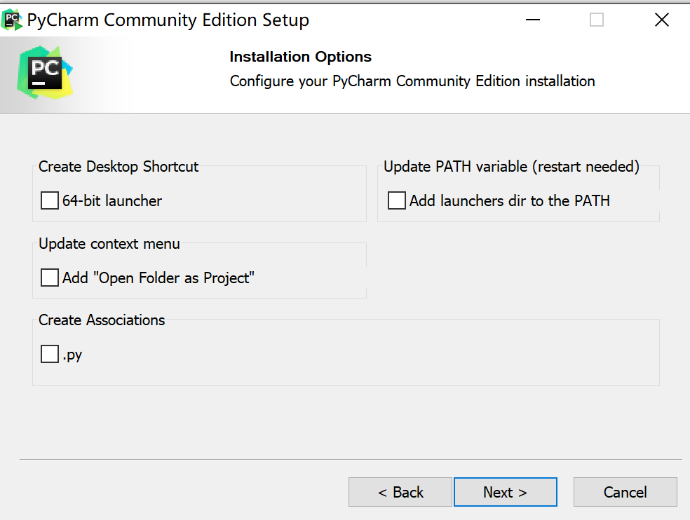
Install option for pycharm

Slide 7
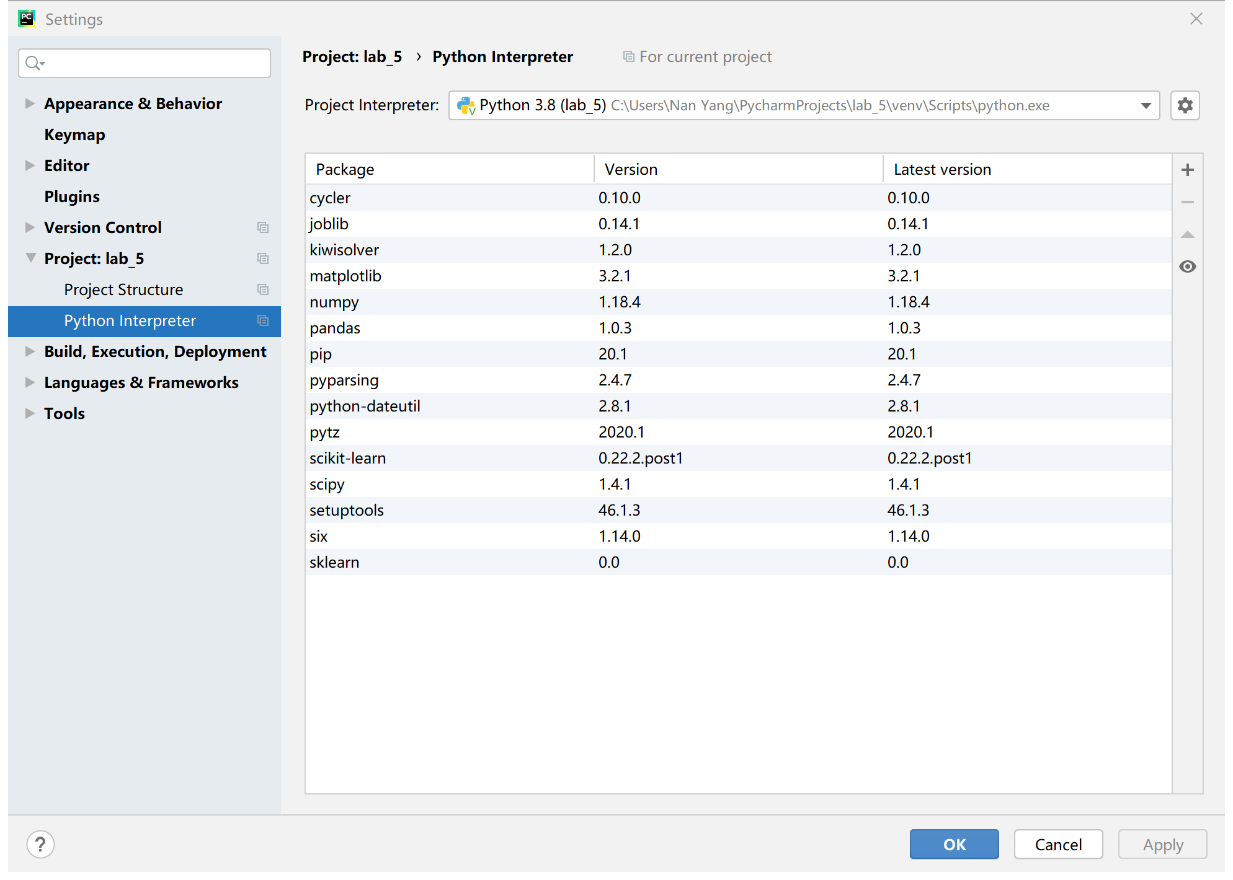
Install package
File -> setting

Slide 8
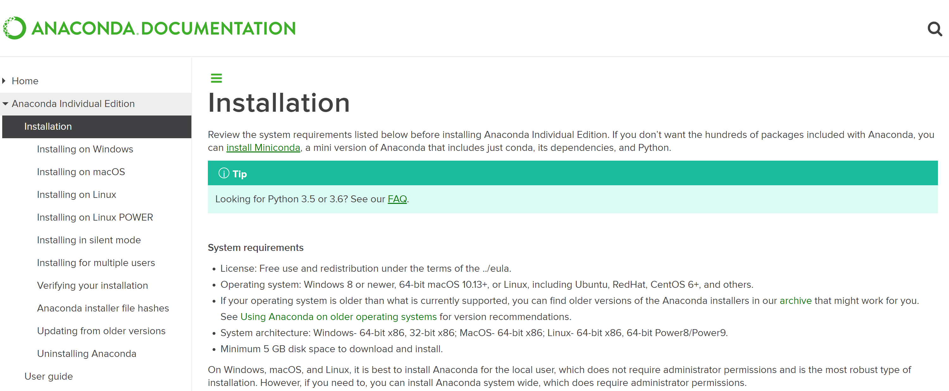
2. Install Jupyter
Anaconda: https://docs.anaconda.com/anaconda/install/

Slide 9
Q1 packages
from sklearn.datasets import make_regression from sklearn.datasets import make_classification import numpy as np import pandas as pd

Slide 10
Q1
Regression model
y
x

Slide 11
KNN model ( 2 dimension as example)
y
x

Slide 12
Q2 packages
from sklearn.model_selection import train_test_split
from sklearn import neighbors import numpy as np import pandas as pd
import matplotlib.pyplot as plt

Slide 13
Q3 packages
(1) Package
import numpy as np import pandas as pd from sklearn.linear_model import LogisticRegression from sklearn.metrics import confusion_matrix from sklearn.metrics import zero_one_loss

Slide 14
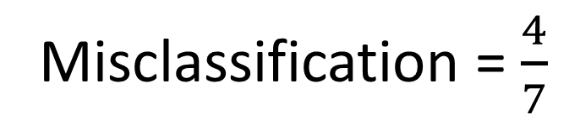
(2) Misclassification
True Value (y) | Predict Value (y) | Same?
0 | 1 | No
1 | 0 | No
0 | 0 | Yes
1 | 1 | Yes
1 | 0 | No
0 | 1 | No
0 | 0 | Yes
Misclassification = $\frac{4}{7}$

Slide 15
(3) Confusion Matrix
Prediction
Yes
No
TP
FN
Yes
True Positive
False Negative
Actual
No
FP
TN
False Positive
True Negative

Slide 16
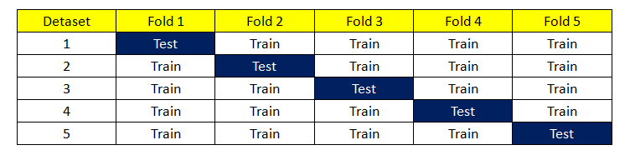
Q4
Cross-validation 0-1 Loss

Slide 17
(2) Classifier Functions
Classifiers | Commend
Multilayer | MLPClassifier(max_iter=2000)
K-Neighbors-Classier | KNeighborsClassifier(n_neighbors=5)
Support Vector Machine | SVC()
Random Forest | RandomForestClassifier(n_estimators=500, random_state=0)
Logistic regression | LogisticRegression()
Notes:
n_estimators : This is the number of trees you want to build before taking the maximum voting or averages of predictions.
Multilayer : multi-layer perceptron (MLP) from neural network models

Slide 18

(3) Scale
No. | A1 | A2
0 | 1 | 30.83
1 | 0 | 58.67
2 | 0 | 24.5
3 | 1 | 27.83
4 | 1 | 20.17
5 | 1 | 32.08
6 | 1 | 33.17
7 | 0 | 22.92
8 | 1 | 54.42
9 | 1 | 42.5
10 | 1 | 22.08
…
686 | 0 | 22.67
Scaled_A1
0.671648
-1.488875
-1.488875
0.671648
0.671648
0.671648
0.671648
-1.488875
0.671648
0.671648
0.671648
-1.488875
$$Scaled A= \frac{(A−\overline{A})}{\text{standard} \text{deviation} (A)}$$

Slide 19
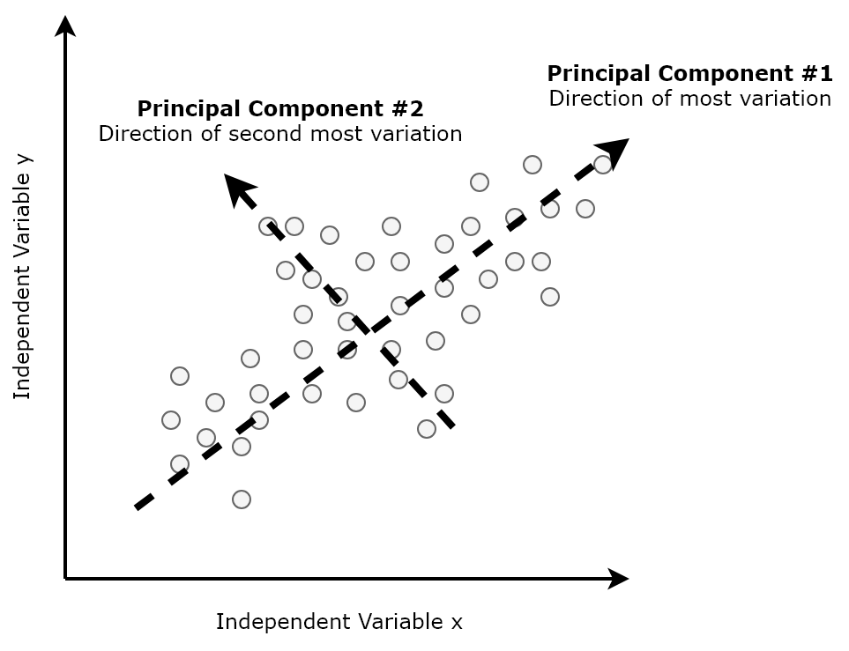
(4) PCA
PCA is a dimensionality reduction technique.
PCA project the entire set of data onto a different subspace, to determine a suitable subspace to distinguish between patterns that belong to different classes.
The purpose of PCA is to simplify the model to only contain the most principal influence components.
It makes the large data set simpler, easy to explore and visualize.
Scaling/normalization is definite important before applying PCA.
Notice: the python code PCA(n_components=ncomp)
has already include the process of scale.

Slide 20
Q5
Y
1
X5 (0.1, 0.9) I=0
N = 430
X2(0.6,0.6) I=0
P = 570 / 1000 = 0.570
X1(0.3,0.3) I=1
N = 570
X4(0.8,0.2) I=0
0
1
X

