Slide 1
Week 9 Decision Tree
4.26.2021

Slide 2
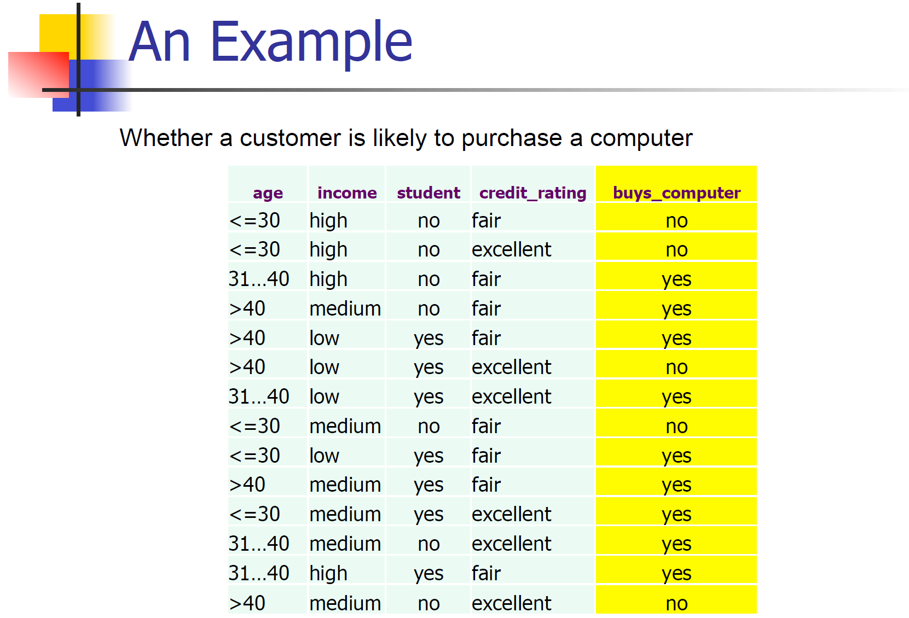
1.Decision Tree Example

Slide 3
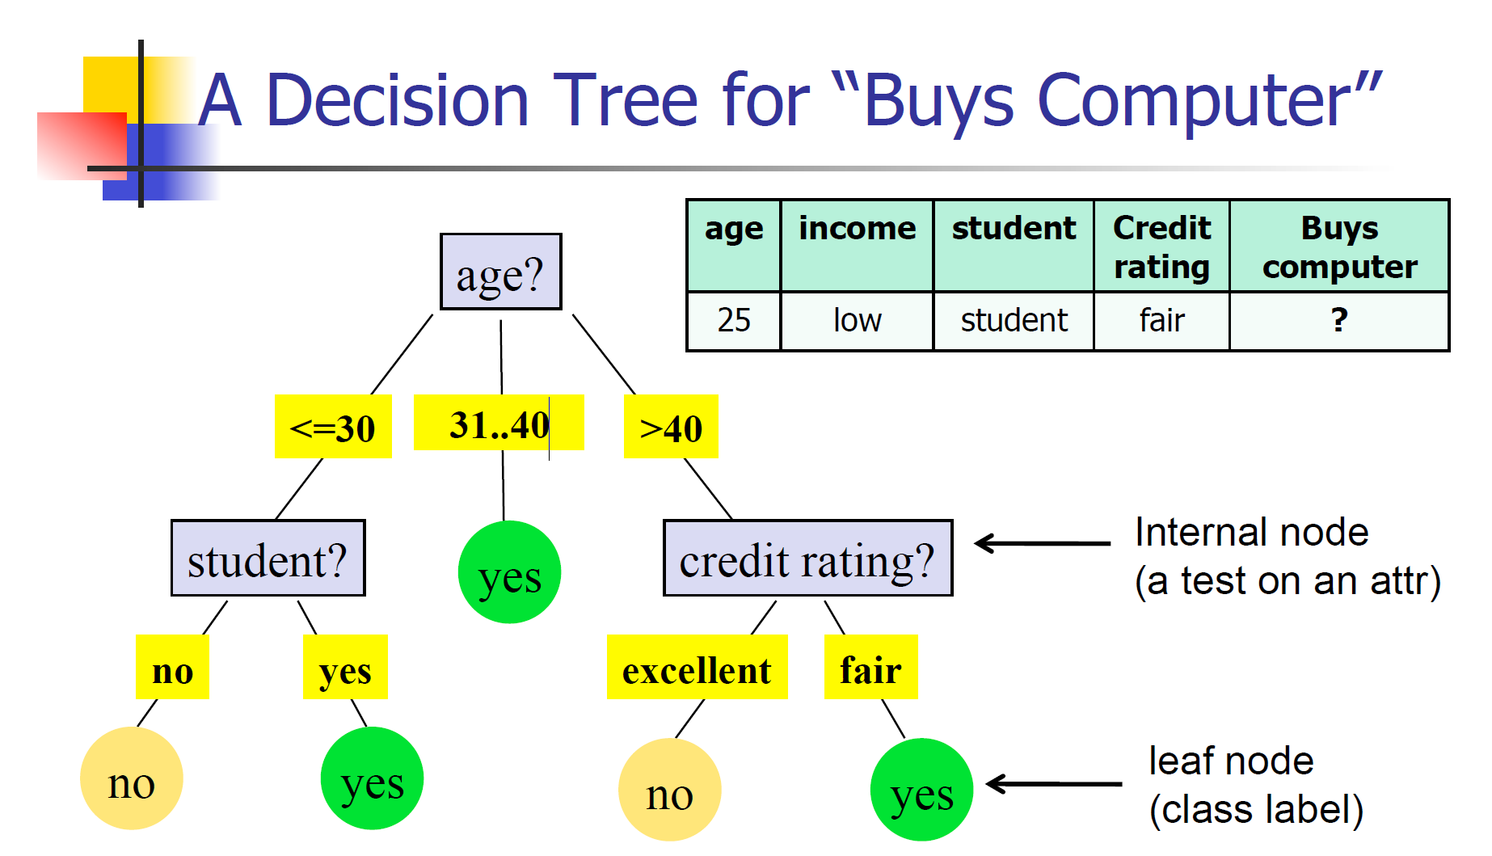
Notes:
Example

Slide 4
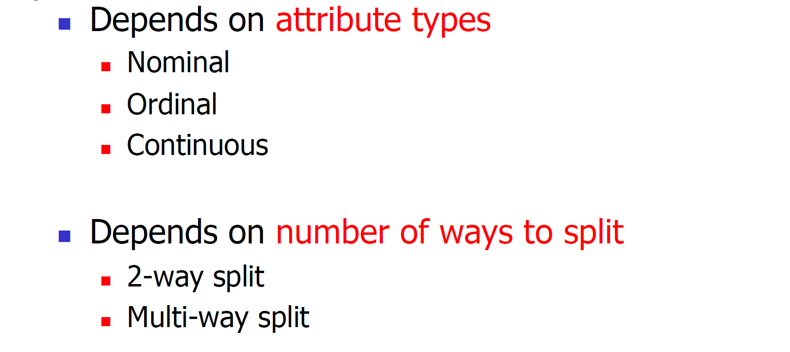
2. Tree types
Notes:
Tree Type

Slide 5
3. Termination conditions
Stop when the number of data points in the tree node is less than or equal to some predefined number.
e.g. the data points in the node is smaller than 5.
Or choose the maximal depth.
(3) Or stop when there is no significant advantage to continue split.
Notes:
Stop condition

Slide 6
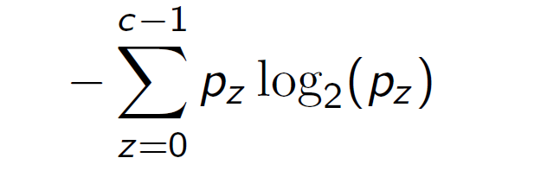
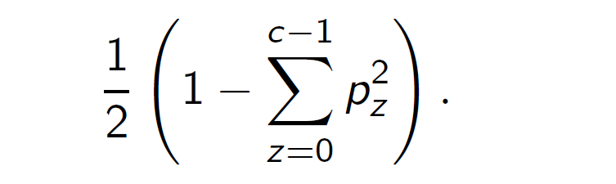
4.Measurement types
Entropy impurity
Gini impurity
Notes:
Measurement types

Slide 7
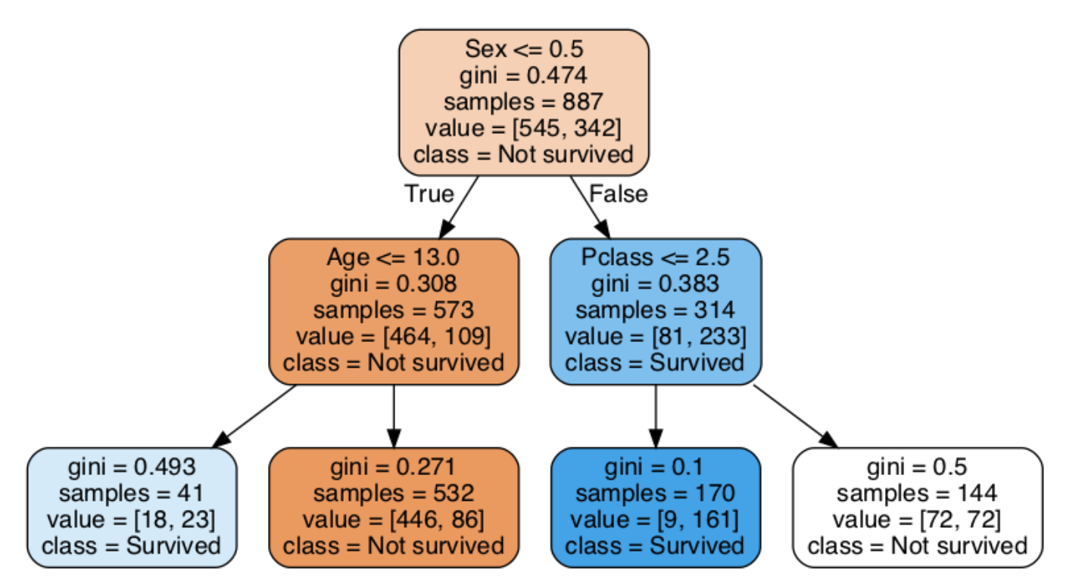
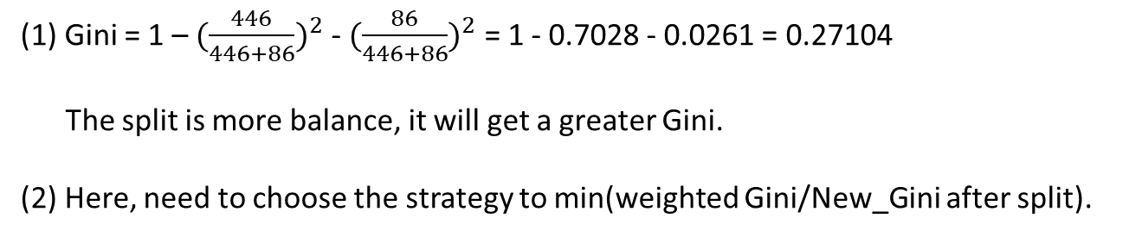
5.Gini Example
New_Gini after split = 0.493 + 0.271 (tips: choose the smallest new Gini)
(1) Gini = 1 – ${(\frac{446}{446+86})}^{2}$ - ${(\frac{86}{446+86})}^{2}$ = 1 - 0.7028 - 0.0261 = 0.27104
The split is more balance, it will get a greater Gini.
(2) Here, need to choose the strategy to min(weighted Gini/New_Gini after split).
Notes:
Measurement types

Slide 8
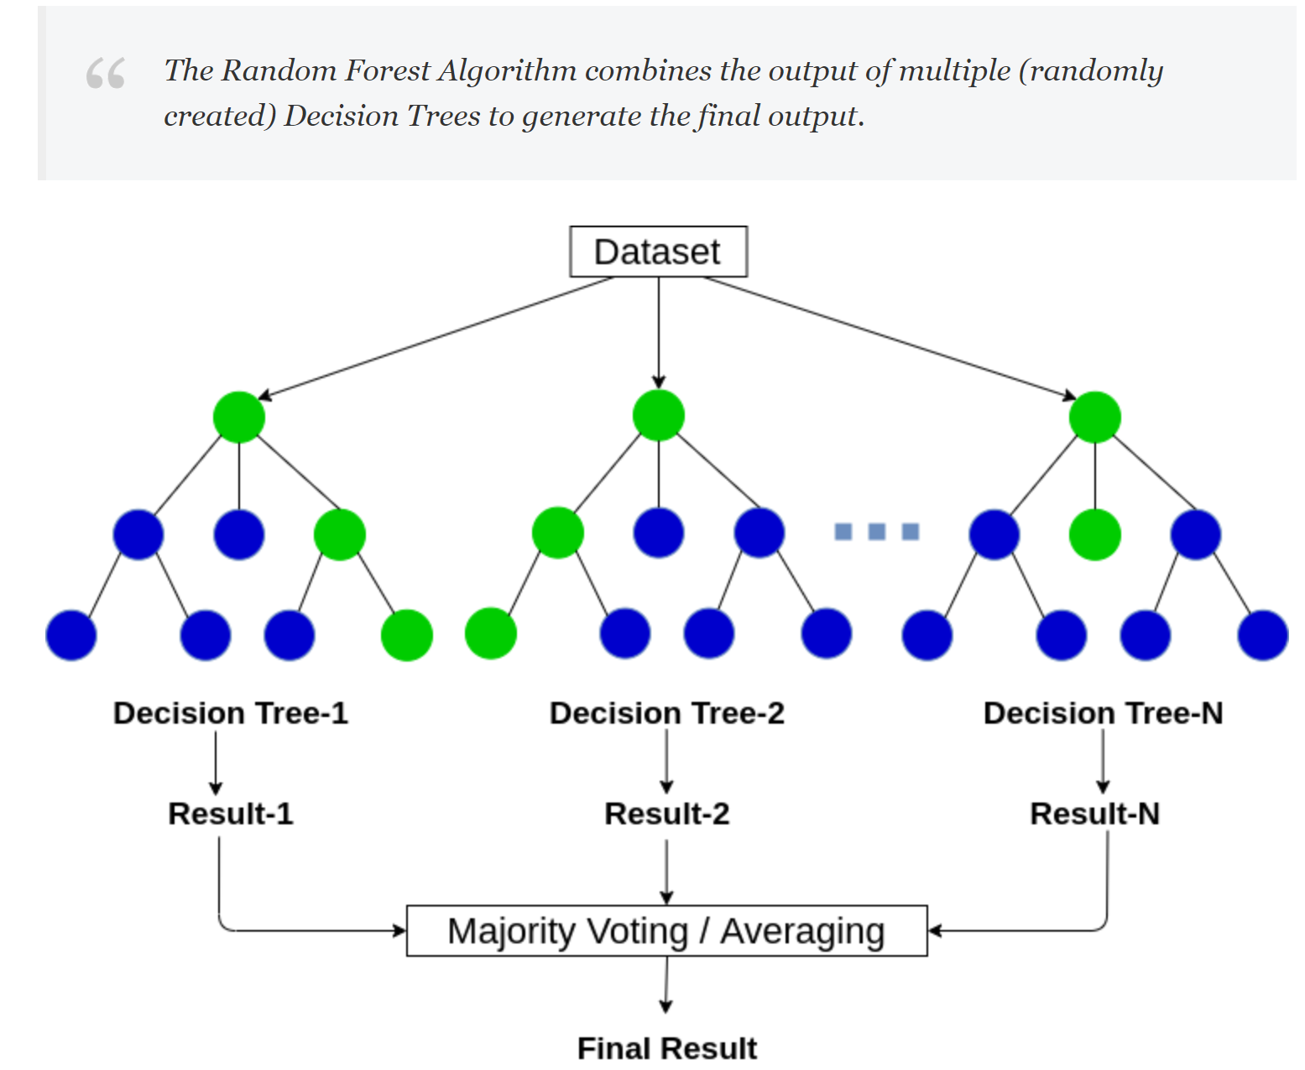
Q4 .Random forest
1 out of m attributes
Notes:
This process of combining the output of multiple individual models (also known as weak learners) is called Ensemble Learning.
http://www2.stat.duke.edu/~rcs46/lectures_2017/08-trees/08-tree-advanced.pdf

Slide 9
Q4. Bagging decision tree
1 out of p total attributes
Notes:
This process of combining the output of multiple individual models (also known as weak learners) is called Ensemble Learning.
http://www2.stat.duke.edu/~rcs46/lectures_2017/08-trees/08-tree-advanced.pdf

Slide 10
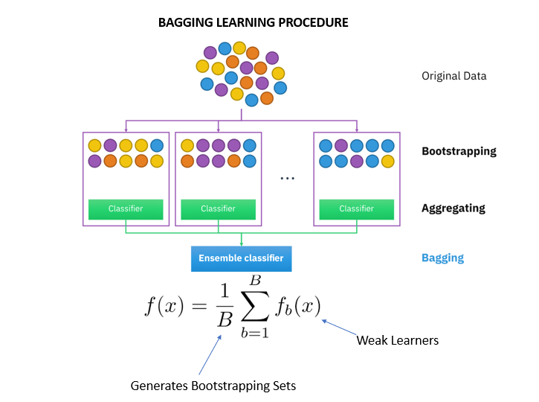
Bagging

Slide 11
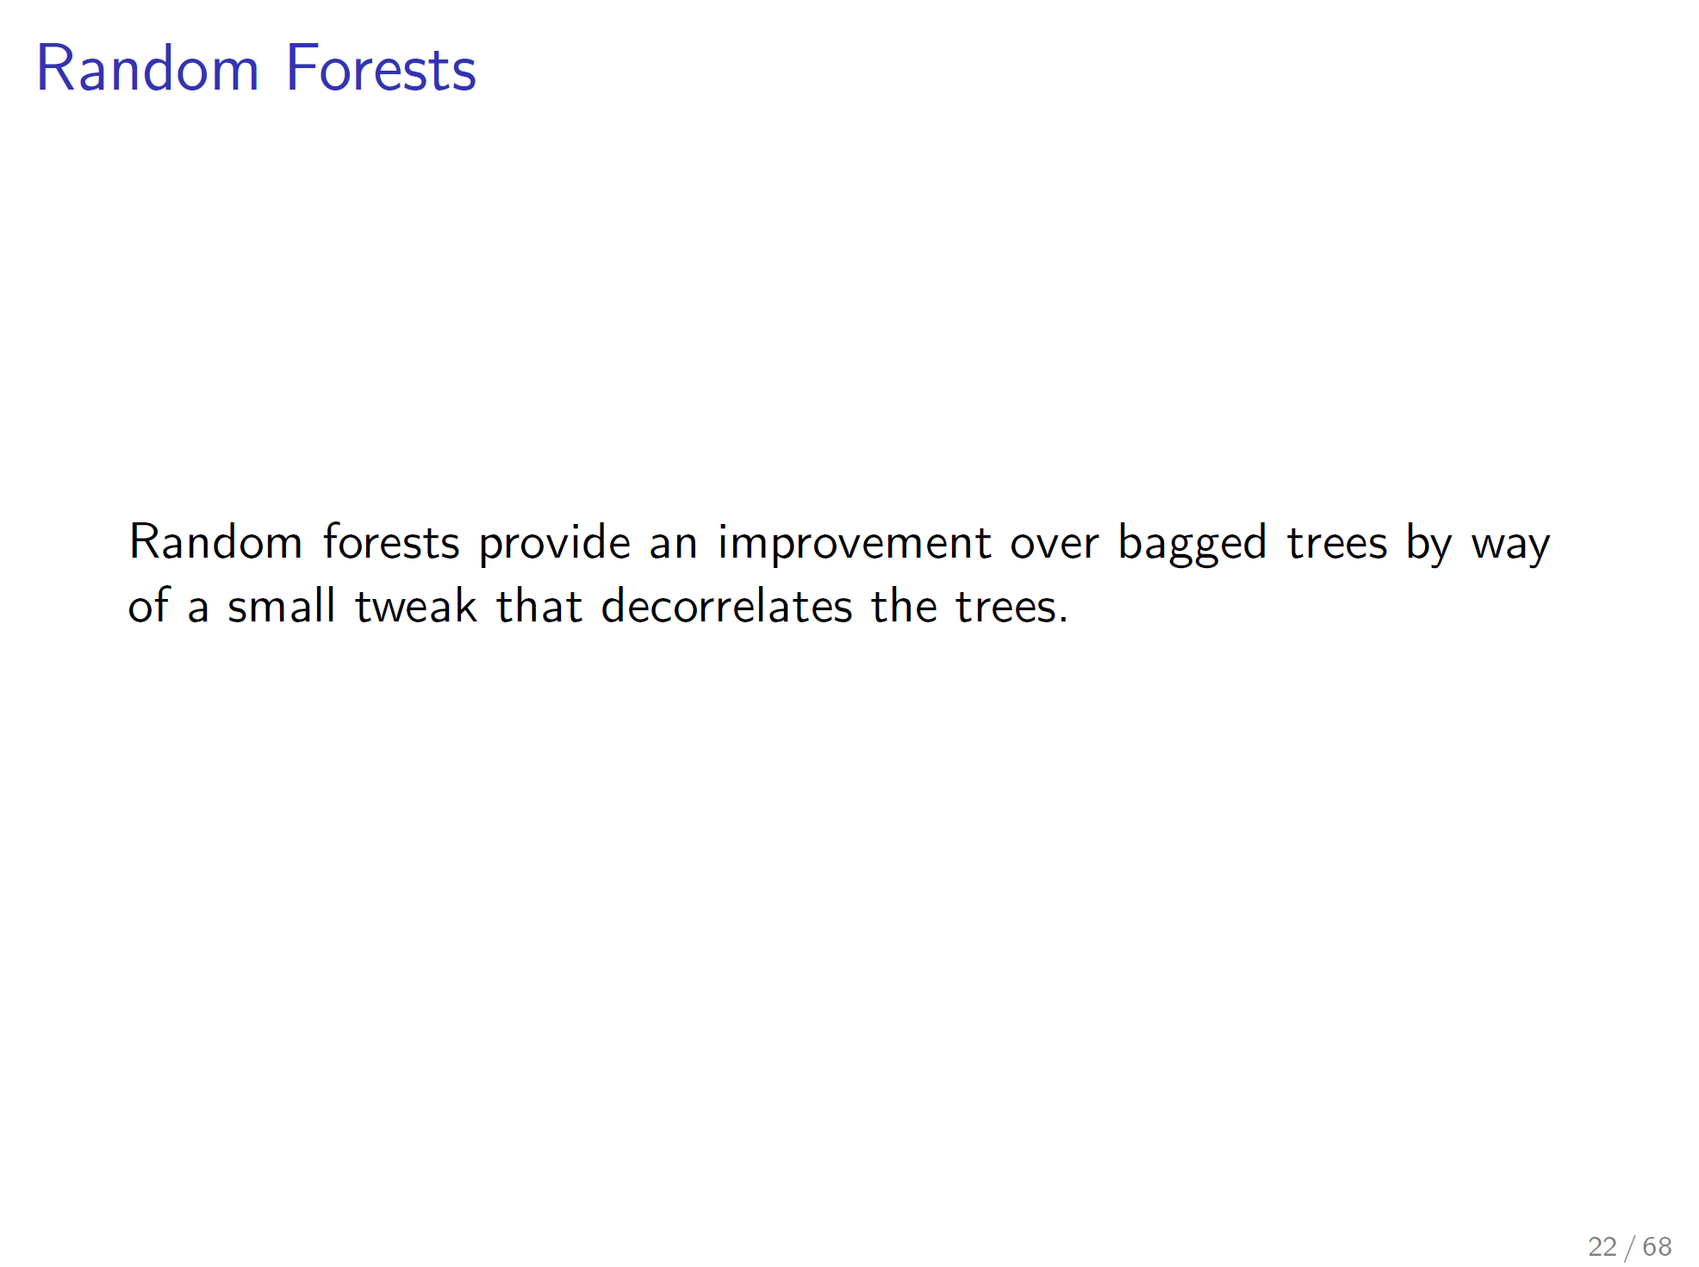
Notes:
http://www2.stat.duke.edu/~rcs46/lectures_2017/08-trees/08-tree-advanced.pdf

Slide 12
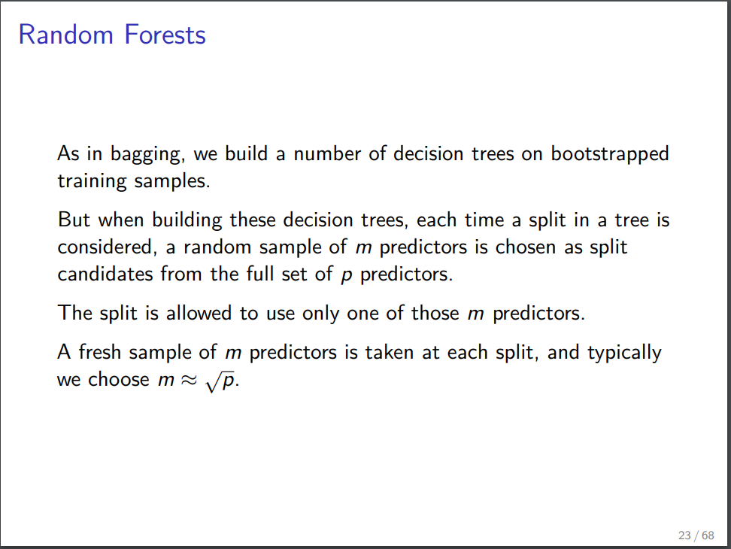
Notes:
http://www2.stat.duke.edu/~rcs46/lectures_2017/08-trees/08-tree-advanced.pdf

Slide 13
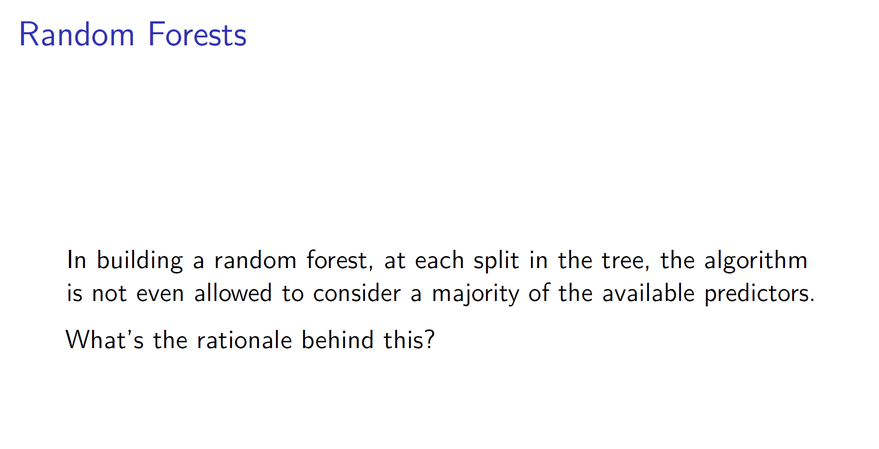

Slide 14
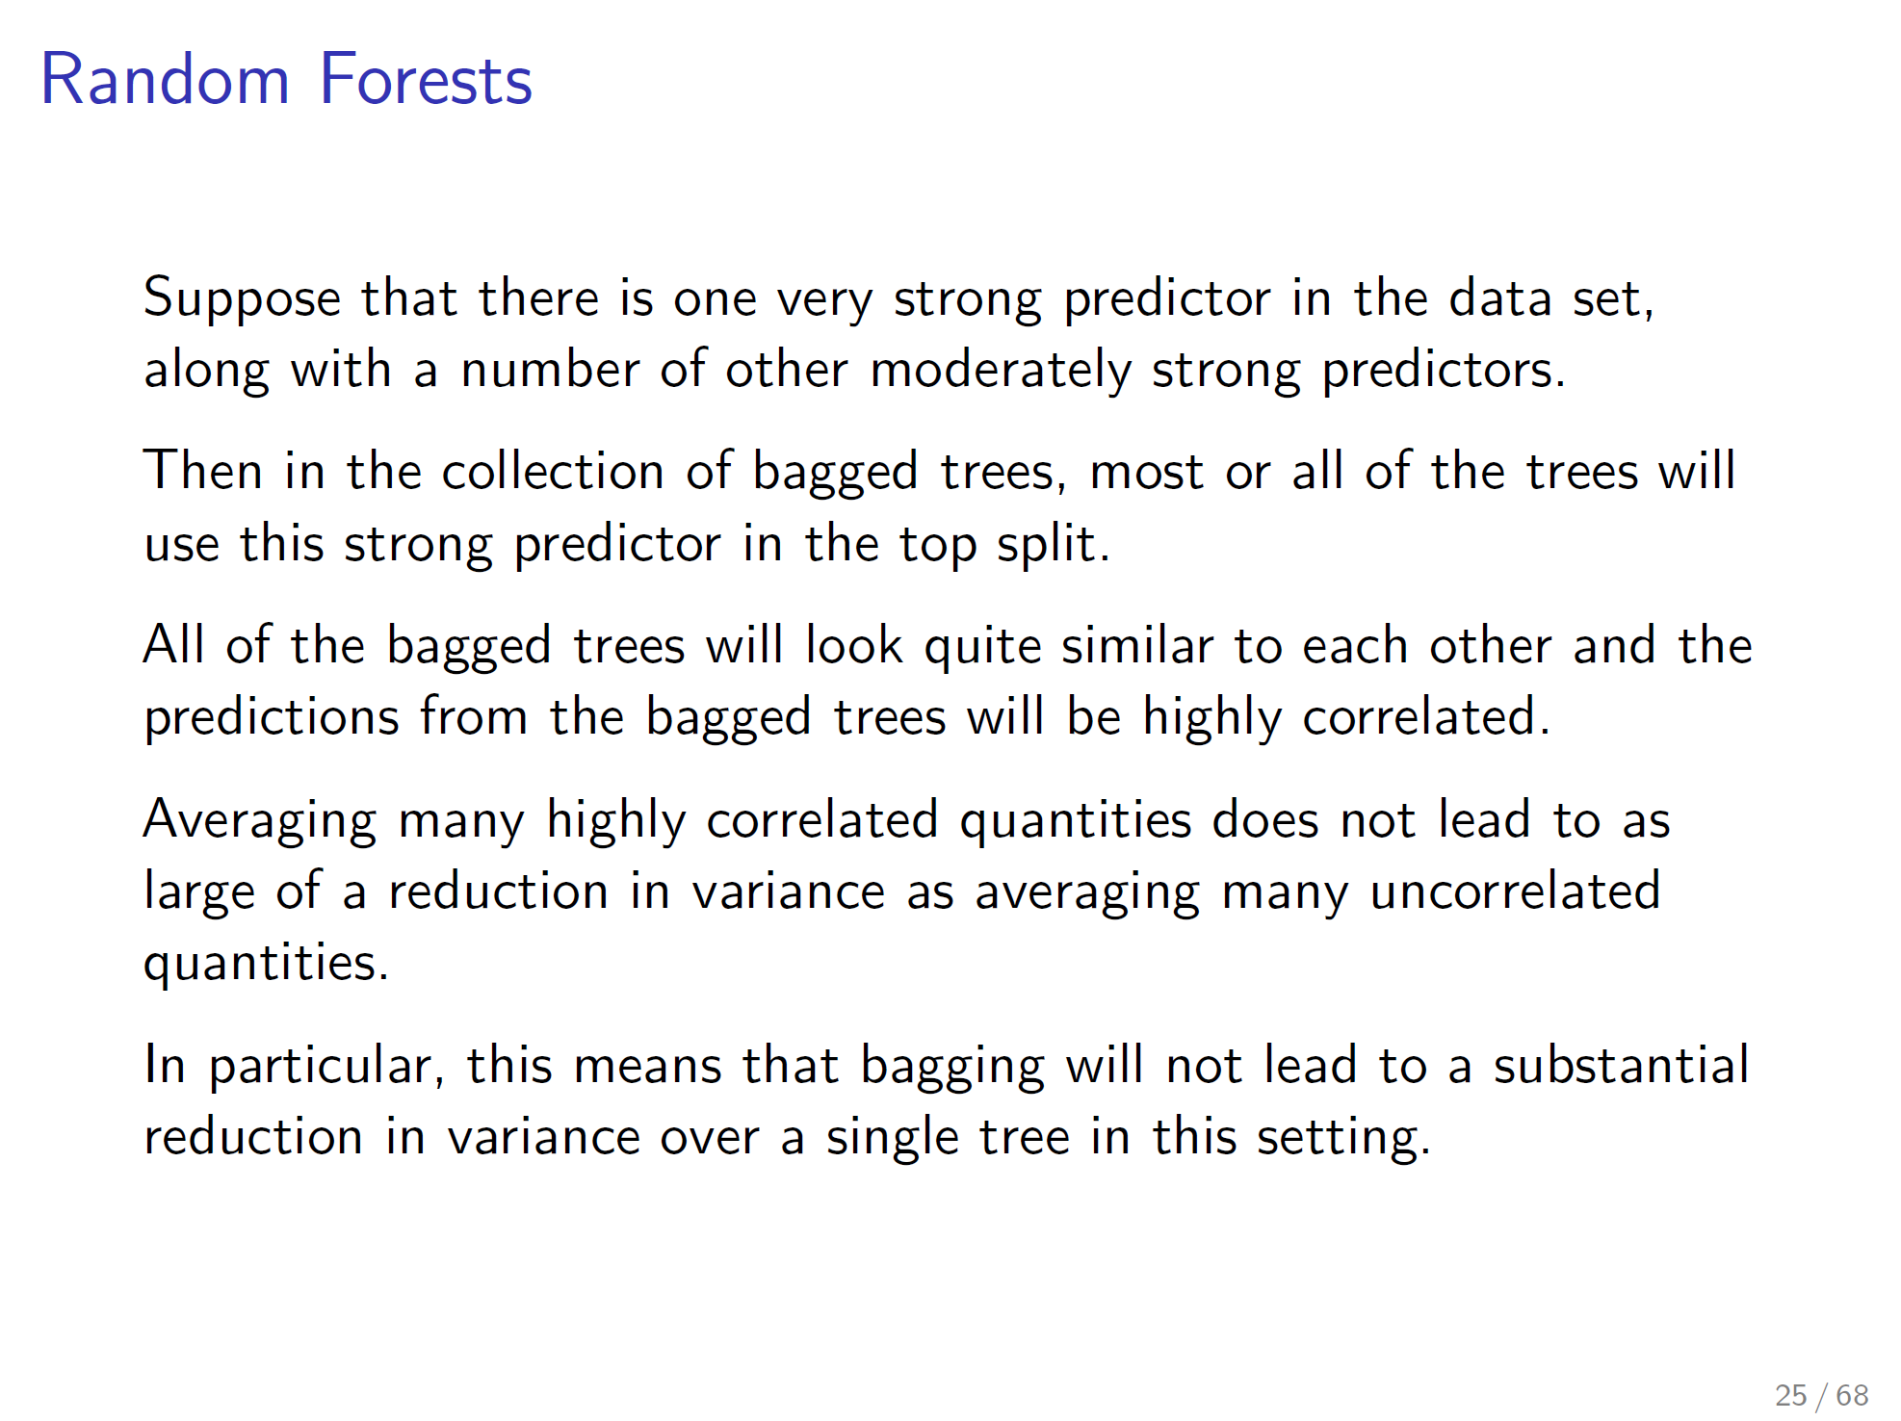

Slide 15
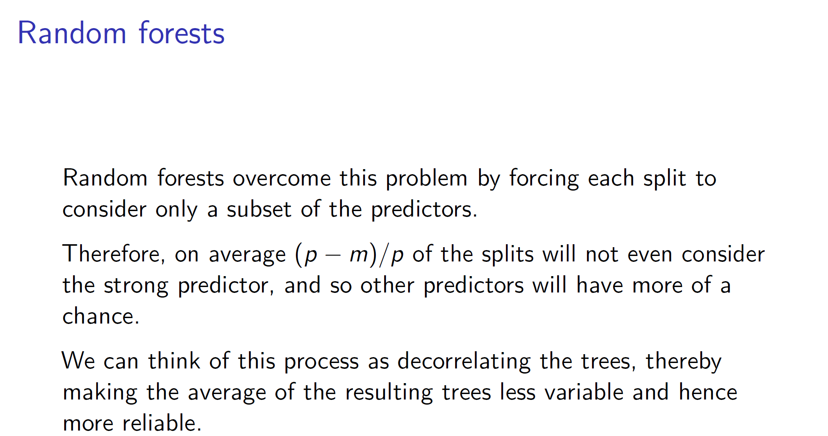

Slide 16
