Slide 1
Parallel Computing 부터 distributed computing, in-memory computing
+
DataBase Management까지

Slide 2
Parallel Computing 부터 distributed computing, in-memory computing
+
DataBase Management까지

Slide 3
Hadoop Cluster Component
HDFS
YARN, Mesos
HIVE
HBASE
Mahout

Slide 4
Hadoop Cluster 구성
core-site.xml
hdfs-site.xml
mapred-site.xml
Hive + MariaDB
Mahout + MongoDB
http://mangastorytelling.tistory.com/6125

Slide 5
Hadoop 실습
Java wordcount + R wordcloud
Python wordcloud

Slide 6
워드클라우드

Slide 7
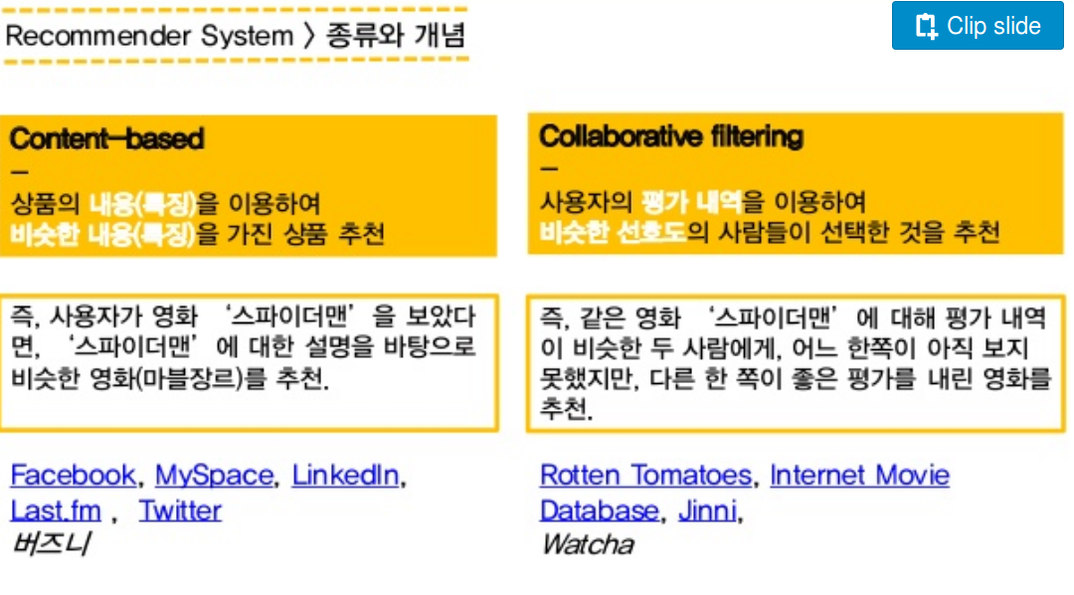
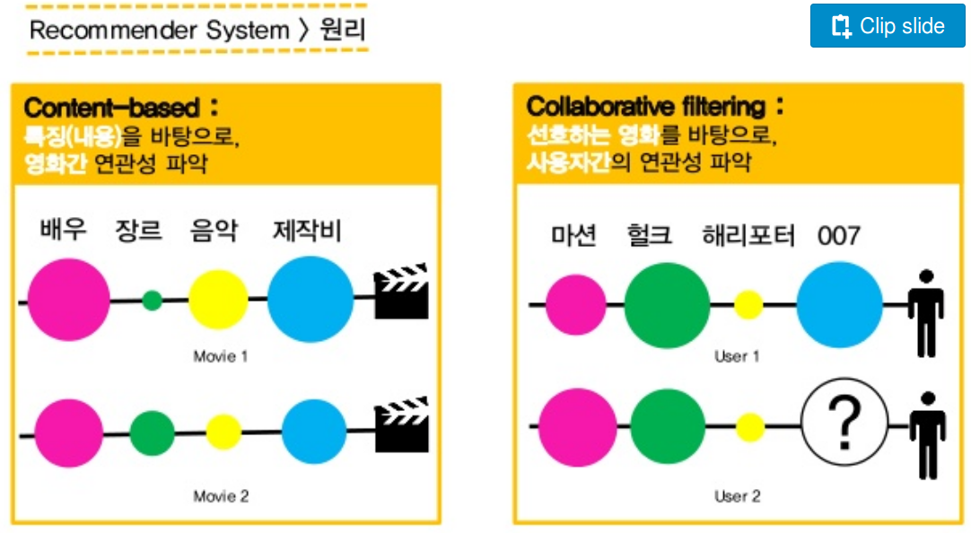
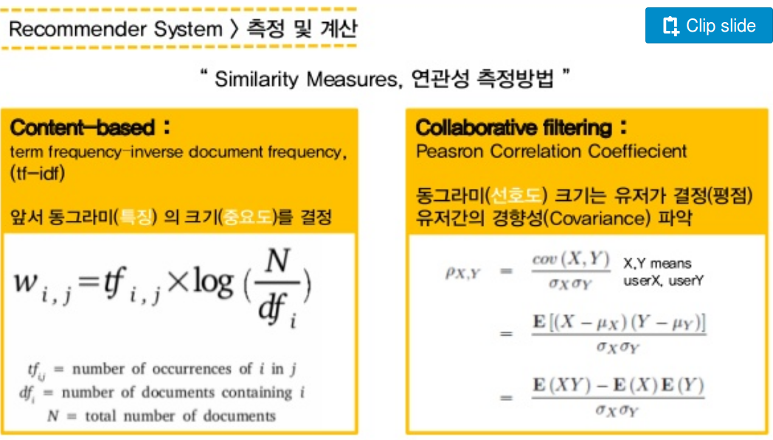
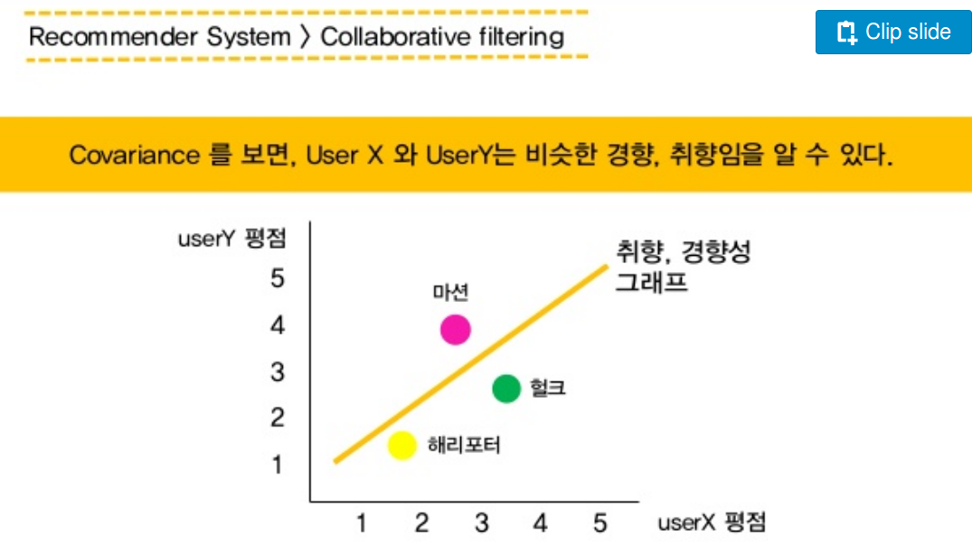
추천 시스템 구성
http://www.slideshare.net/itsociety/4-151106-58384179

Slide 8
추천 시스템 구성

Slide 9
Parallel Computing 부터 distributed computing, in-memory computing
+
DataBase Management까지

Slide 10

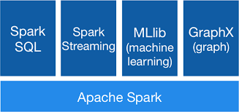

Slide 11
Basic Examples
Word count
Pi calculation
Mllib
Logistic Regression
K-means

Slide 12
Logistic Regression
D = 10
def readPointBatch(iterator):
strs = list(iterator)
matrix = np.zeros((len(strs), D + 1))
for i, s in enumerate(strs):
matrix[i] = np.fromstring(s.replace(',', ' '), dtype=np.float32, sep=' ')
return [matrix]
points = spark.read.text(sys.argv[1]).rdd.map(lambda r: r[0])\
.mapPartitions(readPointBatch).cache()
iterations = 10
w = 2 * np.random.ranf(size=D) - 1
def gradient(matrix, w):
Y = matrix[:, 0] # point labels (first column of input file)
X = matrix[:, 1:] # point coordinates
return ((1.0 / (1.0 + np.exp(-Y * X.dot(w))) - 1.0) * Y * X.T).sum(1)
for i in range(iterations):
print("On iteration %i" % (i + 1))
w -= points.map(lambda m: gradient(m, w)).reduce(add)

Slide 13
Logistic Regression
$ spark-submit --master local[2] logistic_regression.py '../data/mllib/lr_data.txt' 10
/usr/local/src/spark-2.0.2-bin-hadoop2.7/python/lib/pyspark.zip/pyspark/mllib/classification.py:313: UserWarning: Deprecated in 2.0.0. Use ml.classification.LogisticRegression or LogisticRegressionWithLBFGS.
Final weights:
[0.524344399994,0.535422147861,0.511118553685,0.490483087591,
0.516417169831,0.539879160998,0.53180573555,0.519989331301,
0.534036230449,0.527097281011]
Final intercept: 0.0

Slide 14
K-means clustering
$ spark-submit --master local[2] kmeans.py '../data/mllib/kmeans_data.txt' 3
Final centers:
[array([ 9.05, 9.05, 9.05]),
array([ 0.1, 0.1, 0.1]),
array([ 9.2, 9.2, 9.2])]
Total Cost: 0.07500000000004324

Slide 15
Parallel Computing 부터 distributed computing, in-memory computing
+
DataBase Management까지

Slide 16
MongoDB 란?
RDMBS 와 다르다!
데이터 포맷이 json 형식, 비정형 데이터 담기에 좋다.
특별한 데이터 타입이 존재한다.
Sharding(DB 를 잘게 나누는) 이 가능
Database
> Collection (Table의 역할)
> Document (Row 의 역할)
> Field (Column 의 역할)
로 구성.

Slide 17
MongoDB Data Type
Symbol − This datatype is used identically to a string; however, it's generally reserved for languages that use a specific symbol type.
Object ID − This datatype is used to store the document’s ID.
Binary data − This datatype is used to store binary data.
Code − This datatype is used to store JavaScript code into the document.
Regular expression − This datatype is used to store regular expression.
Min/ Max keys − This type is used to compare a value against the lowest and highest BSON elements.
Arrays − This type is used to store arrays or list or multiple values into one key.

Slide 18
Get started MongoDB
Good Starting Document!
https://www.tutorialspoint.com/mongodb/mongodb_drop_database.htm
https://docs.mongodb.com/manual/tutorial/write-scripts-for-the-mongo-shell/
$> service mongodb start
$> service mongod stop
$> mongoimport --db test --collection restaurants --drop --file ~/downloads/Beauty_5.json
$> mongod
> db.help()
> db.stats()
> use <database_name>
> db.<collection_name>.insert({“name”:[data]})
> db.<col_name>.insert({“name”:[data]})
> show dbs
> db.createCollections(<col_name:string_wo>, <col_option:data_format>)
> db.<col_name:string_wo>.find.pretty()
> db.<col_name:string_wo>.find($and:[{}])

Slide 19
기본 operation
insert
update
remove
find
>db.mycol.find({},{"title":1,_id:0}).limit(2)
>db.mycol.find({},{"title":1,_id:0}).limit(1).skip(1)
>db.mycol.find({},{"title":1,_id:0}).sort({"title":-1})
Indexing
>db.mycol.ensureIndex({"title":1,"description":-1})
Aggregation with Pipeline
RDMBS 기본?
Create DB , table, view, trigger,
Insert, delete, update,
select : where, groupby, sorting/ordering
*update
Document 에 key_value 추가하는 방법
document에서 특정 key의 value 만 바꾸고 싶을때는?
여러 collections key-value 한번에 바꾸고 싶을때는?

