Slide 1
Python 다음단
hasattr(classname, ‘attrname’)
클래스명 인스턴스에서 string 으로 받기 : type(instance).__name__
Isinstance
__repr__ , __class__, __doc__, __dict__, __name__

Slide 2
test
Doctest :
docstring 안에 test code를 삽입할 수 있다.
Unittest :

Slide 3
파일 위치 관련 :
os.path.abspath(“.”) 혹은 (“__file__”)
os.path.dirname(<path>)
여러 데이터 읽고 쓰기:
csv
json

Slide 4
알고리즘 부터 디자인 패턴까지
TedJeong

Slide 5
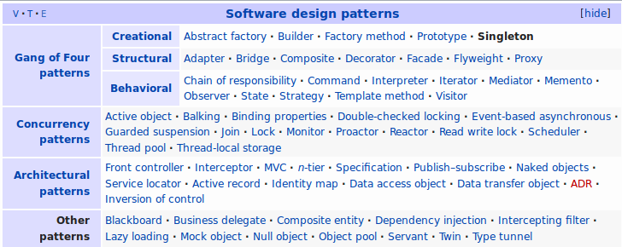
Design Pattern

Slide 6
Python
Java
https://github.com/faif/python-patterns.git
Singleton pattern
Delegate pattern
Controller pattern
Decorator pattern
Composite pattern
Java 언어로 배우는 디자인 패턴 입문
Singleton pattern
Delegate pattern
Controller pattern

Slide 7
Singleton pattern
>>> from singleton import *
>>> a = SingleTon('test')
>>> a
<play.SingleTon object at 0x7fa30eb4f240>
>>> b = SingleTon('test2')
>>> b
<play.SingleTon object at 0x7fa30eb4f240>
>>> a.val
'test2'
>>> b.val
'test2'
instance is produced
a and b is the same instance.

Slide 8
Singleton Pattern : Python
“””
Reference : http://python-3-patterns-idioms-test.
readthedocs.io/en/latest/Singleton.html
“””
class SingleTon(object):
__instance = None
def __new__(cls, val):
if SingleTon.__instance is None:
SingleTon.__instance = object.__new__(cls)
SingleTon.__instance.val = val
return SingleTon.__instance

Slide 9
Singleton Pattern : Java
public class Singleton{
private static Singleton singleton = new Singleton();
private Singleton(){
System.out.println("instance is produced");
}
public static Singleton getInstance(){
return singleton;
}
}
public class SingletonMain{
public static void main(String[] args){
Singleton a = Singleton.getInstance();
Singleton b = Singleton.getInstance();
if(a == b){
System.out.println("a and b is the same instance.");
}else{
System.out.println("a and b are different instances.");
}
}
}

Slide 10
Singleton pattern
>>> from singleton import *
>>> a = SingleTon('test')
>>> a
<play.SingleTon object at 0x7fa30eb4f240>
>>> b = SingleTon('test2')
>>> b
<play.SingleTon object at 0x7fa30eb4f240>
>>> a.val
'test2'
>>> b.val
'test2'
instance is produced
a and b is the same instance.

Slide 11
Delegate pattern

Slide 12
Delegate Pattern : Python
#!/usr/bin/env python
# -*- coding: utf-8 -*-
"""
Reference: https://en.wikipedia.org/wiki/Delegation_pattern
Author: https://github.com/IuryAlves
"""
class Delegator(object):
"""
>>> delegator = Delegator(Delegate())
>>> delegator.do_something("nothing")
'Doing nothing'
>>> delegator.do_anything()
"""
def __init__(self, delegate):
self.delegate = delegate
def __getattr__(self, name):
def wrapper(*args, **kwargs):
if hasattr(self.delegate, name):
attr = getattr(self.delegate, name)
if callable(attr):
return attr(*args, **kwargs)
return wrapper
class Delegate(object):
def do_something(self, something):
return "Doing %s" % something

Slide 13
Controller pattern
Request, RequestController, Dispatcher,

Slide 14
Decorator pattern

Slide 15
Composite pattern
그릇과 내용물을 동일시해서 재귀적인 구조를 만들기 위한 디자인 패턴.
폴더안에 폴더와 파일을 넣을 수 있듯이, 담을 수 있는 그릇과 내용물을 동일시 하면 편한 경우가 있다.

Slide 16
Composite Pattern : Python

Slide 17
Composite Pattern : Java
package com.joo.compositepattern;
public class Main {
public static void main(String[] args){
try{
System.out.println("making root entries..");
Directory rootdir = new Directory("root");
Directory bindir = new Directory("bin");
Directory tmpdir = new Directory("tmp");
Directory usrdir = new Directory("usr");
rootdir.add(bindir);
rootdir.add(tmpdir);
rootdir.add(usrdir);
bindir.add(new File("vi",10000));
bindir.add(new File("latex",20000));
rootdir.printList();
System.out.println("");
System.out.println("making user entries..");
Directory Kim = new Directory("Kim");
Directory Lee = new Directory("Lee");
usrdir.add(Kim);
usrdir.add(Lee);
Kim.add(new File("diary.html",100));
Lee.add(new File("memo.tex",300));
rootdir.printList();
}catch(FileTreatmentException e){
e.printStackTrace();
}
}
}

Slide 18
Factory Method

Slide 19
Builder pattern
Director
Abstract Builder
Concrete builder
product

