Slide 1

Snakebait
Tad Tatsuya Mura
Charlie Ortman
Steve Ricard
Sasha Bridges

Slide 2
Medicare vs Hospitals
Initial Theory
“If Medicare spends more money at a certain hospital,
then that hospital will likely be better quality.”
Our Process:
Areas to compare:
Data Search:
Initial cvs files found – Steve
Income data found – Charlie
Data Cleanup:
Initial cleanup – Sasha and Tad
Jupyter notebook:
Initial – Sasha and Tad
Coding - All
Graphs – All
Conclusion - All
Readmission Rates
Complications & Deaths
Unexpected Hospital Visits
Medicare Spending per Patient
Income per County:
Clay, MO
Jackson, MO
Johnson, KS
Leavenworth, KS
Sedgwick, KS
Wyandotte, KS

Slide 3
Areas of Comparison
Readmission Rates
Complications & Deaths
Unexpected Hospital Visits
Medicare Spending per Patient

Slide 4
The data cleaning saga…
Initially, we had high hopes about these data sets
They all had lots of column merge options! Great!!!
But it turned out that a lot of the columns were Object-type…
And the “Score” column had different meanings for each file…
We tried casting them to floats, but ran into issues with NaN columns and null values
Trying to replace the NaN columns led us to realize that Data Series values are ambiguous, and you can’t directly compare them to a value
Sasha wrote a VB script, but there was too much data and it didn’t work

Slide 5
The data cleaning saga continues…

Slide 6
Question 1: If a county has higher Medicare spending, then they should have less deaths/post-hospital accidents.

Slide 7
Question 2: If a county has higher Medicare spending, then they should have less readmissions.

Slide 8
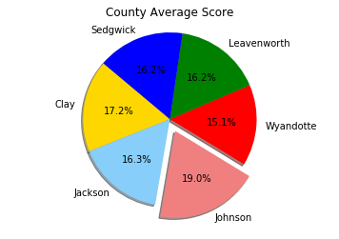
The Medicare Spending Per Patient
Medicare spends more, less, or about the same for an episode of care?
Based on the average score per county:
Johnson County spends more

Slide 9
Question 3: Which county has the greatest count of data recordings? AKA, which county has the least “not available” data? Count each “score” available and then compare between counties.

Slide 10
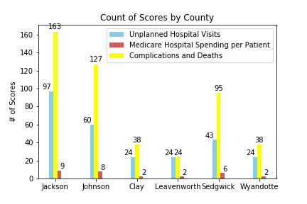
Question 4: Is there a relationship between higher Medicare spending and how much data is recorded?

Slide 11
Question 5: Is there a relationship between higher Medicare spending and how much data is recorded?

Slide 12
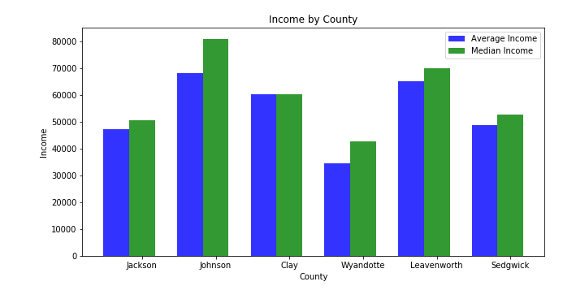
Income by County
Higher Income ~ Better Care
If a county has lower Medicare spending
then there are more unexpected hospital visits.

Slide 13
Conclusion
Based on the data, Medicare is directly related to the income.
CMS.gov files are difficult to work with
There is a correlation between data recorded and Medicade money spent.

