Slide 1









Battery NTC Use Notice
Internal Use
WCP1/SA1/PT
Tim_Lee
Copyright © MediaTek Inc. All rights reserved.

Slide 2
危險場景 (若未使用NTC for 溫度量測)
智能機(smart phone)常被用為車上導航機使用,若將手機置於車上擋風玻璃上(加強通訊),且又是一個豔陽日(日光直接照射電池).
此時,使用者又插上手機充電器, 若手機設計上未使用NTC 來量測電池/手機溫升, 電池充電造成的溫升加上外部環境的加溫,雙重溫升條件,非常有可能造成電池的過熱而發生”爆炸”現象.
→ 強烈建議一定要使用有NTC內建的電池 !!

Slide 3
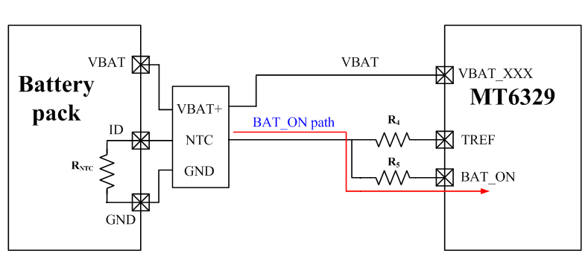
Thermal Detection by NTC
MT6329’s BATON is through the NTC thermistor to achieve thermal detection.
→ If no this NTC, temperature change can’t be sensed.
RNTC: Negative temperature coefficient thermistor (in battery pack)
Copyright © MediaTek Inc. All rights reserved.
2012/6/8
3

Slide 4
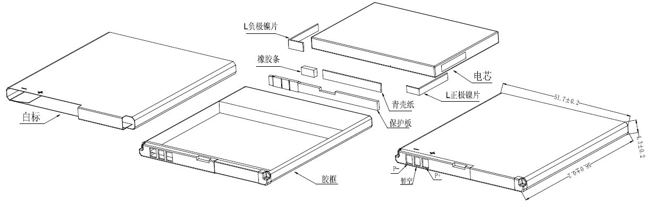
Recommended location of NTC in battery pack
Recommended location of NTC in battery pack
NTC thermistor 遠離 P+ and P- !!
(避免充電IC溫升影響電芯溫度量測)
NTC thermistor 貼附於靠近電芯的PCB 板面!!
10K 1% NTC
P-
P+

