Slide 1
EJAKPOMEHWE FAITH FOS/22/004039 SUPERVISOR: DR. E.A. ENOH
DEPARTMENT OF ENVIRONMENTAL MANAGEMENT AND TOXICOLOGY SOUTHERN DELTA UNIVERSITY, OZORO
A SEMINAR PRESENTATION ON
THE ROLE OF ENVIRONMENTAL EDUCATION IN PROMOTING SUSTAINABLE DEVELOPMENT

Slide 2
INTRODUCTION
Sustainable development faces serious environmental challenges
These challenges result largely from environmental degradation
Environmental degradation arises from unsustainable human activities
Addressing these issues requires informed behavioural change
Environmental education provides knowledge for sustainable development

Slide 3
ENVIRONMENTAL EDUCATION
Environmental education develops environmental knowledge and skills
It shapes values, attitudes, and responsible environmental behaviour
Encourages understanding of human–environment interactions
Promotes lifelong learning for environmental responsibility
Foundation for sustainable development initiatives

Slide 4
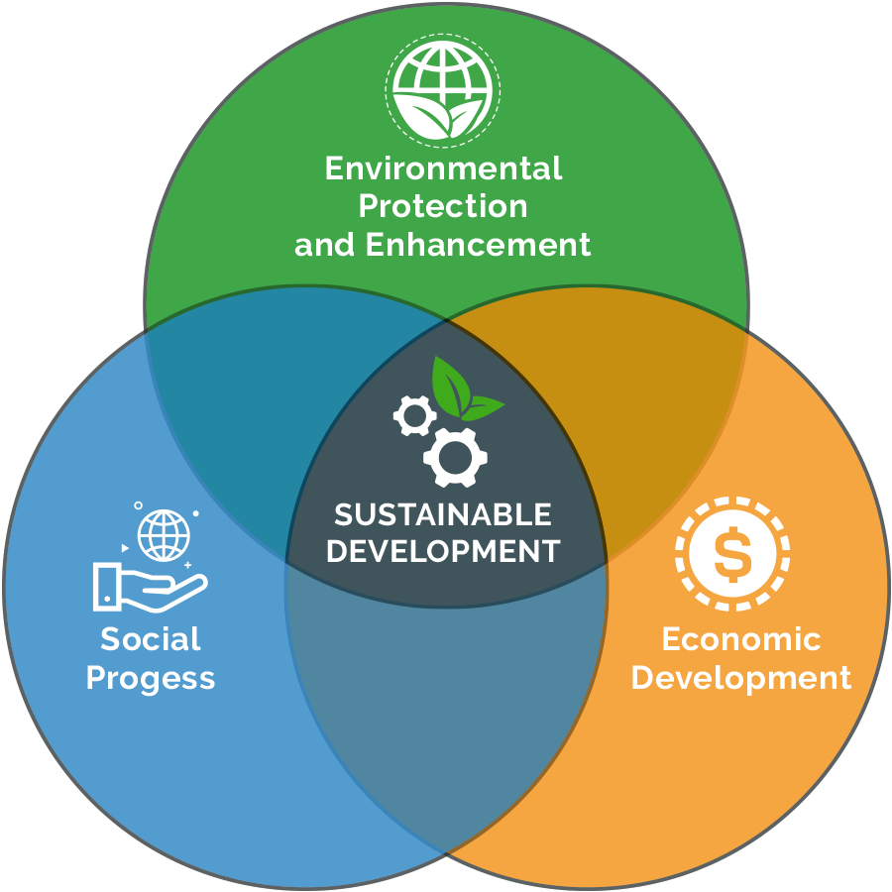
SUSTAINABLE DEVELOPMENT
Sustainable development meets present and future needs
Balances environmental, economic, and social development
Prevents resource depletion and environmental collapse
Promotes long-term environmental and human wellbeing
Central goal of global environmental policies

Slide 5
ENVIRONMENTAL EDUCATION AND SUSTAINABILITY
Environmental education supports sustainable development goals
Builds awareness of climate change and resource conservation
Encourages sustainable lifestyles and consumption patterns
Empowers individuals as environmental change agents
Bridges knowledge and sustainable action

Slide 6
ENVIRONMENTAL AWARENESS AND LITERACY
Environmental literacy means understanding environmental issues
Education improves awareness of environmental challenges
Enhances critical thinking and informed decision-making
Promotes responsible environmental choices
Supports long-term sustainable behaviour

Slide 7
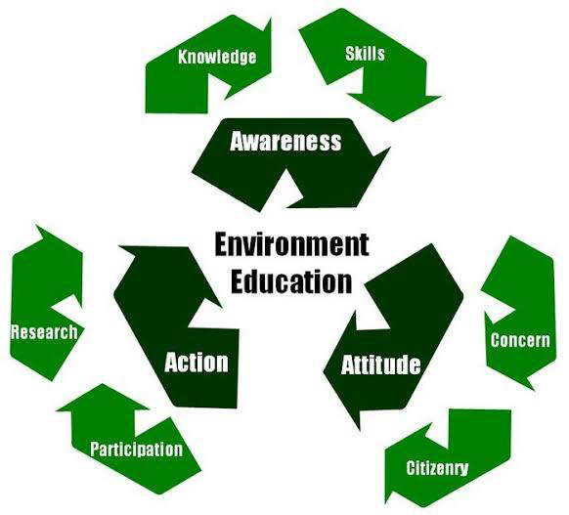
This cycle demonstrates that environmental education is not just about learning, but about allowing information to reshape our perception and propel us into action.

Slide 8
BEHAVIORAL CHANGE
Environmental education shapes attitudes and ethical values
Encourages pro-environmental behaviour and responsibility
Translates knowledge into practical sustainable actions
Supports recycling, conservation, and energy efficiency
Strengthens environmental stewardship culture

Slide 9
COMMUNITY AND INSTITUTIONAL IMPACT
Environmental education promotes community participation
Strengthens institutional sustainability practices
Supports environmental policy implementation
Encourages collective environmental responsibility
Enhances sustainable development outcomes

Slide 10
CONCLUSION
Environmental education is crucial for sustainable development
Builds knowledge, values, and responsible environmental behaviour
Encourages long-term environmental sustainability
Supports resilience to environmental challenges
Essential for a sustainable future

Slide 11
Thank You

