Slide 1
Education Outcomes and Economic Opportunity
Juliana Novic
Theodore Smiley
Nancy Dziak

Slide 2
Questions?
Do charter schools perform better than standard public schools on the Ohio School Board of Education Performance Index Measures?
Do better performing schools correlate to areas with higher payrolls?
Are different populations served better by charter schools?

Slide 3
Data: Counties with Large Metro Areas in Ohio
 | Public | Charter
Cuyahoga (Cleveland Metro) | 368 Schools | 66 Schools
Franklin (Columbus Metro) | 390 Schools | 59 Schools
Hamilton (Cincinnati Metro) | 198 Schools | 19 Schools
Data Sources:
Census API
Ohio School Report Card Data Downloads (https://reportcard.education.ohio.gov/)

Slide 4
Data Exploration and Cleanup

Slide 5
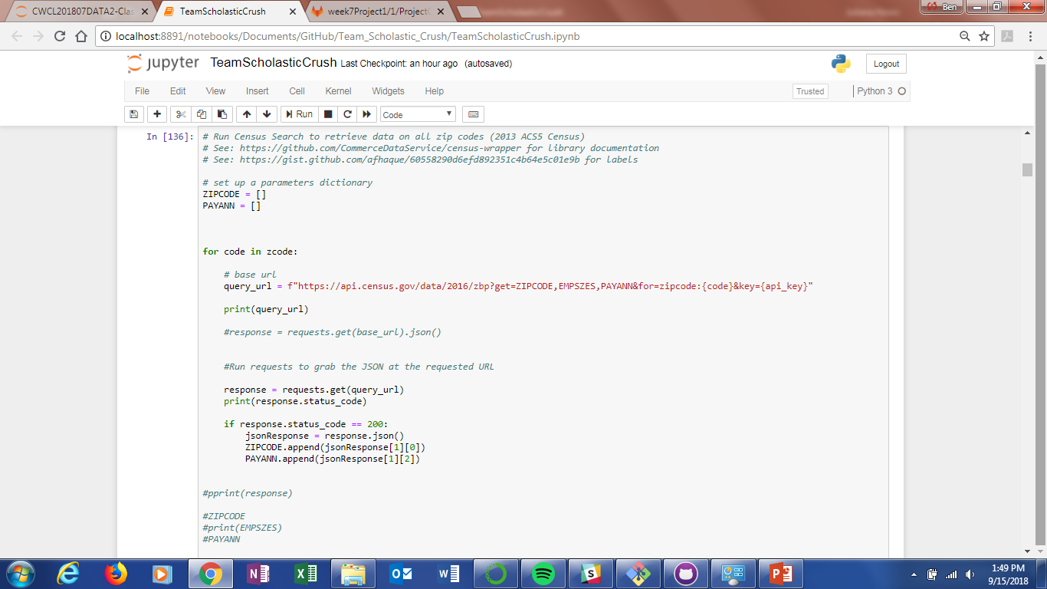
Data Exploration and Cleanup

Slide 6
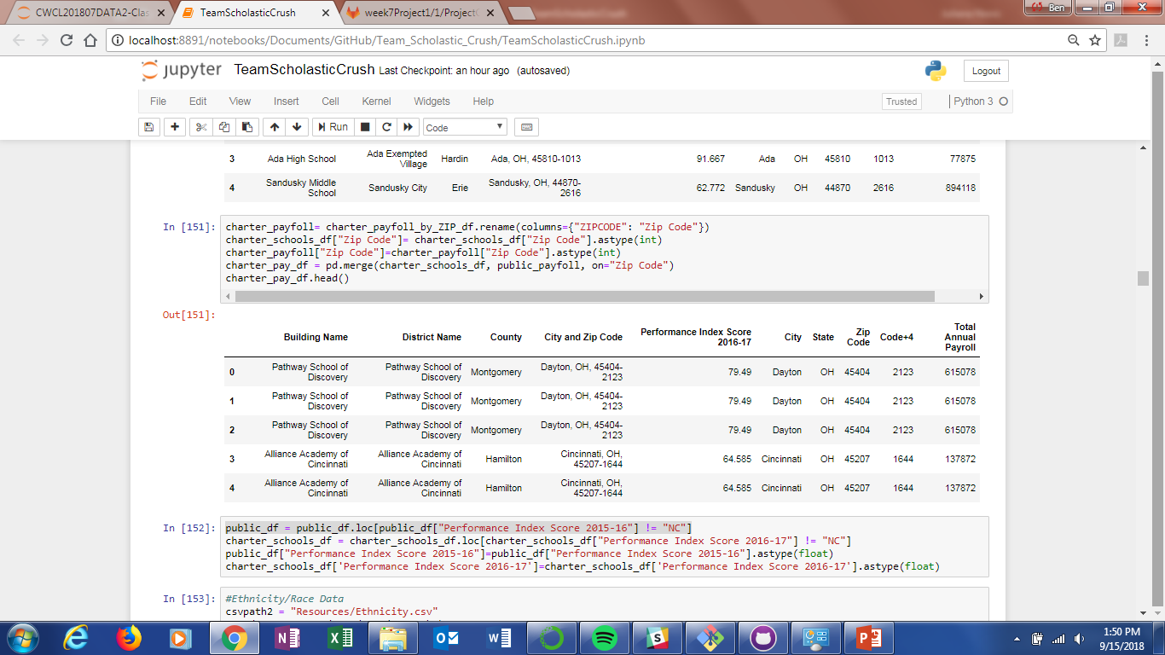

Slide 7
Data Analysis Process

Slide 8
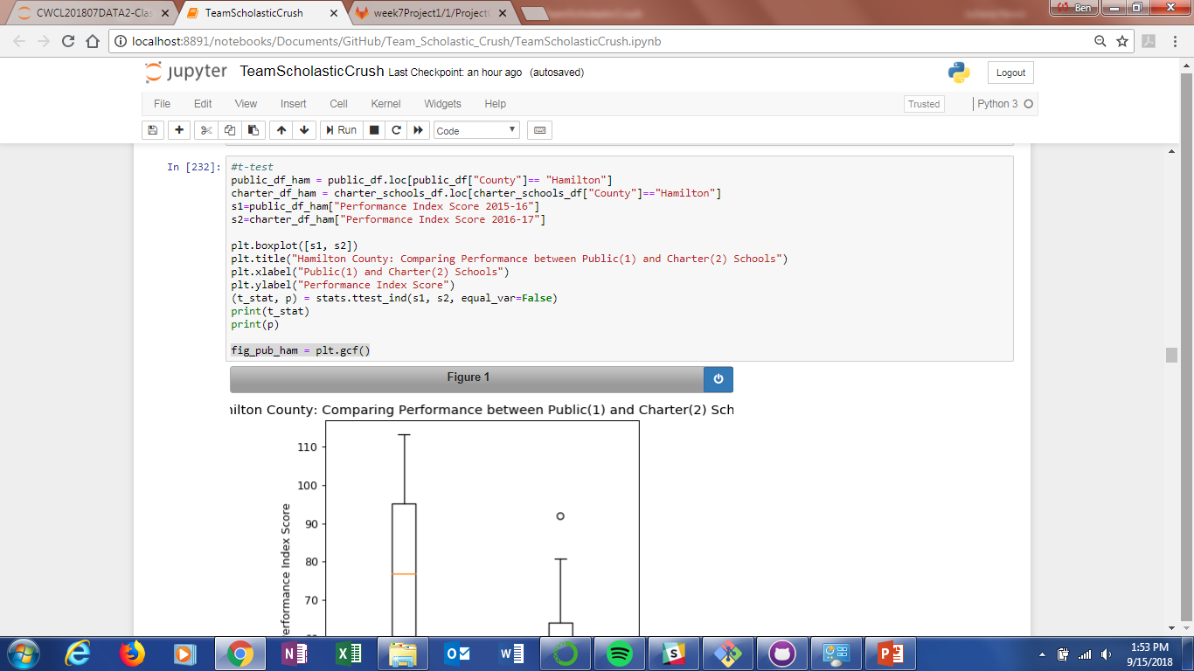
Data Analysis Process

Slide 9
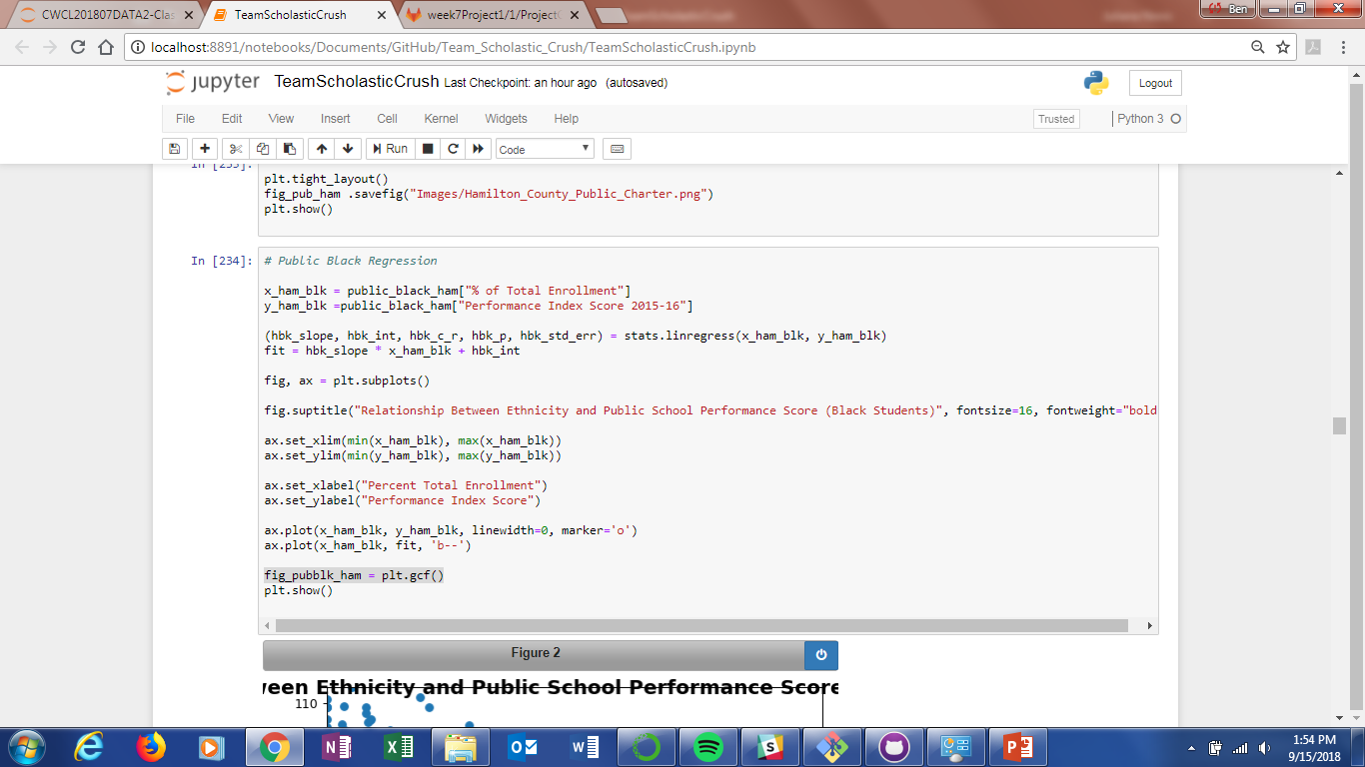

Slide 10
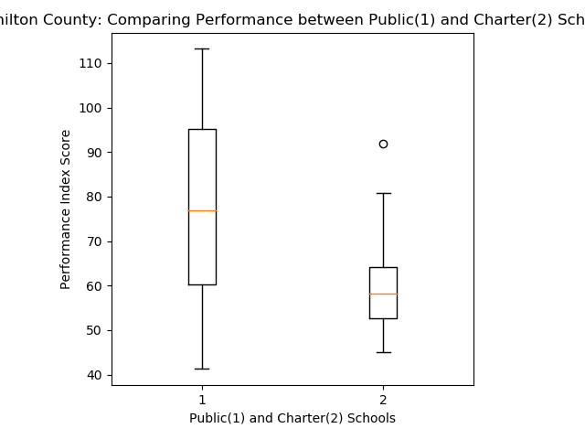
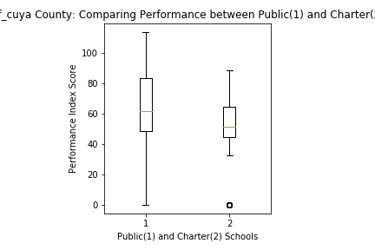
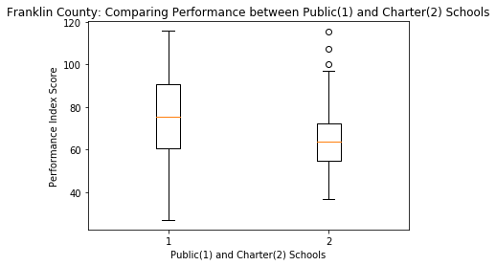
H1: Charter Schools Perform Differently from Public Schools
Hamilton
Cuyahoga
Franklin

Slide 11
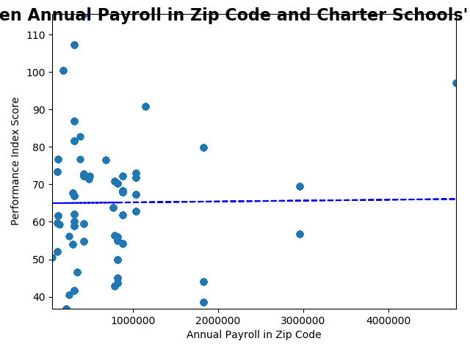
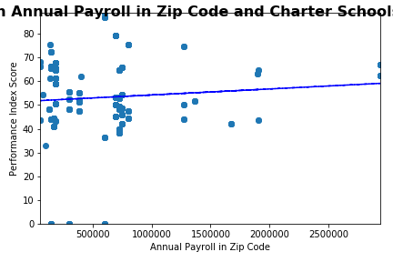
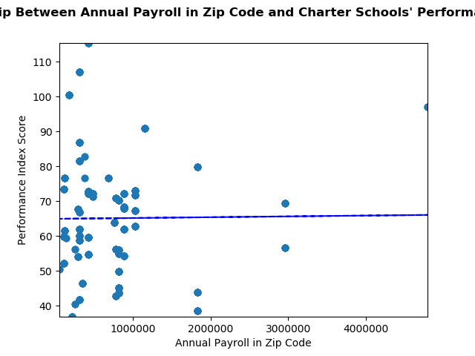
H2: Better Performance Scores Correlate to Higher Annual Payrolls in the Area (Charter Schools)
R = 0.00
Hamilton
Cuyahoga
Franklin
R =

Slide 12
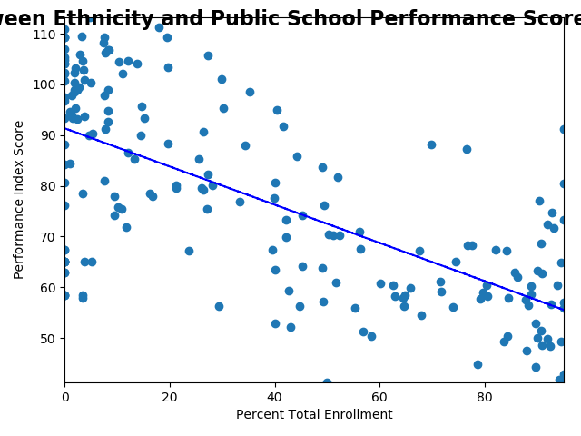
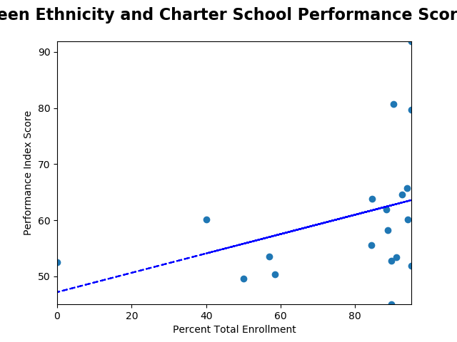
H3: Different Populations are Served Better by Charter Schools (Hamilton County)
R² = -0.67
R² = 0.36
Public
Charter

Slide 13
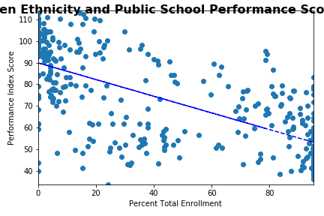
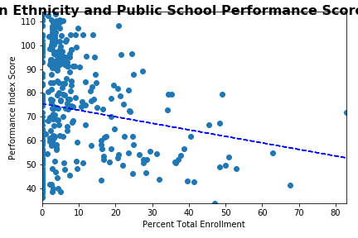
H3: Different Populations are Served Better by Charter Schools (Cuyahoga County)
R² = -0.67
R² = -0.27
Public
Charter

Slide 14
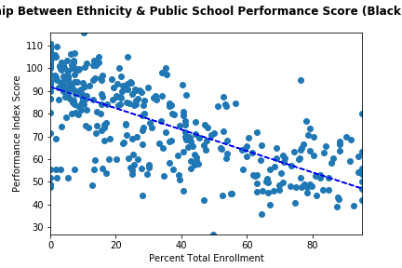
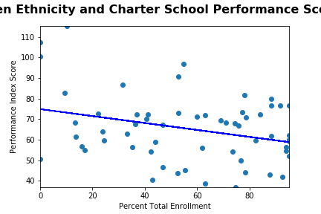
H3: Different Populations are Served Better by Charter Schools (Franklin County)
Public
Charter

Slide 15
Conclusions
Charter schools on average perform as well as public schools, though the spread is greater in public schools performance in Cuyahoga
Charter schools perform on average worse than public schools in Hamilton County, though this is not a statistically significant result
Amount of payroll entering a community does not impact the charter schools performance. This is also true for public schools.
Different populations are not better served by charter schools.

Slide 16
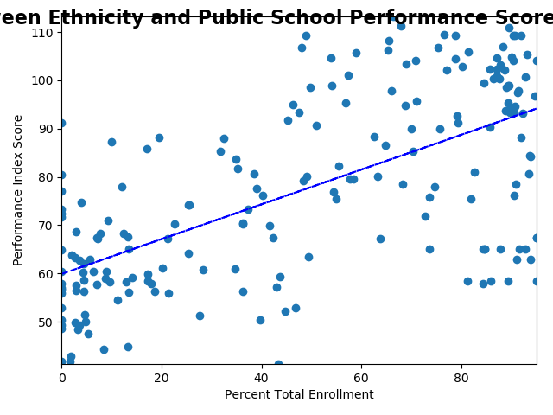
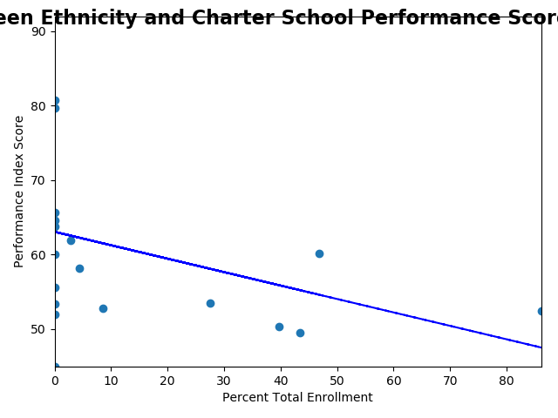
Hamilton County (White)
Public
Charter

Slide 17
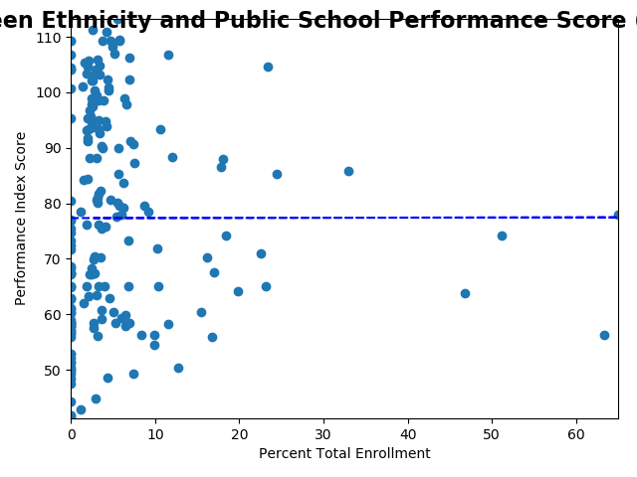
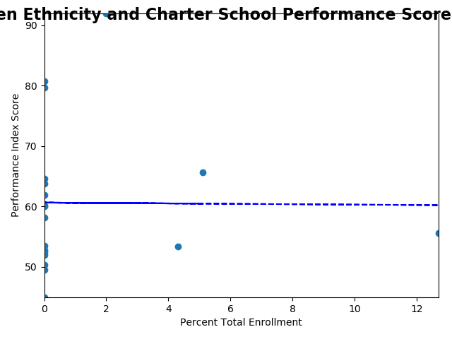
Hamilton County (Latino)
Public
Charter

Slide 18
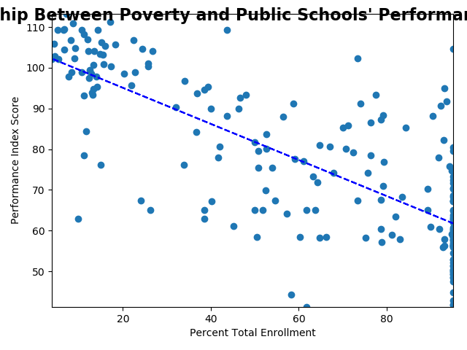
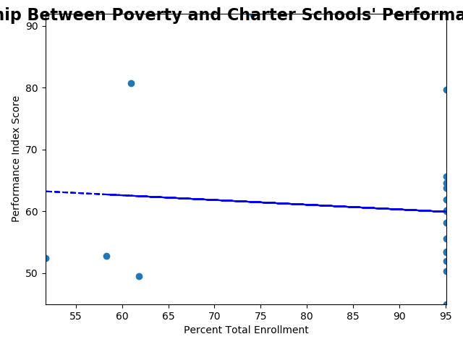
Hamilton County (Economically Disadvantaged)
Public
Charter

Slide 19
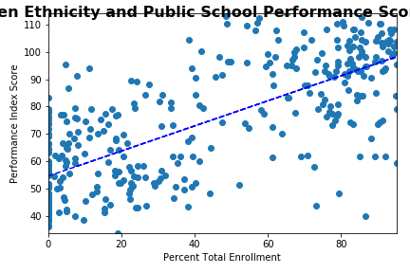
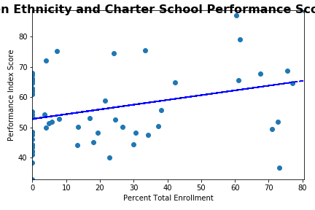
Cuyahoga County (White)

Slide 20
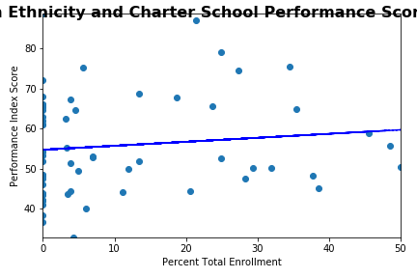
Cuyahoga County (Latino)

