Slide 1

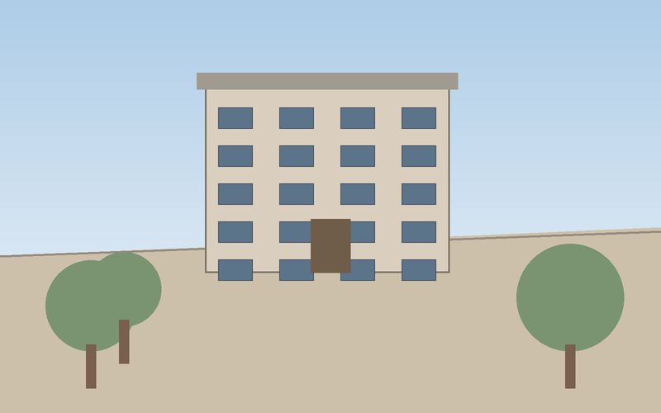
(a) Two-stage adaptation
Stage 1 · frozen backbone
Stage 2 · trainable adapter
frozen
trainable
Image
Encoder
Q-Former
Adapter
frozen
trainable

