Slide 1

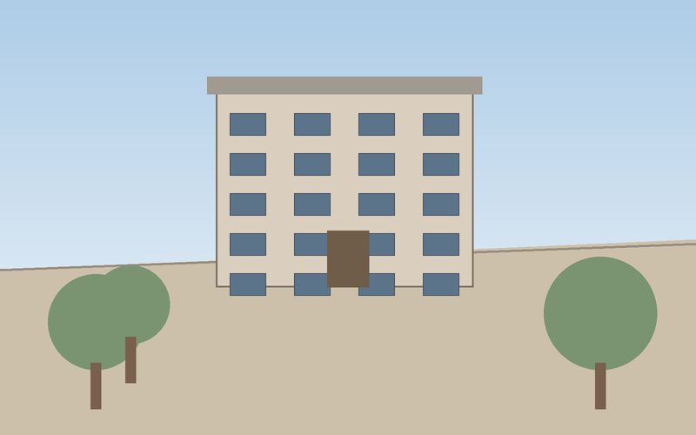
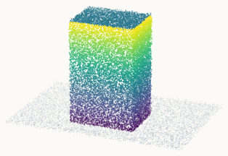
(a) Overall architecture
Attention Block × L
Image
Encoder
Task
Decoder
Frame-wise Attention
Depth
Global Attention
Input views
Point map
skip connection

