Slide 1

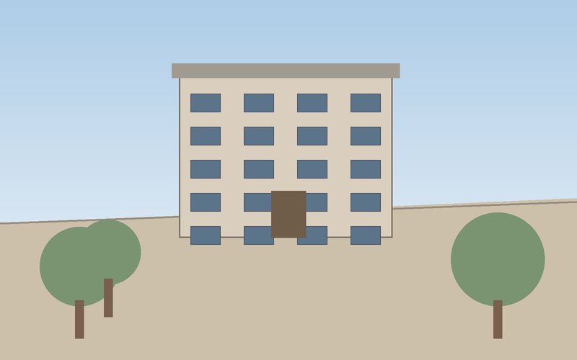
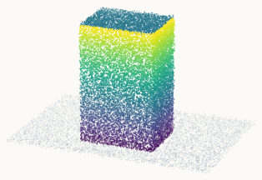
(a) Overall architecture
camera tokens
Attention Block × L
frozen
Visual Encoder
(ViT-B)
Frame-wise Attention
Shared
Decoder
Depth
Global Attention
Input views
Point map
skip connection

