Slide 1
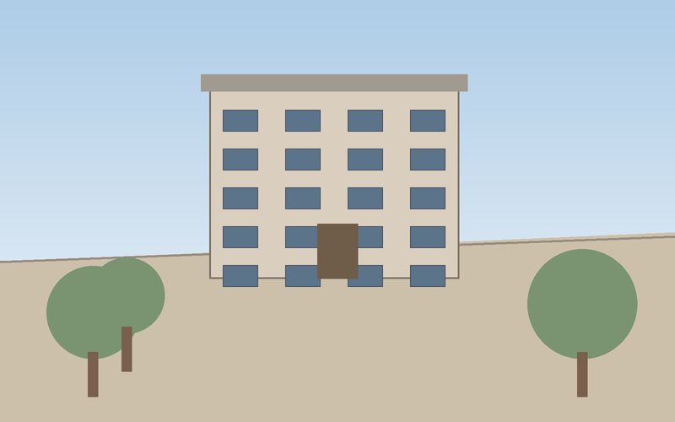

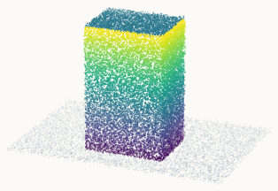
(b) Qualitative comparison
Input
Depth
Point map
Ours

