Slide 1

Game Theory – The Prisoner’s Dilemma: Strategic Application to CROCS INC.
A new Perspective to Decision Science in Trading
By Teddy Thomas Tenetcha
Notes:
In 2021, hedge funds lost billions on GameStop due to a short squeeze a situation that could have been avoided by using risk-adjusted decision science strategy.

Slide 2
Aligning the Prisoner’s dilemma to sig decision science theory
Decision Science at SIG
Susquehanna use poker to teach new traders about decision making under uncertainty. Traders go through similar thought processes while evaluating the expected value of a given trade and deciding how to price risk.
Prisoner’s Dilemma
The Prisoner’s Dilemma is a game theory concept that illustrates why two rational individuals might not cooperate, even if it appears that it is in their best interest to do so.
Game-Theory Driven Adaptation
Using CROCS INC. as an example we aligned the Prisoner’s Dilemma theory to strategically calculate moves based on Market Volatility.
Notes:
Traders execute trades without knowing future market movements, using historical data, market indicators, and probabilistic models to inform decisions.

Slide 3

Building Intuition

Slide 4
Understanding the Prisoner’s Dilemma in Context: CROCS INC.
Players: Two competing entities (e.g., CROCS and a major competitor).
Choices: Each can choose to cooperate (e.g., diversify) or defect (e.g., specialize).
Payoffs: The outcome depends on the combination of choices, illustrating the tension between the two rationality and collective benefit.
 | Competitor Diversifies (Cooperates) | Competitor Specializes (Defects)
CROCS Diversifies (Cooperates) | Both achieve moderate growth | CROCS achieves high growth, Competitor achieves steady growth
CROCS Specializes (Defects) | Competitor achieves high growth, CROCS achieves steady growth | Both achieve steady growth

Slide 5
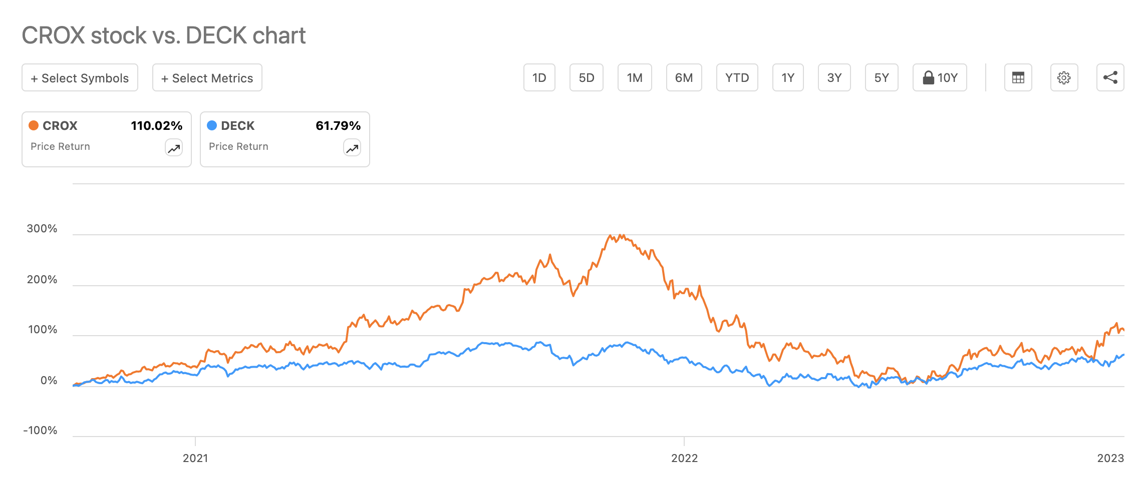
Illustration: CROCS VS DECKERS
Crocs focused on product innovation and customization with Accessories
Crocs enhanced its global expansion efforts
The company also leveraged influencer marketing and social media

Slide 6
Leveraging the Prisoner’s Dilemma in Decision-Making for Trading
Scenario | Expected Outcome | Strategy | Rationale
Both Diversify (Mutual Cooperation) | Moderate growth for both CROCS and its competitor. | Hold or Slight Long Position | Steady growth indicates stability. A balanced approach minimizes risk while capturing moderate gains
CROCS Diversifies and Competitor Specializes | CROCS achieves high growth; Competitor experiences steady growth. | Long CROCS, Short Competitor | Anticipate CROCS’ superior performance and potential stock price surge, while the competitor’s stock remains steady or slightly declines.
CROCS Specializes and Competitor Diversifies | Competitor achieves high growth; CROCS experiences steady growth. | Short CROCS, Long Competitor | CROCS’ stock may underperform relative to the competitor, providing an opportunity to profit from the competitor’s growth.
Both Specialize (Mutual Defection) | Both achieve steady growth. | Hold or Utilize Covered Call Options | Limited upside potential; generating income through options can enhance returns without significant capital exposure.

Slide 7
Refined Uncertainty: Applying Probabilities to Market Scenarios
EV=∑(Probability of Scenario × Return in Scenario)
Strategy | Relevant Scenarios | Probability | Return (%) | Weighted Return (%)
Hold or Slight Long Position | Post-Pandemic Normalization | 21.7% | 5% | 21.7% * 5% = 1.05%
Long CROCS, Short Competitor | Growth in Athletic Footwear & Rise of Eco-Friendly Footwear | 34.8%+21.7%=56.6% | 12% | 56.6% * 12% = 6.79%
Short CROCS, Long Competitor | Emergence of Strong Competitors | 21.7% | 10% | 21% * 10% = 2..10%
Hold or Utilize Covered Call Options | Economic Downturn | 13.0% | 3% | 13% * 3% = 3..9%
Total | - | 100% | - | 13.84%
Notes:
Our refined probabilities are derived using a hybrid approach that combines Bayesian models, time series forecasting, machine learning validation, and Monte Carlo simulations.

Slide 8


Strategic Advantage Through Decision Science
Keen Observational Stance → Strategic Thinking & Anticipation → Building Informed Internal Opinions → Enhancing Decision Science

Slide 9

Thank You!

