Slide 1


From Bits to Tokens: Knowledge-Driven Generative Communication of Multimodal Data
Center for Wireless Communications
Xingyu Chen, Zihao Feng, Wuqiong Zhao, Jianrong Ding, Ke Sun, Xinyu Zhang
Notes:
Hi everyone. My name is Xingyu Chen, I am a fourth year phd student from UC San Diego. I will present our research on 'From Bits to Tokens: Knowledge-Driven Generative Communication of Multimodal Data'.

Slide 2


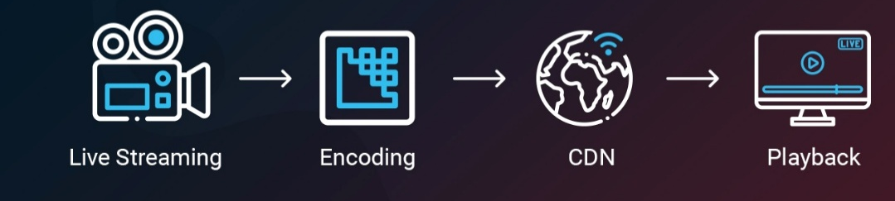
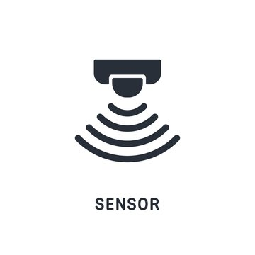

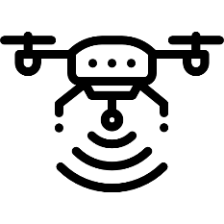
The Communication Bottleneck of Modern IoT
The Old Paradigm:
Human Consumers
The New Paradigm:
Machine Decision-Makers
Sensors
Decision Making
Actions
Notes:
For the past few decades, our communication networks were design with Human a single dominant consumer.
Whether it's live streaming, video conferencing, or web browsing, the end goal has always been human perceptual fidelity.
However, we are now entering a New ERA for AI. The primary consumers of network bandwidth are no longer humans, but Machine Decision-Makers.
In scenarios like autonomous driving, drone controlling, to industrial robotics,
sensors capture vast amounts of data not for humans to watch, but for AI to make decisions and take actions.
. The problem is, our current communication infrastructure hasn't caught up with this shift

Slide 3
The Misalignment in Wireless Communication
Core Theory: Shannon’s Theorem
The Misalignment: • Network Objective: Minimize Bit Error Rate • Application Objective: Maximize Task Accuracy.
The Consequence: In wireless settings with interference and fading, strict bit-fidelity forces retransmissions This kills latency for real-time applications.
Notes:
Today's wireless networks, such as 5G, WiFi are all built on Shannon's paradigm:
they optimize for bit-level fidelity, minimizing bit error rate.
But the applications they don't care about every single bit. They care about task performance: c
Such as an I detect the pedestrian? Can I segment the road?

Slide 4
The Misalignment in Wireless Communication
Core Theory: Shannon’s Theorem
The Misalignment: • Network Objective: Minimize Bit Error Rate • Application Objective: Maximize Task Accuracy.
The Consequence: In wireless settings with interference and fading, strict bit-fidelity forces retransmissions This kills latency for real-time applications.
The Research Question
If the receiver is an AI model, do we really need to recover every bit to understand the semantic meaning?
Notes:
This creates a fundamental mismatch. When packets are lost due to fading or interference, retransmission recovers the bits but adds latency
For real-time application , this latency is unacceptable. So, my core research question is:
If the receiver is an AI model, do we really need to recover every single bit to understand the semantic meaning?

Slide 5
Knowledge Driven Communication
Transmit Knowledge (Tokens), Not Data (Bits)
Lost
“The quick brown jumps over the lazy dog”
Inference: “Fox”
Notes:
We propose Knowledge Driven Communication .
The core idea is: Transmit Knowledge , Not Data .
Look at this sentence: "The quick brown [Blank] jumps over the lazy dog".
Even though the word is lost, you know it is "Fox".
You don't need the bits to understand the meaning
The reason is you have the knowledge of English and maybe this pangram.

Slide 6
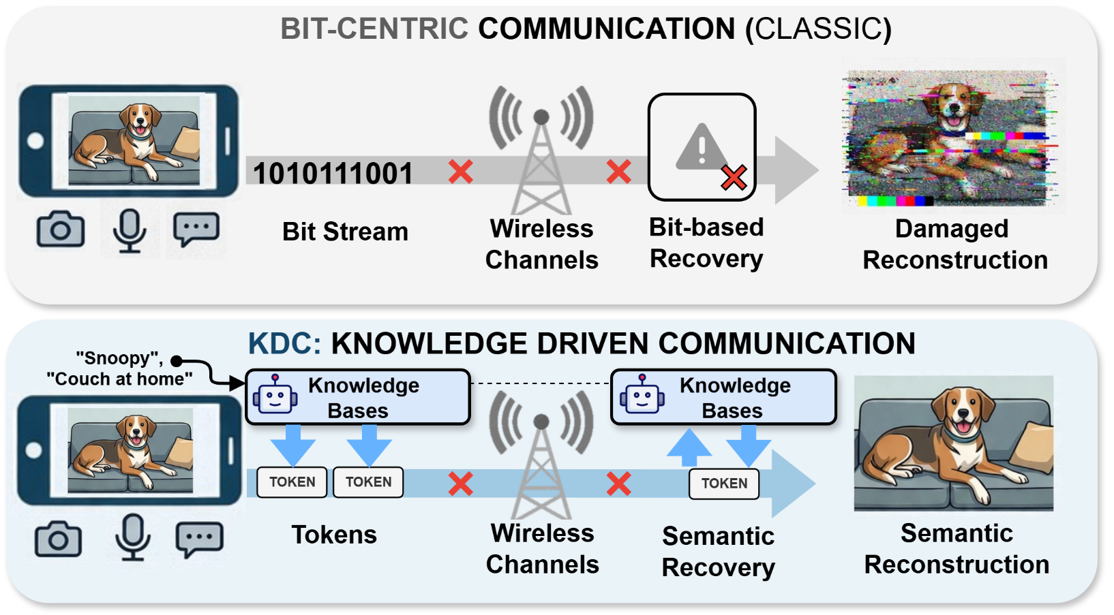
Knowledge Driven Communication
Notes:
This intuition motivates our system design. Instead of treating communication as a problem of perfectly reconstructing raw data, we treat it as a problem of delivering the new information that the receiver actually needs.
If the receiver already has relevant context, then the transmitter can focus on sending compact semantic tokens. The receiver can combine those tokens with its own knowledge to recover what matters for the downstream task.

Slide 7
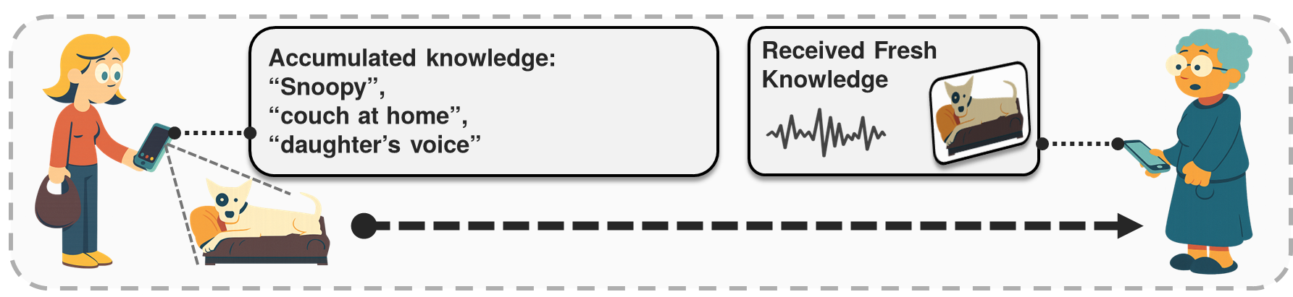
Knowledge Driven Communication
Intelligent Communication via Knowledge Base
Both side has knowledge regarding the context
Notes:
This is like a conversation between two people.
The receiver has Accumulated Knowledge.
For example, she knows her "daughter's voice" or what "Snoopy" looks like.
So, the transmitter only needs to send Fresh Knowledge.
The receiver combines both to restore the reality.

Slide 8
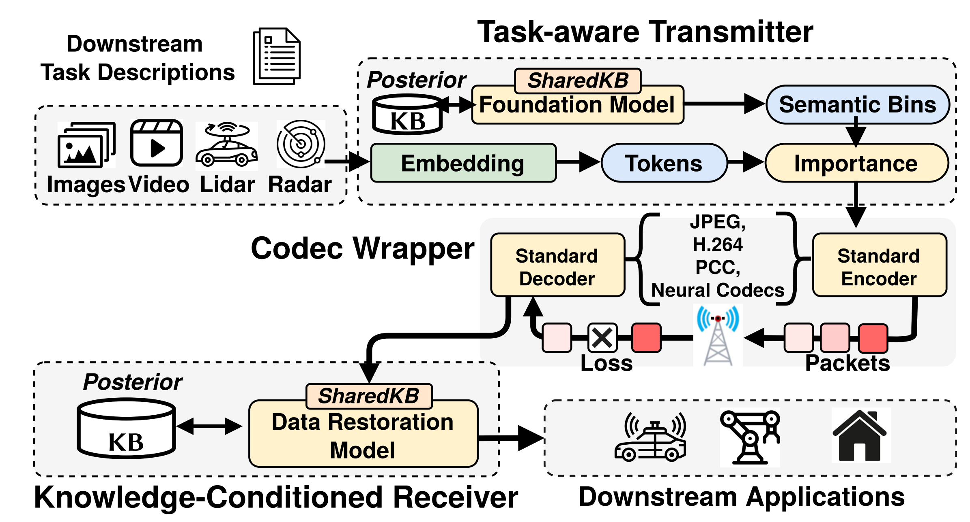
System Architecture Overview
Transmitter
Receiver
Task Prompts
LLM
Knowledge Bases
Offline
Operator
Tokens
Restoration
Notes:
Here is the high-level architecture,.

Slide 9
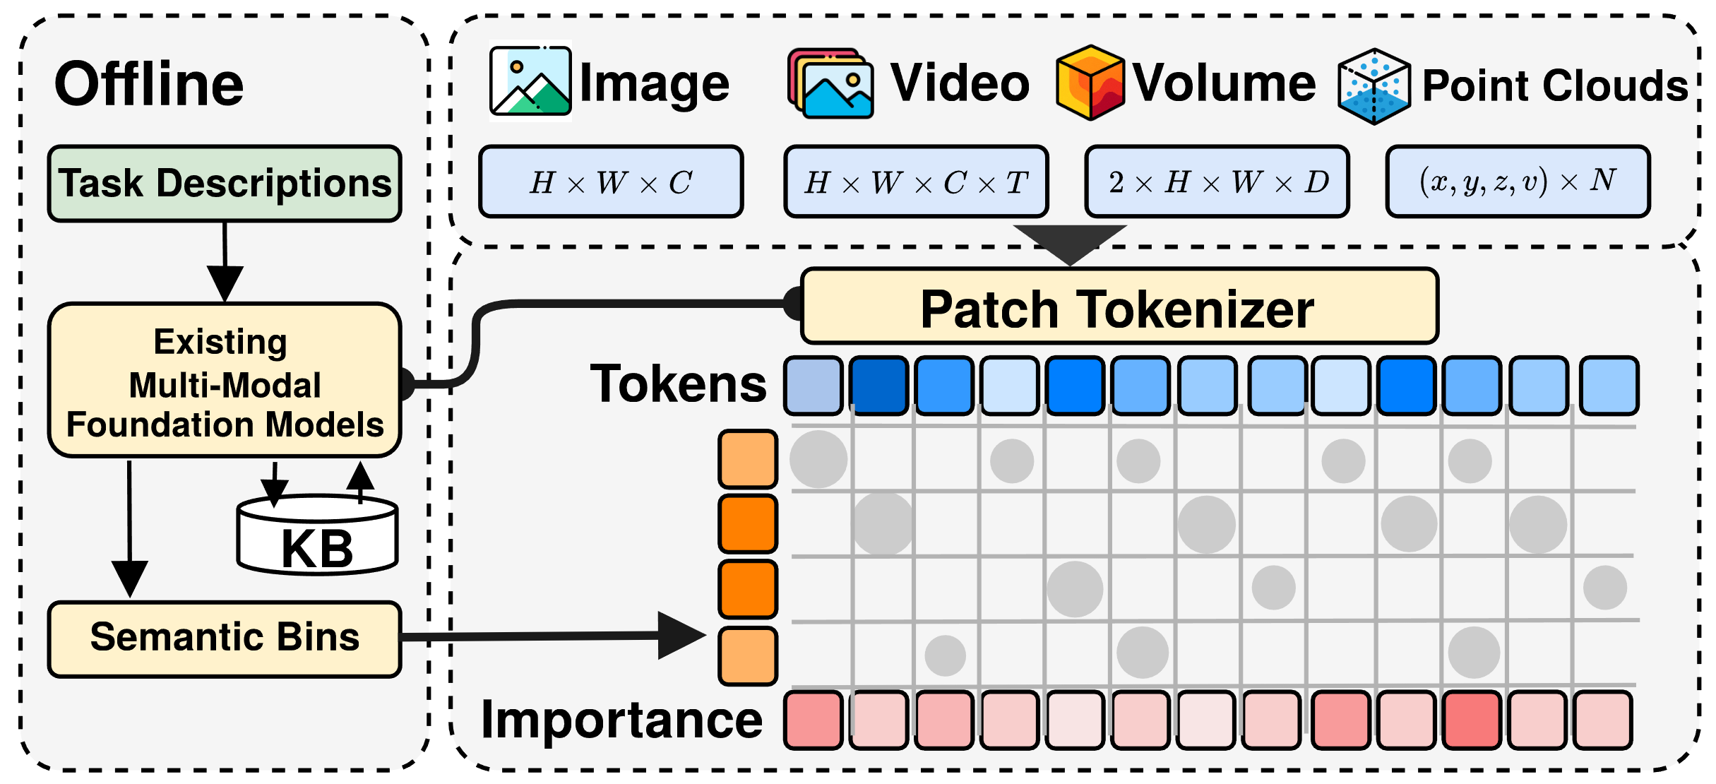
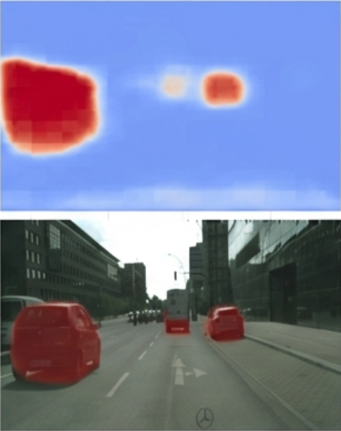
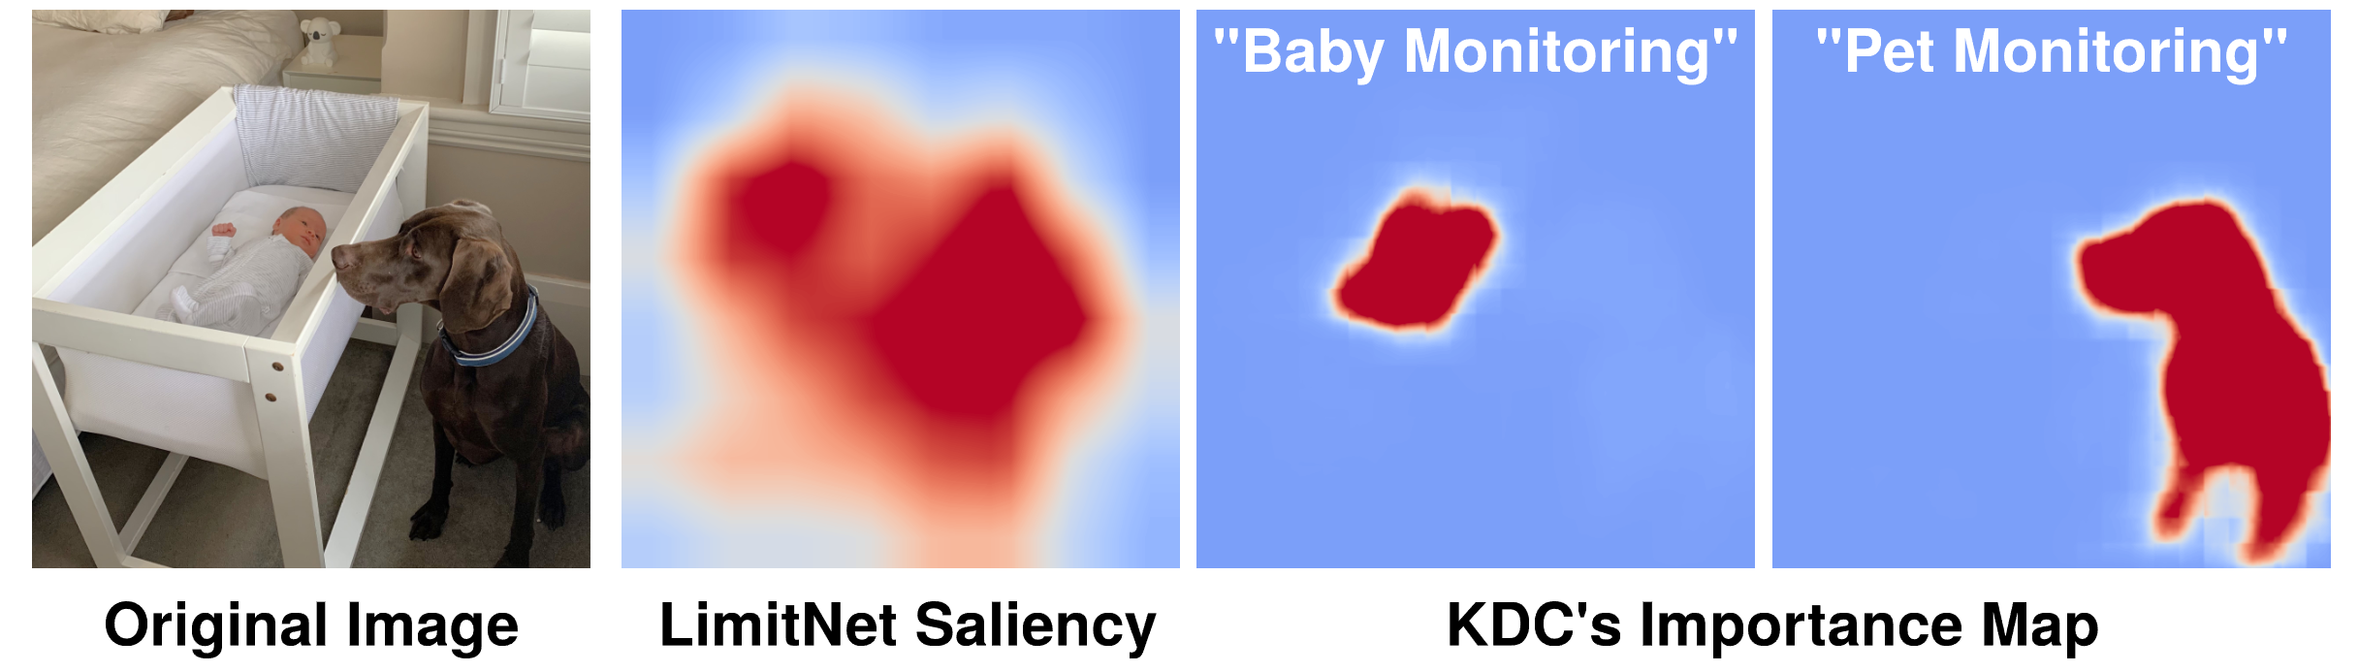
KDC Transmitter
Aligning modalities to a unified semantic space.
Red areas indicate high semantic value (αᵢ)
automatically selected based on the prompt.
Key Advantage: Zero-Shot Task Adaptation
Change the text prompt, and the compression strategy changes instantly without retraining the neural network.
Notes:
Transmitter - Knowledge Representation
Let's look at the Transmitter.
We handle many inputs: Image, Video, Volume, and Point Clouds.
We use a Patch Tokenizer. From corresponding Foundation Models like
This converts all data into a grid of tokens.
We kinda unify all type of sensor data here, as long as they are a corrpoing tokenizer we can use it in our system.
This allows us to adapt different downstream tasks instantly.
In the top image, the task is "Baby Monitoring". The focus is on the crib.
In the bottom image, the task is "Pet Monitoring".
The focus instantly shifts to the dog.
We do not need to retrain the neural network

Slide 10
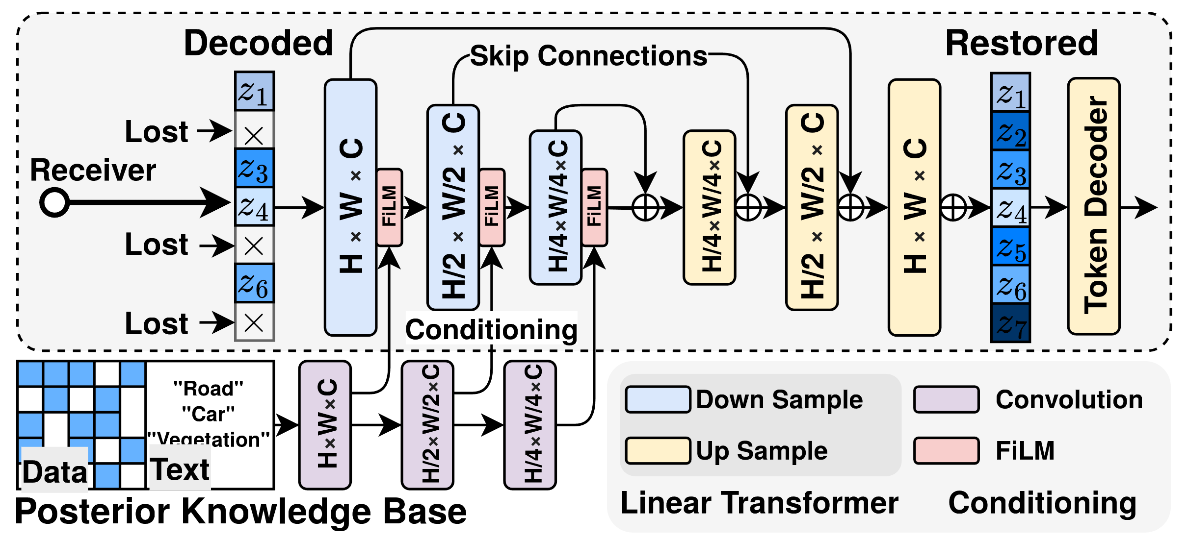
KDC Receiver
Receive Tokens: Accept potentially corrupted/partial stream.
Conditioned Generation: Use FiLM to condition the restoration network weights based on retrieved context.
Restoration: restore missing data in a controlled manner.
Accumulation: Learnable receiver, Positive Feedback Loop
Received Data [Partially Lost]
Restoration Model
Restored Data
Knowledge Base
Notes:
The receiver gets a token stream that is partially lost — the crosses on the left are dropped tokens. Instead of asking for retransmission, it reconstructs them.
The trick is on the bottom path: the Knowledge Base retrieves context relevant to this scene — road, car, vegetation — and that context is fed in through FiLM layers that modulate the restoration network's weights at every scale. So the network isn't hallucinating freely; it's generation conditioned on what we already know about this scene / context.
The restored data flows back into the Knowledge Base. The receiver gets smarter the longer it runs.

Slide 11
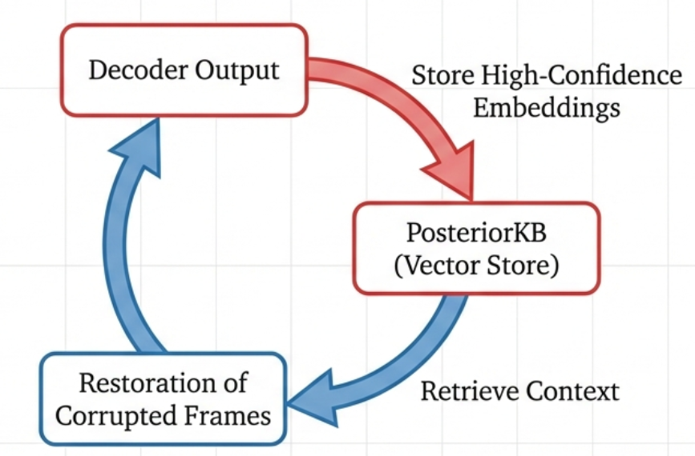
Incremental Knowledge Accumulation
Positive Feedback Loop: The more it receives, the less it needs to receive.
This enables “Early Exit” where the receiver can stop listening once confidence is high, saving latency.
Notes:
This creates a positive feedback loop.
High-confidence decoded frames are stored in the knowledge base.
The more the receiver 'sees,' the more context it has, and the less data the recervier needs to achieve a desirable performance.
This even enables 'Early Exit' to save latency

Slide 12
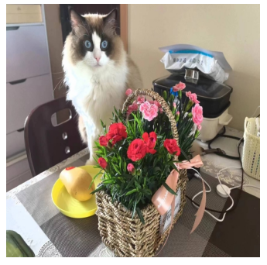
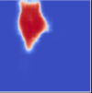
Implementation: The Codec Wrapper
Constraint: Must support legacy standards (JPEG, H.264) and hardware accelerators.
Semantic Pre-Quantization
Fine Quantization
Standard Encoder
(JPEG/ H.264)
Aggressive Quantization
Reduce the entropy of background before the standard encoder.
Standard codec naturally allocates fewer bits to these zeroed-out areas.
Resulting in a valid, standard-compliant bitstream that is semantically optimized.
Notes:
A key design goal is practicality. We do not want to replace existing codecs or hardware accelerators. Instead, KDC works as a wrapper before standard encoders such as JPEG or H.264.
The idea is semantic pre-quantization. For regions that are less important to the task, such as background, we aggressively reduce entropy before encoding. The standard codec then naturally assigns fewer bits to those regions, while preserving more detail in task-critical areas.
So the output is still a valid, standard-compliant bitstream, but it is optimized semantically rather than uniformly.

Slide 13
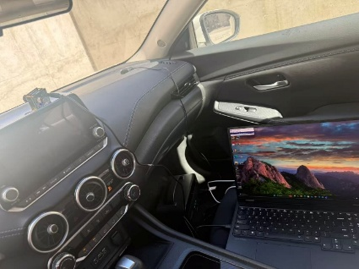
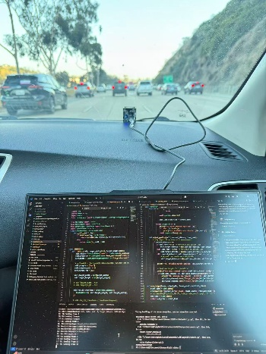
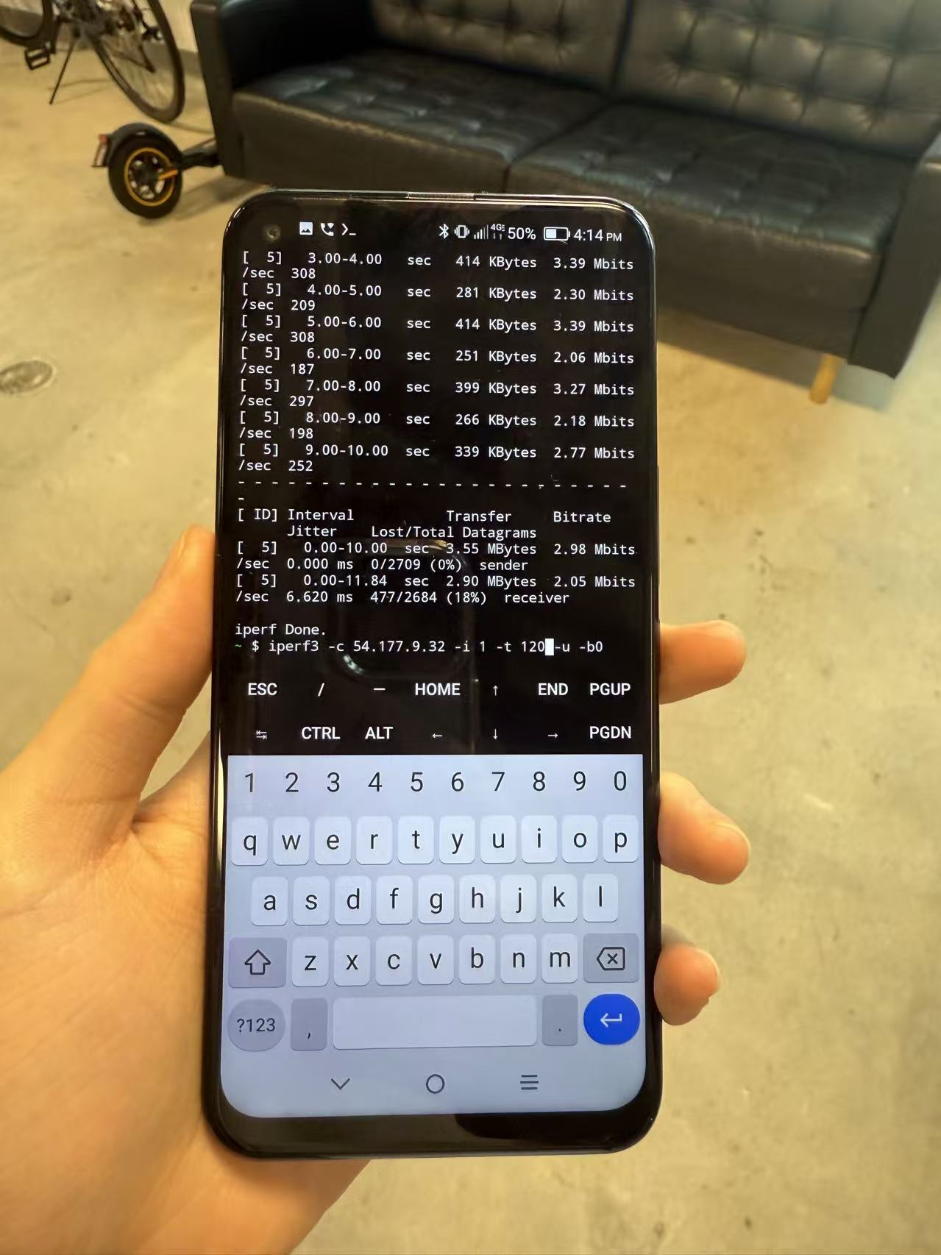
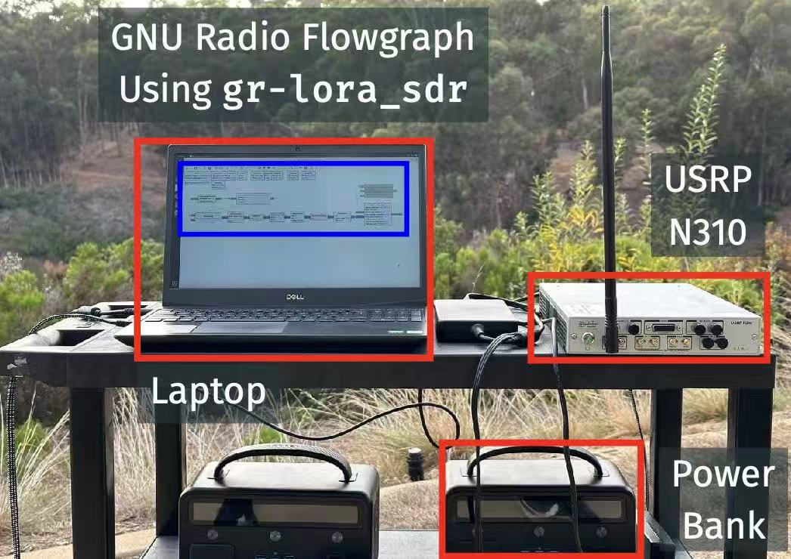
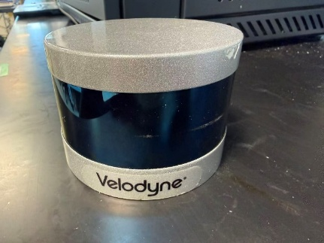
Evaluation Setup
5G Cellular
WiFi (2.4/5 GHz)
LoRa (USRP N310)
Image / Video
Radar
LiDAR
Image and Video on 5G Cellular Networks
Radar on WiFi
LiDAR on LoRa (Long Range, low-power wireless protocol)
Notes:
We evaluate KDC across multiple modalities and wireless protocols. For image and video, we test over 5G cellular networks. For radar, we test over WiFi. For LiDAR, we use LoRa with USRP N310, which represents a long-range, low-power wireless setting.
The goal is to show that this is not a single-modality trick. KDC should work whenever the receiver can use task knowledge and accumulated context to recover the information that matters.

Slide 14
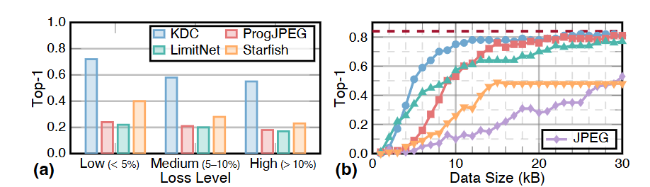
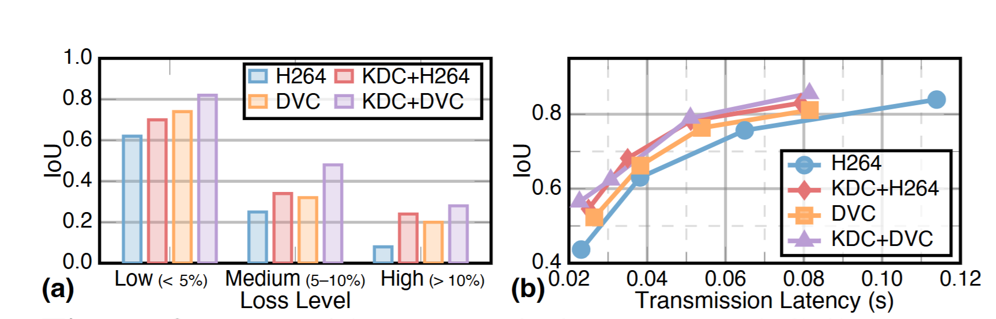
Image and Video
Image Transmission
Video Transmission
3× higher task performance under heavy loss
~2× more bandwidth-efficient at the same accuracy
Notes:
When the channel gets bad — packet loss above ten percent — pixel-based codecs collapse to near zero, while KDC holds roughly three times their task accuracy. And when the channel is fine but the budget is tight, KDC reaches the same accuracy with about half the bytes. Image, radar, and LiDAR results follow the same pattern and are in the paper.

Slide 15
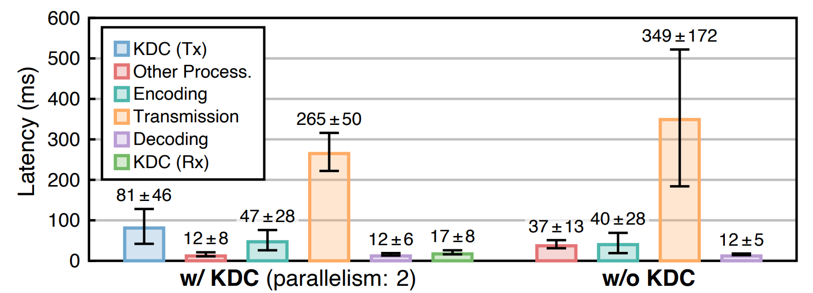
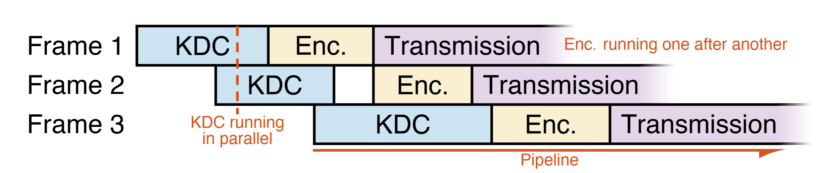
System Implementations
Parallel and Pipelined Processing
3 stages run as producer–consumer pipeline: KDC → encode → transmit
KDC per-frame operations are stateless → parallelizable
Mask caching reuses importance maps for similar frames
Results
32FPS at 1080p video streaming on edge device.
100FPS+ on laptop with RTX 4080 gpu.
Notes:
To make the KDC system practical and usage in real hardware and application.
We need to consider the effiency and latency
We implemented this using a parallel pipeline structure to ensure it runs fast.
KDC processing, Encoding, and Transmission run in parallel stages

Slide 16
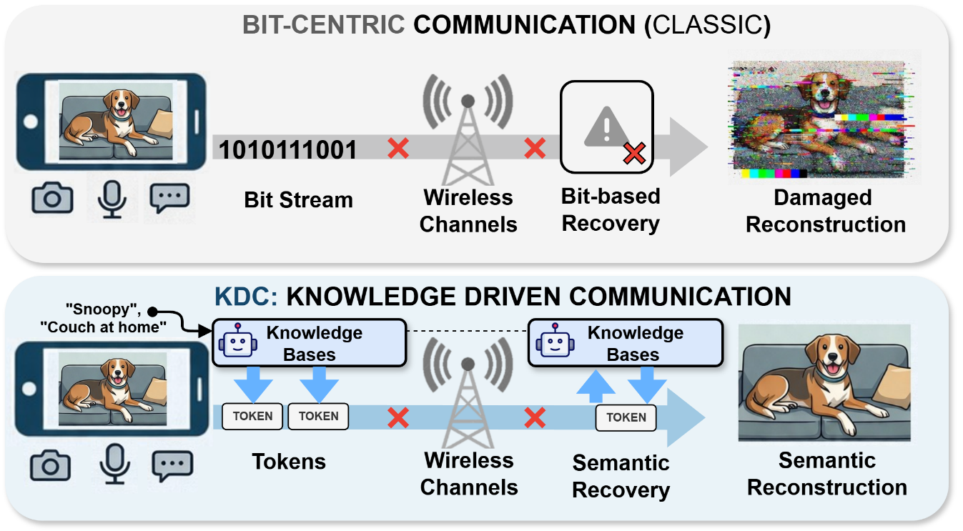
Summary: Knowledge Driven Communication
Notes:
To conclude, KDC represents three major contributions:
Paradigm Shift: use token as the basic transmission unit instead of bit
System Realization:
General & Practical: Proven across multiple modalities and protocols with real-time performance

Slide 17
Thank you!
Notes:
Thank you. I am happy to take any questions

Slide 18
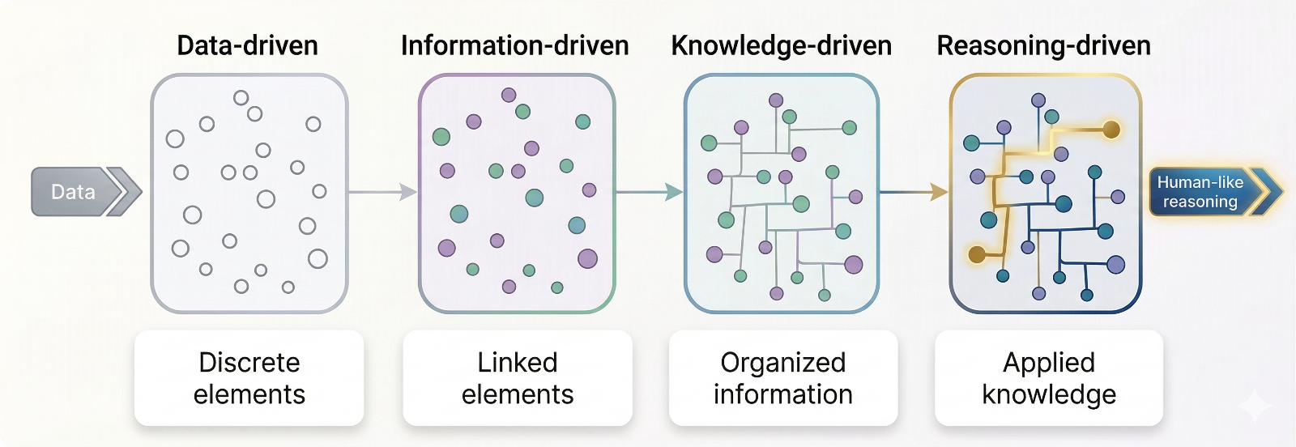
Looking Forward
Data
Human-like
reasoning
Notes:
Looking forward, we see a path from Data-Driven -> Knowledge-Driven -> Reasoning-Driven networks. Future wireless networks won't just move data; they will be AI-native, possessing generalizable intelligence to perform logic and causal reasoning, further optimizing how machines communicate

