Slide 1


From Bits to Tokens: Knowledge-Driven Generative Communication of Multimodal Data
Center for Wireless Communications
Xingyu Chen, Zihao Feng, Wuqiong Zhao, Jianrong Ding, Ke Sun, Xinyu Zhang
Notes:
Hi everyone. My name is Xingyu Chen, I am a fourth year PhD student from UC San Diego. I will present our research on "From Bits to Tokens: Knowledge-Driven Generative Communication of Multimodal Data."

Slide 2


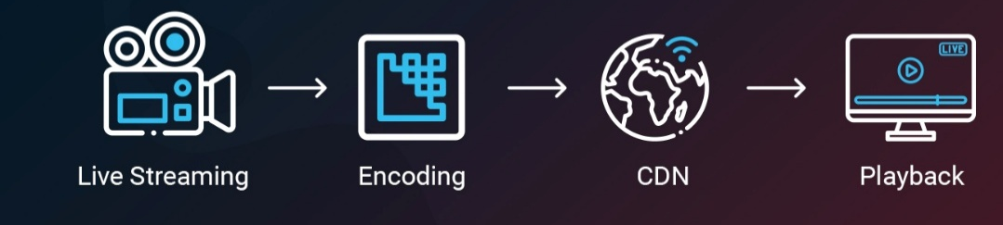
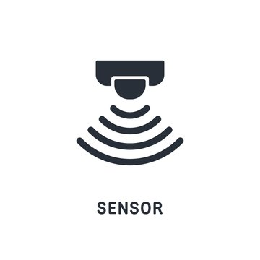

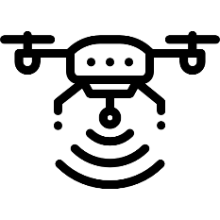
The Communication Bottleneck of Modern IoT
The Old Paradigm:
Human Consumers
The New Paradigm:
Machine Decision-Makers
Sensors
Decision Making
Actions
Notes:
For the past few decades, our communication networks were designed with humans as the dominant consumers. Whether it is live streaming, video conferencing, or web browsing, the end goal has been human perceptual fidelity.
But we are now entering a new era for AI. The primary consumers of network bandwidth are no longer humans, but machine decision-makers. In autonomous driving, drone control, and industrial robotics, sensors capture data not for humans to watch, but for AI to make decisions and take actions. The problem is that our current communication infrastructure has not caught up with this shift.

Slide 3
The Misalignment in Wireless Communication
Core Theory: Shannon’s Theorem
The Misalignment: • Network Objective: Minimize Bit Error Rate • Application Objective: Maximize Task Accuracy.
The Consequence: In wireless settings with interference and fading, strict bit-fidelity forces retransmissions This kills latency for real-time applications.
Notes:
Today's wireless networks, such as 5G and WiFi, are built on Shannon's paradigm: they optimize for bit-level fidelity and minimize bit error rate.
But many applications do not care about every single bit. They care about task performance: can I detect the pedestrian? Can I segment the road?

Slide 4
The Misalignment in Wireless Communication
Core Theory: Shannon’s Theorem
The Misalignment: • Network Objective: Minimize Bit Error Rate • Application Objective: Maximize Task Accuracy.
The Consequence: In wireless settings with interference and fading, strict bit-fidelity forces retransmissions This kills latency for real-time applications.
The Research Question
If the receiver is an AI model, do we really need to recover every bit to understand the semantic meaning?
Notes:
This creates a fundamental mismatch. When packets are lost due to fading or interference, retransmission can recover the bits, but it adds latency. For real-time applications, this latency is unacceptable.
So my core research question is: if the receiver is an AI model, do we really need to recover every single bit to understand the semantic meaning?

Slide 5
Knowledge Driven Communication
Transmit Knowledge (Tokens), Not Data (Bits)
Lost
“The quick brown jumps over the lazy dog”
Inference: “Fox”
Notes:
We propose Knowledge Driven Communication. The core idea is: transmit knowledge, not data.
Look at this sentence: "The quick brown [blank] jumps over the lazy dog." Even though the word is lost, you know it is "fox." You do not need the exact bits to understand the meaning, because you already have knowledge of English and this common phrase.

Slide 6
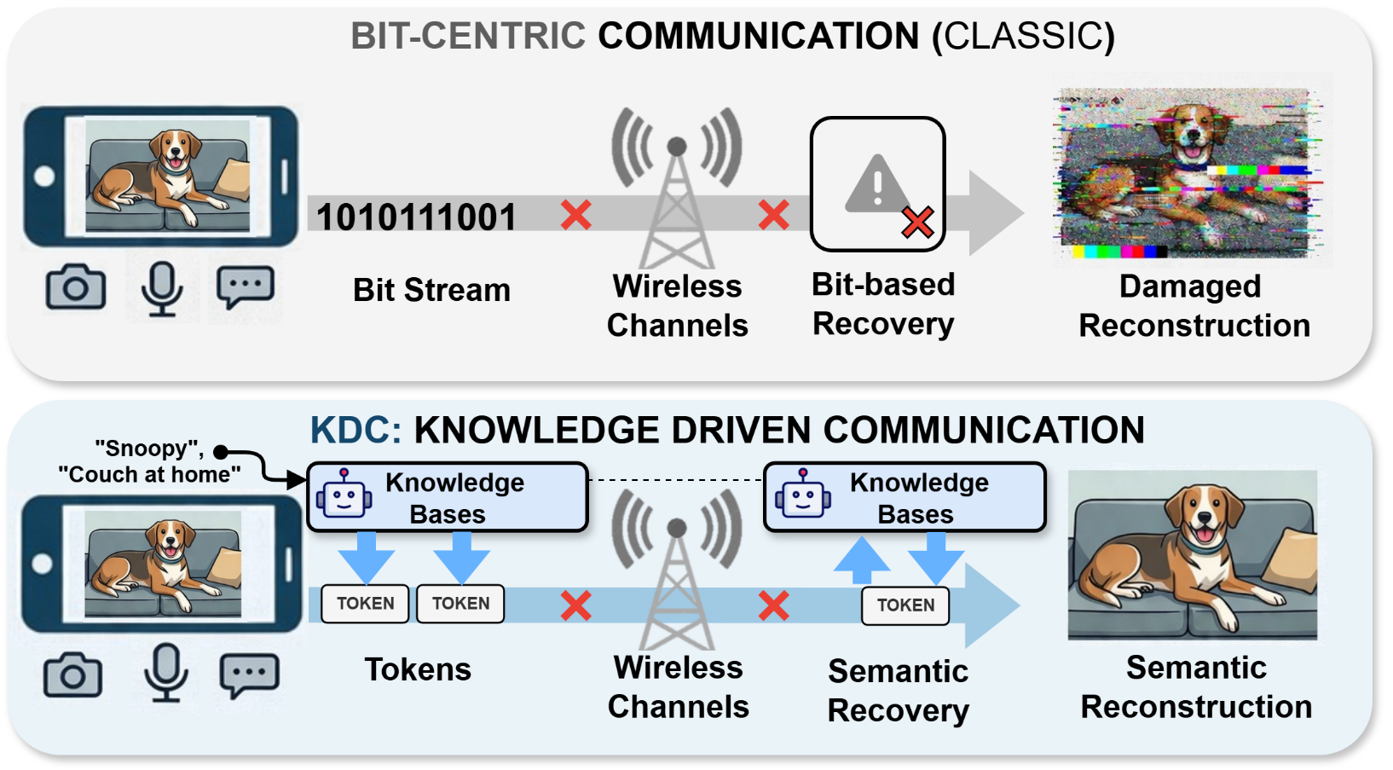
Knowledge Driven Communication
Notes:
This intuition motivates our system design. Instead of treating communication as a problem of perfectly reconstructing raw data, we treat it as a problem of delivering the new information that the receiver actually needs.
If the receiver already has relevant context, then the transmitter can focus on sending compact semantic tokens. The receiver can combine those tokens with its own knowledge to recover what matters for the downstream task.

Slide 7
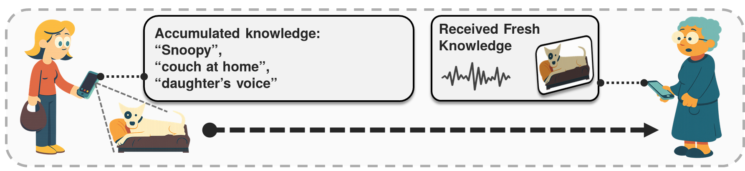
Knowledge Driven Communication
Intelligent Communication via Knowledge Base
Both side has knowledge regarding the context
Notes:
This is like a conversation between two people. The receiver has accumulated knowledge. For example, she knows her daughter's voice, or what Snoopy looks like.
So the transmitter only needs to send fresh knowledge. The receiver combines both to restore the reality.

Slide 8
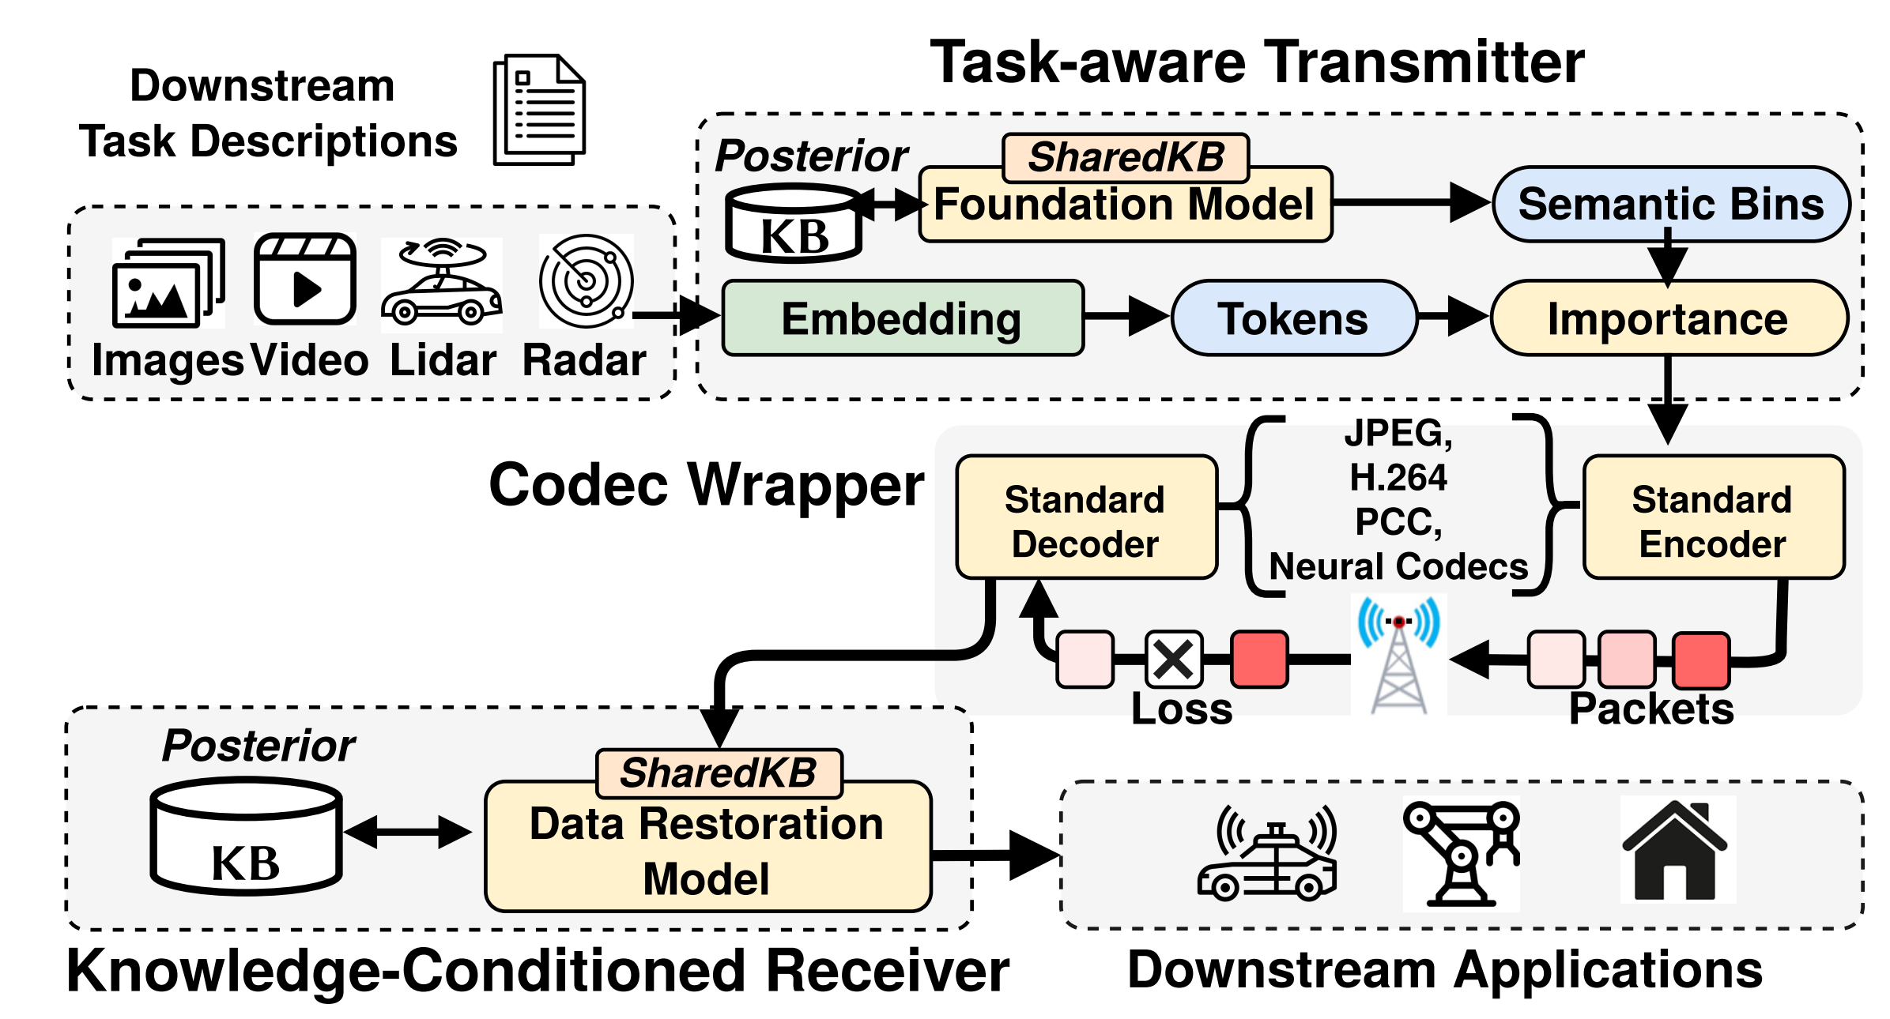
System Architecture Overview
Transmitter
Receiver
Task Prompts
LLM
Knowledge Bases
Offline
Operator
Tokens
Restoration
Notes:
Here is the high-level architecture. The transmitter converts multimodal sensor data into tokens guided by the task prompt. These tokens are transmitted through the wireless channel. On the receiver side, an LLM or operator retrieves relevant knowledge from the knowledge base and uses it to guide restoration.
The important point is that communication is no longer only between encoder and decoder; it is between encoder, decoder, task, and accumulated knowledge.

Slide 9
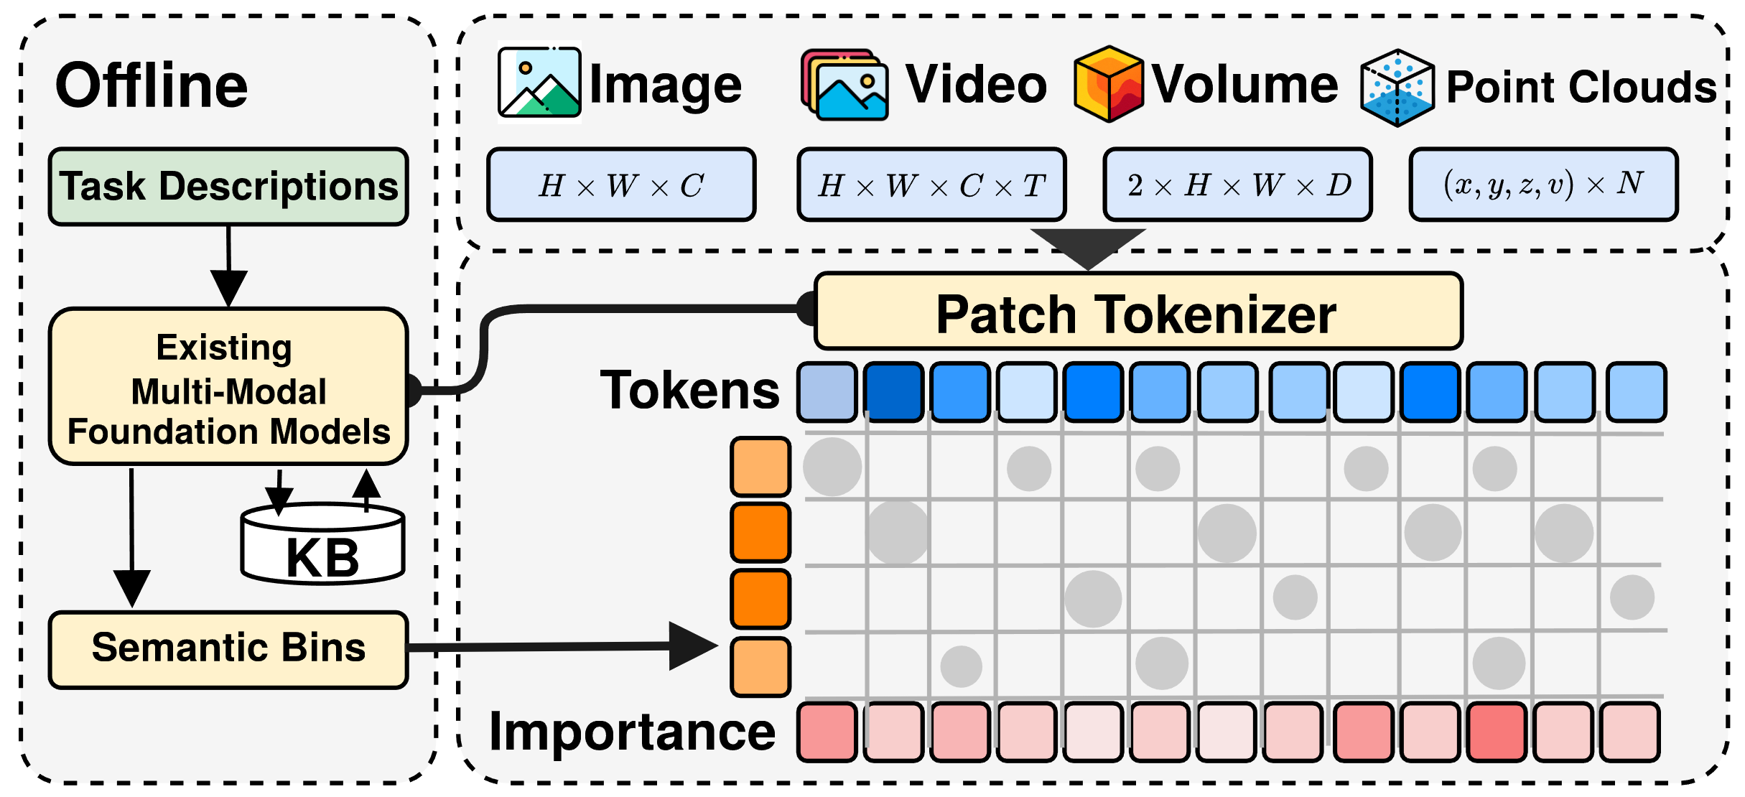
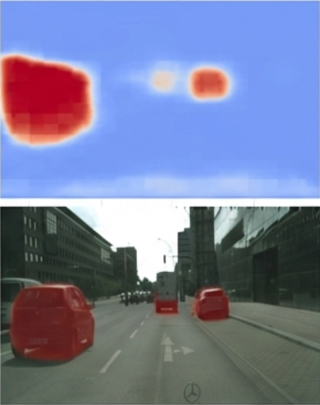
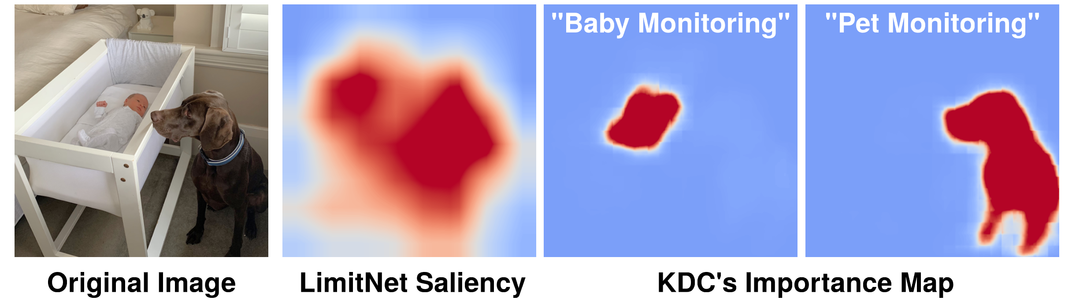
KDC Transmitter
Aligning modalities to a unified semantic space.
Red areas indicate high semantic value (αᵢ)
automatically selected based on the prompt.
Key Advantage: Zero-Shot Task Adaptation
Change the text prompt, and the compression strategy changes instantly without retraining the neural network.
Notes:
Let's look at the transmitter. We handle many inputs: image, video, volume, and point clouds. We use patch tokenizers from corresponding foundation models to convert data into a grid of tokens.
This lets us unify different types of sensor data as long as there is a corresponding tokenizer. It also allows zero-shot task adaptation. In the top image, the task is baby monitoring, so the focus is on the crib. In the bottom image, the task is pet monitoring, so the focus shifts to the dog. We do not need to retrain the neural network.

Slide 10
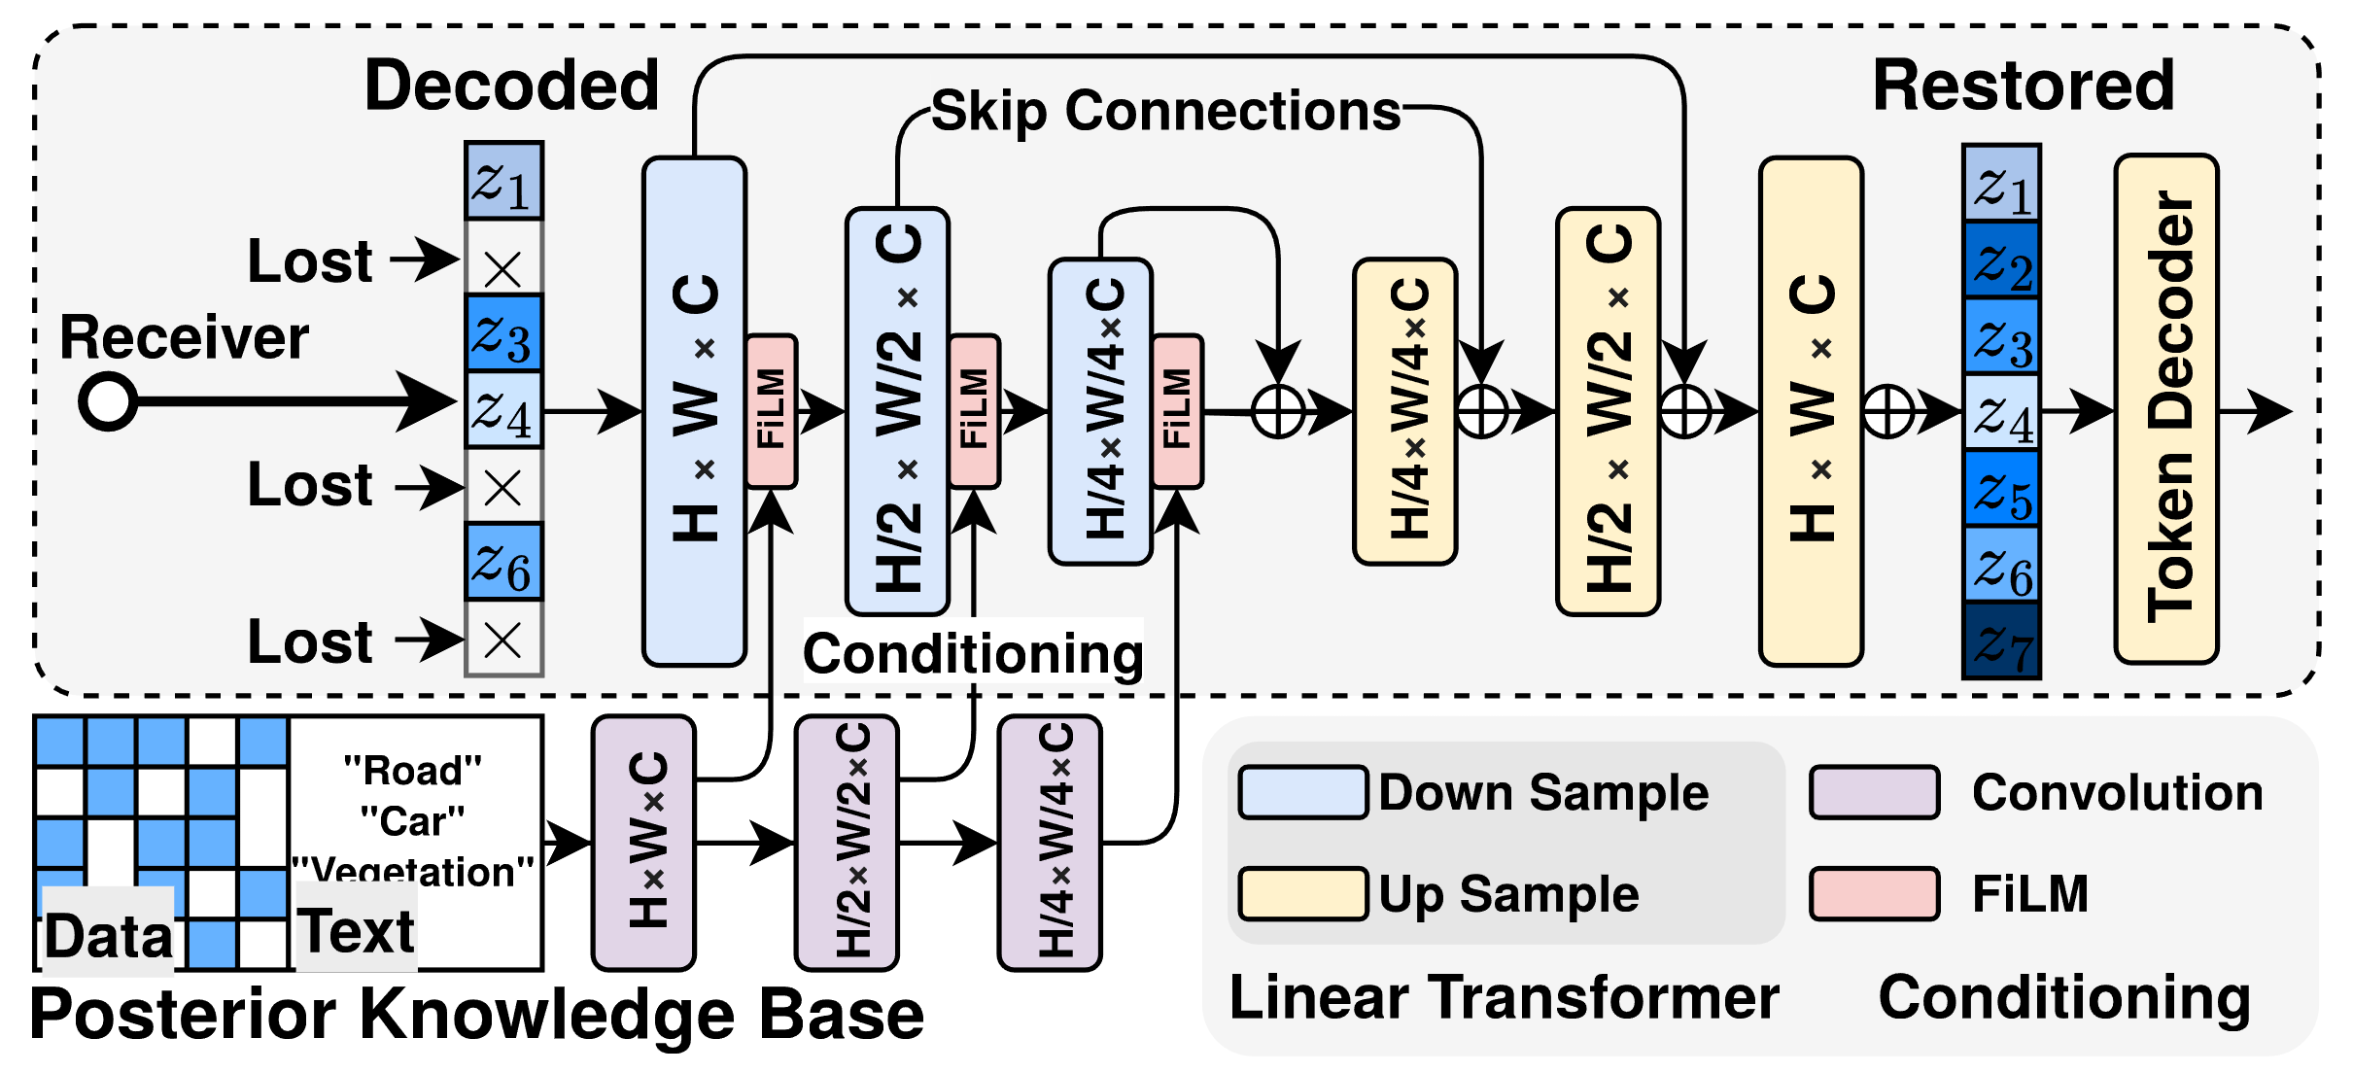
KDC Receiver
Receive Tokens: Accept potentially corrupted/partial stream.
Conditioned Generation: Use FiLM to condition the restoration network weights based on retrieved context.
Restoration: restore missing data in a controlled manner.
Accumulation: Learnable receiver, Positive Feedback Loop
Received Data [Partially Lost]
Restoration Model
Restored Data
Knowledge Base
Notes:
The receiver gets a token stream that is partially lost. The crosses on the left are dropped tokens. Instead of asking for retransmission, it reconstructs them.
The trick is on the bottom path: the knowledge base retrieves context relevant to this scene, such as road, car, or vegetation. That context is fed through FiLM layers that modulate the restoration network at every scale. So the network is not hallucinating freely; it is generating conditioned on what we already know about the scene.
The restored data then flows back into the knowledge base, so the receiver gets smarter the longer it runs.

Slide 11
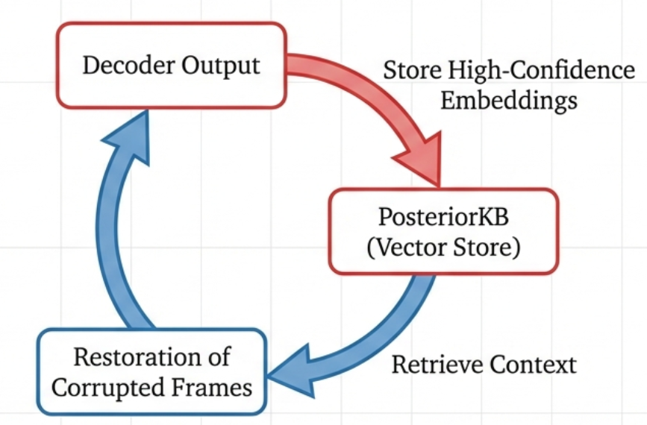
Incremental Knowledge Accumulation
Positive Feedback Loop: The more it receives, the less it needs to receive.
This enables “Early Exit” where the receiver can stop listening once confidence is high, saving latency.
Notes:
This creates a positive feedback loop. High-confidence decoded frames are stored in the knowledge base. The more the receiver sees, the more context it has, and the less data it needs to receive to achieve the desired performance.
This also enables early exit, where the receiver can stop listening once confidence is high, saving latency.

Slide 12
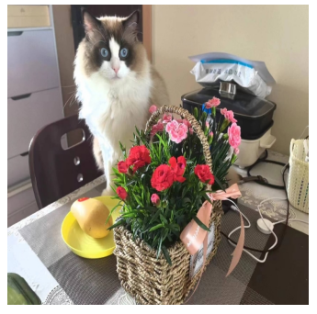
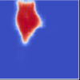
Implementation: The Codec Wrapper
Constraint: Must support legacy standards (JPEG, H.264) and hardware accelerators.
Semantic Pre-Quantization
Fine Quantization
Standard Encoder
(JPEG/ H.264)
Aggressive Quantization
Reduce the entropy of background before the standard encoder.
Standard codec naturally allocates fewer bits to these zeroed-out areas.
Resulting in a valid, standard-compliant bitstream that is semantically optimized.
Notes:
A key design goal is practicality. We do not want to replace existing codecs or hardware accelerators. Instead, KDC works as a wrapper before standard encoders such as JPEG or H.264.
The idea is semantic pre-quantization. For regions that are less important to the task, such as background, we aggressively reduce entropy before encoding. The standard codec then naturally assigns fewer bits to those regions, while preserving more detail in task-critical areas.
So the output is still a valid, standard-compliant bitstream, but it is optimized semantically rather than uniformly.

Slide 13
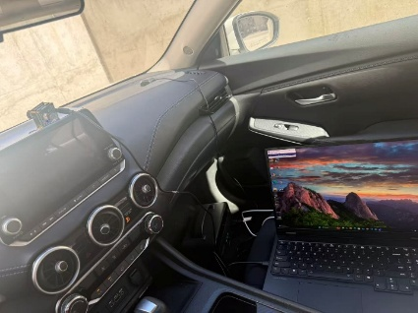
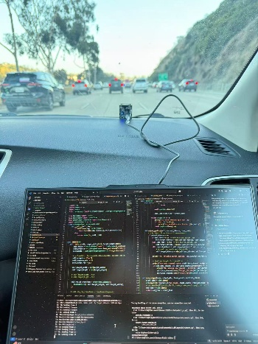
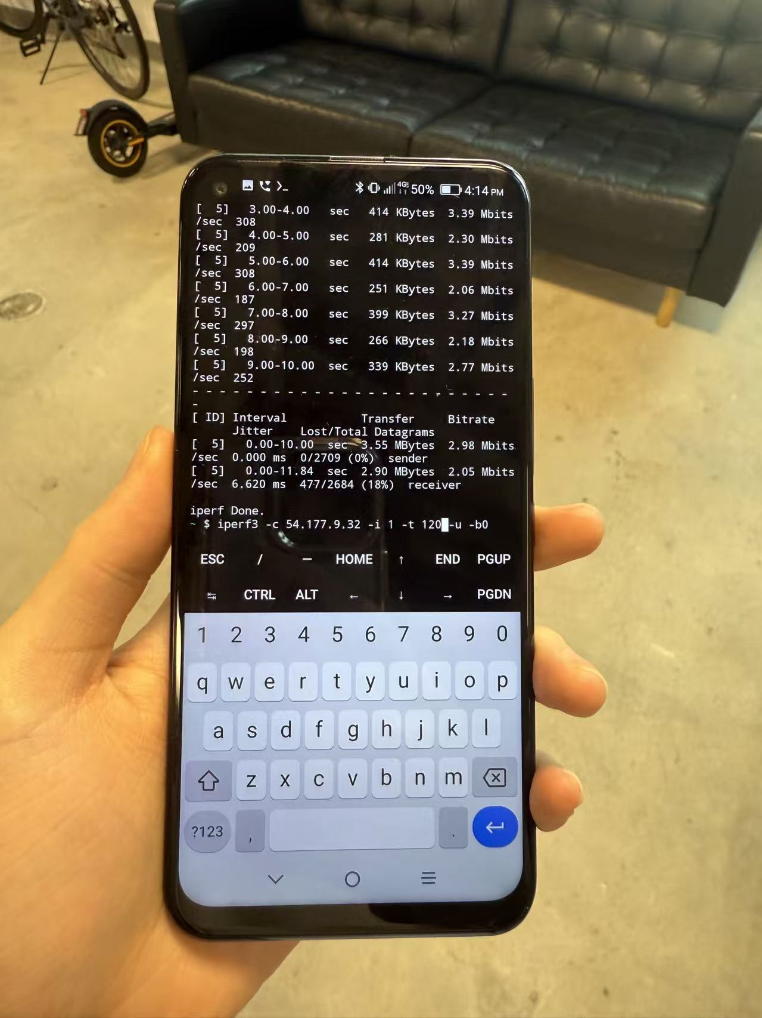
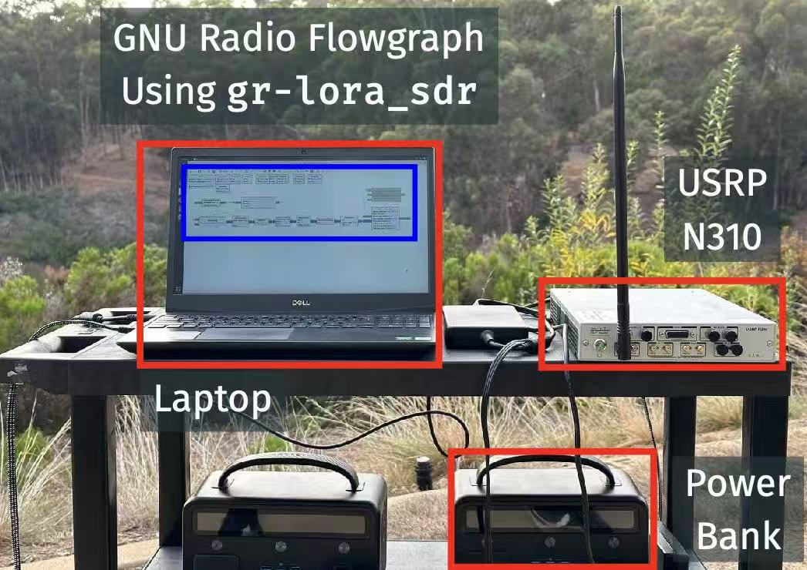
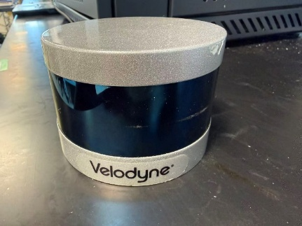
Evaluation Setup
5G Cellular
WiFi (2.4/5 GHz)
LoRa (USRP N310)
Image / Video
Radar
LiDAR
Image and Video on 5G Cellular Networks
Radar on WiFi
LiDAR on LoRa (Long Range, low-power wireless protocol)
Notes:
We evaluate KDC across multiple modalities and wireless protocols. For image and video, we test over 5G cellular networks. For radar, we test over WiFi. For LiDAR, we use LoRa with USRP N310, which represents a long-range, low-power wireless setting.
The goal is to show that this is not a single-modality trick. KDC should work whenever the receiver can use task knowledge and accumulated context to recover the information that matters.

Slide 14
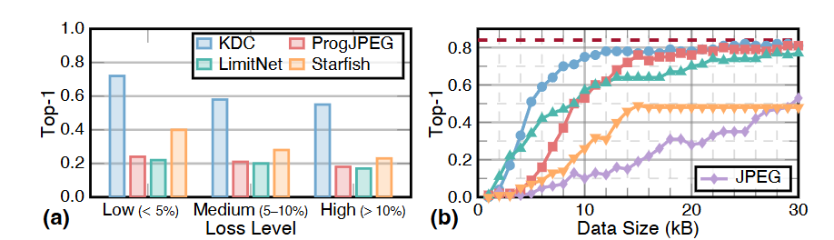
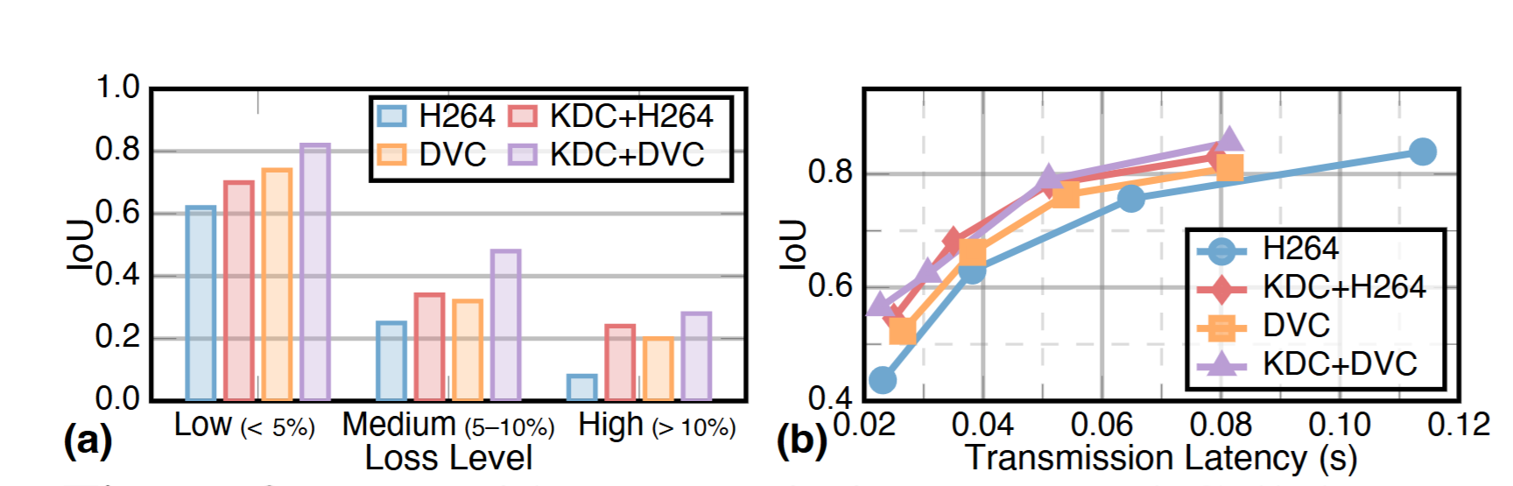
Image and Video
Image Transmission
Video Transmission
3× higher task performance under heavy loss
~2× more bandwidth-efficient at the same accuracy
Notes:
When the channel gets bad, with packet loss above ten percent, pixel-based codecs collapse to near zero, while KDC holds roughly three times their task accuracy.
And when the channel is fine but the budget is tight, KDC reaches the same accuracy with about half the bytes. Image, radar, and LiDAR results follow the same pattern and are included in the paper.

Slide 15
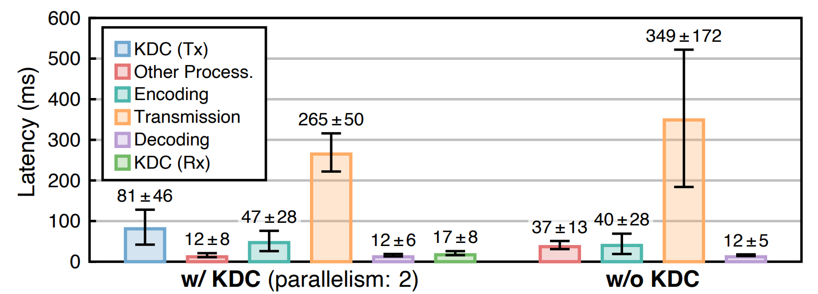
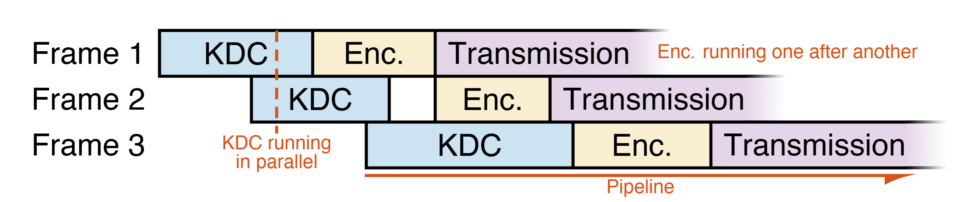
System Implementations
Parallel and Pipelined Processing
3 stages run as producer–consumer pipeline: KDC → encode → transmit
KDC per-frame operations are stateless → parallelizable
Mask caching reuses importance maps for similar frames
Results
32FPS at 1080p video streaming on edge device.
100FPS+ on laptop with RTX 4080 gpu.
Notes:
To make KDC practical on real hardware and applications, we need to consider efficiency and latency. We implemented the system using a parallel pipeline structure.
KDC processing, encoding, and transmission run as producer-consumer stages. The per-frame KDC operations are stateless, so they can be parallelized. We also cache masks for similar frames. As a result, we achieve 32 FPS at 1080p on an edge device, and over 100 FPS on a laptop with an RTX 4080 GPU.

Slide 16
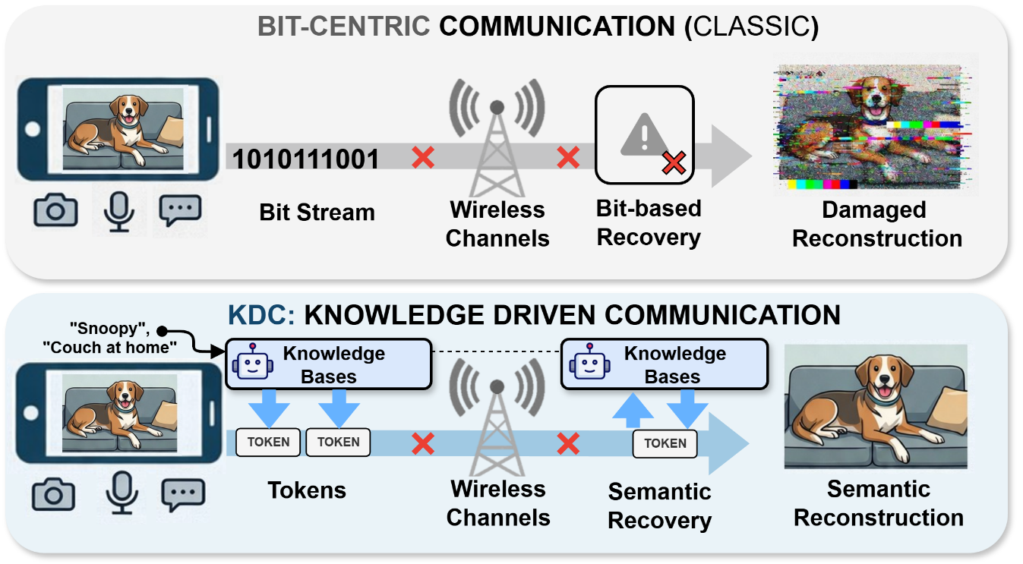
Summary: Knowledge Driven Communication
Notes:
To conclude, KDC represents three major contributions. First, it is a paradigm shift: using tokens as the basic transmission unit instead of bits. Second, it provides a system realization of knowledge-driven communication. Third, it is general and practical, demonstrated across multiple modalities and protocols with real-time performance.

Slide 17
Thank you!
Notes:
Thank you. I am happy to take any questions.

Slide 18
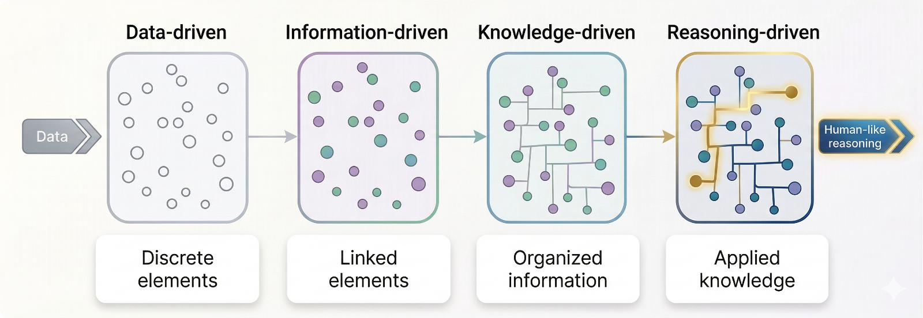
Looking Forward
Data
Human-like
reasoning
Notes:
Looking forward, we see a path from data-driven to knowledge-driven, and eventually to reasoning-driven networks. Future wireless networks will not just move data; they will be AI-native systems with generalizable intelligence, able to perform logic and causal reasoning to further optimize how machines communicate.

