Slide 1
LG Automated Testing using UTE Cloud Manager
Teodor Branescu
Timisoara/09.08.2019

Slide 2
Objectives
LG equipement
What is automated testing ?
What are the advantages of using UTE Cloud Manager
Cloud Manager platform reservation
Cloud Manager single run
Reservations history/User test executions history

Slide 3
What is RF Sharing ?
RF Sharing stands for Radio Frequency Sharing
Radio Frequency Sharing mens that one or more radio modules are shared between two technologies , e.g. 2G/4G,3G/4G etc.
LG means sharing a radio module between 2G(GSM)/4G(LTE) (LG)

Slide 4
LTE-GSM equipement
For GSM we use the following system modules:
ESMC
FSMF
For LTE we are using:
FSMF
In this combination LTE-GSM, LTE allways will be the master and GSM slave.

Slide 5
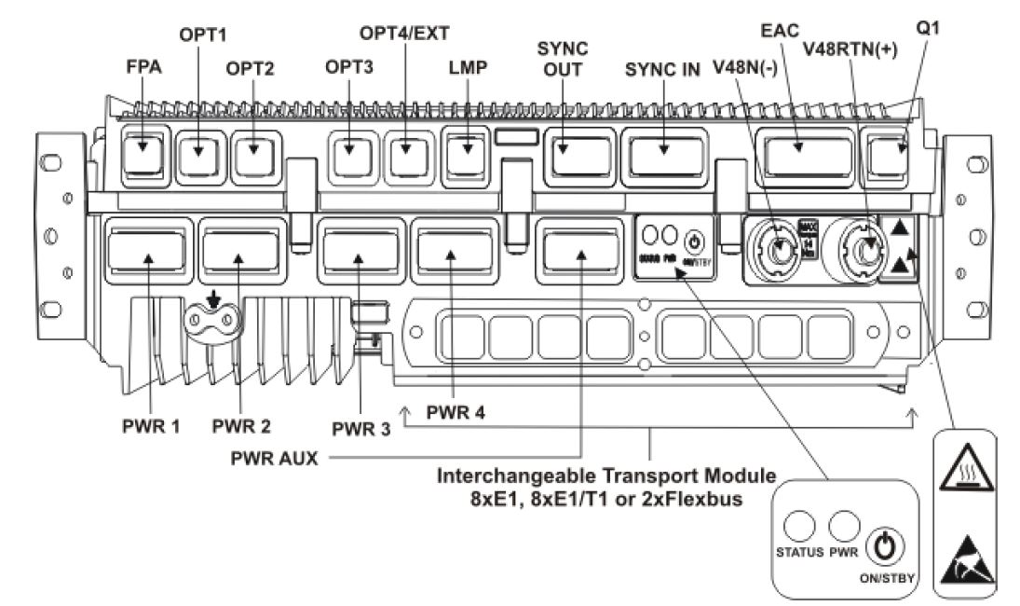
ESMC System Module
The System Module ESMC is a unit providing BTS common functionalities and external and internal connections for the whole BTS. The ESMB/C is an evolutionary development from ESMA System Module used in Flexi EDGE BTS. The System Module supports configurations of up to 36 TRXs. It also acts as a communication link between RF/RRH modules and enables chaining of a WCDMA/LTE System Module.

Slide 6
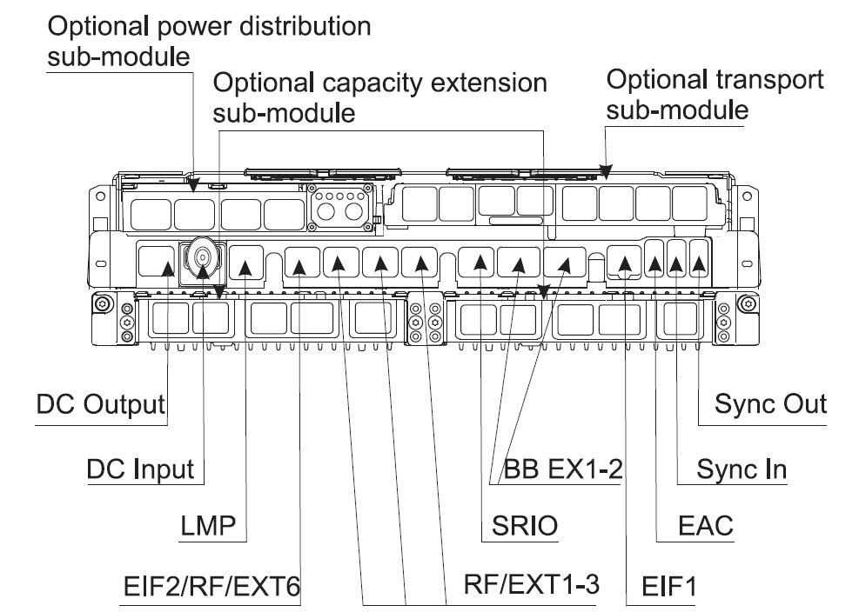
FSMF System Module
Flexi Multiradio System Module is an integral part of Flexi Multiradio 10 BTS. It supports the following software operating modes GSM/EDGE, WCDMA, HSPA, HSPA Evolution LTE. The System Module supports configurations of up to 36 TRXs in GSM. Additional optional equipment that can be installed in the System Module casing is:
• up to two capacity extension sub-modules
• one transport sub-module
• one power distribution sub-module

Slide 7
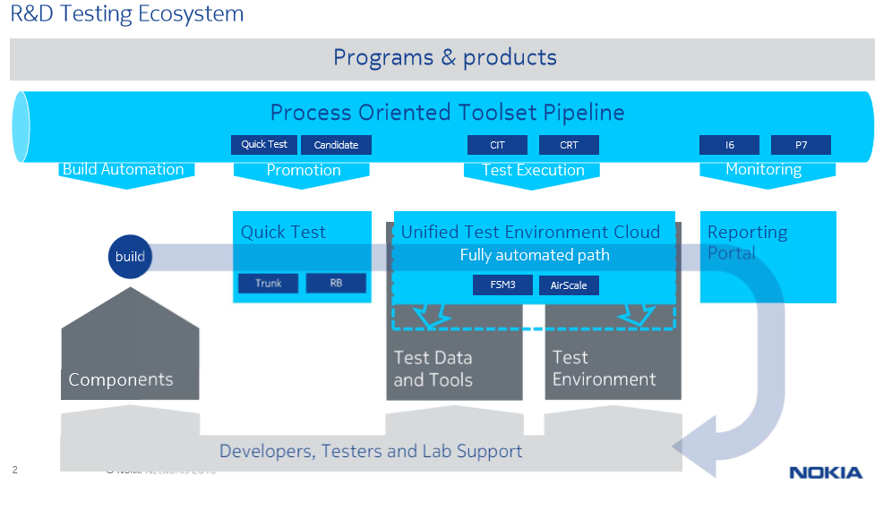
What is Automated testing ?
Automated testing is a method in software testing that makes use of special software tools to control the execution of tests and then compares actual test results with predicted or expected results. All of this is done automatically with little or no intervention from the test engineer.
Automation is used to add additional testing that may be too difficult or time consuming to be performed manually

Slide 8
What type of software do we use for automated testing ?
Here at Nokia we are using 2 main tools for automated testing:
HRAN Jenkins
UTE Cloud Manager
The process of automation is based on scripts written in 2 scripting languages:
Python, which is a general purpose scripting language.
Robot framework, which is a generic open source, operating system and aplication independent automation framework with the core written in Python.
In the following slides we are going to focus on UTE Cloud Manager

Slide 9
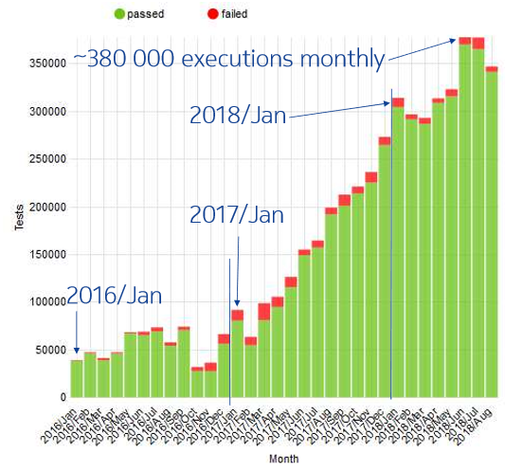
The purpose of UTE Cloud Manager
Cloud manager has the purpose to make tests that are executed 100% automatically
Scheduling, test line reservation and test execution are all robotized and they require zero human intervention

Slide 10
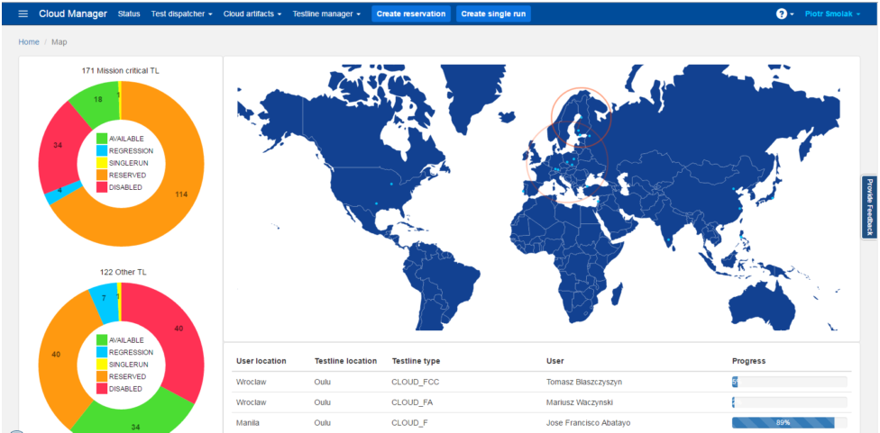
UTE Cloud Manager
At the main page of Cloud Manager we can see informations about platforms and test (like User location, Testline location, Testline type, User, Progress etc.) in different locations of the NOKIA sites.

Slide 11
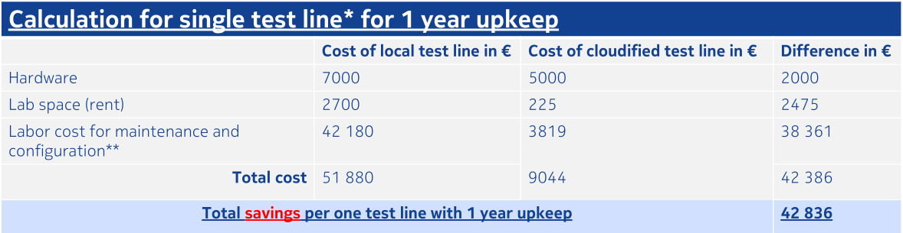
Cloud Manager Advantages
Power consumption reduction due to time scheduling and the ability to share a platform between people.
Clean install of the newest software.
The ability to use each platform from all NOKIA sites all around the globe.
Easy to use.

Slide 12
Cloud Manager Platform Reservation
In order to reserve a platform we have to give the following information:
Testline type(e.g. CLOUD_F, CLOUD_FCC, CLOUD_4RP, etc.)
Duration(e.g. 1h,2h,3h or 4h , however it is posible to manually extend it)
eNB build(e.g. FL00_FSM4_9999_161116_012698:base)
UTE build(e.g. 1645-03-00+wheeny,always choose latest)
RobotLTE version(e.g. HEAD -latest version,100, 9953,10117)
eNB minimal required state: (e.g. ssh_only, enb_commisioned, end_configured).

Slide 13
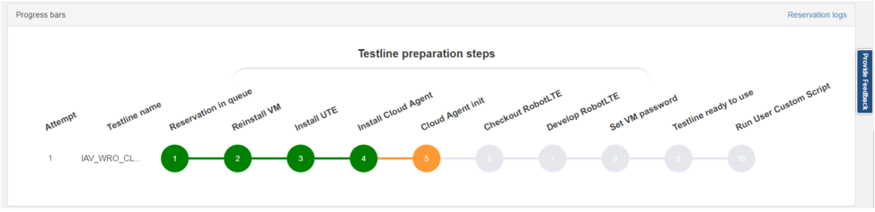
Reservation state and problems
We can check what is the current state of our reservation:
When something is wrong(problem with build,problem with SCF conversion etc.) reservation can't be finished with success. In this case attempts will be executed automatically. We can also check reservation logs visible in progress bar.

Slide 14
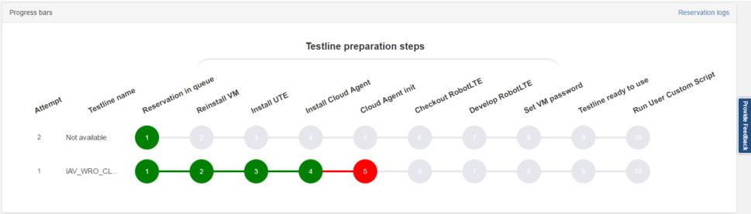
Reservation state and problems
When test line is ready to use the user will receive a mail and a message with the status of the reservation.
Reservation time extend is possible only one hour before release.

Slide 15
Cloud manager single run
Once the platform is reserved we can create a single run in order to perform tests.
Single run is a single testsuite execution
Single run can be executed to check if your testsuite is working.
You can make up several single runs simultaneously.

Slide 16
Create single run
In order to create a single run we have to specify:
Test suite path(relative path to test suite in test repository e.g. testsuite/legacy/CIEXEC/02_QTp1.robot)
Testline type(e.g. CLOUD_F, CLOUD_FCC, CLOUD_4RP, etc.)
Tags
ENB build(DNH0.0_ENB_94170905_25407:base)
ENB minimal required state(e.g. configured, commisioned, configured)
UTE build(e.g. 1735.01.01)
Test repository revision(Number between 1 and latest revision e.g. 243696)

Slide 17
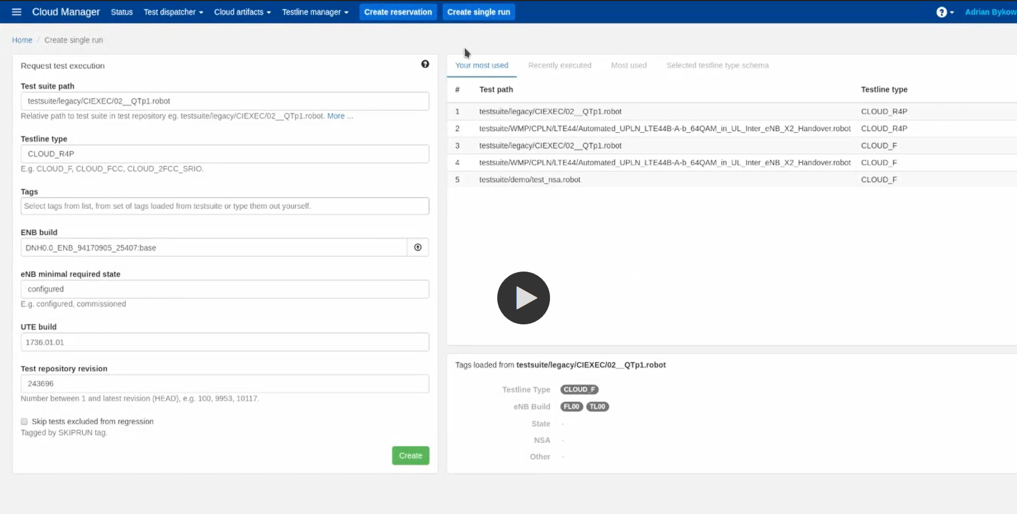
Create single run

Slide 18
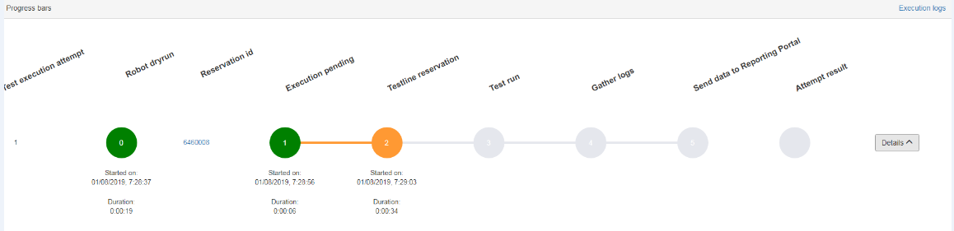
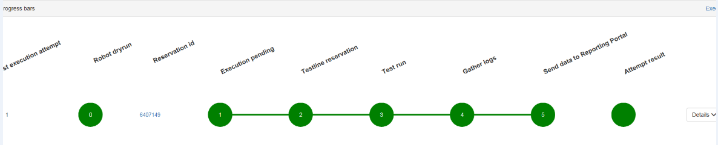
Create single run -steps
We can also see what is the current state of our single run:

Slide 19
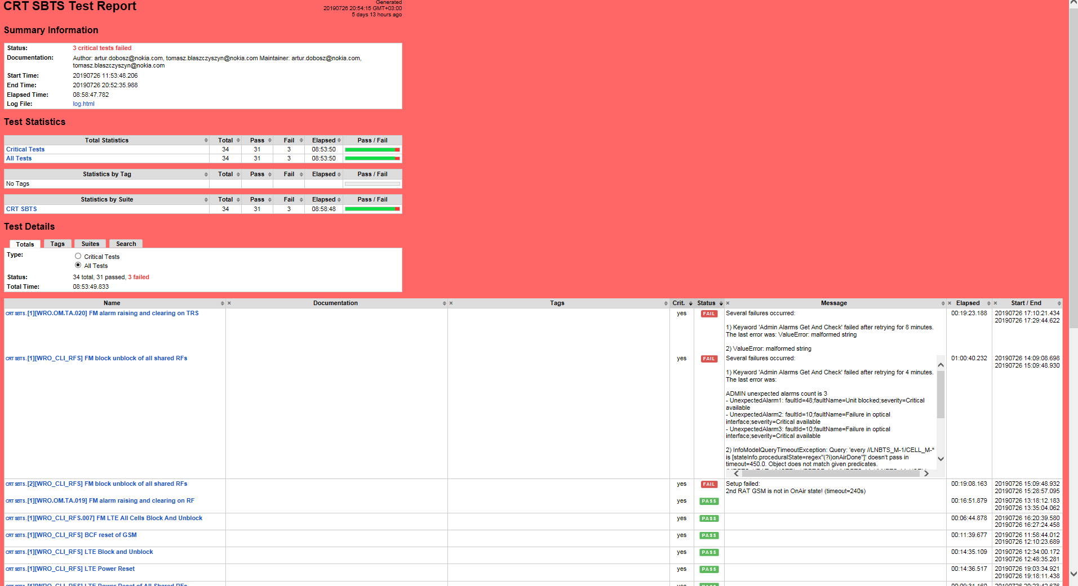
Single run results
Usually each test is ran 3 times and in order for it to be considered as passed each individual execution has to be correct.
After the test suite is finished we can see a test report with details about each test and execution.

Slide 20
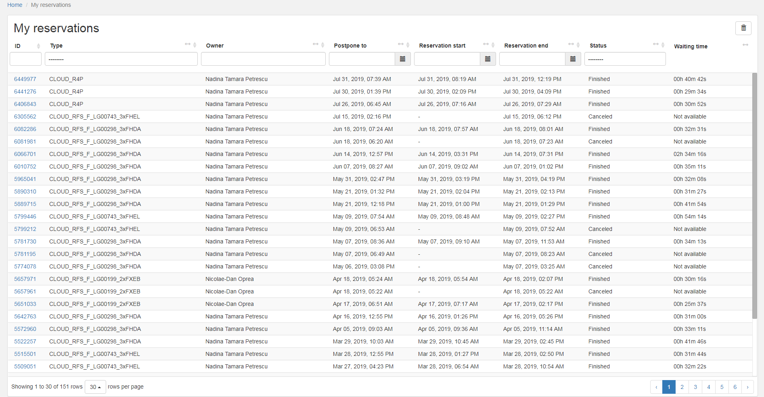
Reservation history
Cloud manager allows us to see details about our latest reservations:

Slide 21
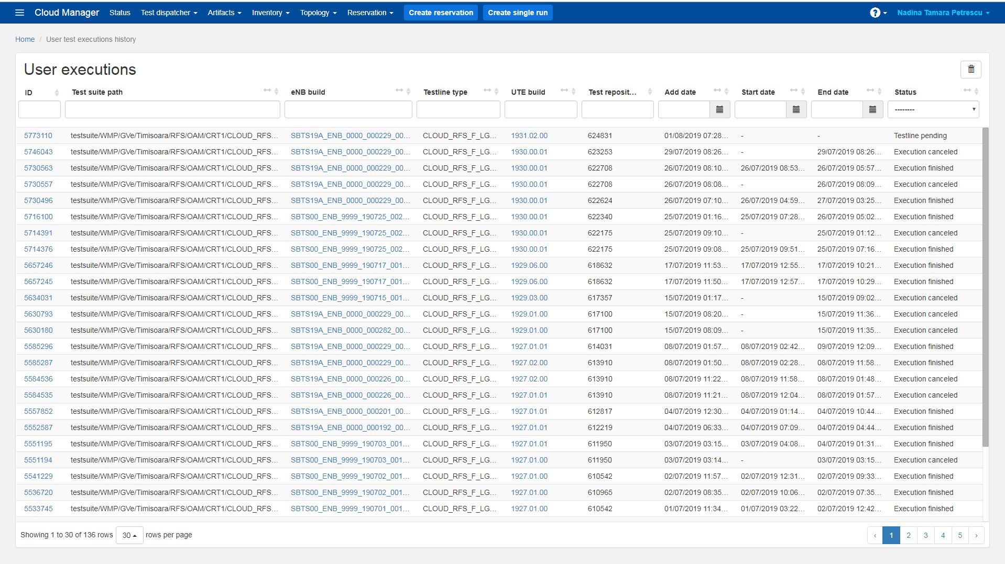
User test executions history
As well as informations about our latest single runs:

Slide 22
Objectives
LG equipement
What is automated testing ?
What are the advantages of using UTE Cloud Manager
Cloud Manager platform reservation
Cloud Manager single run
Reservations history/User test executions history

Slide 23


