Slide 1

Atla Labs Attrition Analysis: Key Insights and Recommendations
Presented by: Olajobi Muhtady

Slide 2

Objectives of the Analysis
Understand the factors driving employee attrition.
Explore trends by department, job roles, tenure, and demographics.
Identify areas for improvement in employee satisfaction and retention.
Provide actionable recommendations for HR strategies.

Slide 3
Data Overview
Dataset Coverage: Employee Count, Age, Attrition, Business travel, Department, Ethnicity, Full Name, Gender, Hire Date, Job Role, Marital Status, Overtime, Salary, Years At Company, Environment Satisfaction, Job Satisfaction, Work-Life Balance, Relationship Satisfaction, Self Rating, Manager Rating, Rating Level, Satisfaction Level, Review Date
Timeframe: 2012 – 2022
Key Metrics: Attrition Rate, Active Employees by Department and Job Role, Attrition by Travel Frequency, Attrition by Hire Date, Attrition by Tenure, Attrition by Overtime Requirement
Sample Size: Total Employees: 1470, Active Employees: 1233, Inactive Employees: 237

Slide 4
Overall Attrition Rate
Total Attrition Rate: 16.1%.
Departments with Highest Attrition Rate: Sales (20.6%), Human Resources (19.0%), Technology (13.8%).
Roles at risk:
Sales: Sales Representative (39.8%), Sales Executive (17.5%).
Human Resources: Recruiter (37.5%), HR Executive (10.7%).
Technology: Data Scientist (23.8%), Software Engineer (16.0%).

Slide 5

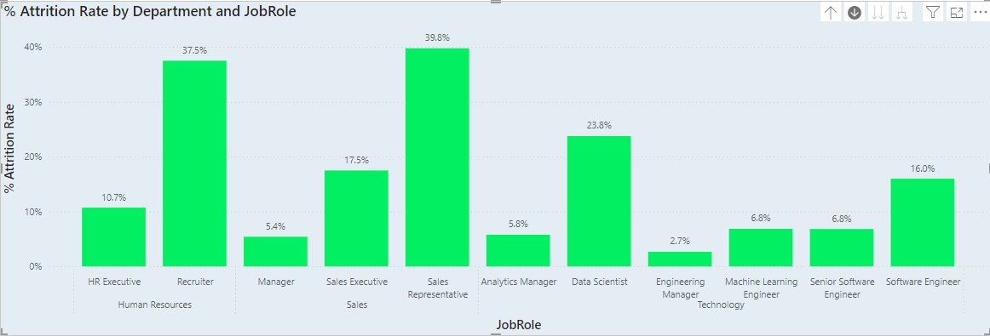

Slide 6
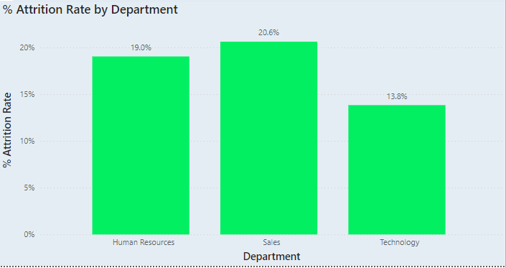
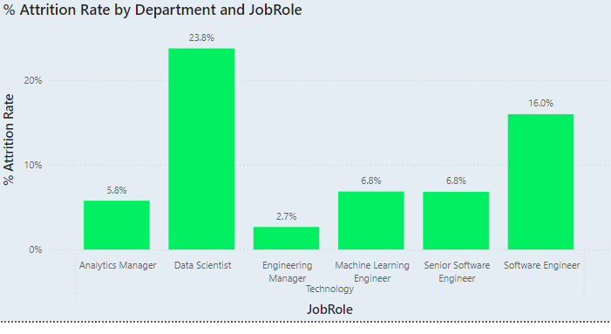
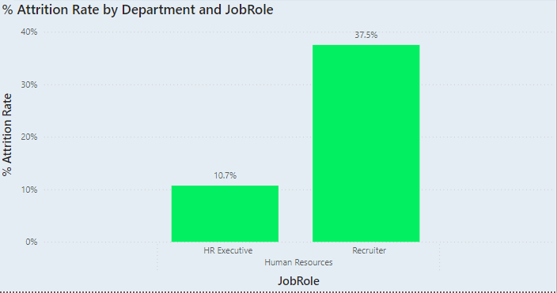
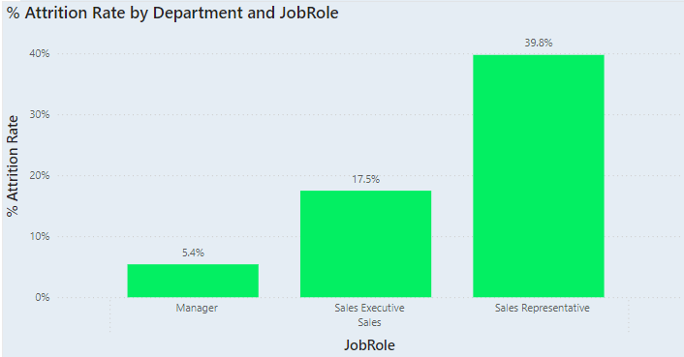

Slide 7
Attrition by Employee Tenure
Employees with short tenure are leaving at a higher rate.
Retaining employees during the first few years is critical.

Slide 8
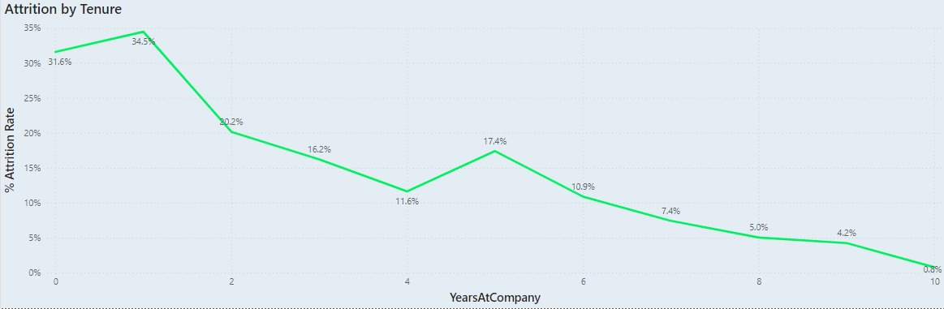

Slide 9
Impact of Travel Frequency on Attrition
Employees that are Frequent travellers have high attrition rates.
Implement flexible travel policies or adjust workloads for frequent travellers.

Slide 10
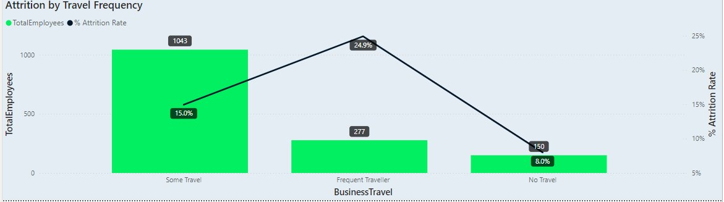

Slide 11
Demographics and Attrition
Younger employees (<30) have higher attrition rates.
Attrition rate is higher in males by 2.1%.

Slide 12
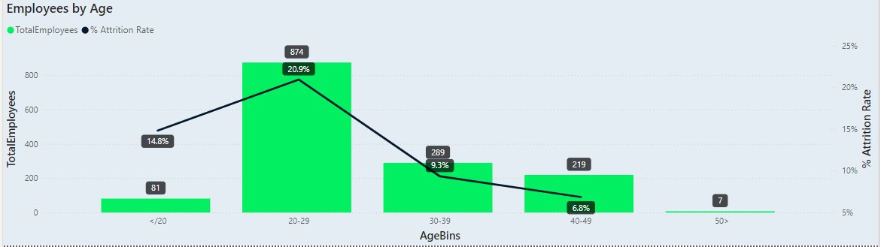
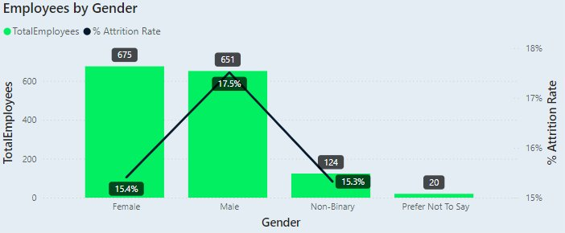

Slide 13
Impact of Overtime on Attrition
Employees that work overtime have higher attrition rate.
The attrition rate is higher by 20.1%
The difference in average salary is about 1.22%

Slide 14
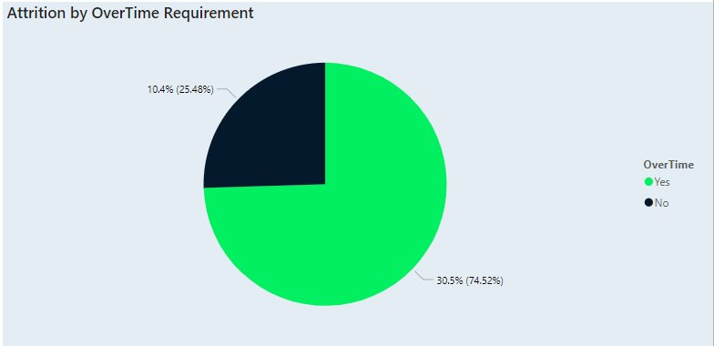
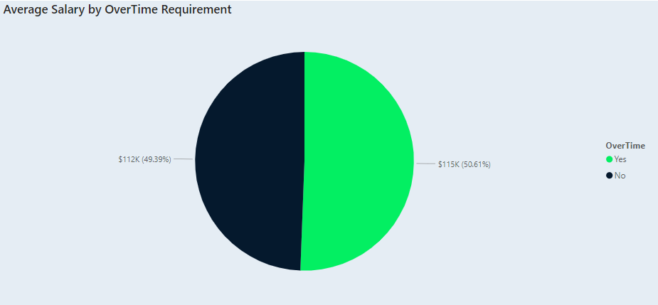

Slide 15
Recommendations for HR strategy
Address
Address high attrition in key departments and roles.
Re-evaluate
Re-evaluate travel-heavy roles and consider flexible travel policies.
Develop
Develop retention programs for employees with shorter tenure.
Enhance
Enhance employee satisfaction through targeted initiatives (e.g. reducing overtime).

Slide 16
Next Steps
Collaborate with department heads to address high-risk areas.
1
Monitor attrition trends over time to evaluate the impact of implemented strategies.
2
Schedule follow-up analysis in six months
3

Slide 17
Thank You!
Contact: Muhtadyajibola@gmail.com

