Slide 1
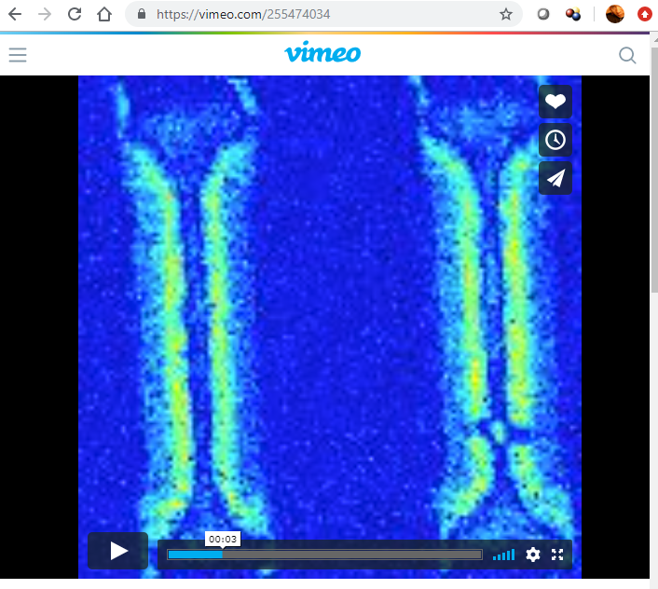
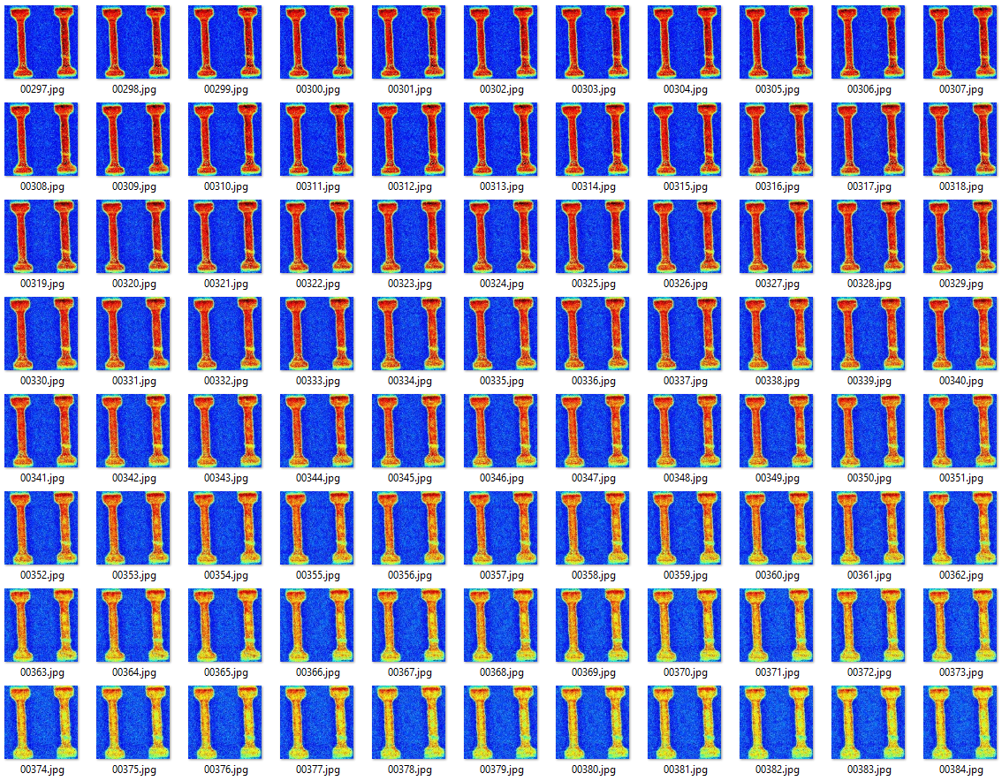
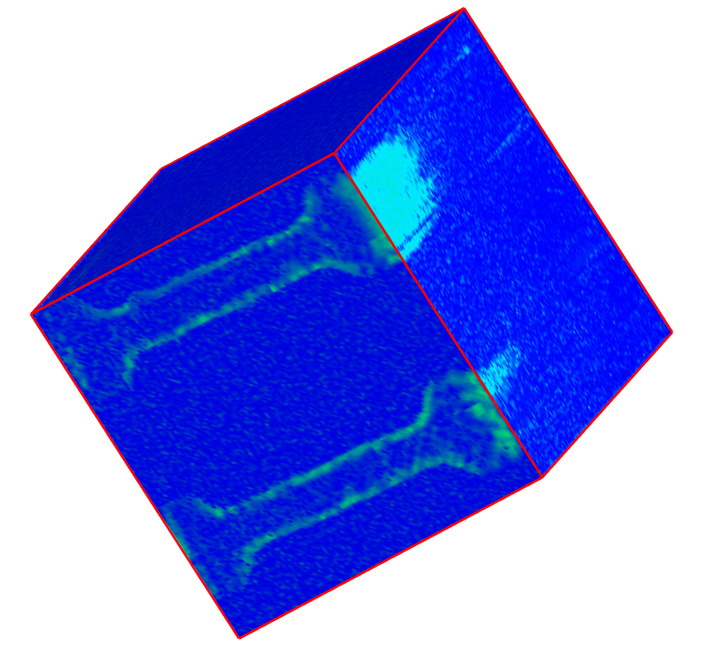
Original Movie Online
Extract Movie Frames
Converted to Data Cube

Slide 2
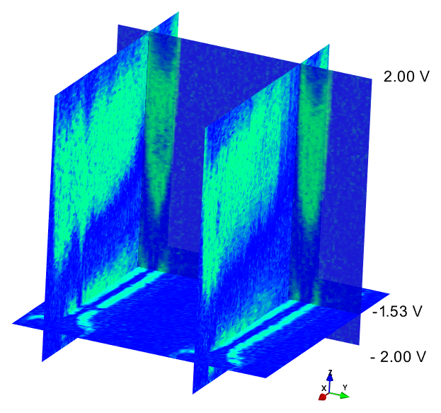
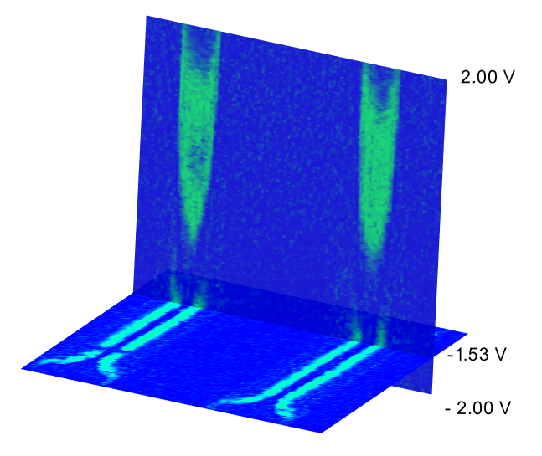
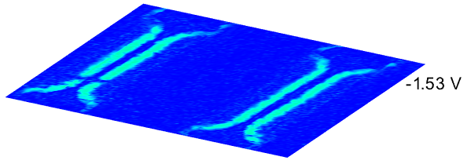

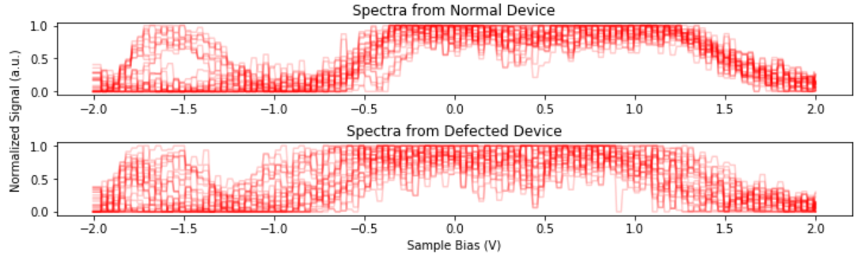
Insights from Data Cube Viewed at Different Angles
Device 1
Device 2
defect
defect
Bias
Device 1
Device 2
Collections of Point Spectra from Same Regions
Device 2
Device 1

