Slide 1
X
Y
1 R
10 R
10 C
2 Layer
1 C
2 Layer
X
Y

Slide 2
X
Y

Slide 4
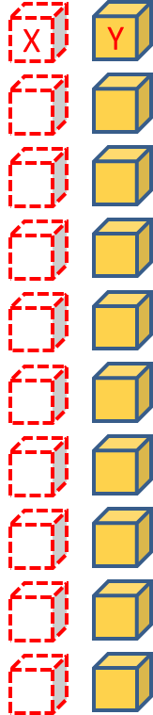
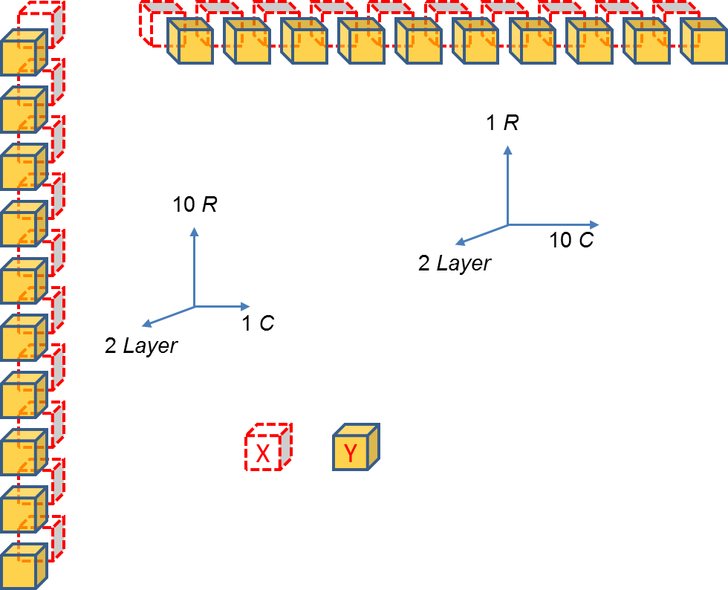
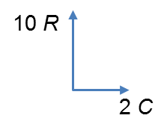
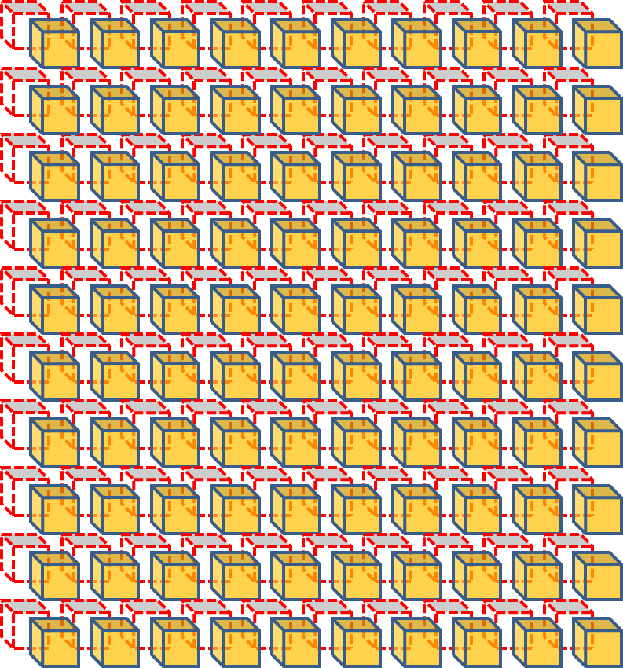

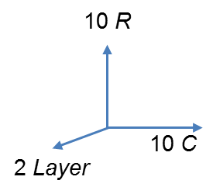
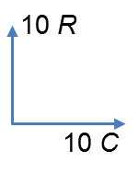
3. b = Arr[newaxis, :, :]
Increase dimension
2. a = Arr[:, newaxis, :]
1. Arr = np.random.rand(10, 2)
Broadcasting
Aggregation
4. c = a - b
5. d = c ** 2
6. results = np.sum(d, axis = -1)

