Slide 1

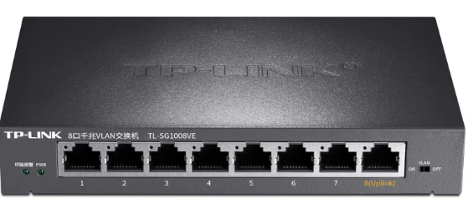

WAN IP: 57.2.60.12
WAN MAC: 0a:08:99:fb:10:06
WAN IP: 11.42.0.75
WAN MAC: a4:67:b3:48:a7:d3
LAN IP: 126.4.61.249/30
LAN MAC: 7b:0a:7c:2f:12:4a
RA
RB
LAN IP: 126.4.61.253/30
LAN MAC: a0:cd:02:6d:fa:2d
IP: 126.4.61.250/30
MAC: 66:66:33:33:11:11
IP: 126.4.61.254/30
MAC: 77:77:33:33:11:11
Nested subnet 126.4.61.248/30
Nested subnet 126.4.61.252/30

