Slide 1
ENGI 301 Guest Counter PCB
11/25/19
Theodore Hoisington

Slide 2
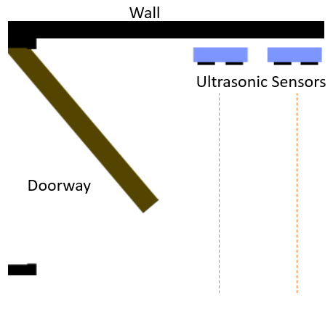
Board Functionality
The device will be used to count how many people enter or exit a room. It will use two IR Analog Distance sensors set up next to each other a few inches apart. The original distance reading of the sensors when they turn on will be saved as the default. Whichever sensor detects a change in distance first will determine the direction that the person is going.
In addition the assembly will include an OLED Display which will display the number of people in the room, how many total have exited, and how many total have entered.
There will also be a button that when pressed once will reset the zero distance of the IR sensors and if held down for 5 seconds will clear the number of people displayed on the display.
Finally, the device will also have a buzzer which will play notes when a person leaves and a different sequence of notes when someone walks into the room.
IR Distance Sensors
When the distance reading changes from default, we know that a person is walking through.
Notes:
Adding a tone using buzzer or speaker
Using a different display
Connect to wifi and send a text message. Twitter api etc IOT service text api.
-Has Wifi dongles
Legend of Zelda candy dispenser project used PWM for sound
Make different sounds to play.
Add 1 more slide between 5 and 6 about stretch goals.
34

Slide 3
Existing Projects
People Counter
Uses three laser modules which point at three photo resistors across a doorway
https://www.hackster.io/kutluhan-aktar/create-a-people-counter-controlled-by-an-android-app-615f46
Visitor Counter
Uses two IR break beam sensors
https://www.hackster.io/c-team/visitor-counter-aca37b
The first project implementation uses three laser modules on one side and three photoresistors on the other side of a doorway. The laser modules are connected to a constant supply of power, while the photoresistors are connected to the board and are giving feedback. Similarly, the second project uses two IR break beam sensors that each have an emitter side and receiver side that is used to tell when the line of sight is broken. While these are both effective methods for accomplishing our goal, they are not ideal because they don’t contain the device to one area and instead require parts of the device to be on either side of the doorway.

Slide 4
Prototype to Product
The biggest difference between the final product and the prototype is the switch from ultrasonic sensors to the IR analog sensors. The reason for the change is that for the ultrasonic sensors to be accurate, you can’t have both taking in sensor readings at the same time because of interference. To accommodate this, the sensors must be staggered and delayed in the programing. Doing so created several problems due to the nature of having to use threading to handle the delays from the sensors while also running the rest of the code.
There was a big problem where every time the Pocketbeagle would run an intensive task like changing the image displayed on the display, the board would get inaccurate readings from the ultrasonic sensors. This caused the program to believe that there were people crossing past the device and try to update the display causing a loop of inaccurate readings.

Slide 5
System Block Diagram
IR Distance Sensor
Vin
GND
IR Distance Sensor
Vin
GND
µUSB Power Source
Aout
Aout
*Voltage Divider
*Voltage Divider
USB0
GND Vout
Large Enclosed
Piazo Element
Ain 1.8V – 0
PWM1 A
Ain 1.8V – 1
Mikroe
OLED C
Click
Ain 5(3.3V)
GPIO 45
SPI1.CS
SPI1.CLK
SPI1.MISO
SPI1.MOSI
3.3V
GND
GND
Vout
I2C2.SDA
I2C2.SCL
UART0.TX
UART0.RX
GPIO 26
PWM0 A
AN
RST
CS
SCK
MISO
MOSI
3.3V
GND
PWM
INT
TX
RX
SCL
SDA
5V
GND
Pocketbeagle
Generic
Push Button
GPIO 23
*Note: The voltage dividers
cut the output voltage in half

Slide 6
Mechanical Block Diagram – Facing Up (Top)
150
Default Units: mm
JST
JST
3-Pin JST Connectors for IR Analog Sensors
OLED Screen
Button
Mounting Holes:
Parts on the opposite side:
Parts on this side:
10
75
Speaker
Pocketbeagle
57
35
34
56
25

Slide 7
Mechanical Block Diagram – Facing Down (Bottom)
150
Default Units: mm
JST
JST
3-Pin JST Connectors for IR Analog Sensors
OLED Screen
Button
Mounting Holes:
Parts on the opposite side:
Parts on this side:
10
75
Speaker
Pocketbeagle
57
35
34
56
25

Slide 8
Components / Budget
Component | Need to Buy | Cost
Pocketbeagle | No
2x IR Distance Sensor - GP2Y0A21YK0F | Yes | $13 ea
Mikroe OLED C Click Board | No
Push Button | No
Large Enclosed Piezo Element | No
Resistors for voltage divider | No
Total Cost: |  | $26

