Slide 1
ENGI 301 Room Guest Counter
10/20/19
Teddy Hoisington

Slide 2
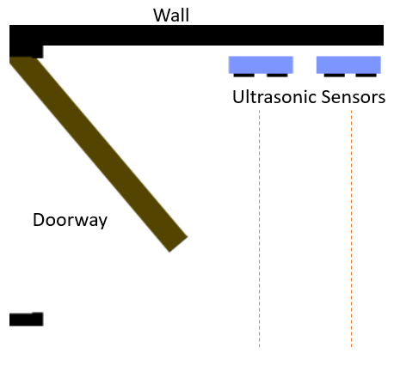
Background Information
The device will be used to count how many people enter or exit a room. It will use two ultrasonic sensors set up next to each other a few inches apart. The original distance reading of the sensors when they turn on will be saved as the default. Whichever sensor detects a change in distance first will determine the direction that the person is going.
In addition the assembly will include a Hex display which will display the number of people who entered the room on the left two digits and the number of people who exited on the right two digits.
There will also be a button that when pressed once will reset the zero distance of the ultrasonic sensors and if pressed twice will clear the number of people displayed on the hex display.
Finally, the device will also have a buzzer which will play a certain sequence of notes when a person leaves and a different sequence when someone walks into the room.
When the distance reading changes from default, we know that a person is walking through.
Notes:
Adding a tone using buzzer or speaker
Using a different display
Connect to wifi and send a text message. Twitter api etc IOT service text api.
-Has Wifi dongles
Legend of Zelda candy dispenser project used PWM for sound
Make different sounds to play.
Add 1 more slide between 5 and 6 about stretch goals.
34

Slide 3
Existing Projects
People Counter
Uses three laser modules which point at three photo resistors across a doorway
https://www.hackster.io/kutluhan-aktar/create-a-people-counter-controlled-by-an-android-app-615f46
Visitor Counter
Uses two IR break beam sensors
https://www.hackster.io/c-team/visitor-counter-aca37b
The first project implementation requires some sort of feedback from the other side of the doorway requiring some method of communicating between both sides. By using ultrasonic sensors, the entire device can be contained on one side of the doorway. In addition, you gain more flexibility with the software since you would get constant distance readings, while the two methods above can only tell you whether an object is blocking the path or not.
Using my method I will be able to use the extra information in my code to reduce the possibility of double counting people and other types of errors.

Slide 4
System Block Diagram
µUSB Power Source
Power
HC – SR04
HC – SR04
Pocketbeagle
USB0
sys Vout
TRIG
ECHO
TRIG
ECHO
+
Large Enclosed
Piazo Element
PWM1 A
GPIO 59
GPIO 58
GPIO 57
GPIO 60
GPIO 15
GPIO 14
GPIO 23
Digital Inputs
D
C
Hex Display
Generic
Push Button
*Note: GPIOs labeled are likely to change

Slide 5
Power Block Diagram
5V
µUSB Power Source
HC – SR04
5V
VCC
GND
Pocketbeagle
USB0
GND
Vout Sys
Voltage Divider: 5V to 3.3V
1k R1
Echo
GPIO 58
GND
GPIO 60
GND
+
PWM1 A
2k R2
Large Enclosed
Piazo Element
_
HC – SR04
VCC
GND
2k R2
GND
1k R1
Echo
GPIO 15
3.3V
GPIO 14
3.3V
GND
3.3V
2.2k R
3.3V
2.2k R
GPIO 23 GND
D C
Hex Display
-
Generic
Push Button
+
1k R
*Note: GPIOs labeled are likely to change and a different display may be used
Notes:
Find library for Sensor.

Slide 6
Components / Budget
Component | Need to Buy | Cost
3x AAA Battery Pack | No
3x AAA Battery | No
2x Ultrasonic Distance Sensor – HC SR04 | No
Adafruit 0.56" 4-Digit 7-Segment Display w/I2C Backpack | No
Push Button | No
Large Enclosed Piezo Element | No

Slide 7
Original Stretch Goals
Using a Larger LCD display instead of the Hex display to show more information
Creating software to be able to tell if multiple people are passing by at the same time
Use a wifi dongle to connect to wifi and send an alert using the twitter API or via text when someone enters or exits the room

Slide 8
*Project Recap
Having since completed a prototype the following has changed:
Uses a Mikroe OLED C Click display instead of the original Hex Display
Software recognizes when a person is still in the sensors and takes measures not to double count
Future plans include building a robust enclosure for the device that could integrate the push button switch
Moving away from a solderless breadboard and reorganizing the internals

