Slide 1
W
hat is
,
W
oT
Industrial Automation and Agriculture
Notes:
The Web of Things finds applications in diverse fields beyond smart homes and cities, with industrial and agriculture systems being two major and complex examples.

Slide 2


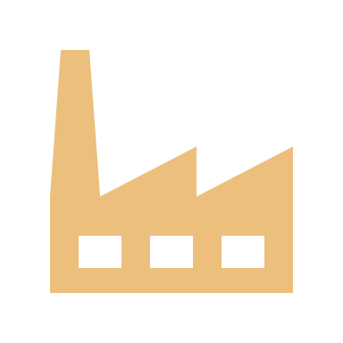
Smart Cities
Industrial Applications
Agriculture
Smart Homes
Notes:
The Web of Things finds applications in diverse fields beyond smart homes and cities, with industrial and agriculture systems being two major and complex examples.

Slide 3
Notes:
Let’s first take a look at industrial systems.

Slide 4
Manufacturing Equipment
Manufacturing
Product
Notes:
Unlike smart home scenarios, industrial applications have broader and more demanding requirements. These include advanced monitoring of connected manufacturing equipment, tracking products and predicting possible machine failures.

Slide 5
Manufacturing Equipment
Manufacturing
Product
Notes:
Unlike smart home scenarios, industrial applications have broader and more demanding requirements. These include advanced monitoring of connected manufacturing equipment, tracking products and predicting possible machine failures.

Slide 6
Manufacturing Equipment
Manufacturing
Product
Notes:
Unlike smart home scenarios, industrial applications have broader and more demanding requirements. These include advanced monitoring of connected manufacturing equipment, tracking products and predicting possible machine failures.

Slide 7
Manufacturing Equipment
Manufacturing
Product
Notes:
Unlike smart home scenarios, industrial applications have broader and more demanding requirements. These include advanced monitoring of connected manufacturing equipment, tracking products and predicting possible machine failures.

Slide 8


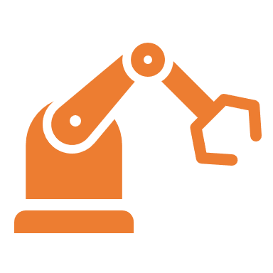
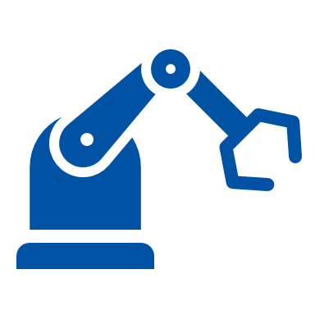


Servers
MQTT
MQTT
Modbus
Controllers
Profinet
OPC UA
Remote Monitoring
Notes:
In factories, for example, devices from multiple manufacturers must work together seamlessly. WoT simplifies this by supporting a range of industrial protocols such as Modbus, Profinet, OPC UA, and MQTT, including legacy ones. Each device is described using a Thing Description, which tells other systems exactly how to interact with it. This reduces complexity and engineering effort without introducing overhead or security concerns - TDs enhance existing workflows.

Slide 9
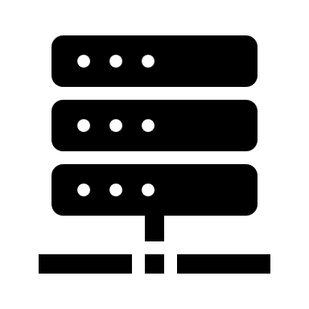

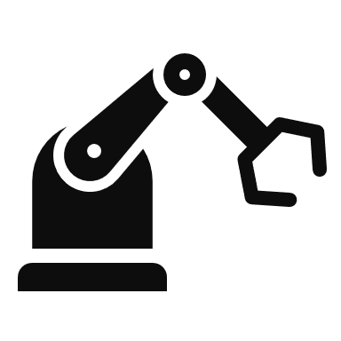
Servers
Controllers
Remote Monitoring
Notes:
TDs also enable a new way to build application logic - whether it's control logic, business logic or mashups - using simple files instead of being locked into proprietary systems. This decouples devices from vendor-specific applications, offering flexibility and long-term maintainability. With TDs, we can add context to the system by including annotations from domain models, providing more meaning to how devices are used within their environment.

Slide 10
Servers
Controllers
Remote Monitoring
Notes:
TDs also enable a new way to build application logic - whether it's control logic, business logic or mashups - using simple files instead of being locked into proprietary systems. This decouples devices from vendor-specific applications, offering flexibility and long-term maintainability. With TDs, we can add context to the system by including annotations from domain models, providing more meaning to how devices are used within their environment.

Slide 11
Located: In factory
Role: Temperature Control
Sensor Controller

Slide 12
Smart Cities
Industrial Applications
Agriculture
Smart Homes
Notes:
Moving on to another domain-specific application of WoT — agriculture systems.

Slide 13
Notes:
Agriculture offers a wide range of automation possibilities, from monitoring soil moisture and automating watering, to handling fertilization schedules and machinery operation. However, finding a single solution that fits all needs is challenging, especially for small and medium-sized farms. These farmers often aim to automate just one specific task, like soil monitoring, for example.

Slide 14



Notes:
Agriculture offers a wide range of automation possibilities, from monitoring soil moisture and automating watering, to handling fertilization schedules and machinery operation. However, finding a single solution that fits all needs is challenging, especially for small and medium-sized farms. These farmers often aim to automate just one specific task, like soil monitoring, for example.

Slide 15
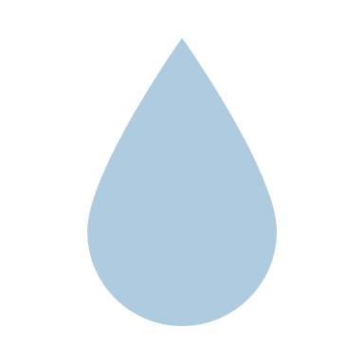
Plants need to be watered.
Humidity
Sensor
Low
Notes:
WoT plays a crucial role as an interoperable interface here, allowing these farmers to integrate only the parts they need without committing to an all-encompassing solution. By enabling flexibility and compatibility across different devices and systems, WoT makes it easier for farms to adopt new solutions at their own pace and budget.

Slide 16
Humidity
Sensor
Normal
Notes:
WoT plays a crucial role as an interoperable interface here, allowing these farmers to integrate only the parts they need without committing to an all-encompassing solution. By enabling flexibility and compatibility across different devices and systems, WoT makes it easier for farms to adopt new solutions at their own pace and budget.

Slide 17
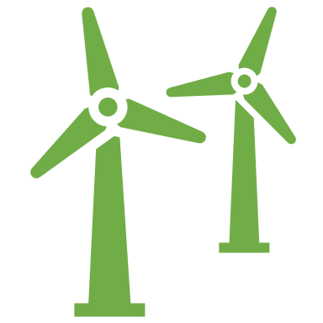
Notes:
WoT plays a crucial role as an interoperable interface here, allowing these farmers to integrate only the parts they need without committing to an all-encompassing solution. By enabling flexibility and compatibility across different devices and systems, WoT makes it easier for farms to adopt new solutions at their own pace and budget.

Slide 18
Notes:
WoT plays a crucial role as an interoperable interface here, allowing these farmers to integrate only the parts they need without committing to an all-encompassing solution. By enabling flexibility and compatibility across different devices and systems, WoT makes it easier for farms to adopt new solutions at their own pace and budget.

Slide 19
Online
Notes:
Agriculture systems also come with their own set of constraints. Often, devices in agricultural environments are constrained in terms of power and connectivity. For example, sensors in a cornfield may not have access to power sources or network cables and rely on batteries. WoT accommodates these constraints by allowing data to be transmitted only when the device is online, helping conserve energy and avoid unnecessary power drain.

Slide 20
Online
Notes:
Agriculture systems also come with their own set of constraints. Often, devices in agricultural environments are constrained in terms of power and connectivity. For example, sensors in a cornfield may not have access to power sources or network cables and rely on batteries. This works well with WoT, as metadata can be stored externally and protocols like MQTT let devices send data only when they're online, conserving energy and avoiding unnecessary power drain.

Slide 21

Offline
Notes:
Agriculture systems also come with their own set of constraints. Often, devices in agricultural environments are constrained in terms of power and connectivity. For example, sensors in a cornfield may not have access to power sources or network cables and rely on batteries. This works well with WoT, as metadata can be stored externally and protocols like MQTT let devices send data only when they're online, conserving energy and avoiding unnecessary power drain.
Thus WoT's functionality ensures it is both practical and efficient without adding any unnecessary complexity.

Slide 22
Smart Cities
Industrial Applications
Agriculture
Smart Homes
Notes:
Thanks to the interoperability of WoT, cross-domain collaborations are also made possible. In cross-domain collaborations, each system involves other systems in other domains. For example, Smart Factory with Smart City, Smart City with Smart Home. In these models, information can be exchanged directly between systems in a peer-to-peer manner or indirectly via collaboration platforms.

Slide 23
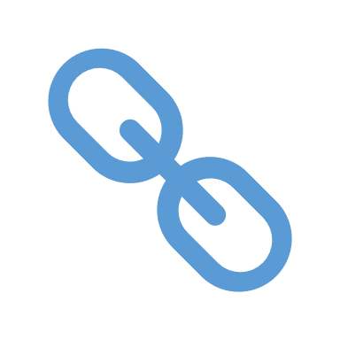
Cross-domain Collaborations
Notes:
Thanks to the interoperability of WoT, cross-domain collaborations are also made possible. In cross-domain collaborations, each system involves other systems in other domains. For example, a Smart Factory and a Smart City can collaborate on energy grid management, where the city's infrastructure is influenced by the factory's energy usage. As different platforms and protocols can be used in WoT, information can be easily shared across domains.

Slide 24
Cross-domain Collaborations
Notes:
Thanks to the interoperability of WoT, cross-domain collaborations are also made possible. In cross-domain collaborations, each system involves other systems in other domains. For example, a Smart Factory and a Smart City can collaborate on energy grid management, where the city's infrastructure is influenced by the factory's energy usage. As different platforms and protocols can be used in WoT, information can be easily shared across domains.

Slide 25
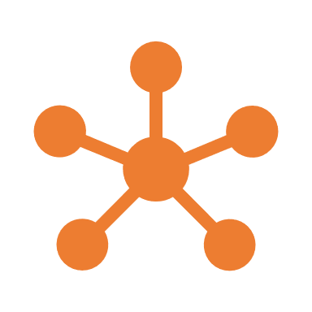



Advantages of WoT
Domain-agnostic
Interoperability
across protocols
Built on open standards
Device-agnostic
Notes:
To summarize, WoT provides numerous advantages across its applications:
- It is domain-agnostic, allowing for seamless integration across various systems.
- It supports multiple protocols, ensuring interoperability among devices from different manufacturers.
- WoT is built on open standards, promoting long-term adaptability and innovation.
- It works with resource-constrained devices, edge or the cloud.
By enabling efficient and secure interactions between devices across different domains, WoT serves as a transformative framework.

Slide 26
Subscribe to our Channel
Playlist
Next Video

