Slide 1
W
hat is
,
W
oT
JSON Schema
in Practice
Notes:
In the previous three videos, we have shown the features and basic implementations of JSON Schema. In this video, we will look into the actual validation process with programming libraries and examples.

Slide 2
Validation

Slide 3


Validator Examples
jsonschema
AJV
Notes:
Throughout this video, we will mainly focus on validation with the JavaScript library AJV (https://github.com/ajv-validator/ajv) and the Python library jsonschema(https://github.com/python-jsonschema/jsonschema) but there are many other libraries in different programming languages and tools to validate JSON with a JSON Schema.

Slide 4
Validator Examples
…
jsonschema
AJV
Notes:
Throughout this video, we will mainly focus on validation with the JavaScript library AJV (https://github.com/ajv-validator/ajv) and the Python library jsonschema(https://github.com/python-jsonschema/jsonschema) but there are many other libraries in different programming languages and tools to validate JSON with JSON Schema.

Slide 5
Validator Examples
…
…
AJV
Notes:
Throughout this video, we will mainly focus on validation with the JavaScript library AJV (https://github.com/ajv-validator/ajv) and the Python library jsonschema(https://github.com/python-jsonschema/jsonschema) but there are many other libraries in different programming languages and tools to validate JSON with JSON Schema.

Slide 6
Validator Examples
jsonschema
AJV
Notes:
Throughout this video, we will mainly focus on validation with the JavaScript library AJV (https://github.com/ajv-validator/ajv) and the Python library jsonschema(https://github.com/python-jsonschema/jsonschema) but there are many other libraries in different programming languages and tools to validate JSON with JSON Schema.

Slide 7





Validator Examples
json-everything
gojsonschema
json-kotlin-schema
jsonschema-rs
json-schema-validator
Notes:
Here are some of the popular ones in different programming languages.
There are many more validators. For further information, you can check the JSON Schema website.
(https://json-schema.org/implementations.html#validator-rust).
json-everything -> https://github.com/gregsdennis/json-everything
json-schema-validator -> https://github.com/pboettch/json-schema-validator
Gojsonschema -> https://github.com/xeipuuv/gojsonschema
jsonschema-rs -> https://github.com/Stranger6667/jsonschema-rs
json-kotlin-schema -> https://github.com/pwall567/json-kotlin-schema

Slide 8


https://json-schema.org/
Notes:
For further information, you can check the JSON Schema homepage.

Slide 9
Basic Validation Flow
Parsing &
Compilation
Library
JSON Schema
Validation Result
(Typically a Boolean)
JSON Data
Notes:
This is the basic validation flow that all libraries follow.
The library takes a schema for your JSON data and validates your data according to the schema. Outputs the validation result as a Boolean, with additional output of validation such as errors.

Slide 10
JavaScript-AJV
Notes:
So lets start with AJV! It is a JavaScript library.

Slide 11
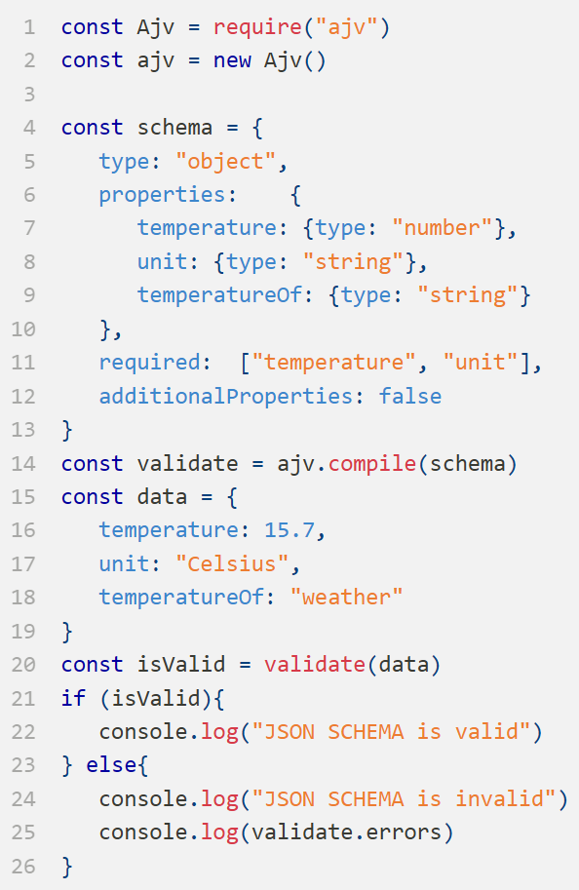
Output
Notes:
This is the same temperature sensor example we used before. Let’s examine this in JavaScript code.

Slide 12
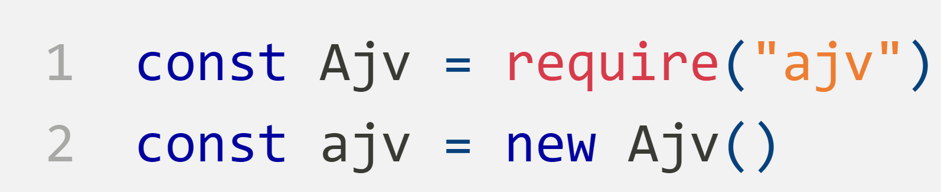
Importing the AJV
Notes:
First, We are importing the AJV.

Slide 13
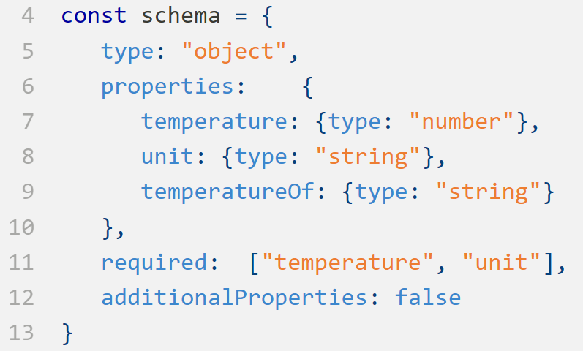
Schema
Notes:
Then, we insert the schema that describes the JSON that is expected.

Slide 14
AJV compiles schemas to functions and caches them
Notes:
With this line of code, AJV takes schema as a parameter, compiles it to a function, and caches it.

Slide 15
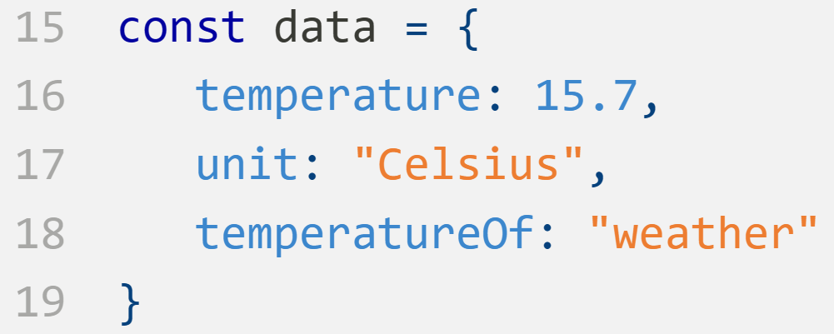
Data to be validated
Notes:
This is the data to be validated.

Slide 16
Validating the data
Notes:
This step actually validates the data and writes the result into a boolean.

Slide 17
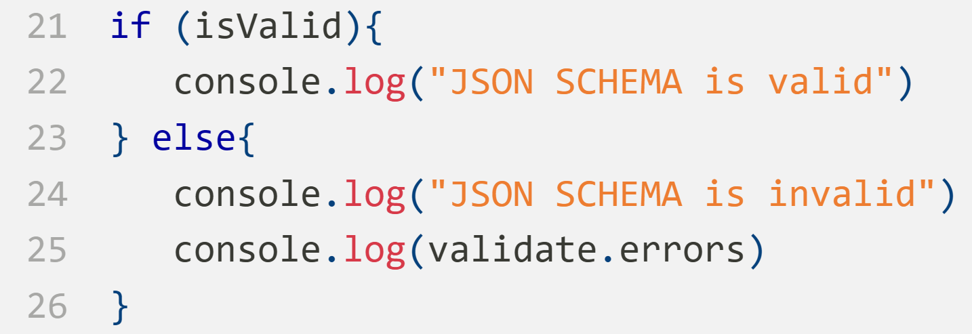
Printing the output and errors if it is needed
Notes:
This step is for printing the result of the validation. If the result of the validation is true, then, it prints “JSON input is valid according to Schema”. Otherwise, it prints “JSON input is invalid according to Schema” and the error message.

Slide 18
const Ajv = require("ajv")
const ajv = new Ajv()
const schema = {
type: "object",
properties: {
temperature: {type: "number"},
unit: {type: "string"},
temperatureOf: {type: "string"}
},
required: ["temperature", "unit"],
additionalProperties: false
}
const validate = ajv.compile(schema)
const data = {
temperature: 15.7,
unit: "Celsius",
temperatureOf: "weather"
}
const valid = validate(data)
if (valid) {
console.log("JSON SCHEMA is valid")
} else {
console.log("JSON SCHEMA is invalid")
console.log(validate.errors)
}
Importing the Ajv
Schema
Ajv compiles schemas to functions and caches them
Data to be validated
Validating the data
Printing the output and errors if it is needed
Notes:
HIDED

Slide 19
Output
" JSON input is valid
according to Schema "
Notes:
It outputs that input is valid according to schema since the data that we enter suits the predefined schema.

Slide 20
Python- jsonschema
Notes:
Now let's take a look at the same JSON Schema example in Python jsonschema. It is an implementation of the JSON Schema specification for Python.

Slide 21
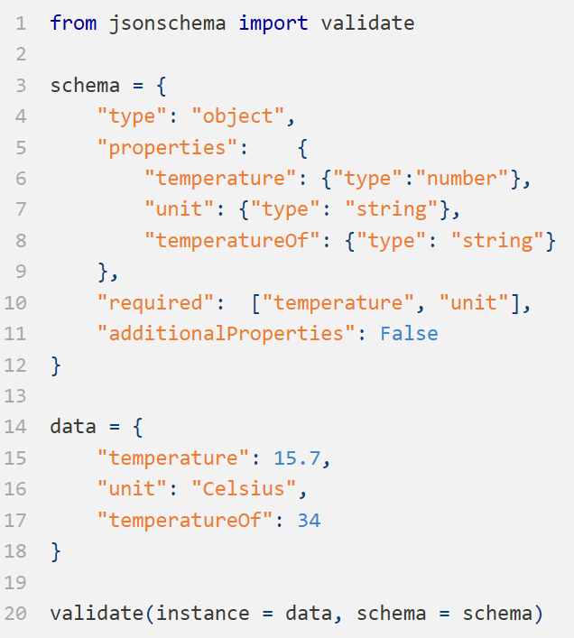
Output
Notes:
We will use the same temperature example that we use for AJV but for Python this time with jsonschema library.
Let's take a look at the code in detail.

Slide 22
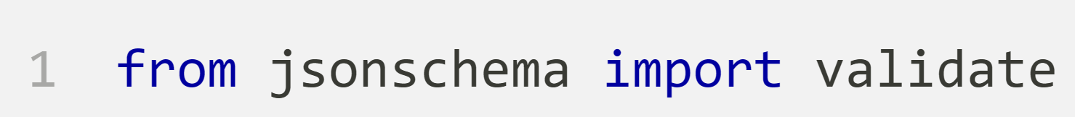
Importing function from library
Notes:
With this line of code, we are importing the function from the library.

Slide 23
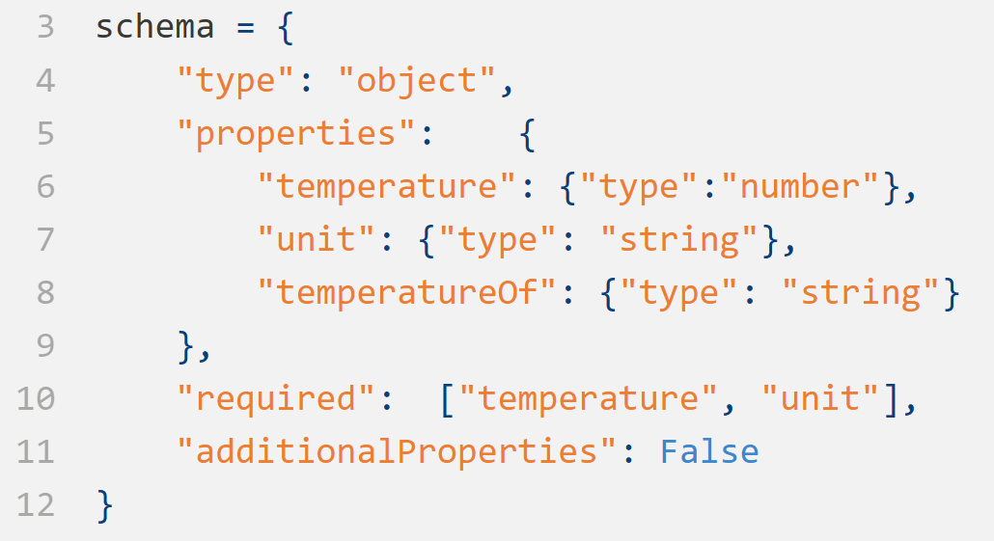
Schema
Notes:
This is the same schema in the previous example.
Note that we are using the the dict structure of Python and variables according to Python language. You see that capital “False” is used instead of ”false” that is used for JavaScript.

Slide 24
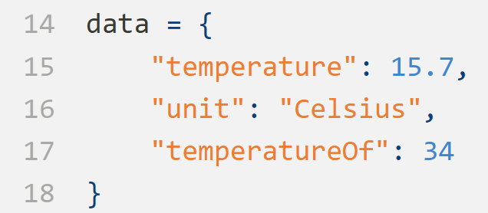
Data to be validated
Notes:
This is the data to be validated.

Slide 25
Validating the data
Notes:
This validate function takes the data and the schema, validates it and prints the result. If the data is valid, it does not print anything. Otherwise, an error message is thrown.

Slide 26
Output
jsonschema.exceptions.ValidationError:
34 is not of type 'string'
Failed validating 'type' in schema['properties’]
['temperatureOf']: {'type': 'string'}
On instance['temperatureOf’]: 34
Notes:
The code outputs that the data is not valid since the property, "temperatureOf ” is declared as string. However, in the given data it is an integer.

Slide 27


JSON
Schema
in Practice -2
JSON
Schema
in Practice -3
NEXT VIDEO
OSI Layers
Generic
WoT-1
Notes:
In the next video, we will talk about OSI Layers.

Slide 28
JSON
Schema
in Practice -2
JSON
Schema
in Practice -3
OSI Layers
NEXT VIDEO
Generic
WoT-1
Notes:
In the next video, we will talk about OSI Layers.

Slide 30
Subscribe to our Channel
Playlist
Next Video
Notes:
You can proceed to the next tutorial by clicking on the card or the video description.

