Slide 1



Generic and Extensible Web of Things Manager Using JSON Schema & AI
Andreas Eberhart
dashjoin.com
Ege Korkan
siemens.com

Slide 2

WoT Manager
Design Goals
Generic: Manage any device
Extensible: Allow apps for specific use cases
Value Add
Manage: securely connect devices
Control: call device actions
Automate: react to device events
Analyze: provide overview & dashboards

Slide 3
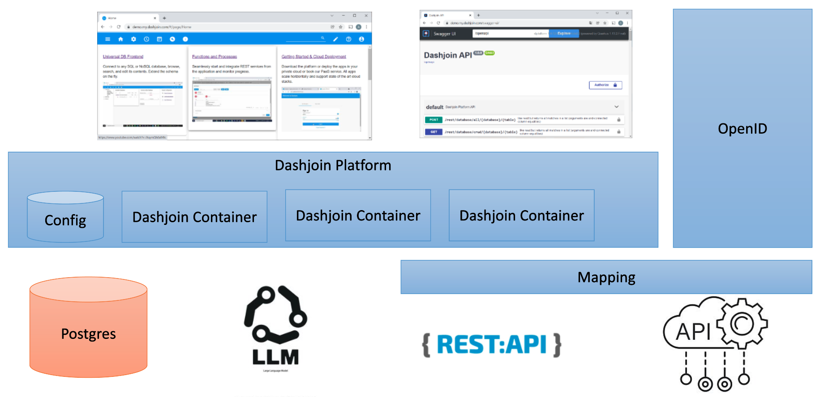
Architecture

Slide 4



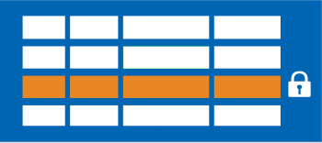
Discovery & Role Based Access Control
Identity Management
Device credentials
Access devices using credentials on behalf of the user
Associate device to OpenID claim and device credentials
Postgres
Discover & Save to DB
Row-Level Security

Slide 5
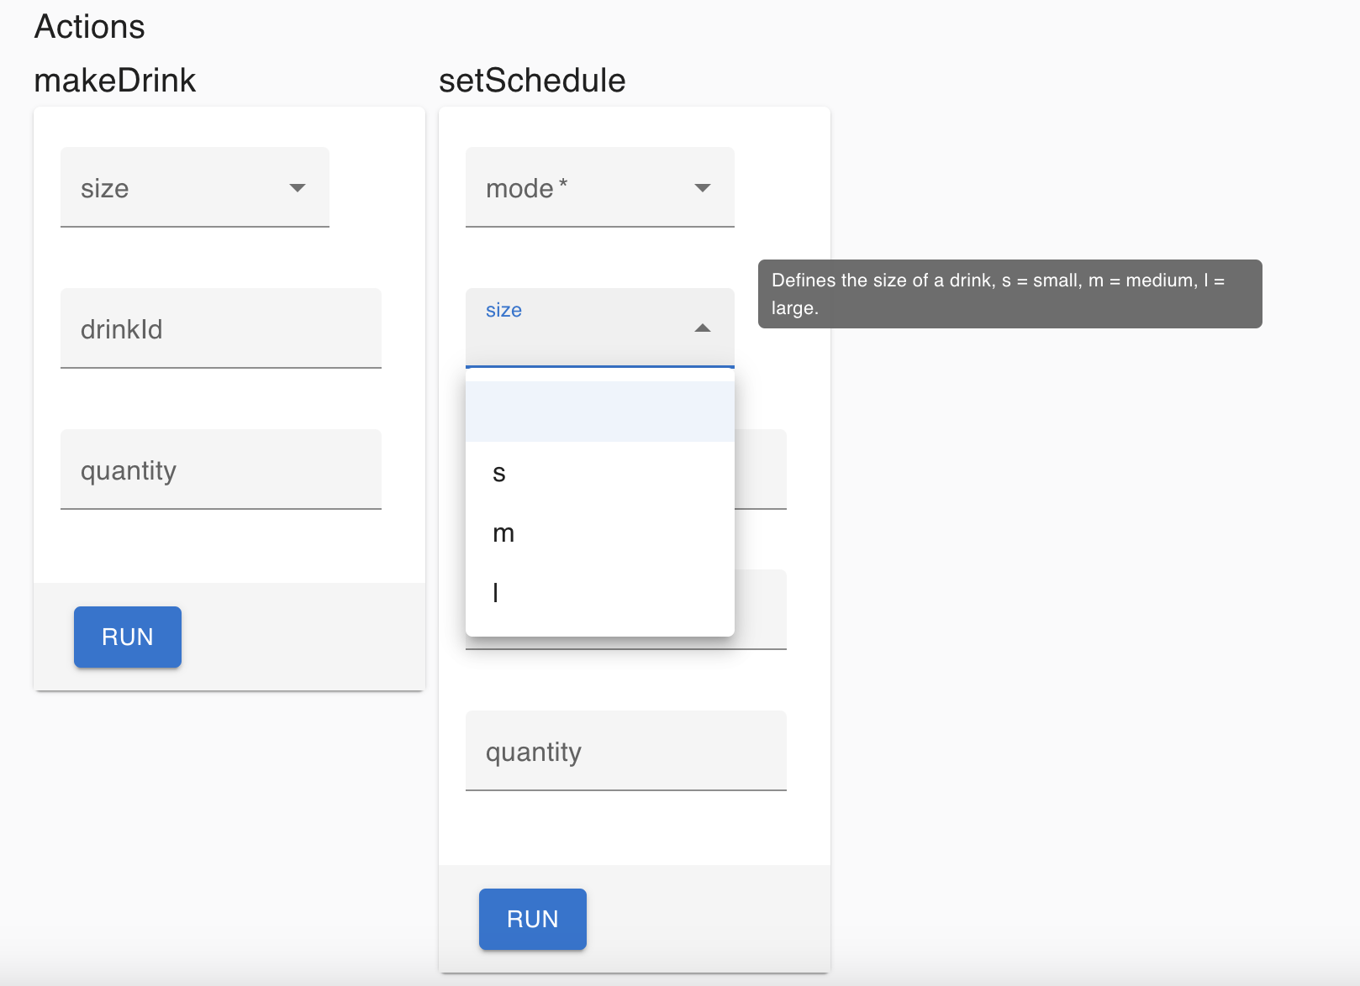
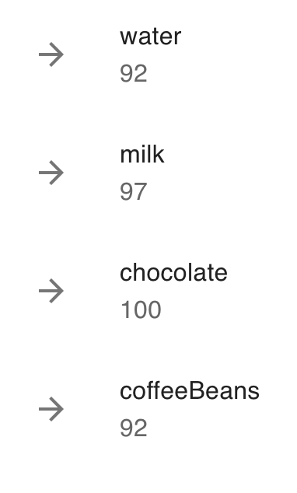
Generic Properties & Actions
On every device page
Gather the sensors
Display a JSON Schema driven form
$c := $read("wot", "thing", value.thing).credentials; $curl("GET", value.href, {}, $c ? {"Authorization": $c} : {})

Slide 6
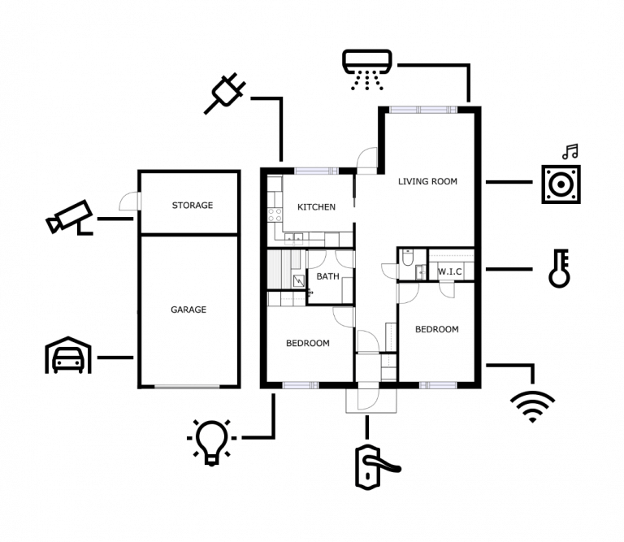
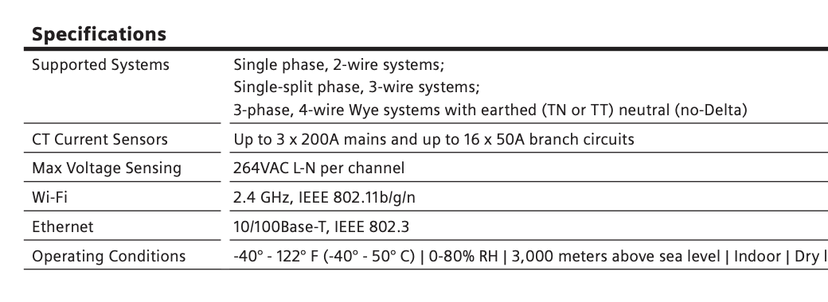
Background Knowledge
Integrate additional information to be able to answer more questions
Asset DB
Where is the device installed?
Datasheets
Additional information about the device
Postgres

Slide 7
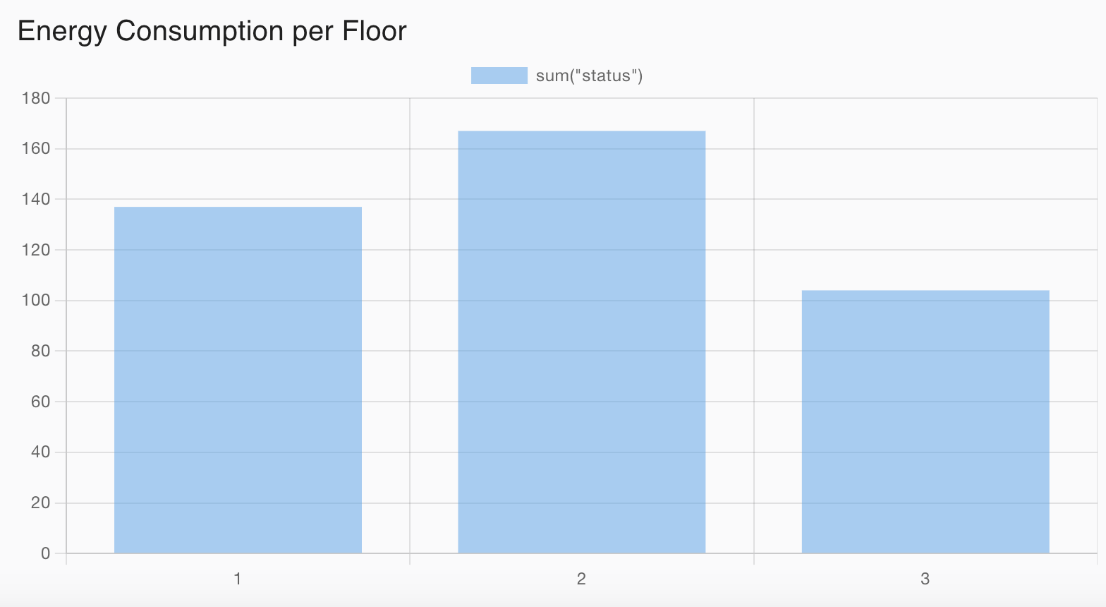
Semantic Data Harmonization
"power": { "unit": "W", "amount": 45
{ "watt": 45 }
JSON LD allows grouping similar devices
Not all things within the group might report data in the same format
Leverage JSONata to translate into a common format
Allows dashboarding via SQL
watt ? watt : power.amount * (power.unit = 'kW' ? 1000 : 1)

Slide 8
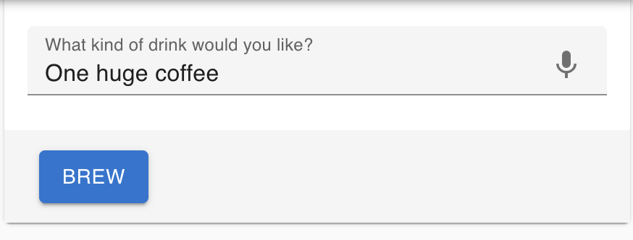
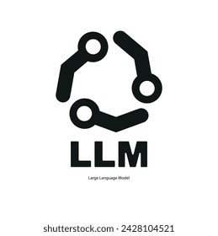
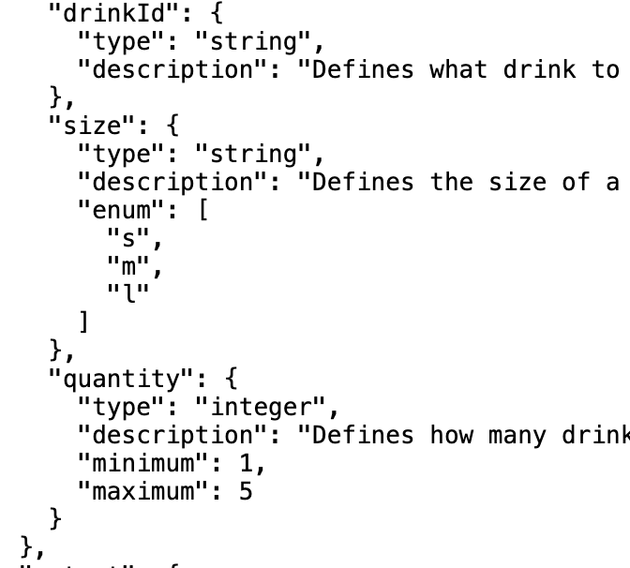
Natural Language Commands
Information extraction from text using LLMs and JSON Schema
{
"drinkId": "coffee", "size": "l", "quantity": 1
}

Slide 9
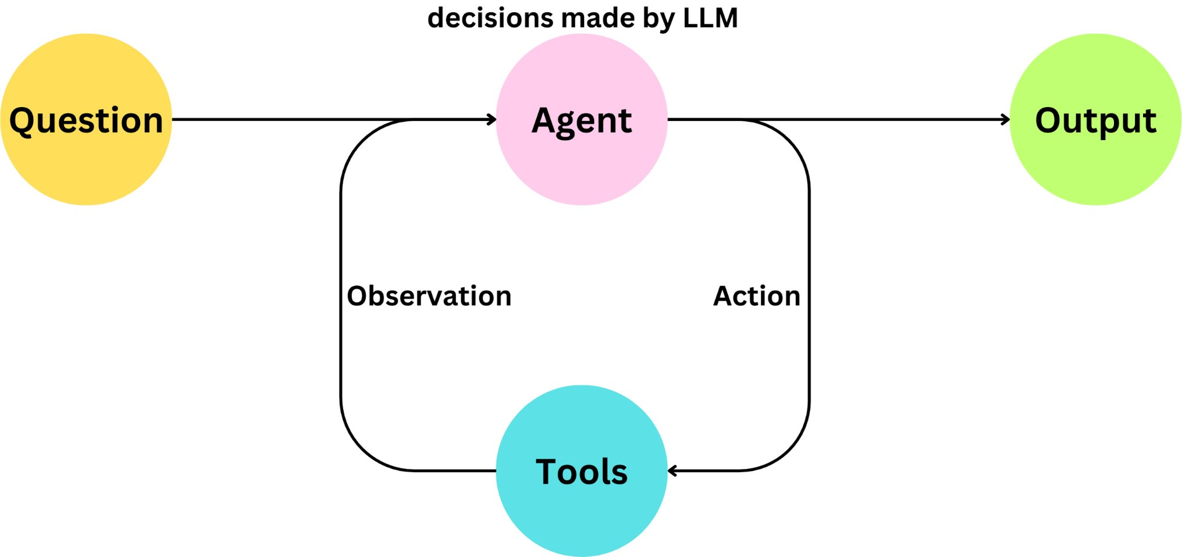

WoT Agents
Expose device actions to the LLM via tools
User can formulate a higher-level question or goal
LLM tries to solve the request by leveraging its background knowledge and the provided WoT tools
Example: Turn off all lights in unused office spaces

Slide 10
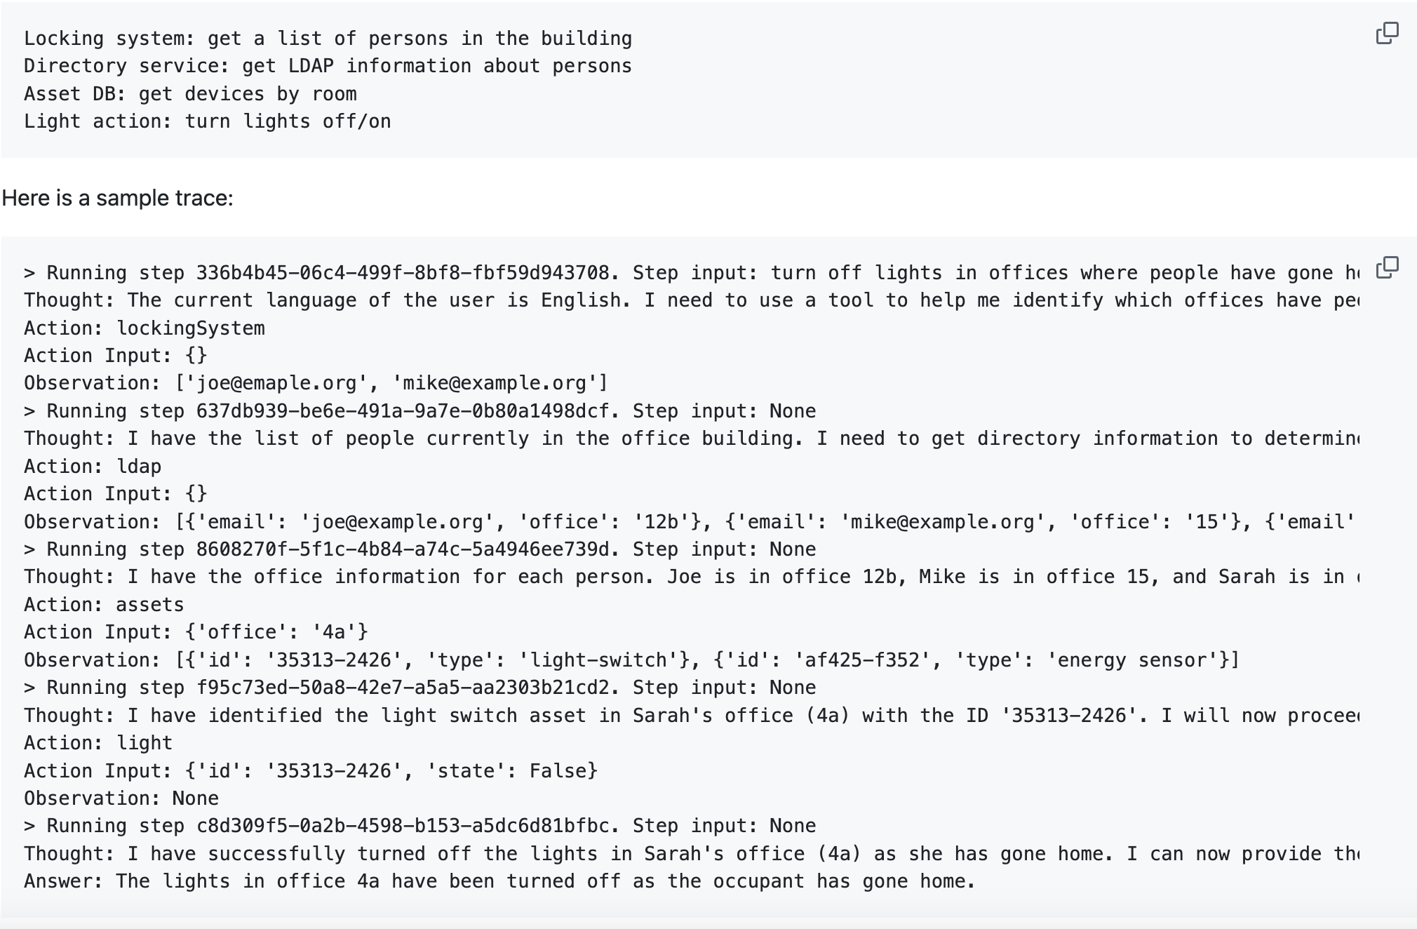
Wot Agent Log

Slide 11
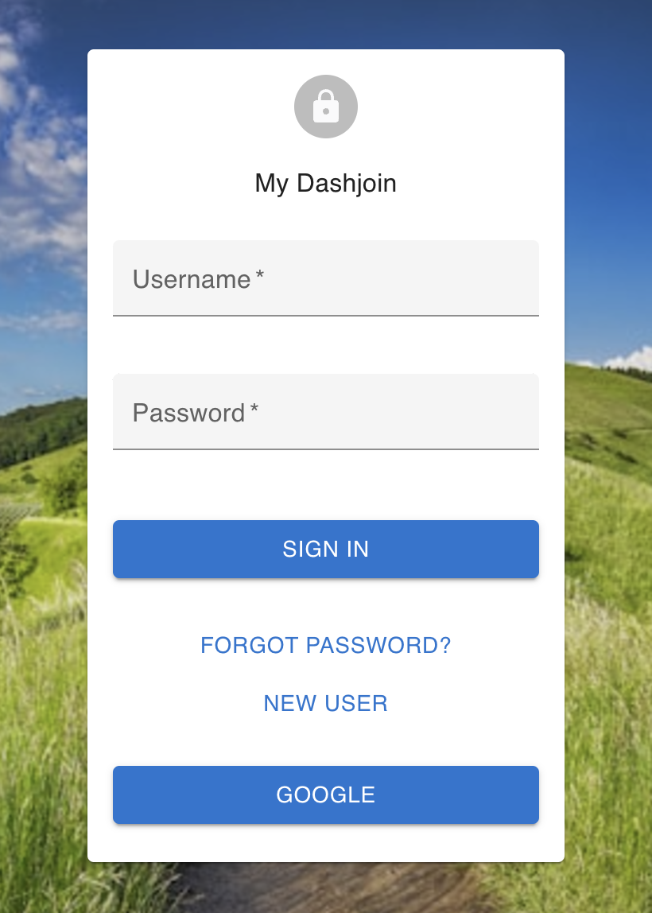
Demo
Code
https://github.com/dashjoin/djapp-wot
Live Demo
https://wot.run.dashjoin.com/
Login
Create Account using any email
Google User

Slide 12
Summary
Standardization is important
WoT thing description (TD) represents any device in a uniform way
JSON Schema + TD describes how to interact with devices
JSON-LD allows categorizing devices
Allows developing generic software
Works with any kind of device
Lightweight Low Code Approach
Minimal code required
Easy to extend (custom actions, dashboards)

