Slide 1
W
hat is
,
W
oT
Thing
Description
Notes:
In this video, we will provide a general overview of a fundamental concept in the Web of Things — the Thing Description, or TD.

Slide 2
Thing
Notes:
A TD acts as a unique blueprint for the respective Thing, offering a standardized way to describe its functionality and how a Consumer should interact with it.

Slide 3

Thing
Notes:
A TD acts as a unique blueprint for the respective Thing, offering a standardized way to describe its functionality and how a Consumer should interact with it.

Slide 4

Thing
Notes:
A TD acts as a unique blueprint for the respective Thing, offering a standardized way to describe its functionality and how a Consumer should interact with it.

Slide 5

Thing
Notes:
A TD acts as a unique blueprint for the respective Thing, offering a standardized way to describe its functionality and how a Consumer should interact with it.

Slide 6


Thing Description (TD)
Notes:
A TD acts as a unique blueprint for the respective Thing, offering a standardized way to describe its functionality and how a Consumer should interact with it.

Slide 7



Consumer
Notes:
A Consumer is any application or service that communicates with a Thing over the network using its Thing Description. It understands the TD and uses it to interact with the Thing.

Slide 8


JSON-LD
Notes:
Thing Descriptions are written using the JSON-LD format, making it both machine and human-readable.

Slide 9
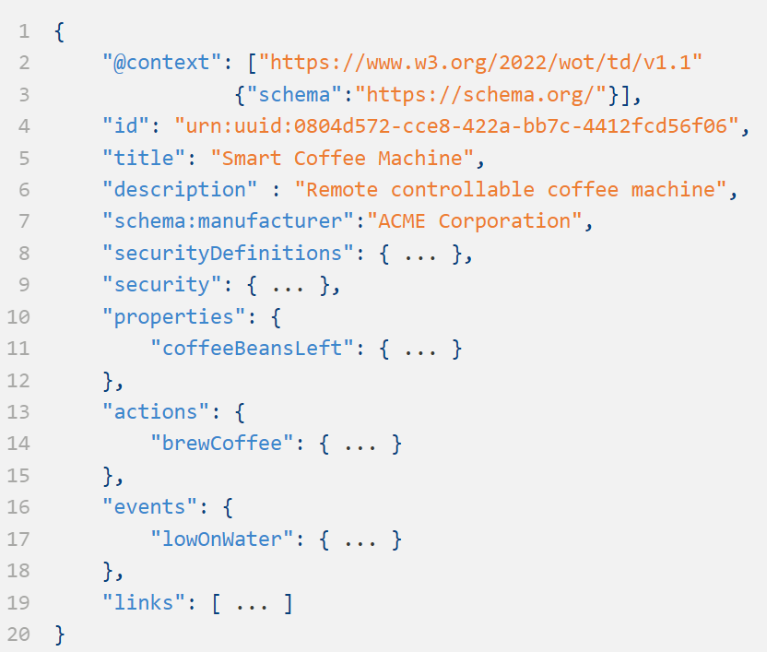
Notes:
To understand this better, let's take a look at a simple example — a smart coffee machine — and break down the components in its Thing Description:

Slide 10
Notes:
To understand this better, let's take a look at a simple example — a smart coffee machine — and break down the components in its Thing Description:

Slide 11
{
"@context": ["https://www.w3.org/2022/wot/td/v1.1"
{"schema":"https://schema.org/"}],
"id": "urn:uuid:0804d572-cce8-422a-bb7c-4412fcd56f06",
"title": "Smart Coffee Machine",
"description": "Remote controllable coffee machine",
"schema:manufacturer": "ACME Corporation",
"securityDefinitions": { ... },
"security": { ... },
"properties": {
"coffeeBeansLeft": { ... }
},
"actions": {
"brewCoffee": { ... }
},
"events": {
"lowOnWater": { ... }
},
"links": [ ... ]
}
Notes:
To understand this better, let's take a look at a simple example — a smart coffee machine — and break down the components in its Thing Description:

Slide 12
{
"@context": ["https://www.w3.org/2022/wot/td/v1.1"
{"schema":"https://schema.org/"}],
"id": "urn:uuid:0804d572-cce8-422a-bb7c-4412fcd56f06",
"title": "Smart Coffee Machine",
"description": "Remote controllable coffee machine",
"schema:manufacturer": "ACME Corporation",
"securityDefinitions": { ... },
"security": { ... },
"properties": {
"coffeeBeansLeft": { ... }
},
"actions": {
"brewCoffee": { ... }
},
"events": {
"lowOnWater": { ... }
},
"links": [ ... ]
}
Thing Metadata
Notes:
The Thing Description begins with the Thing's metadata. It provides the essential information about the device, like its unique ID, title, and description.

Slide 13
{
"@context": ["https://www.w3.org/2022/wot/td/v1.1"
{"schema":"https://schema.org/"}],
"id": "urn:uuid:0804d572-cce8-422a-bb7c-4412fcd56f06",
"title": "Smart Coffee Machine",
"description": "Remote controllable coffee machine",
"schema:manufacturer": "ACME Corporation",
"securityDefinitions": { ... },
"security": { ... },
"properties": {
"coffeeBeansLeft": { ... }
},
"actions": {
"brewCoffee": { ... }
},
"events": {
"lowOnWater": { ... }
},
"links": [ ... ]
}
Thing Metadata
Notes:
Then, in the definitions of Interaction Affordances, we specify ways a Consumer application can interact with the Thing, through its various properties, actions, and events exposed on its network interfaces. The example here shows the property `coffeeBeansLeft`, which describes the current state of the coffee beans; the action `brewCoffee`, which triggers brewing; and the event `lowOnWater`, which alerts the Consumer when the machine is low on water. We’ll explore Interaction Affordances in greater detail in the next video of this series.

Slide 14
{
"@context": ["https://www.w3.org/2022/wot/td/v1.1"
{"schema":"https://schema.org/"}],
"id": "urn:uuid:0804d572-cce8-422a-bb7c-4412fcd56f06",
"title": "Smart Coffee Machine",
"description": "Remote controllable coffee machine",
"schema:manufacturer": "ACME Corporation",
"securityDefinitions": { ... },
"security": { ... },
"properties": {
"coffeeBeansLeft": { ... }
},
"actions": {
"brewCoffee": { ... }
},
"events": {
"lowOnWater": { ... }
},
"links": [ ... ]
}
Thing Metadata
Definition of Interaction Affordances
Notes:
Then, in the definitions of Interaction Affordances, we specify ways a Consumer application can interact with the Thing, through its various properties, actions, and events exposed on its network interfaces. The example here shows the property `coffeeBeansLeft`, which describes the current state of the coffee beans; the action `brewCoffee`, which triggers brewing; and the event `lowOnWater`, which alerts the Consumer when the machine is low on water. We’ll explore Interaction Affordances in greater detail in the next video of this series.

Slide 15
{
"@context": ["https://www.w3.org/2022/wot/td/v1.1"
{"schema":"https://schema.org/"}],
"id": "urn:uuid:0804d572-cce8-422a-bb7c-4412fcd56f06",
"title": "Smart Coffee Machine",
"description": "Remote controllable coffee machine",
"schema:manufacturer": "ACME Corporation",
"securityDefinitions": { ... },
"security": { ... },
"properties": {
"coffeeBeansLeft": { ... }
},
"actions": {
"brewCoffee": { ... }
},
"events": {
"lowOnWater": { ... }
},
"links": [ ... ]
}
Thing Metadata
Definition of Interaction Affordances
Notes:
The Security Metadata defines security mechanisms required to ensure secure access to the Thing by the Consumer application. This way the Consumer application knows what type of credentials are needed to execute different operations.

Slide 16
{
"@context": ["https://www.w3.org/2022/wot/td/v1.1"
{"schema":"https://schema.org/"}],
"id": "urn:uuid:0804d572-cce8-422a-bb7c-4412fcd56f06",
"title": "Smart Coffee Machine",
"description": "Remote controllable coffee machine",
"schema:manufacturer": "ACME Corporation",
"securityDefinitions": { ... },
"security": { ... },
"properties": {
"coffeeBeansLeft": { ... }
},
"actions": {
"brewCoffee": { ... }
},
"events": {
"lowOnWater": { ... }
},
"links": [ ... ]
}
Thing Metadata
Security Metadata
Definition of Interaction Affordances
Notes:
The Security Metadata defines security mechanisms required to ensure secure access to the Thing by the Consumer application. This way the Consumer application knows what type of credentials are needed to execute different operations.

Slide 17
{
"@context": ["https://www.w3.org/2022/wot/td/v1.1"
{"schema":"https://schema.org/"}],
"id": "urn:uuid:0804d572-cce8-422a-bb7c-4412fcd56f06",
"title": "Smart Coffee Machine",
"description": "Remote controllable coffee machine",
"schema:manufacturer": "ACME Corporation",
"securityDefinitions": { ... },
"security": { ... },
"properties": {
"coffeeBeansLeft": { ... }
},
"actions": {
"brewCoffee": { ... }
},
"events": {
"lowOnWater": { ... }
},
"links": [ ... ]
}
Thing Metadata
Security Metadata
Definition of Interaction Affordances
Notes:
To add keywords that are not part of the TD standard, we can add Semantic Annotations. These allow other systems to consistently interpret the device’s terms and functions. Here, we annotate using `schema.org` to add the name of the manufacturer, which is not part of the core TD specification.

Slide 18
{
"@context": ["https://www.w3.org/2022/wot/td/v1.1"
{"schema":"https://schema.org/"}],
"id": "urn:uuid:0804d572-cce8-422a-bb7c-4412fcd56f06",
"title": "Smart Coffee Machine",
"description": "Remote controllable coffee machine",
"schema:manufacturer": "ACME Corporation",
"securityDefinitions": { ... },
"security": { ... },
"properties": {
"coffeeBeansLeft": { ... }
},
"actions": {
"brewCoffee": { ... }
},
"events": {
"lowOnWater": { ... }
},
"links": [ ... ]
}
Semantic Annotations
Thing Metadata
Security Metadata
Definition of Interaction Affordances
Notes:
To add keywords that are not part of the TD standard, we can add Semantic Annotations. These allow other systems to consistently interpret the device’s terms and functions. Here, we annotate using `schema.org` to add the name of the manufacturer, which is not part of the core TD specification.

Slide 19
{
"@context": ["https://www.w3.org/2022/wot/td/v1.1"
{"schema":"https://schema.org/"}],
"id": "urn:uuid:0804d572-cce8-422a-bb7c-4412fcd56f06",
"title": "Smart Coffee Machine",
"description": "Remote controllable coffee machine",
"schema:manufacturer": "ACME Corporation",
"securityDefinitions": { ... },
"security": { ... },
"properties": {
"coffeeBeansLeft": { ... }
},
"actions": {
"brewCoffee": { ... }
},
"events": {
"lowOnWater": { ... }
},
"links": [ ... ]
}
Semantic Annotations
Thing Metadata
Security Metadata
Definition of Interaction Affordances
Notes:
Finally, we can link the Thing Description to other documents, such as documentation or a user interface.

Slide 20
{
"@context": ["https://www.w3.org/2022/wot/td/v1.1"
{"schema":"https://schema.org/"}],
"id": "urn:uuid:0804d572-cce8-422a-bb7c-4412fcd56f06",
"title": "Smart Coffee Machine",
"description": "Remote controllable coffee machine",
"schema:manufacturer": "ACME Corporation",
"securityDefinitions": { ... },
"security": { ... },
"properties": {
"coffeeBeansLeft": { ... }
},
"actions": {
"brewCoffee": { ... }
},
"events": {
"lowOnWater": { ... }
},
"links": [ ... ]
}
Semantic Annotations
Thing Metadata
Security Metadata
Definition of Interaction Affordances
Links to other documents
Notes:
Finally, we can link the Thing Description to other documents, such as documentation or a user interface.

Slide 21
{
"@context": ["https://www.w3.org/2022/wot/td/v1.1"
{"schema":"https://schema.org/"}],
"id": "urn:uuid:0804d572-cce8-422a-bb7c-4412fcd56f06",
"title": "Smart Coffee Machine",
"description": "Remote controllable coffee machine",
"schema:manufacturer": "ACME Corporation",
"securityDefinitions": { ... },
"security": { ... },
"properties": {
"coffeeBeansLeft": { ... }
},
"actions": {
"brewCoffee": { ... }
},
"events": {
"lowOnWater": { ... }
},
"links": [ ... ]
}
Semantic Annotations
Thing Metadata
Security Metadata
Definition of Interaction Affordances
Links to other documents
Notes:
This overview should give you a solid foundation for understanding the role of Thing Descriptions in the Web of Things. The next videos will explain the components in detail.

Slide 22

Notes:
This overview should give you a solid foundation for understanding the role of Thing Descriptions in the Web of Things. The next videos will explain the components in detail.

Slide 23
Notes:
This overview should give you a solid foundation for understanding the role of Thing Descriptions in the Web of Things. The next videos will explain the components in detail.

Slide 24
Notes:
This overview should give you a solid foundation for understanding the role of Thing Descriptions in the Web of Things. The next videos will explain the components in detail.

Slide 25
Subscribe to our Channel
Playlist
Next Video

