Slide 1
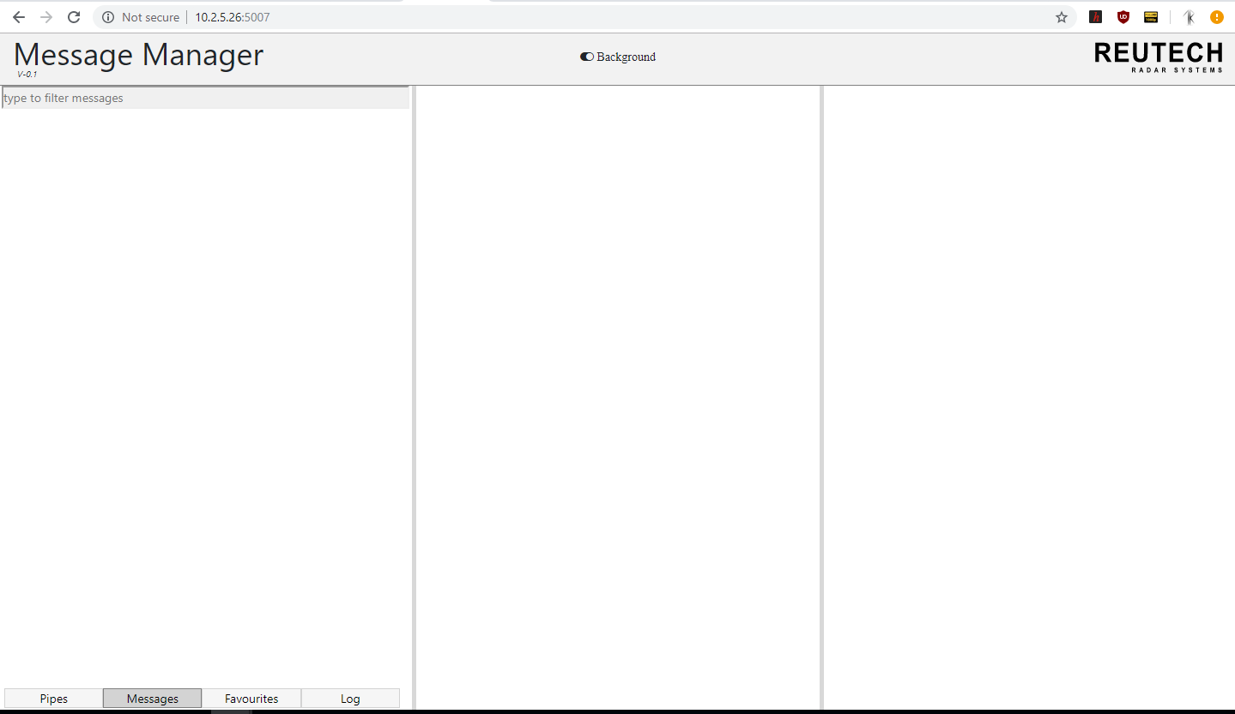
This is the first page you’ll see when
WebMM start
To add first new xml, click ‘Pipes’ on
Menu Bar ‘Bottom Left’

Slide 2
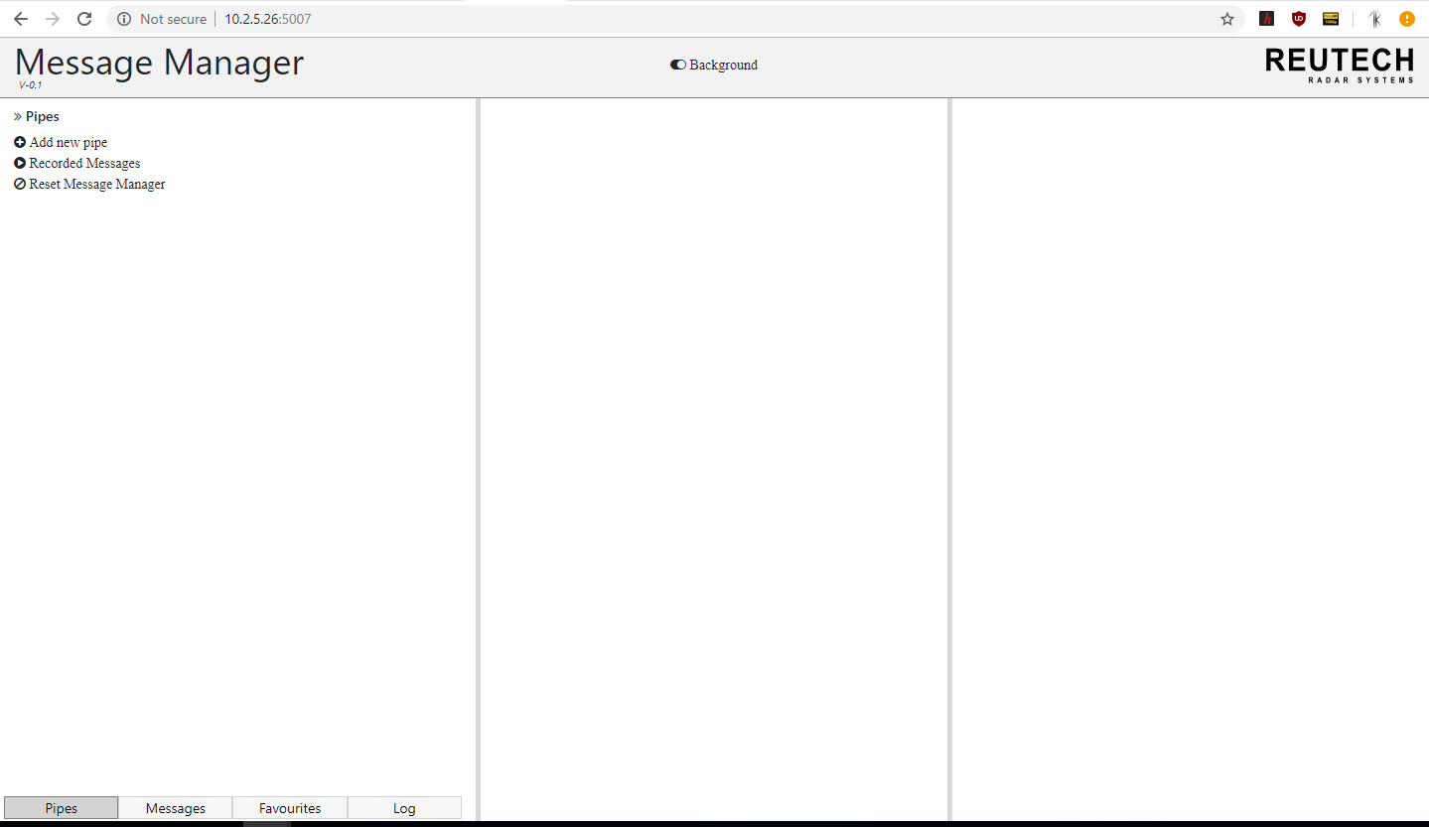
Top Left menu will appear after
clicking the Pipe menu
Click Add new pipe
In case you made any mistake, click
Reset Message Manager button

Slide 3
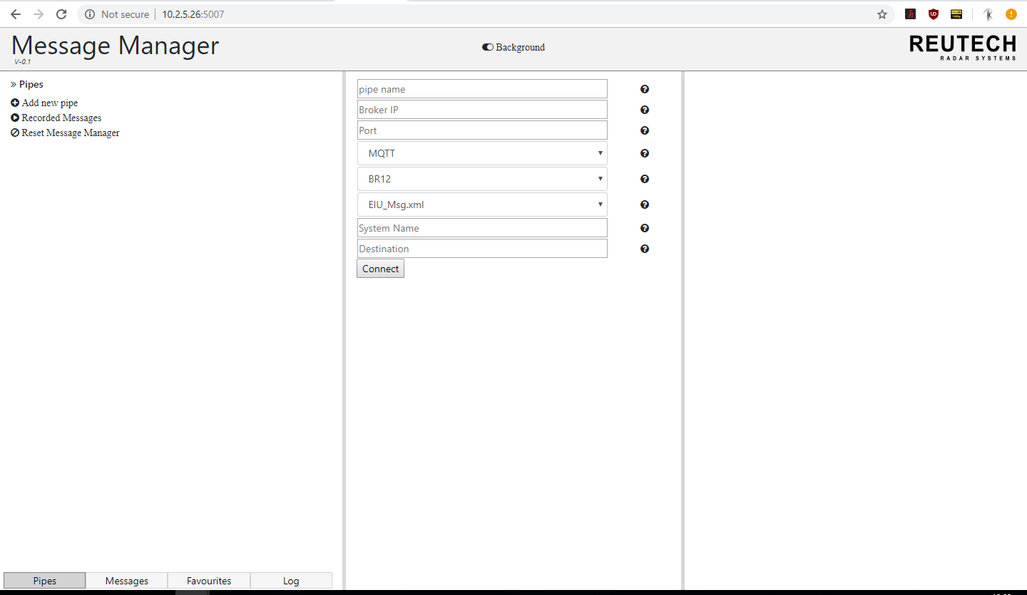
Hover over the info button
to get more information
about the field

Slide 4
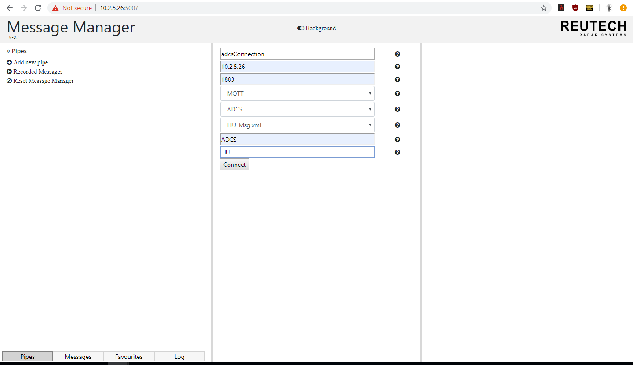
Fill in the fields respectively and
click Connect
Wait for 4 seconds and the pipe
will connect, if it doesn’t, check the
IP and port of the broker provided,
Make sure MQTT broker is running.

Slide 5
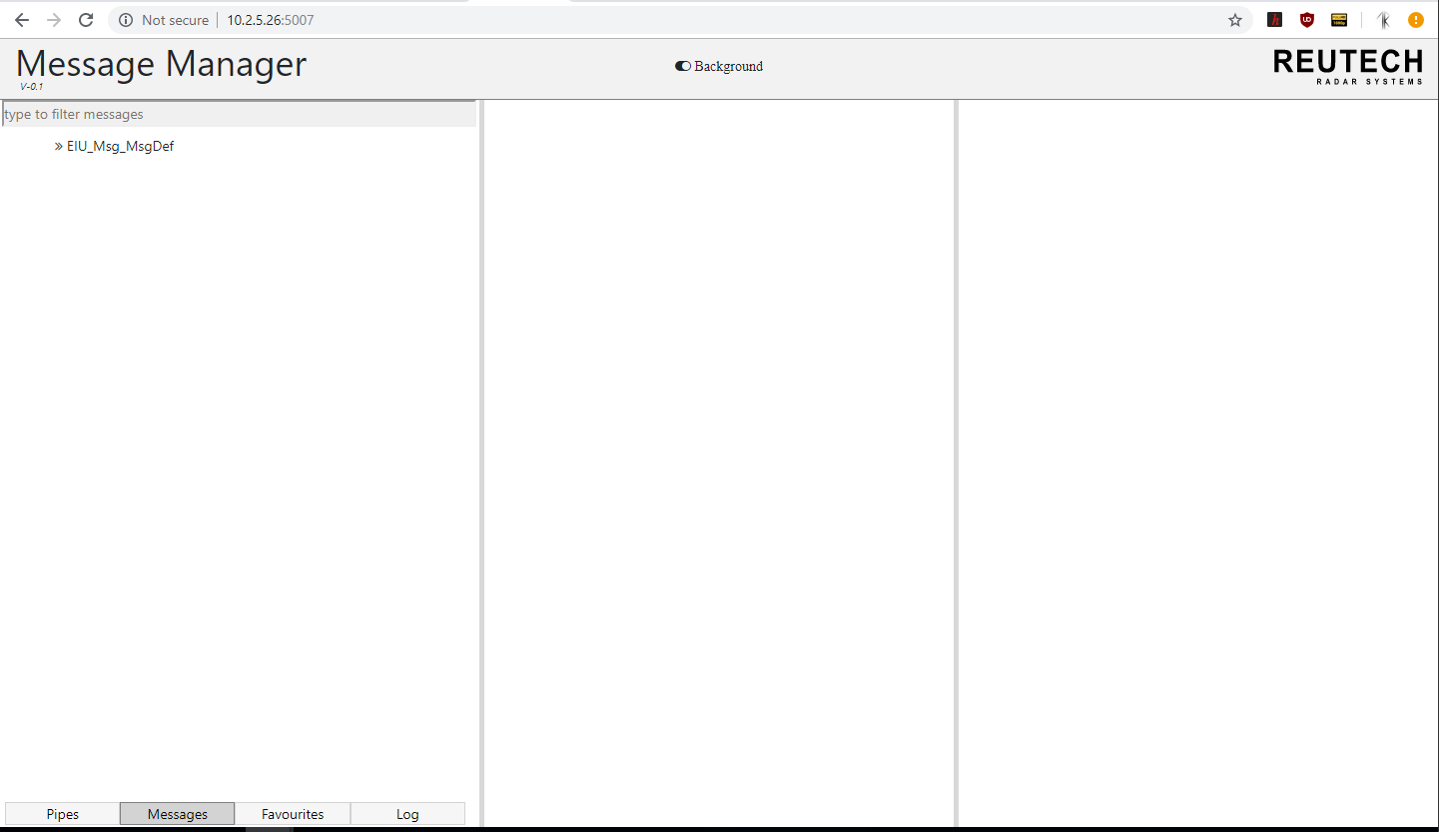
Messages will appear collapsed

Slide 6
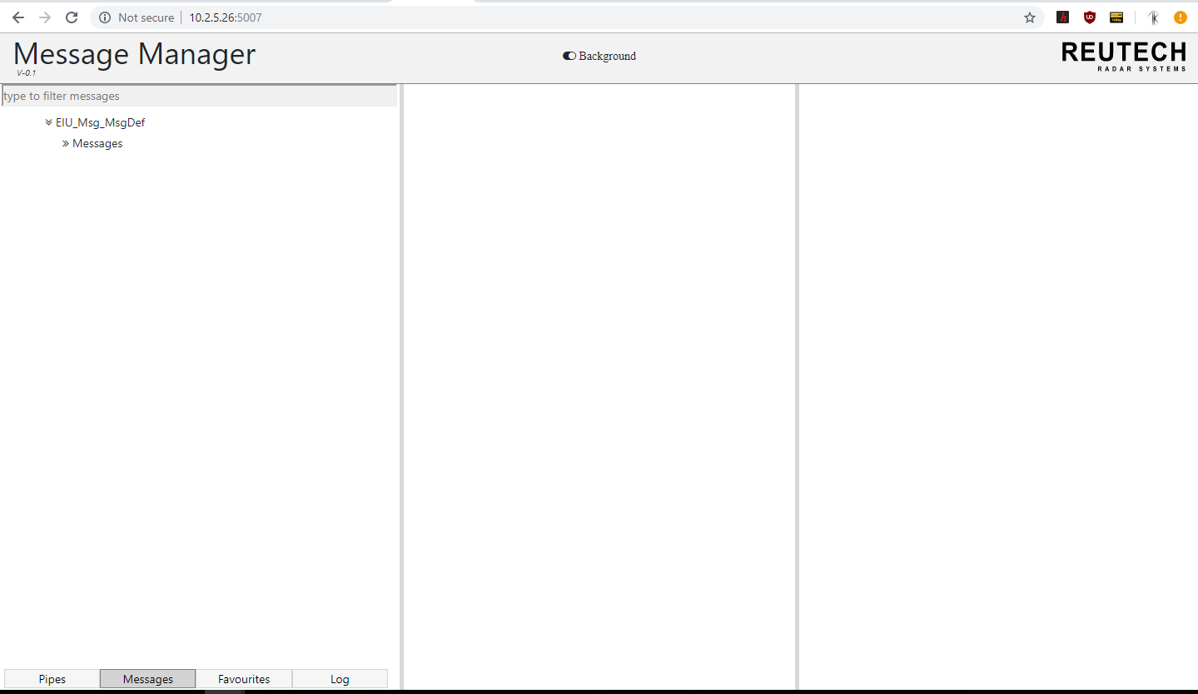
Click xml to expand xml

Slide 7
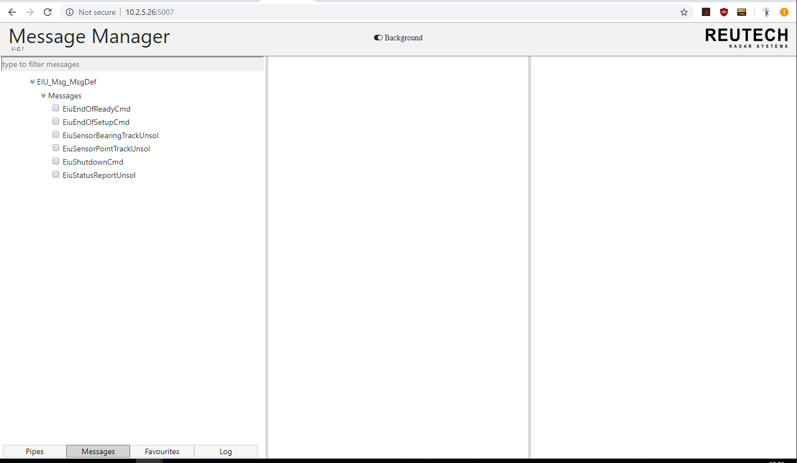
Expand Message structure to view
All messages
Select any message to view the
Message information

Slide 8
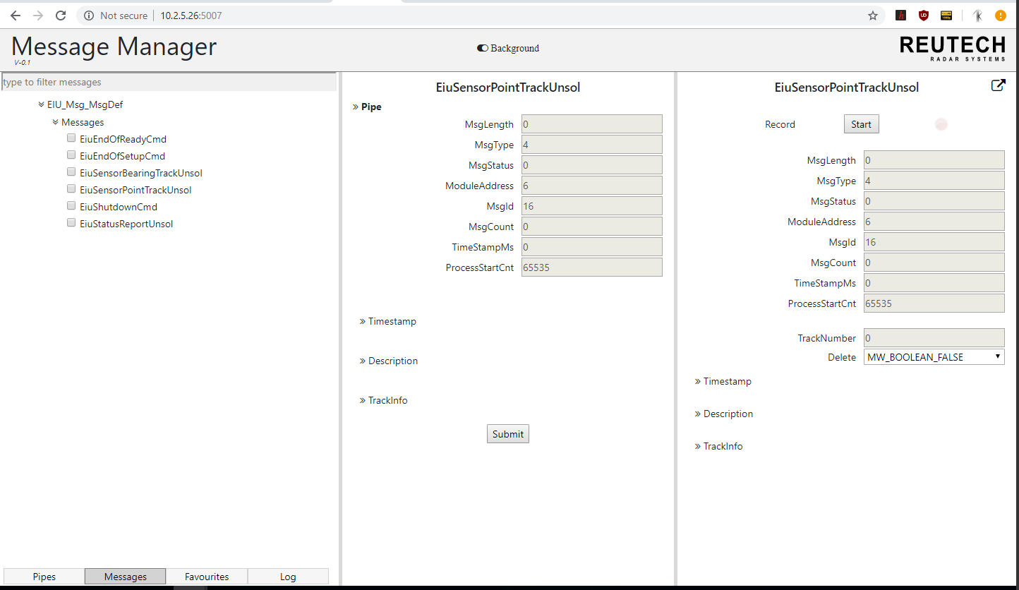
Field structure appear in
collapsed format

Slide 9
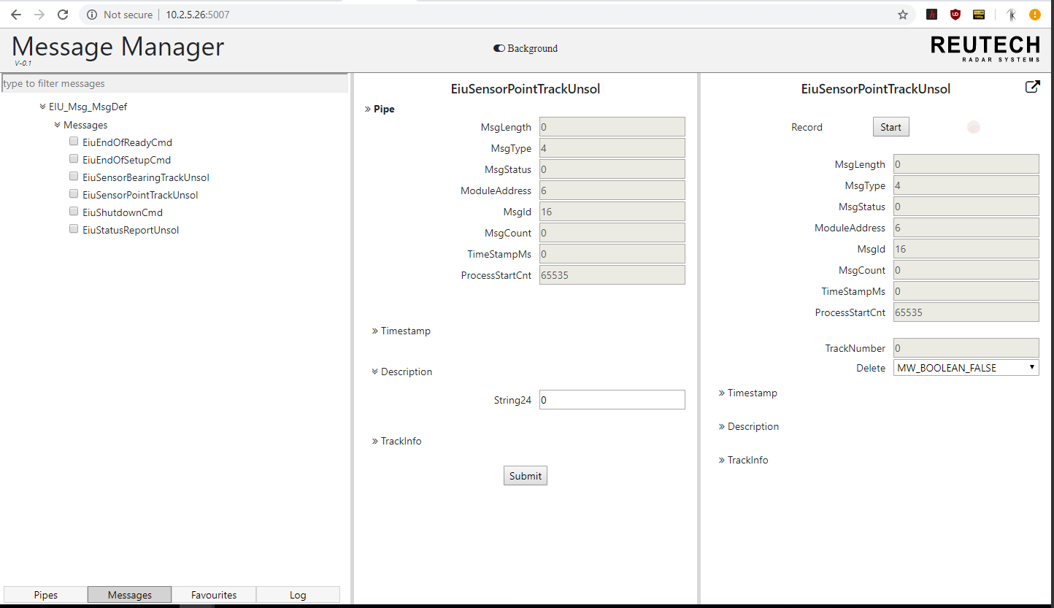
Expand and collapse structure
to view its content

Slide 10
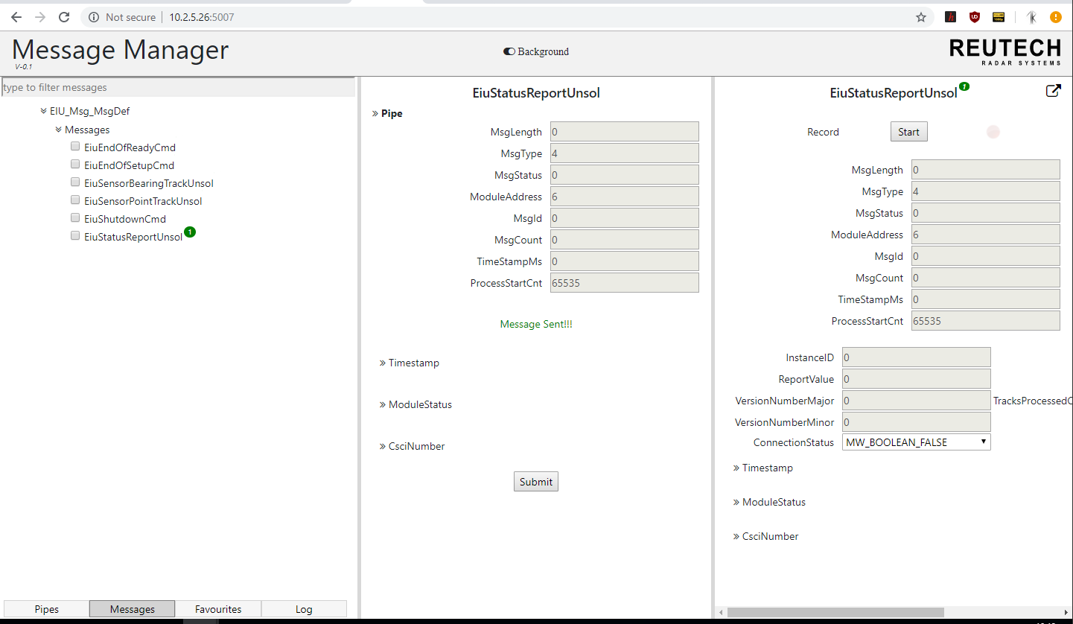
This number shows which message and
how many messages are received.
If a message is sent successfully,
it will show like this
To send a message, click Submit

Slide 11
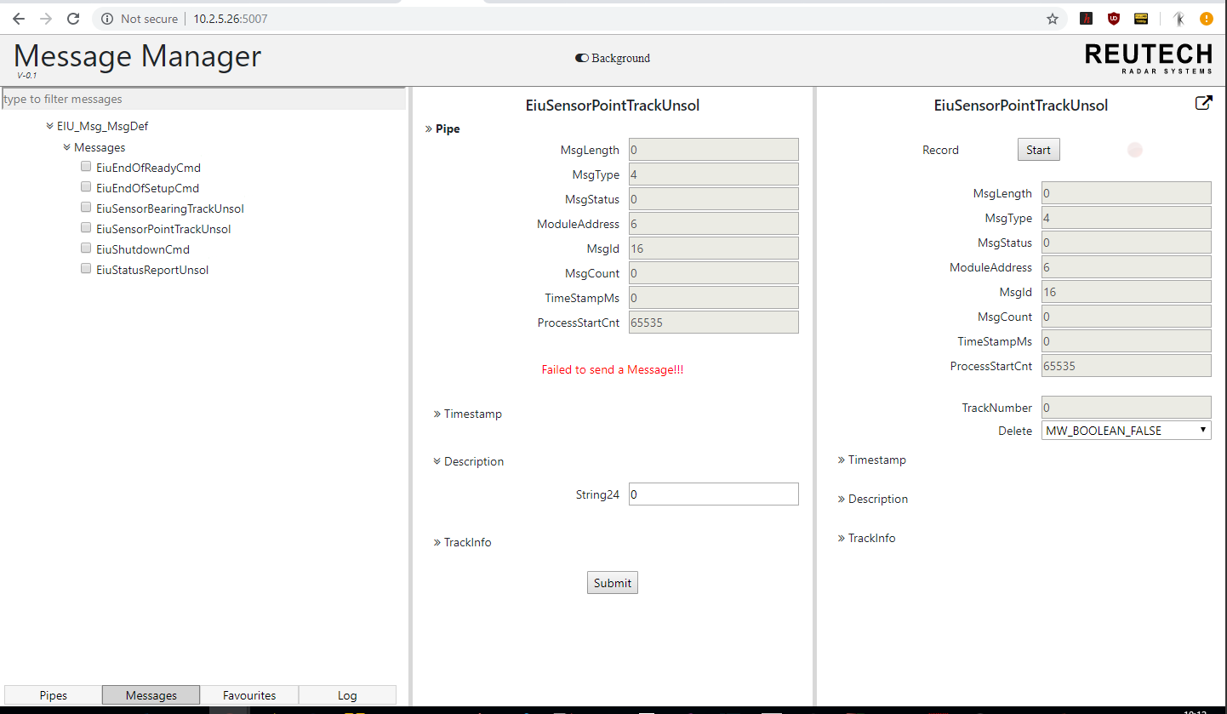
If a message fail to send,
It will display error message.

Slide 12
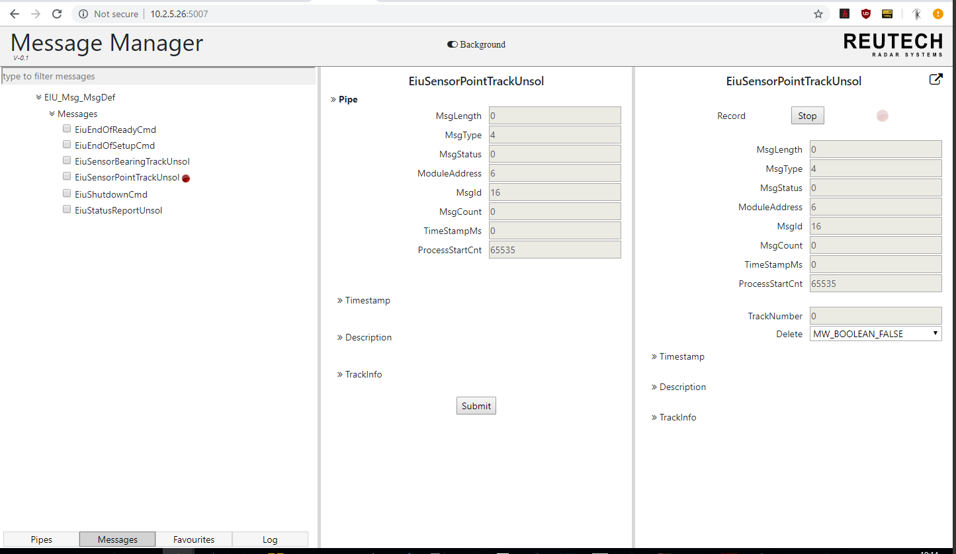
Messages being recorded will show
By red circle
To record message, click on start, and stop
To stop recording

