Slide 1
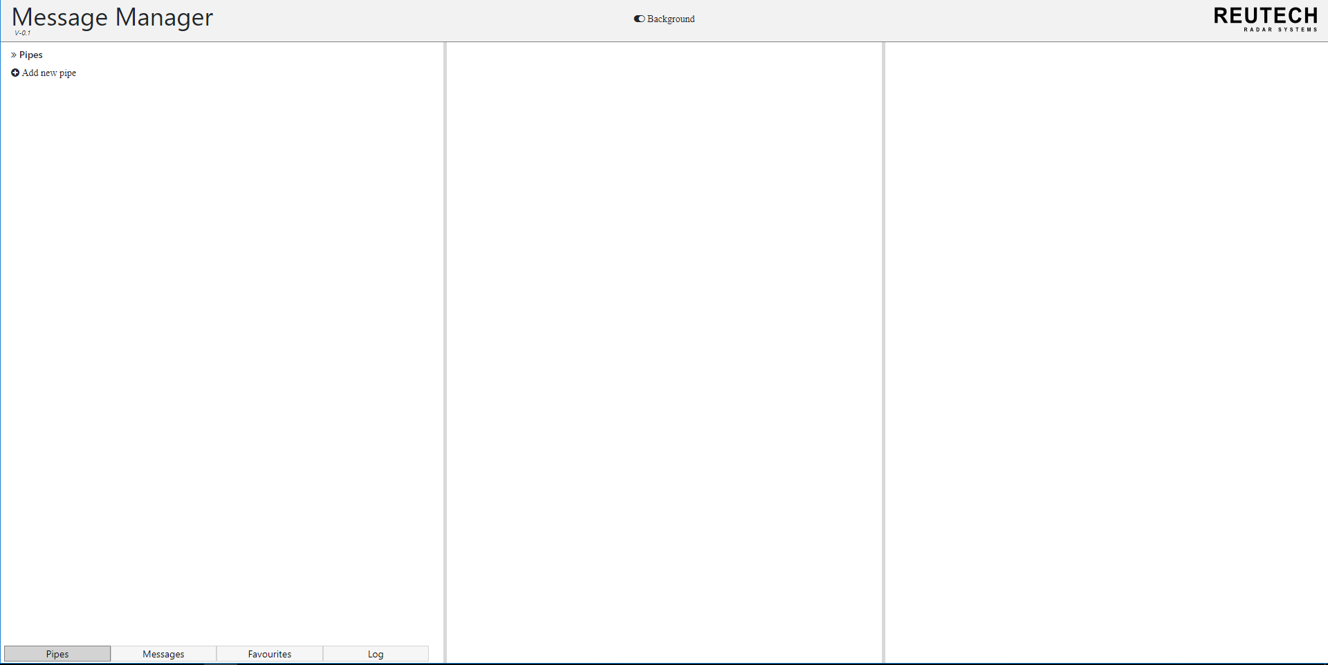
Change background of MMS interface

Slide 2
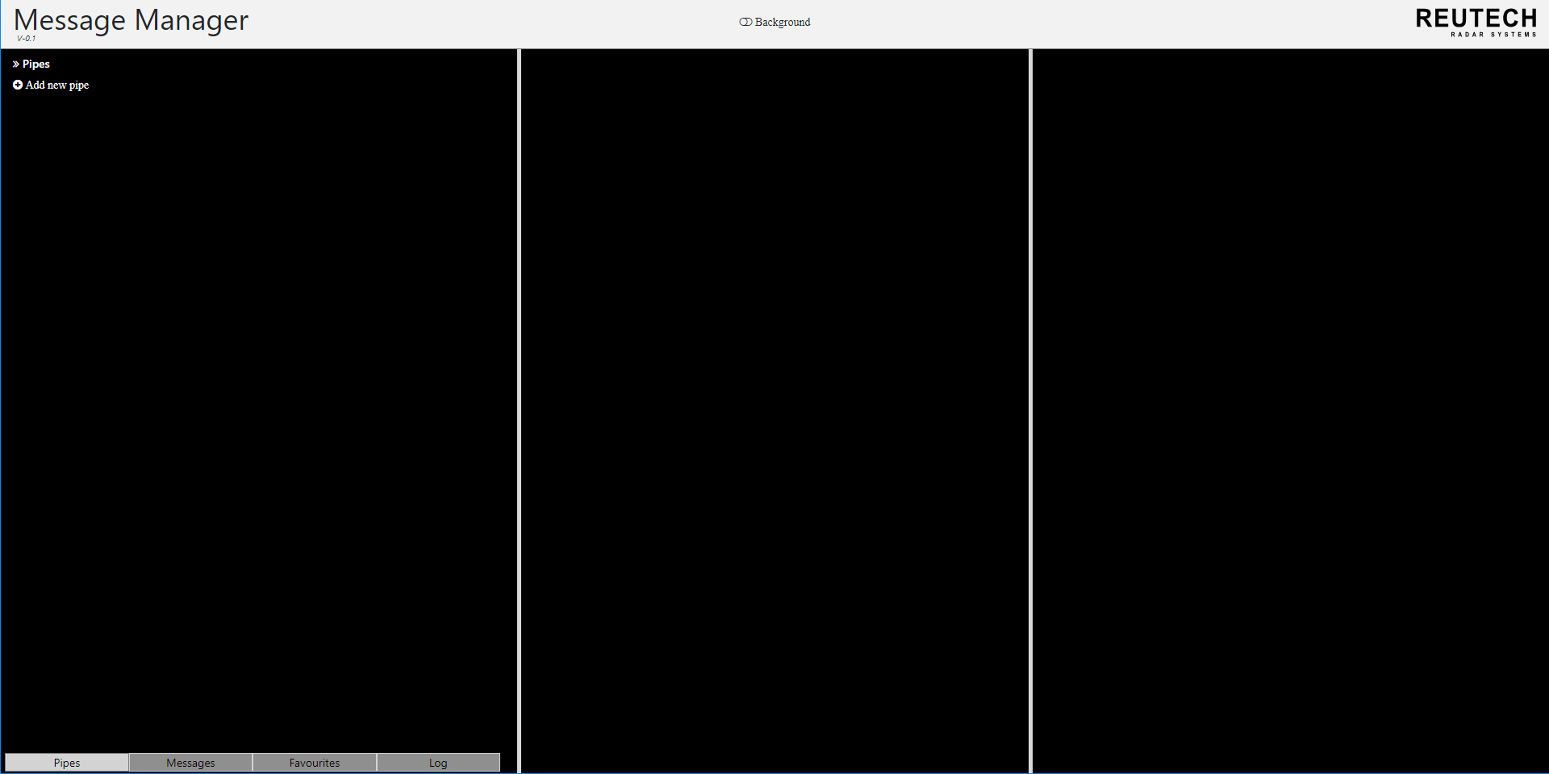

Slide 3
Click to add new pipe. This gives you a page to fill information about the pipe connection

Slide 4
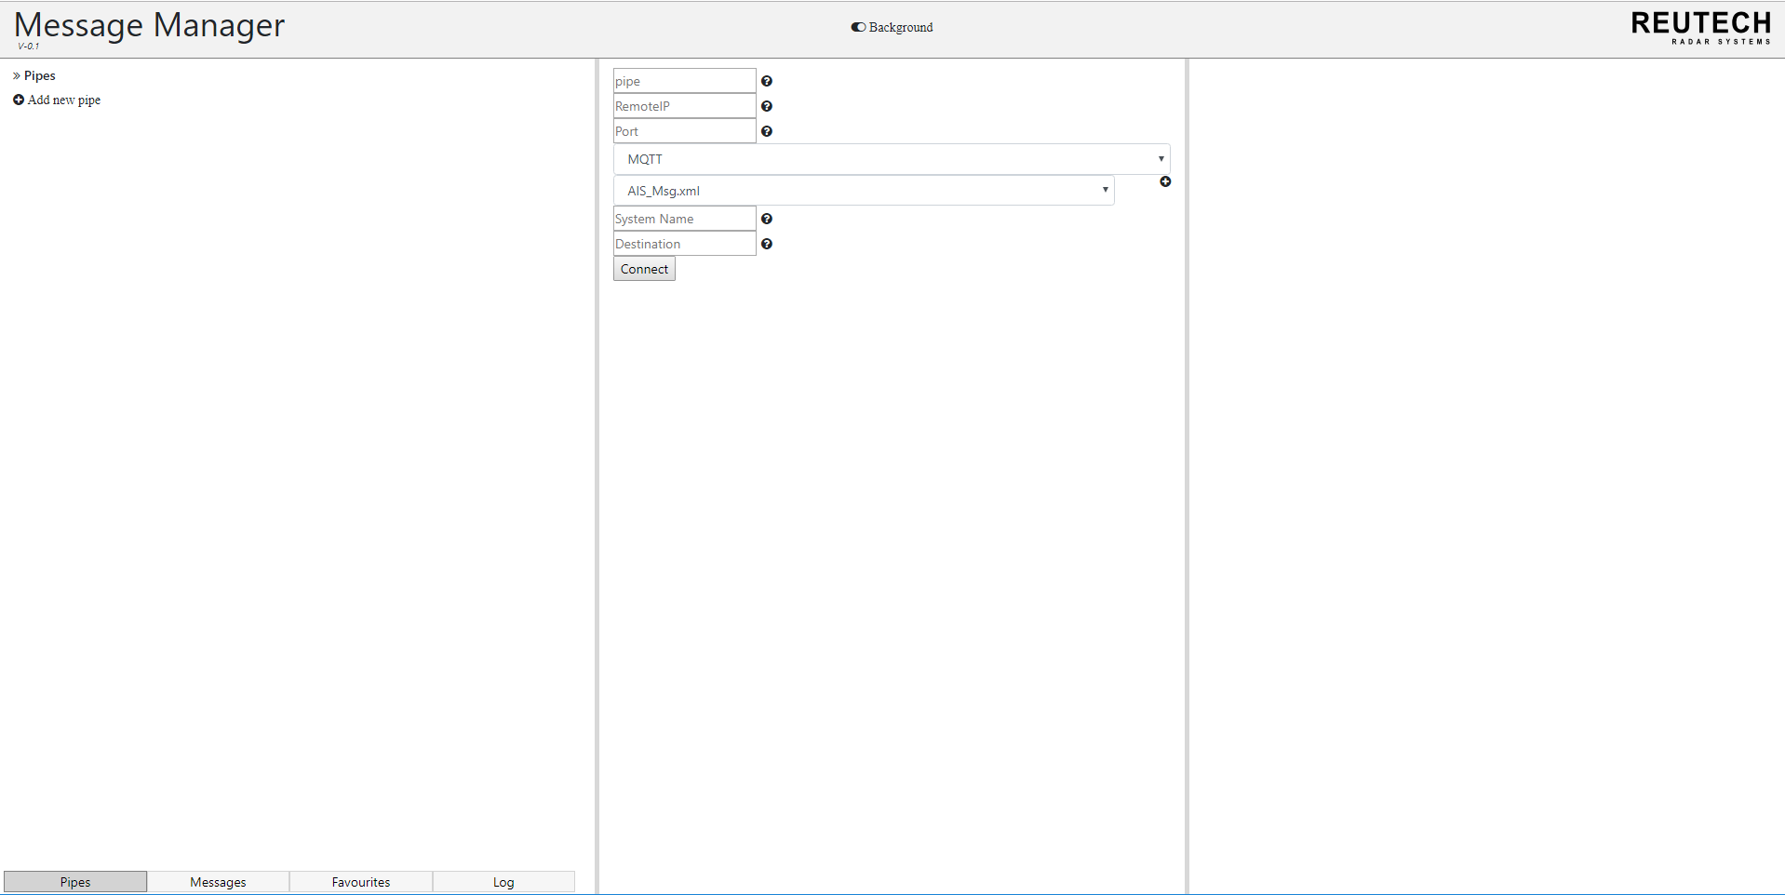
Click connect, to connect the pipe

Slide 5
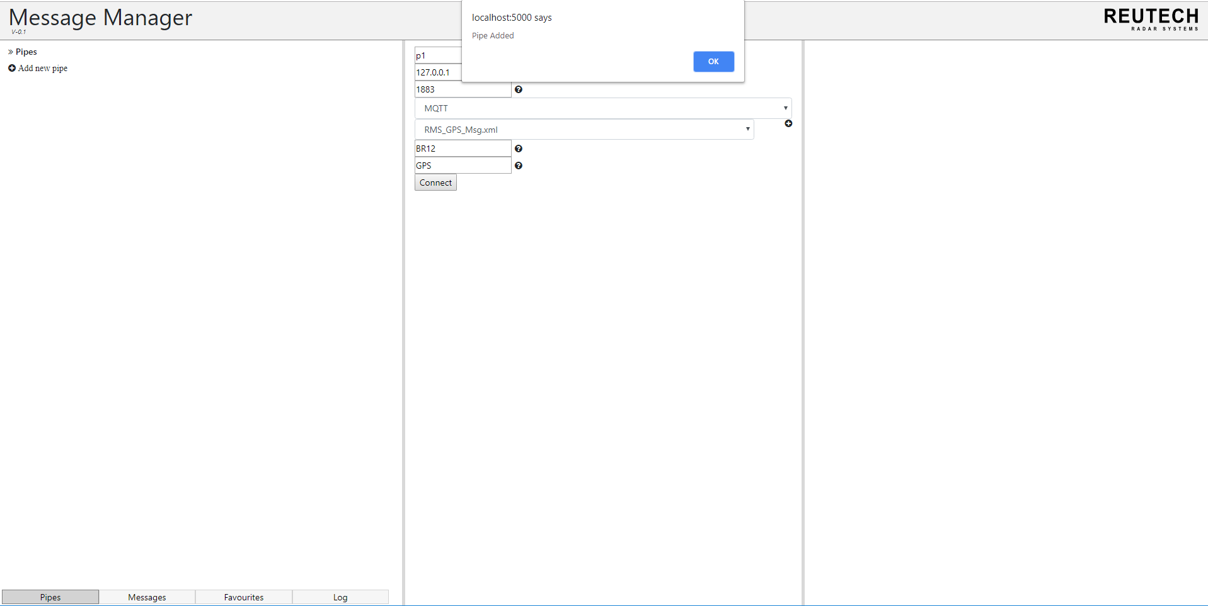
Pipe has been officially added

Slide 6
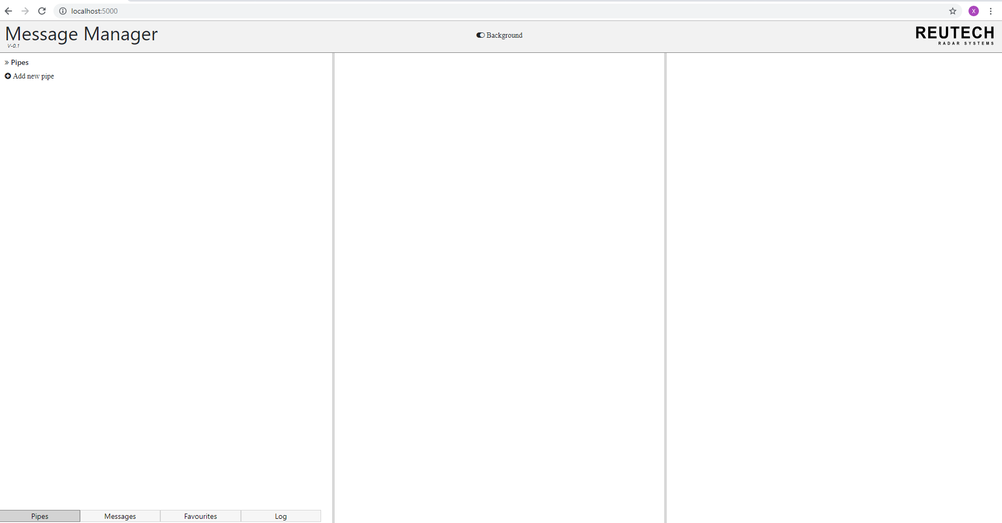
Press ctrl + refresh to get XML name for pipe connection

Slide 7
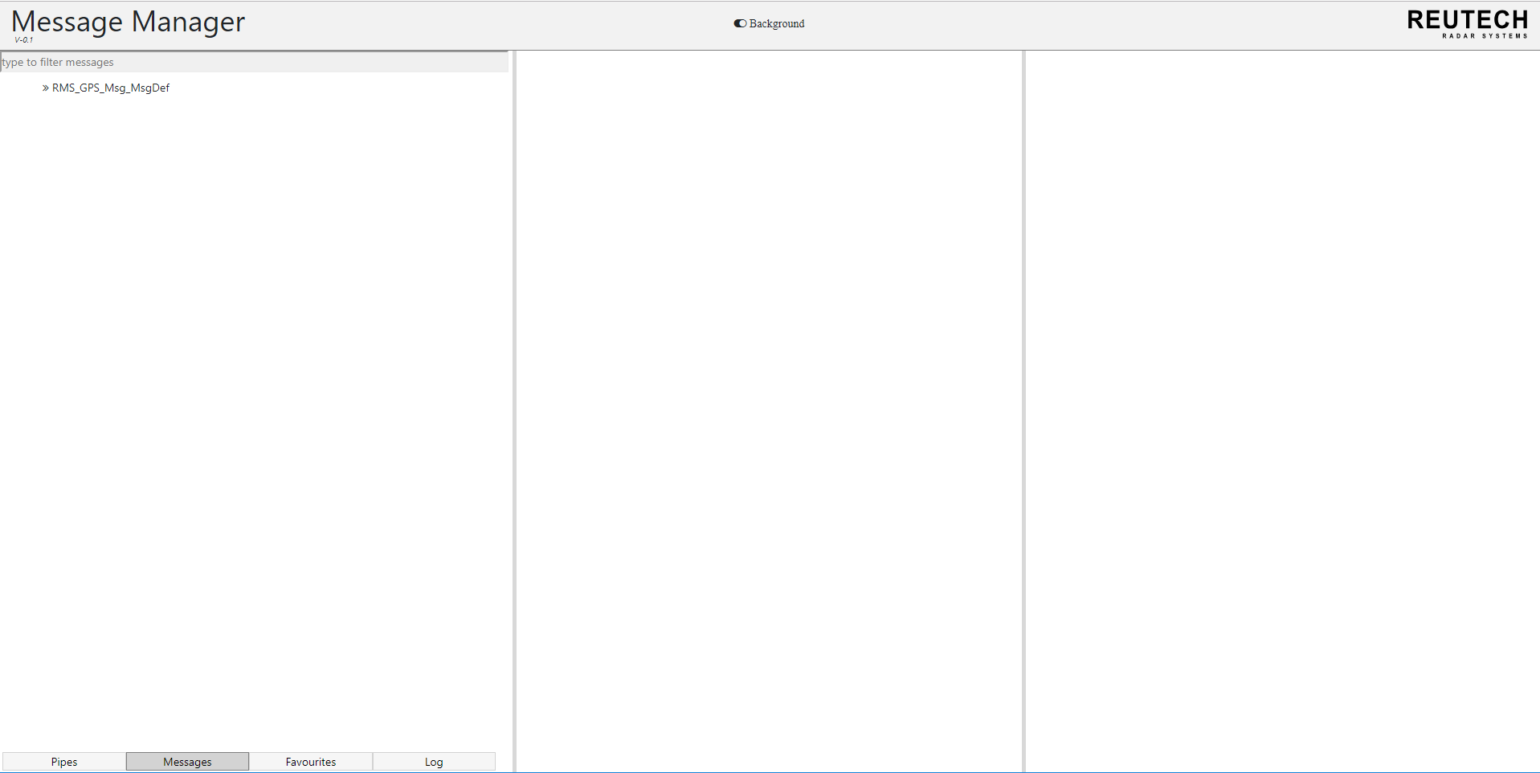
Click the XML name to get the messages for the XML

Slide 8
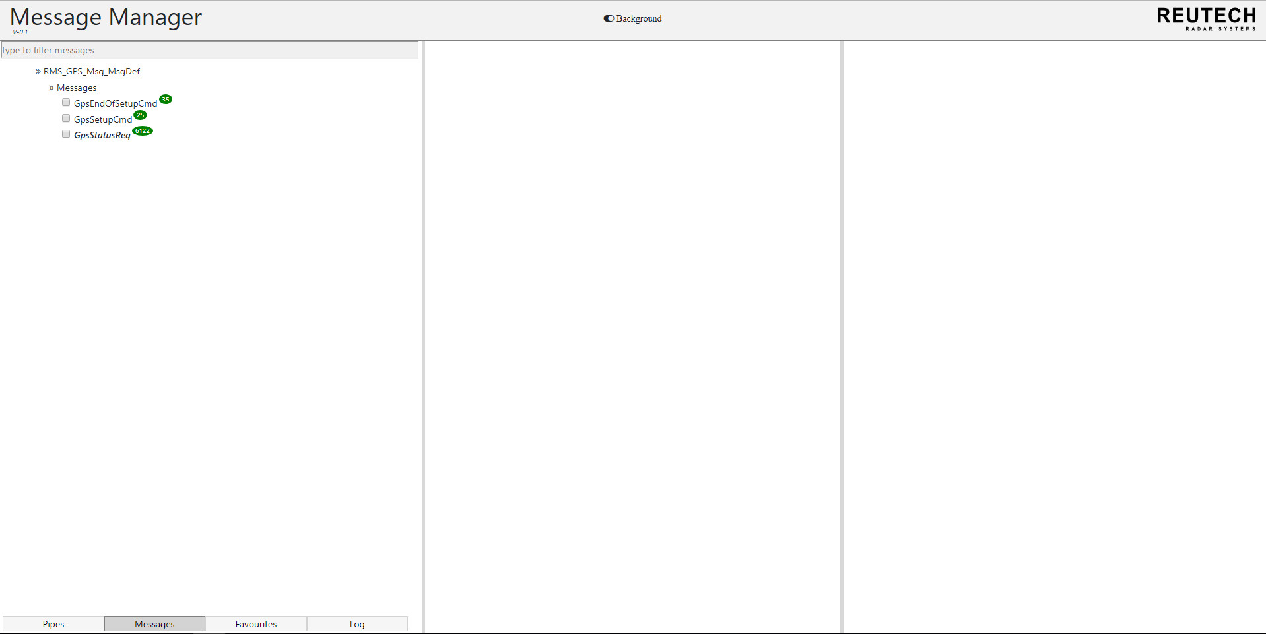
This is the messages for the XML. Click one message to get information about the message

Slide 9
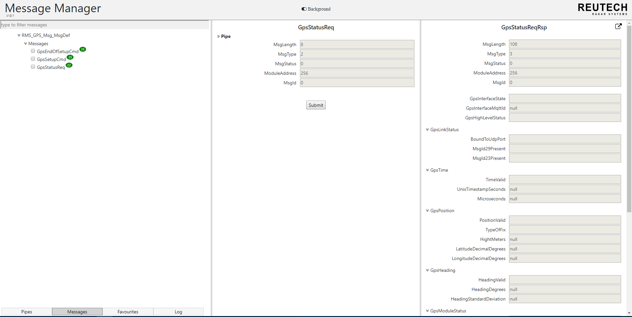
Click submit to get the response of this message

Slide 10
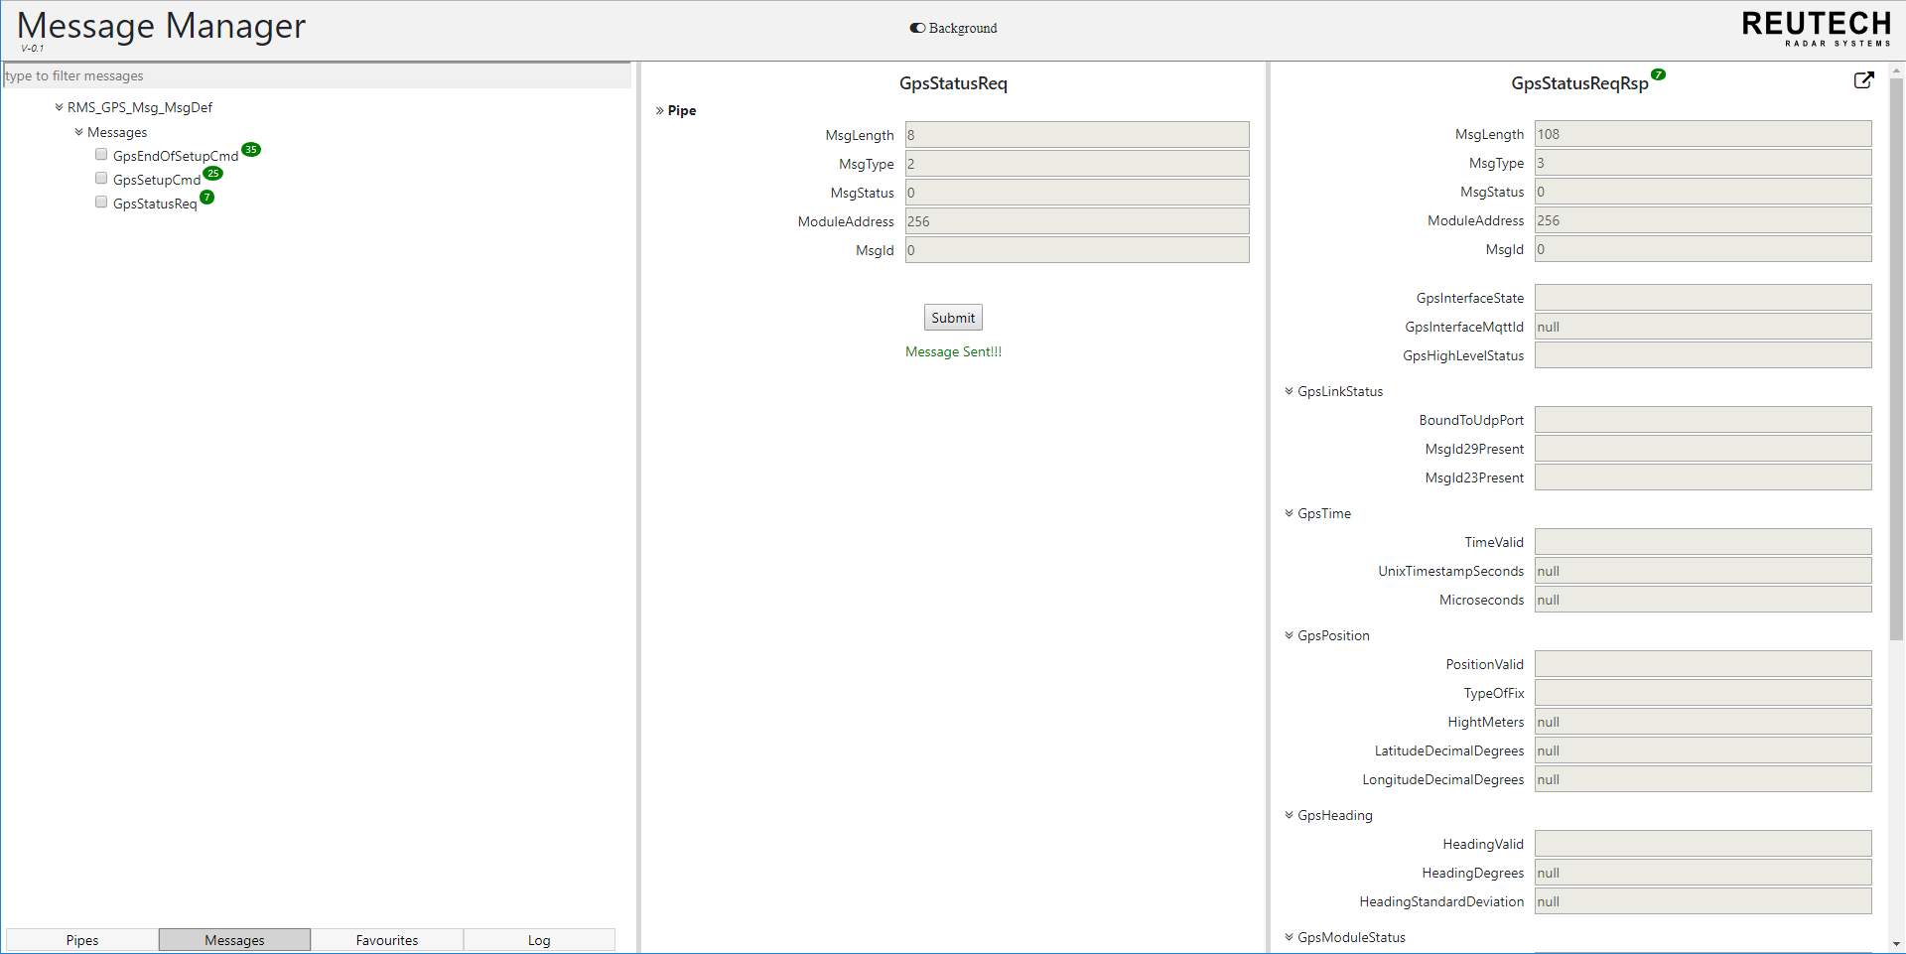
Shows message was sent successfully

Slide 11

Click on the message name again to get the response information

Slide 12
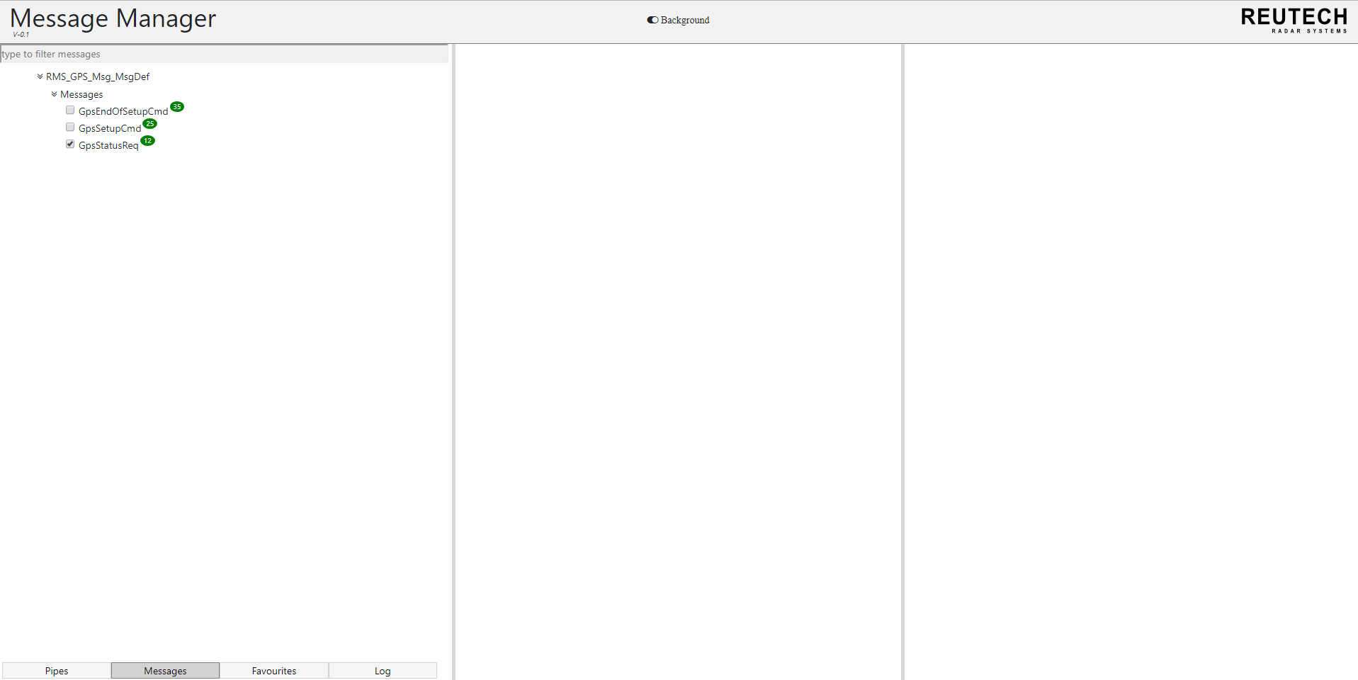
Check the checkbox to add the message to the favourites list.

Slide 13
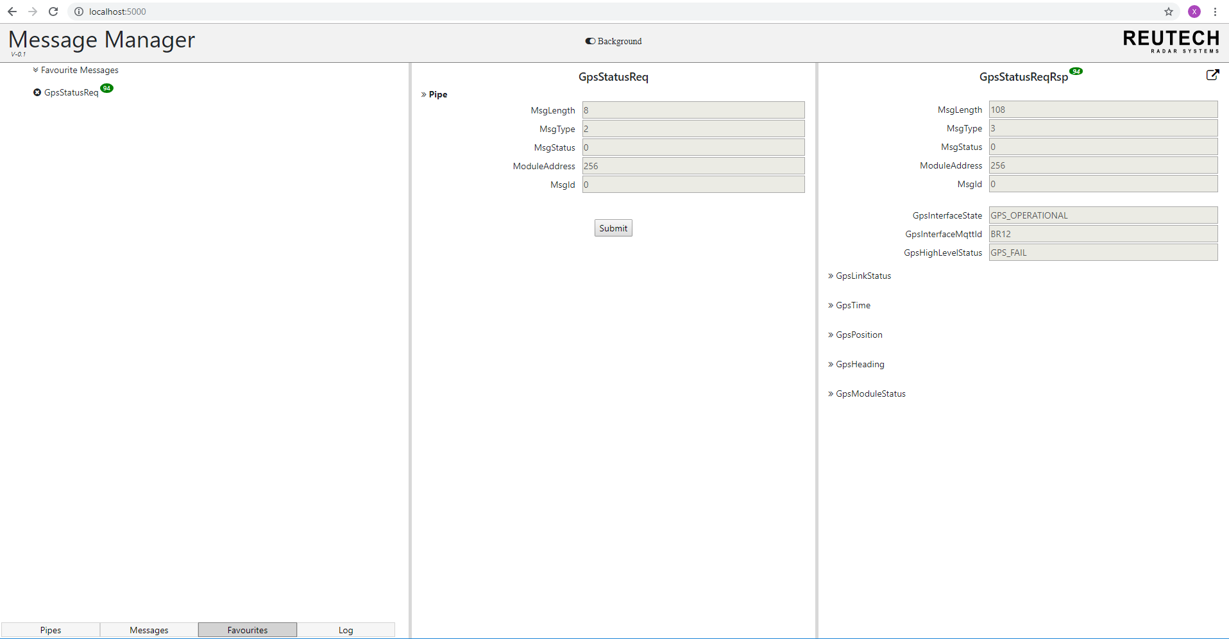
Press ctrl + refresh to view the message in favourite list. Click on the message to get the message information

