Slide 1

RESEARCH PROPOSAL
SY 2025-2026
RESEARCH AND INSTRUCTIONAL INNOVATION DEPARTMENT

Slide 2





Research Profile
PICTURE
Denzel Troy S. Reformado
0009-0007-4971-2382
denzeltroy_reformado@smccnasipit.edu.ph
Bea Azenith B. Taglucop
0009-0002-5813-1516
beaazenith_taglucop@smccnasipit.edu.ph
Charles G. Olayan
0009-0003-3561-9612
charles_olayan@smccnasipit.edu.ph
Jhomarie p. Alsado
0009-0000-1656-7333
jhomarie_alsado@smccnasipit.edu.ph
Julius G. Sabandal
0009-0006-6875-4855
julius_sabandal@smccnasipit.edu.ph
RESEARCH AND INSTRUCTIONAL INNOVATION DEPARTMENT

Slide 3

Research Adviser
PICTURE
Ms: Rea Mie A Omas-as
Orcid Link: 0000-0003-3021-4280
Email: reaomas-as@smccnasipit.edu.ph
Field of Expertise: Programming VGD
RESEARCH AND INSTRUCTIONAL INNOVATION DEPARTMENT

Slide 4
Web-Based SMART LEAP Application and Remittance System for CSWDD Butuan City
RESEARCH AND INSTRUCTIONAL INNOVATION DEPARTMENT

Slide 5
INTRODUCTION
PROJECT CONTEXT
LITERATURE REVIEW (THEMES)
PROJECT OBJECTIVES
SCOPE AND LIMITATIONS
RESEARCH AND INSTRUCTIONAL INNOVATION DEPARTMENT

Slide 6
INTRODUCTION
PROJECT CONTEXT
LITERATURE REVIEW(THEMES)
SCOPE AND LIMITATIONS
PROJECT OBJECTIVES
The City Social Welfare and Development Department (CSWDD) of Butuan City implements programs that promote social protection and inclusive growth. One of its key initiatives, the Sustainable Market and Technology-Driven Livelihood and Employment Assistance Program (SMART LEAP), helps low-income residents start small businesses by providing financial aid, tools, and skills training. However, the program still relies on manual processes, which cause delays, data errors, and poor monitoring. Studies by Lowe (2022), Zulkifli et al. (2023), and Camorongan (2023) highlight similar challenges in semi-digital systems—such as fragmented data and lack of integration—making programs less efficient and transparent. To solve these issues, the researchers propose a Web-Based SMART LEAP Application and Remittance System that automates applications, verification, training, and payments. The system aims to improve efficiency, data accuracy, and accountability while supporting the government’s e-governance initiative and serving as a model for other LGUs.
RESEARCH AND INSTRUCTIONAL INNOVATION DEPARTMENT

Slide 7
INTRODUCTION
PROJECT CONTEXT
LITERATURE REVIEW (THEMES)
PROJECT OBJECTIVES
SCOPE AND LIMITATIONS
RESEARCH AND INSTRUCTIONAL INNOVATION DEPARTMENT

Slide 8
INTRODUCTION
PROJECT CONTEXT
LITERATURE REVIEW (THEMES)
PROJECT OBJECTIVES
SCOPE AND LIMITATIONS
To design and develop a Web-Based SMART LEAP Assistance and Remittance System for the City Social Welfare and Development Department (CSWDD) of Butuan City that will digitize the online application, monitoring, verification, and tracking of beneficiaries’ assistance repayments and training, thereby improving efficiency, transparency, and accountability in the program.
Specifically the study aims to:
1. Analyze the problem experienced by the City Social Welfare Development Department (CSWDD).
2. Develop a web-based portal that allows applicants to submit SMART LEAP requirements online, reducing the need for manual paperwork and in-person submission.
3. Automate the assistance application verification, evaluation, and approval process through integrated digital records management and validation tools.
4. Develop a digital remittance module that enables beneficiaries to upload proof of payment or receipts to verify partial and complete assistance repayments.
5. Create a training tracking module that records beneficiary attendance, progress, and completion in livelihood and entrepreneurship training programs under SMART LEAP.
6. Provide real-time monitoring and reporting features for CSWDD officers to oversee assistance status, training compliance, and overall beneficiary performance.
RESEARCH AND INSTRUCTIONAL INNOVATION DEPARTMENT

Slide 9
INTRODUCTION
BACKGROUND OF THE STUDY
LITERATURE REVIEW (THEMES
THEORETICAL FRAMEWROK
SCOPE AND LIMITATIONS
Purpose:
Develop a web-based system for the City Social Welfare and Development Department (CSWDD) in Butuan City to digitalize verification, monitoring, and repayment tracking.
Main Goal:
Replace manual paper-based processes with a centralized, database-driven platform to streamline:
Application intake and beneficiary registration
Training attendance tracking
Remittance validation and repayment monitoring
Data reporting and feedback collection
System Users:
Admin (Superuser): ICT Focal or authorized CSWDD staff; full access to user management, data control, and reporting.
Project Development Officers (PDOs): Validate applications, verify repayments, and monitor training.
Social Workers: Manage beneficiary information and support program supervision.
Beneficiaries: Submit applications, upload repayment receipts, and view training schedules.
Key Features:
Secure Google sign-in for authentication
Automated repayment schedule and transaction logging
Data visualization dashboards
Feedback module for program improvement
RESEARCH AND INSTRUCTIONAL INNOVATION DEPARTMENT

Slide 10
METHODOLOGY
RESEARCH DESIGN
SOFTWARE DEVELOPMENT LIFE CYCLE
SYSTEM ARCHITECTURE
CONCEPTUAL FRAMEWORK
ALGORITHMS / FRAMEWORK USED
USE CASE DIAGRAM
ACTIVITY DIAGRAM
SEQUENCE DIAGRAM
ERD (DATABASE DESIGN)
USER INTERFACE DESIGN (PROTOTYPE)
SOFTWARE PLATFORMS,DEVELOPMENT, ENVIRONMENTS AND TOOLS
HARDWARE REQUIREMENTS
RESEARCH ETHICAL STANDARDS
SYSTEM EVALUATION
RESEARCH AND INSTRUCTIONAL INNOVATION DEPARTMENT

Slide 11
METHODOLOGY
RESEARCH DESIGN
ERD (DATABASE DESIGN)
USER INTERFACE DESIGN (PROTOTYPE)
SOFTWARE PLATFORMS, DEVELOPMENT, ENVIRONMENTS & TOOLS
HARWARE REQUIREMENTS
RESEARCH ETHICAL STANDARDS
SEQUENCE DIAGRAM
SOFTWARE DEVELOPMENT LIFE CYCLE
SYSTEM ARCHITECTURE
CONCEPTUAL FRAMEWORK
ALGORITHMS/FRAMEWORK USED
USE CASE DIAGRAM
ACTIVITY DIAGRAM
SYSTEM EVALUATION
This study will use a Developmental Research Design (Systems Development Research). It focuses on designing, developing, and evaluating the Web-Based SMART LEAP Application and Remittance System for CSWDD, Butuan City. The research will follow the Design and Development (D&D) method, ensuring the System's functionality and usability.
RESEARCH AND INSTRUCTIONAL INNOVATION DEPARTMENT

Slide 12
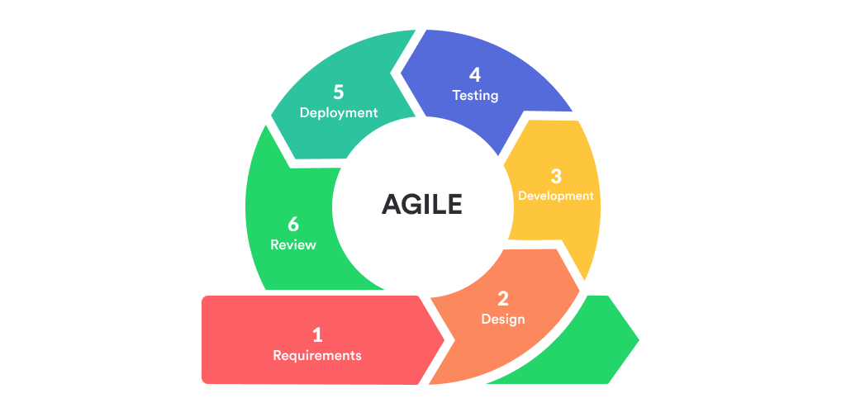
METHODOLOGY
SOFTWARE DEVELOPMENT LIFE CYCLE
SEQUENCE DIAGRAM
ERD (DATABASE DESIGN)
USER INTERFACE DESIGN (PROTOTYPE)
SOFTWARE PLATFORMS, DEVELOPMENT, ENVIRONMENTS & TOOLS
HARWARE REQUIREMENTS
RESEARCH ETHICAL STANDARDS
RESEARCH DESIGN
SYSTEM ARCHITECTURE
CONCEPTUAL FRAMEWORK
USE CASE DIAGRAM
ACTIVITY DIAGRAM
ALGORITHMS/
FRAMEWORK USED
SYSTEM EVALUATION
RESEARCH AND INSTRUCTIONAL INNOVATION DEPARTMENT

Slide 13
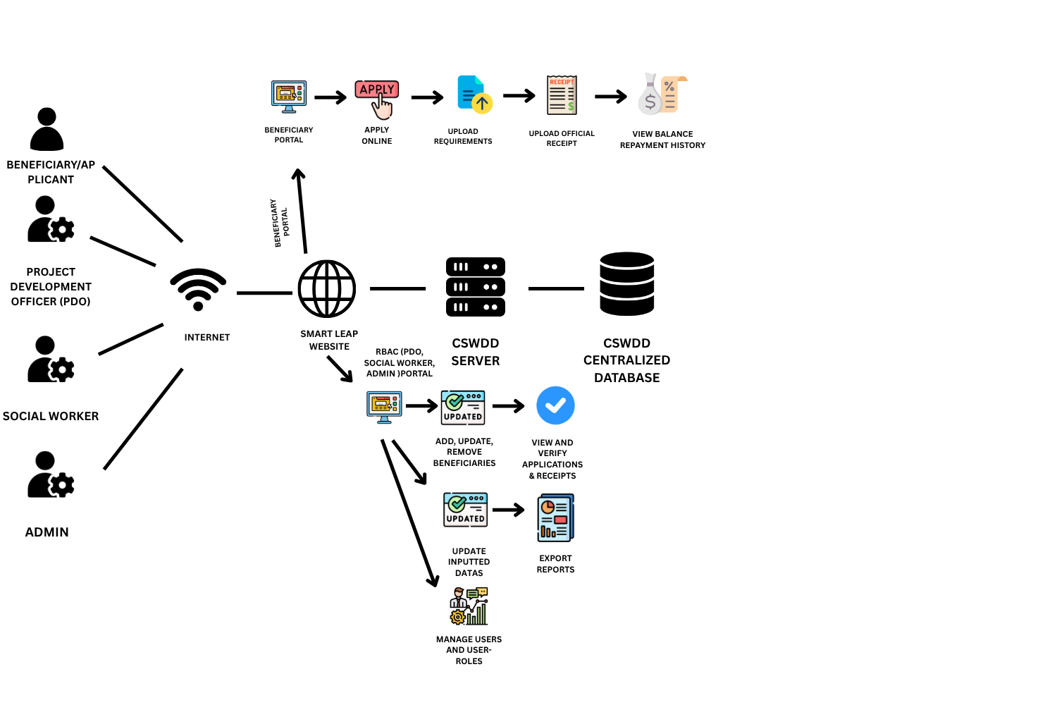
METHODOLOGY
SYSTEM ARCHITECTURE
SEQUENCE DIAGRAM
ERD (DATABASE DESIGN)
USER INTERFACE DESIGN (PROTOTYPE)
SOFTWARE PLATFORMS, DEVELOPMENT, ENVIRONMENTS & TOOLS
HARWARE REQUIREMENTS
RESEARCH ETHICAL STANDARDS
RESEARCH DESIGN
CONCEPTUAL FRAMEWORK
USE CASE DIAGRAM
ACTIVITY DIAGRAM
SOFTWARE DEVELOPMENT LIFE CYCLE
ALGORITHMS/
FRAMEWORK USED
SYSTEM EVALUATION
RESEARCH AND INSTRUCTIONAL INNOVATION DEPARTMENT

Slide 14
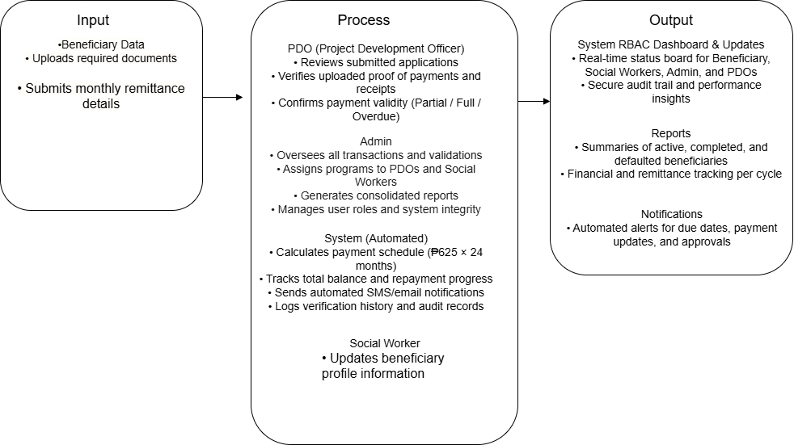
METHODOLOGY
CONCEPTUAL FRAMEWORK
ERD(DATABASE DESIGN)
USER INTERFACE DESIGN(PROTOTYPE)
SOFTWARE PLATFORMS, DEVELOPMENT, ENVIRONMENTS & TOOLS
HARWARE REQUIREMENTS
RESEARCH ETHICAL STANDARDS
RESEARCH DESIGN
ALGORITHMS/
FRAMEWORK USED
ACTIVITY DIAGRAM
SEQUENCE DIAGRAM
SOFTWARE DEVELOPMENT LIFE CYCLE
USE CASE DIAGRAM
SYSTEM EVALUATION
SYSTEM ARCHITECTURE
RESEARCH AND INSTRUCTIONAL INNOVATION DEPARTMENT

Slide 15
METHODOLOGY
ALGORITHMS/FRAMEWORK USED
ERD(DATABASE DESIGN)
USER INTERFACE DESIGN(PROTOTYPE)
SOFTWARE PLATFORMS, DEVELOPMENT, ENVIRONMENTS & TOOLS
HARWARE REQUIREMENTS
RESEARCH ETHICAL STANDARDS
RESEARCH DESIGN
ACTIVITY DIAGRAM
SEQUENCE DIAGRAM
SOFTWARE DEVELOPMENT LIFE CYCLE
USE CASE DIAGRAM
SYSTEM EVALUATION
SYSTEM ARCHITECTURE
CONCEPTUAL FRAMEWORK
RESEARCH AND INSTRUCTIONAL INNOVATION DEPARTMENT

Slide 16
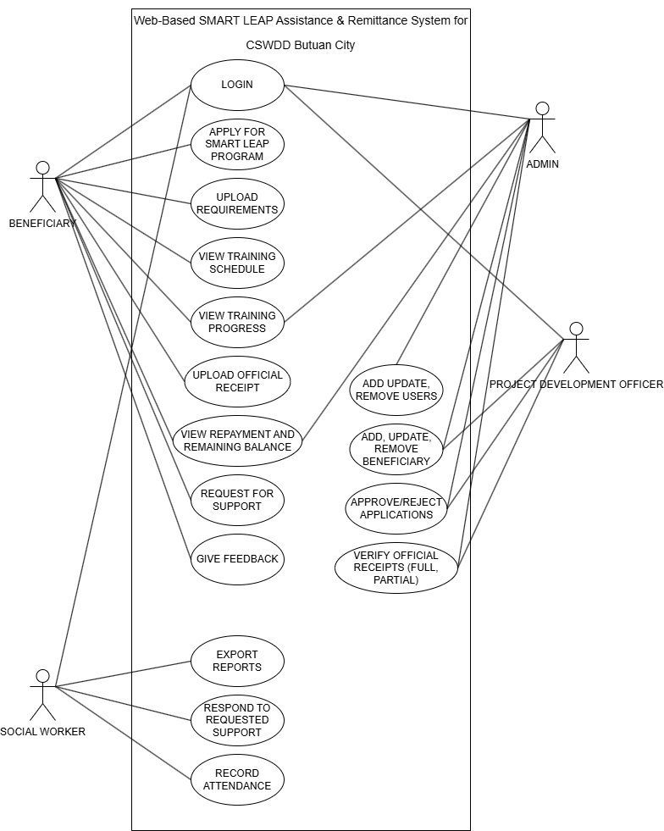
METHODOLOGY
USE CASE DIAGRAM
ERD(DATABASE DESIGN)
USER INTERFACE DESIGN(PROTOTYPE)
SOFTWARE PLATFORMS, DEVELOPMENT, ENVIRONMENTS & TOOLS
HARWARE REQUIREMENTS
RESEARCH ETHICAL STANDARDS
RESEARCH DESIGN
ACTIVITY DIAGRAM
SEQUENCE DIAGRAM
SOFTWARE DEVELOPMENT LIFE CYCLE
SYSTEM EVALUATION
SYSTEM ARCHITECTURE
CONCEPTUAL FRAMEWORK
ALGORITHMS /FRAMEWORK USED
RESEARCH AND INSTRUCTIONAL INNOVATION DEPARTMENT

Slide 17
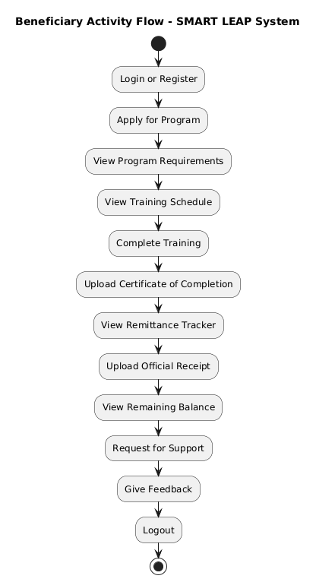
METHODOLOGY
RESEARCH DESIGN
SOFTWARE DEVELOPMENT LIFE CYCLE
SYSTEM ARCHITECTURE
CONCEPTUAL FRAMEWORK
ACTIVITY DIAGRAM
ALGORITHMS/FRAMEWORK USED
SEQUENCE DIAGRAM
ERD (DATABASE DESIGN)
USER INTERFACE DESIGN (PROTOTYPE)
SOFTWARE PLATFORMS, DEVELOPMENT, ENVIRONMENTS & TOOLS
HARWARE REQUIREMENTS
RESEARCH ETHICAL STANDARDS
USE CASE DIAGRAM
SYSTEM HARDWARE
RESEARCH AND INSTRUCTIONAL INNOVATION DEPARTMENT

Slide 18
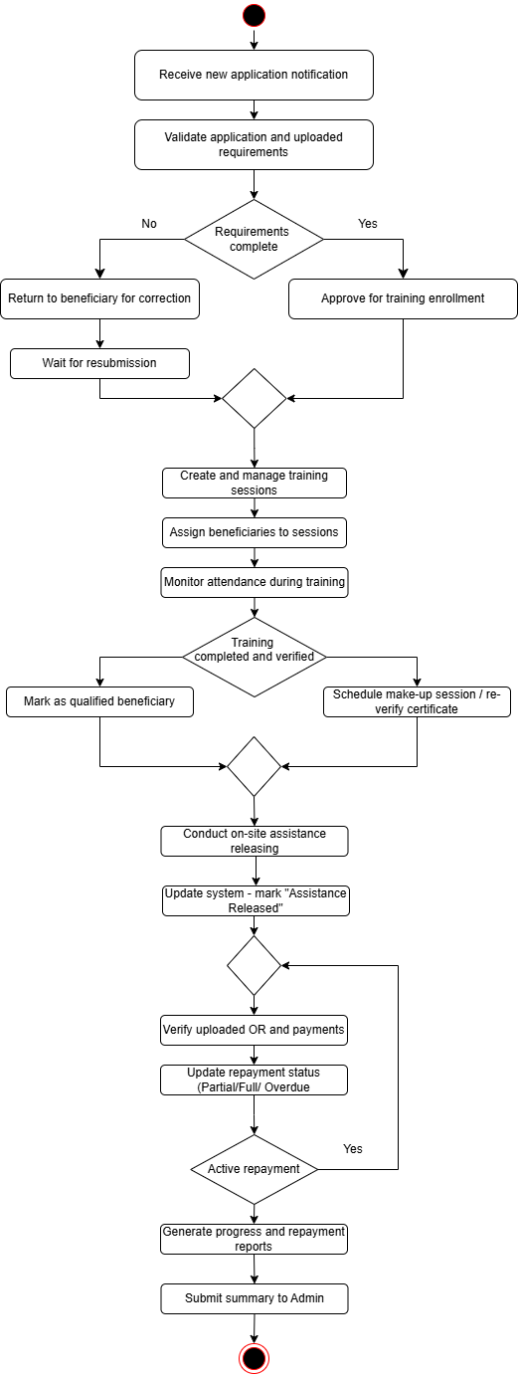
METHODOLOGY
RESEARCH DESIGN
SOFTWARE DEVELOPMENT LIFE CYCLE
SYSTEM ARCHITECTURE
CONCEPTUAL FRAMEWORK
ACTIVITY DIAGRAM
ALGORITHMS/FRAMEWORK USED
SEQUENCE DIAGRAM
ERD (DATABASE DESIGN)
USER INTERFACE DESIGN (PROTOTYPE)
SOFTWARE PLATFORMS, DEVELOPMENT, ENVIRONMENTS & TOOLS
HARWARE REQUIREMENTS
RESEARCH ETHICAL STANDARDS
USE CASE DIAGRAM
SYSTEM HARDWARE
PDO ACTIVITY DIAGRAM
RESEARCH AND INSTRUCTIONAL INNOVATION DEPARTMENT

Slide 19
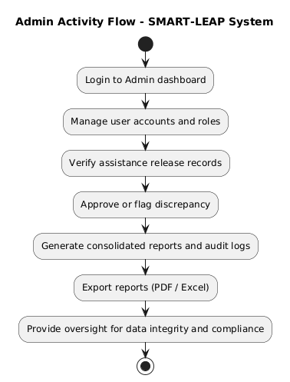
METHODOLOGY
RESEARCH DESIGN
SOFTWARE DEVELOPMENT LIFE CYCLE
SYSTEM ARCHITECTURE
CONCEPTUAL FRAMEWORK
ACTIVITY DIAGRAM
ALGORITHMS/FRAMEWORK USED
SEQUENCE DIAGRAM
ERD (DATABASE DESIGN)
USER INTERFACE DESIGN (PROTOTYPE)
SOFTWARE PLATFORMS, DEVELOPMENT, ENVIRONMENTS & TOOLS
HARWARE REQUIREMENTS
RESEARCH ETHICAL STANDARDS
USE CASE DIAGRAM
SYSTEM HARDWARE
RESEARCH AND INSTRUCTIONAL INNOVATION DEPARTMENT

Slide 20
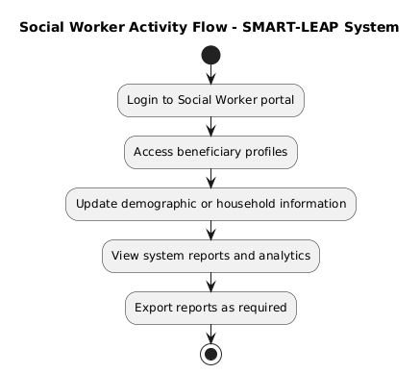
METHODOLOGY
RESEARCH DESIGN
SOFTWARE DEVELOPMENT LIFE CYCLE
SYSTEM ARCHITECTURE
CONCEPTUAL FRAMEWORK
ACTIVITY DIAGRAM
ALGORITHMS/FRAMEWORK USED
SEQUENCE DIAGRAM
ERD (DATABASE DESIGN)
USER INTERFACE DESIGN (PROTOTYPE)
SOFTWARE PLATFORMS, DEVELOPMENT, ENVIRONMENTS & TOOLS
HARWARE REQUIREMENTS
RESEARCH ETHICAL STANDARDS
USE CASE DIAGRAM
SYSTEM HARDWARE
RESEARCH AND INSTRUCTIONAL INNOVATION DEPARTMENT

Slide 21
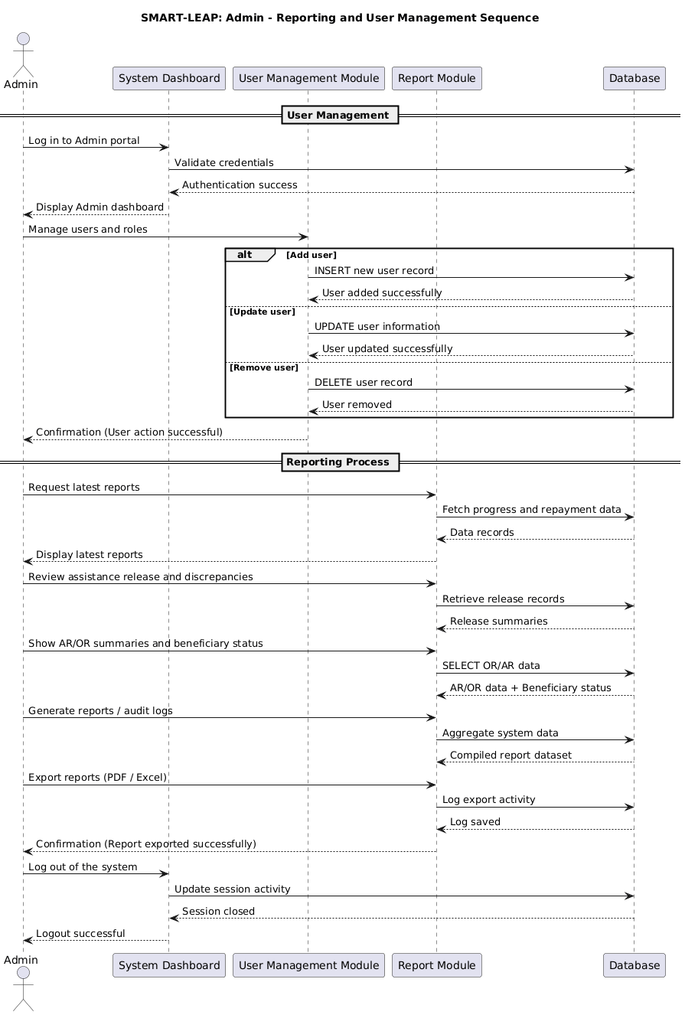
METHODOLOGY
RESEARCH DESIGN
SOFTWARE DEVELOPMENT LIFE CYCLE
SYSTEM ARCHITECTURE
CONCEPTUAL FRAMEWORK USED
SEQUENCE DIAGRAM
ALGORITHMS/FRAMEWORK USED
ERD (DATABASE DESIGN)
USER INTERFACE DESIGN(PROTOTYPE)
SOFTWARE PLATFORMS, DEVELOPMENT,ENVIRONMENTS & TOOLS
HARDWARE TOOLS
RESEARCH ETHICAL STANDARDS
USE CASE DIAGRAM
ACTIVITY DIAGRAM
SYSTEM EVALUATION
RESEARCH AND INSTRUCTIONAL INNOVATION DEPARTMENT

Slide 22
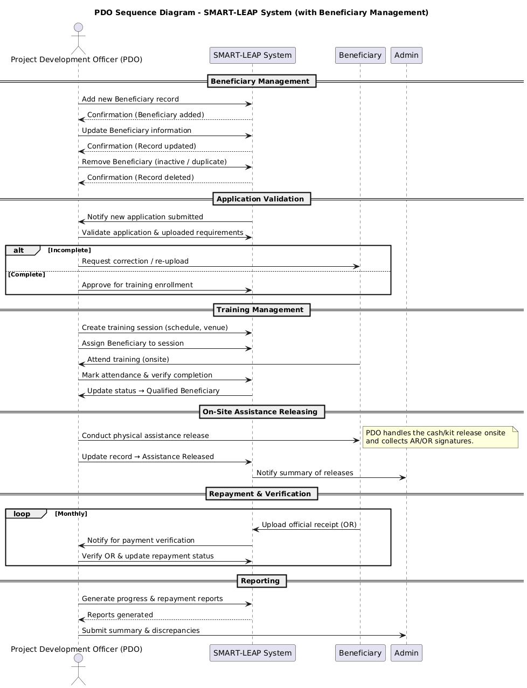
METHODOLOGY
RESEARCH DESIGN
SOFTWARE DEVELOPMENT LIFE CYCLE
SYSTEM ARCHITECTURE
CONCEPTUAL FRAMEWORK USED
SEQUENCE DIAGRAM
ALGORITHMS/FRAMEWORK USED
ERD (DATABASE DESIGN)
USER INTERFACE DESIGN(PROTOTYPE)
SOFTWARE PLATFORMS, DEVELOPMENT,ENVIRONMENTS & TOOLS
HARDWARE TOOLS
RESEARCH ETHICAL STANDARDS
USE CASE DIAGRAM
ACTIVITY DIAGRAM
SYSTEM EVALUATION
RESEARCH AND INSTRUCTIONAL INNOVATION DEPARTMENT

Slide 23
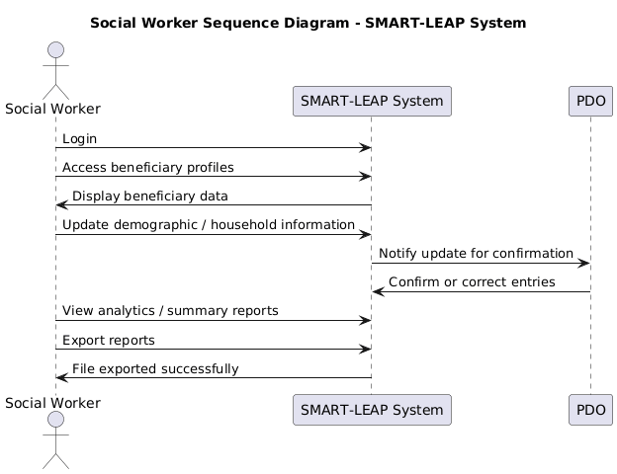
METHODOLOGY
RESEARCH DESIGN
SOFTWARE DEVELOPMENT LIFE CYCLE
SYSTEM ARCHITECTURE
CONCEPTUAL FRAMEWORK USED
SEQUENCE DIAGRAM
ALGORITHMS/FRAMEWORK USED
ERD (DATABASE DESIGN)
USER INTERFACE DESIGN(PROTOTYPE)
SOFTWARE PLATFORMS, DEVELOPMENT,ENVIRONMENTS & TOOLS
HARDWARE TOOLS
RESEARCH ETHICAL STANDARDS
USE CASE DIAGRAM
ACTIVITY DIAGRAM
SYSTEM EVALUATION
RESEARCH AND INSTRUCTIONAL INNOVATION DEPARTMENT

Slide 24
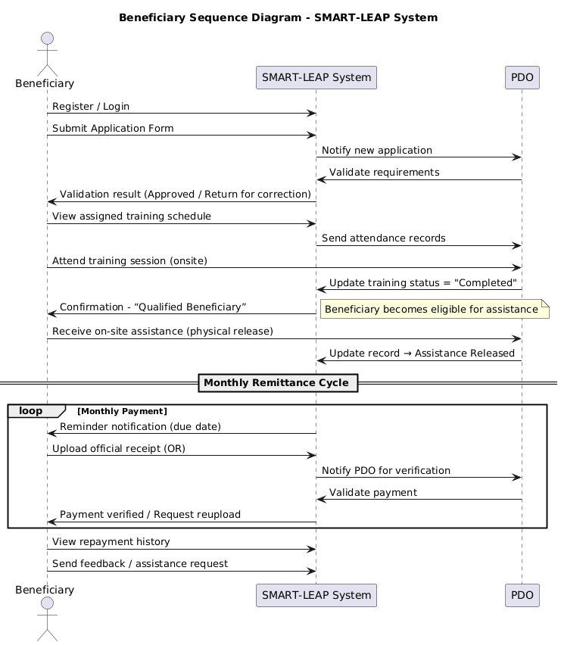
METHODOLOGY
RESEARCH DESIGN
SOFTWARE DEVELOPMENT LIFE CYCLE
SYSTEM ARCHITECTURE
CONCEPTUAL FRAMEWORK USED
SEQUENCE DIAGRAM
ALGORITHMS/FRAMEWORK USED
ERD (DATABASE DESIGN)
USER INTERFACE DESIGN(PROTOTYPE)
SOFTWARE PLATFORMS, DEVELOPMENT,ENVIRONMENTS & TOOLS
HARDWARE TOOLS
RESEARCH ETHICAL STANDARDS
USE CASE DIAGRAM
ACTIVITY DIAGRAM
SYSTEM EVALUATION
RESEARCH AND INSTRUCTIONAL INNOVATION DEPARTMENT

Slide 25
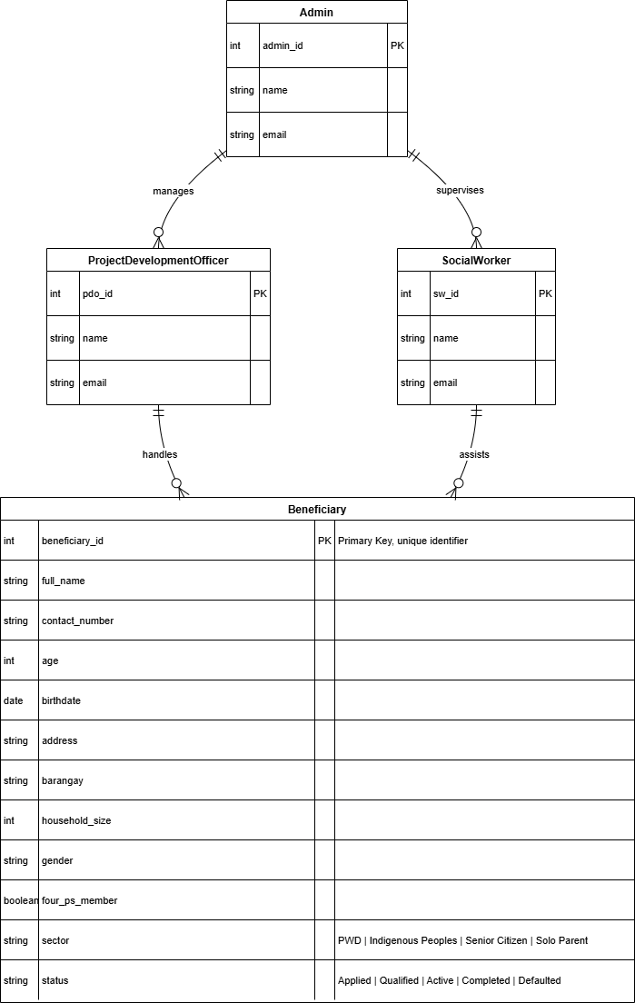
METHODOLOGY
RESEARCH DESIGN
SOFTWARE DEVELOPMENT LIFE CYCLE
SYSTEM ARCHITECTURE
CONCEPTUAL FRAMEWORK USED
ERD (DATABASE DESIGN)
ALGORITHMS/FRAMEWORK USED
USER INTERFACE DESIGN(PROTOTYPE)
SOFTWARE PLATFORMS, DEVELOPMENT,ENVIRONMENTS & TOOLS
HARDWARE TOOLS
RESEARCH ETHICAL STANDARDS
USE CASE DIAGRAM
ACTIVITY DIAGRAM
SEQUENCE DIAGRAM
SYSTEM EVALUATION
RESEARCH AND INSTRUCTIONAL INNOVATION DEPARTMENT

Slide 26
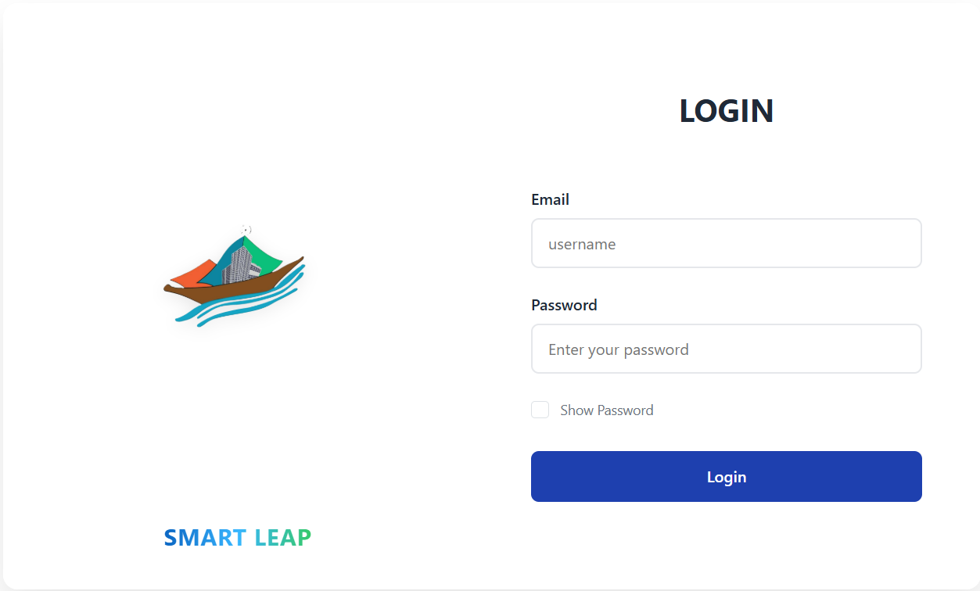
METHODOLOGY
RESEARCH DESIGN
SOFTWARE DEVELOPMENT LIFE CYCLE
SYSTEM ARCHITECTURE
CONCEPTUAL FRAMEWORK USED
USER INTERFACE DESIGN (PROTOTYPE)
ALGORITHMS/FRAMEWORK USED
SOFTWARE PLATFORMS, DEVELOPMENT,ENVIRONMENTS & TOOLS
HARDWARE TOOLS
RESEARCH ETHICAL STANDARDS
USE CASE DIAGRAM
ACTIVITY DIAGRAM
SEQUENCE DIAGRAM
ERD(DATABASE DESIGN)
SYSTEM EVALUATION
Figure 14. Login Page (Admin, PDO, Social Worker)
RESEARCH AND INSTRUCTIONAL INNOVATION DEPARTMENT

Slide 27
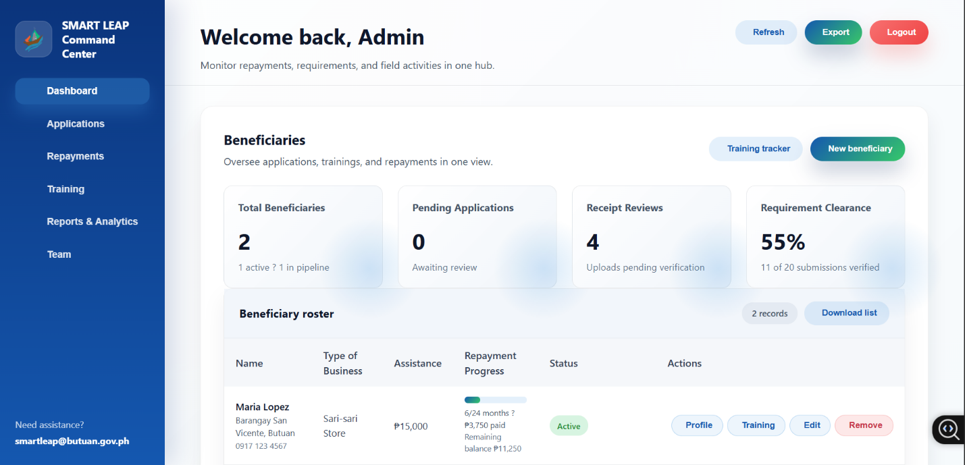
METHODOLOGY
RESEARCH DESIGN
SOFTWARE DEVELOPMENT LIFE CYCLE
SYSTEM ARCHITECTURE
CONCEPTUAL FRAMEWORK USED
USER INTERFACE DESIGN (PROTOTYPE)
ALGORITHMS/FRAMEWORK USED
SOFTWARE PLATFORMS, DEVELOPMENT,ENVIRONMENTS & TOOLS
HARDWARE TOOLS
RESEARCH ETHICAL STANDARDS
USE CASE DIAGRAM
ACTIVITY DIAGRAM
SEQUENCE DIAGRAM
ERD(DATABASE DESIGN)
SYSTEM EVALUATION
Figure 15. Admin Dashboard
RESEARCH AND INSTRUCTIONAL INNOVATION DEPARTMENT

Slide 28
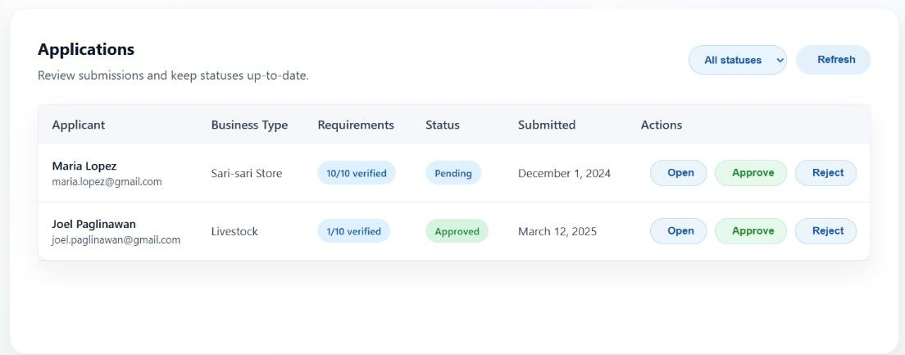
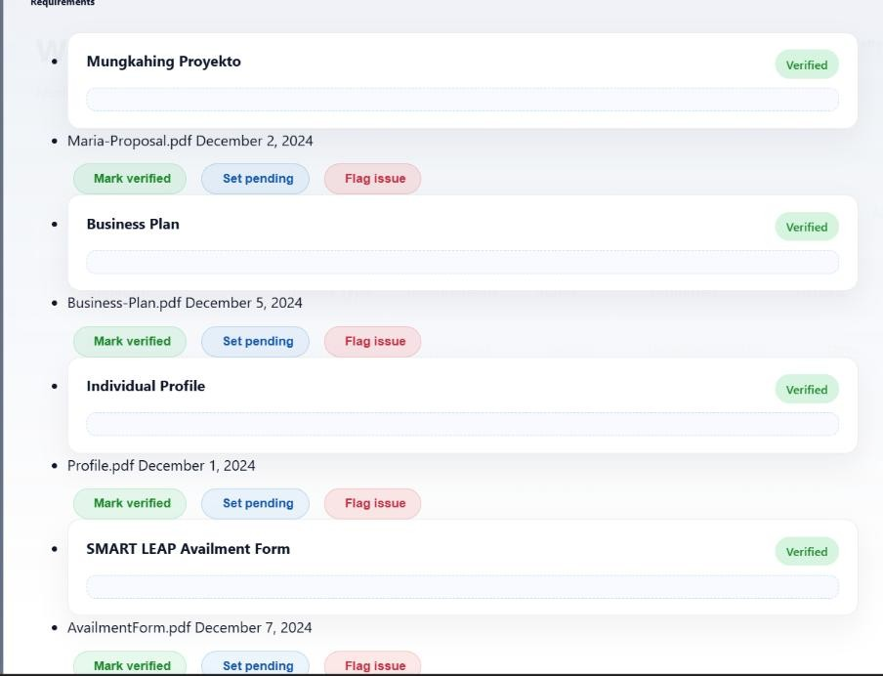
METHODOLOGY
RESEARCH DESIGN
SOFTWARE DEVELOPMENT LIFE CYCLE
SYSTEM ARCHITECTURE
CONCEPTUAL FRAMEWORK USED
USER INTERFACE DESIGN (PROTOTYPE)
ALGORITHMS/FRAMEWORK USED
SOFTWARE PLATFORMS, DEVELOPMENT,ENVIRONMENTS & TOOLS
HARDWARE TOOLS
RESEARCH ETHICAL STANDARDS
USE CASE DIAGRAM
ACTIVITY DIAGRAM
SEQUENCE DIAGRAM
ERD(DATABASE DESIGN)
SYSTEM EVALUATION
Figure 16. Admin & PDO Application Management
RESEARCH AND INSTRUCTIONAL INNOVATION DEPARTMENT

Slide 29
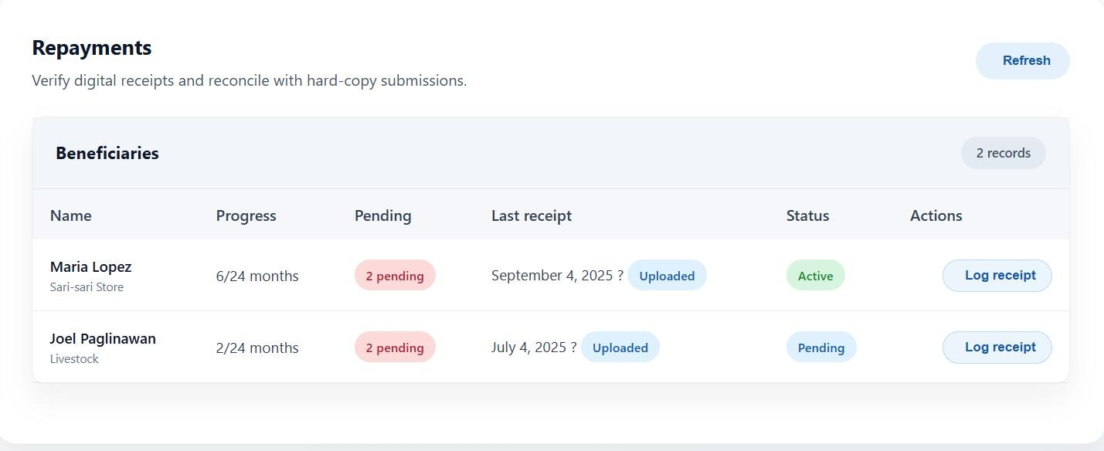
METHODOLOGY
RESEARCH DESIGN
SOFTWARE DEVELOPMENT LIFE CYCLE
SYSTEM ARCHITECTURE
CONCEPTUAL FRAMEWORK USED
USER INTERFACE DESIGN (PROTOTYPE)
ALGORITHMS/FRAMEWORK USED
SOFTWARE PLATFORMS, DEVELOPMENT,ENVIRONMENTS & TOOLS
HARDWARE TOOLS
RESEARCH ETHICAL STANDARDS
USE CASE DIAGRAM
ACTIVITY DIAGRAM
SEQUENCE DIAGRAM
ERD(DATABASE DESIGN)
SYSTEM EVALUATION
Figure 17. Repayments(Admin & PDO)
RESEARCH AND INSTRUCTIONAL INNOVATION DEPARTMENT

Slide 30
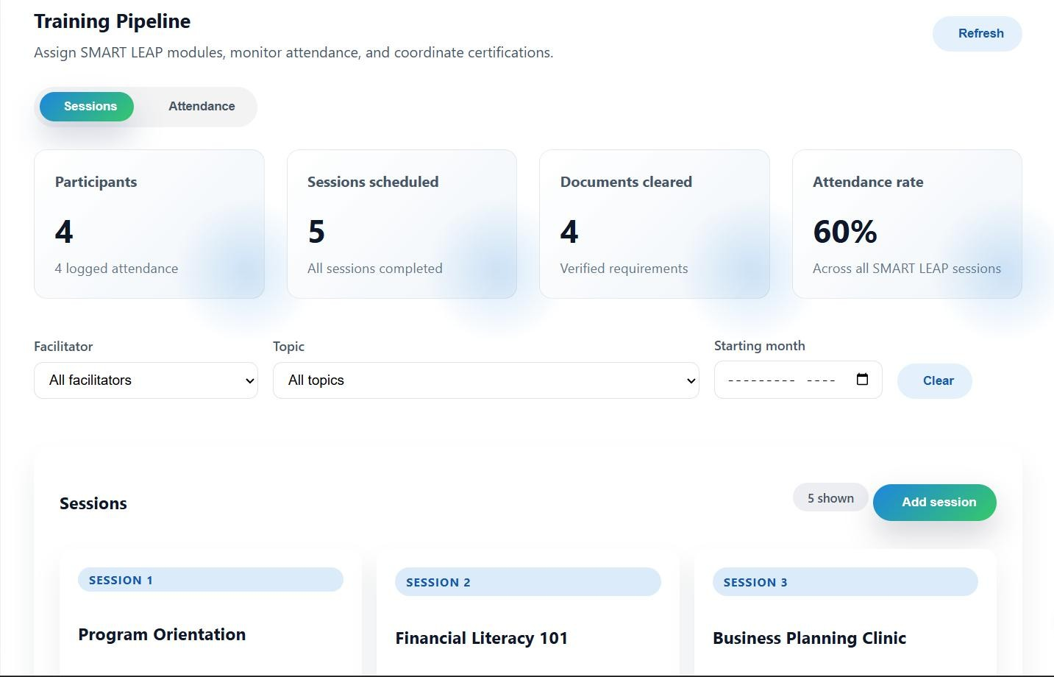
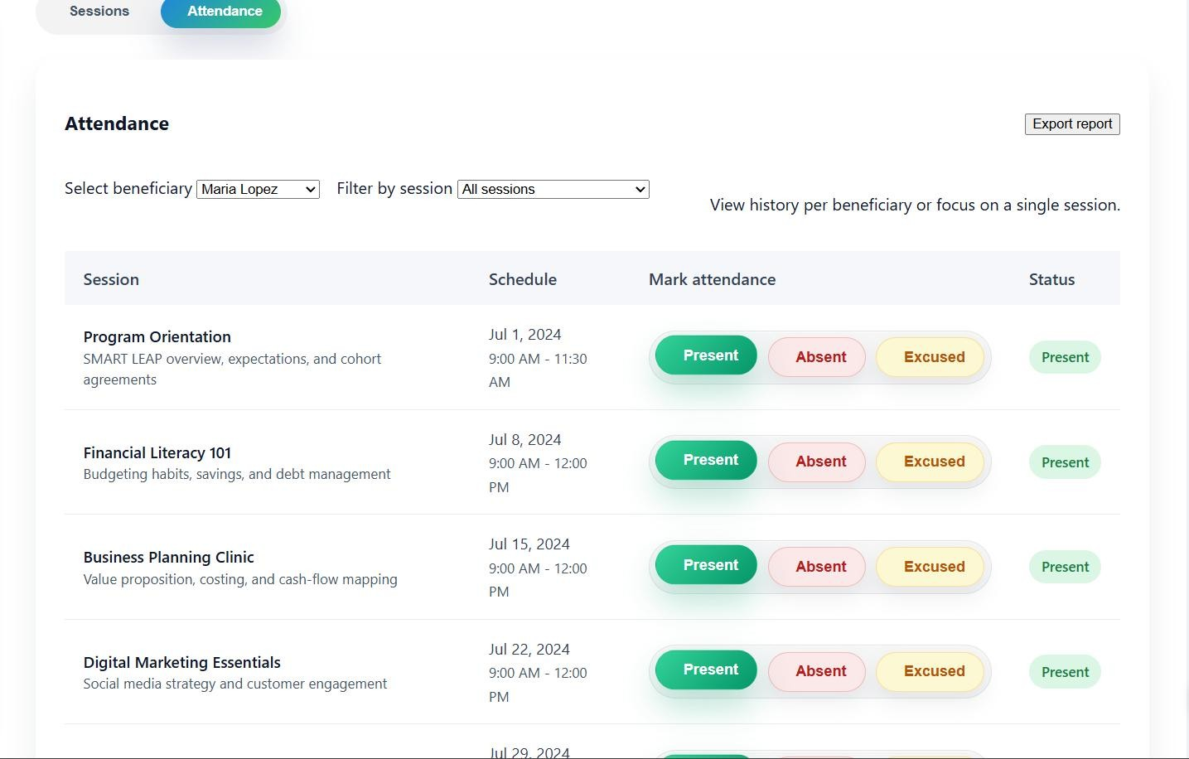
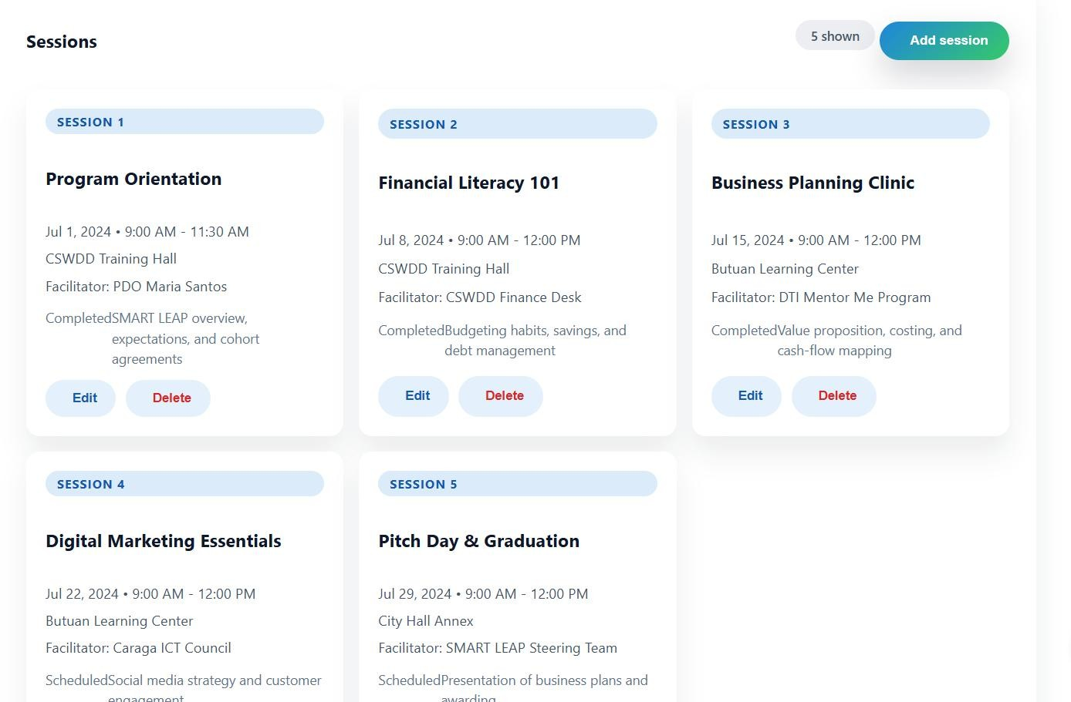
METHODOLOGY
RESEARCH DESIGN
SOFTWARE DEVELOPMENT LIFE CYCLE
SYSTEM ARCHITECTURE
CONCEPTUAL FRAMEWORK USED
USER INTERFACE DESIGN (PROTOTYPE)
ALGORITHMS/FRAMEWORK USED
SOFTWARE PLATFORMS, DEVELOPMENT,ENVIRONMENTS & TOOLS
HARDWARE TOOLS
RESEARCH ETHICAL STANDARDS
USE CASE DIAGRAM
ACTIVITY DIAGRAM
SEQUENCE DIAGRAM
ERD(DATABASE DESIGN)
SYSTEM EVALUATION
Figure 18. Training (Admin & PDO)
RESEARCH AND INSTRUCTIONAL INNOVATION DEPARTMENT

Slide 31
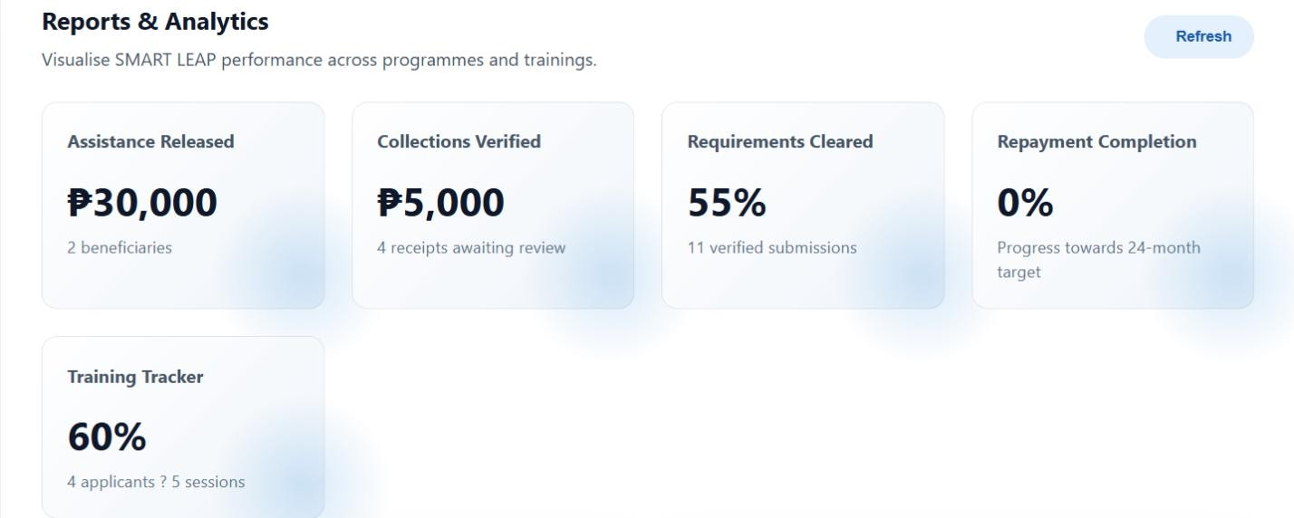
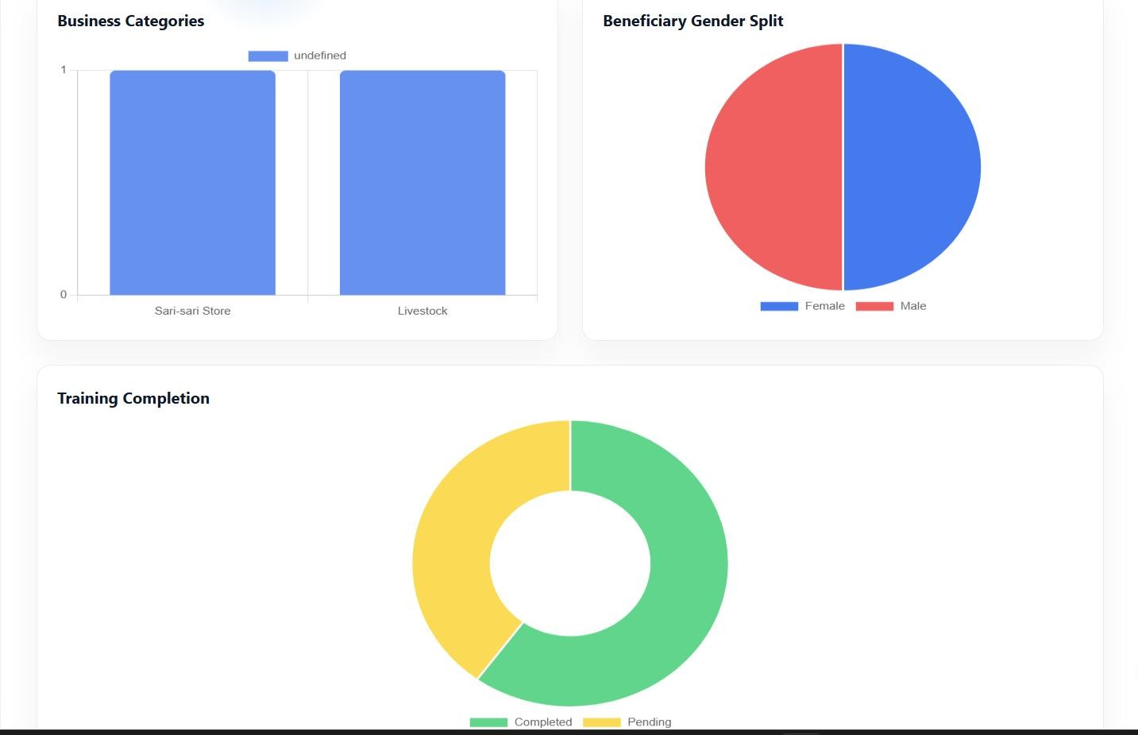
METHODOLOGY
RESEARCH DESIGN
SOFTWARE DEVELOPMENT LIFE CYCLE
SYSTEM ARCHITECTURE
CONCEPTUAL FRAMEWORK USED
USER INTERFACE DESIGN (PROTOTYPE)
ALGORITHMS/FRAMEWORK USED
SOFTWARE PLATFORMS, DEVELOPMENT,ENVIRONMENTS & TOOLS
HARDWARE TOOLS
RESEARCH ETHICAL STANDARDS
USE CASE DIAGRAM
ACTIVITY DIAGRAM
SEQUENCE DIAGRAM
ERD(DATABASE DESIGN)
SYSTEM EVALUATION
Figure 19. Reports & Analytics (Admin)
RESEARCH AND INSTRUCTIONAL INNOVATION DEPARTMENT

Slide 32
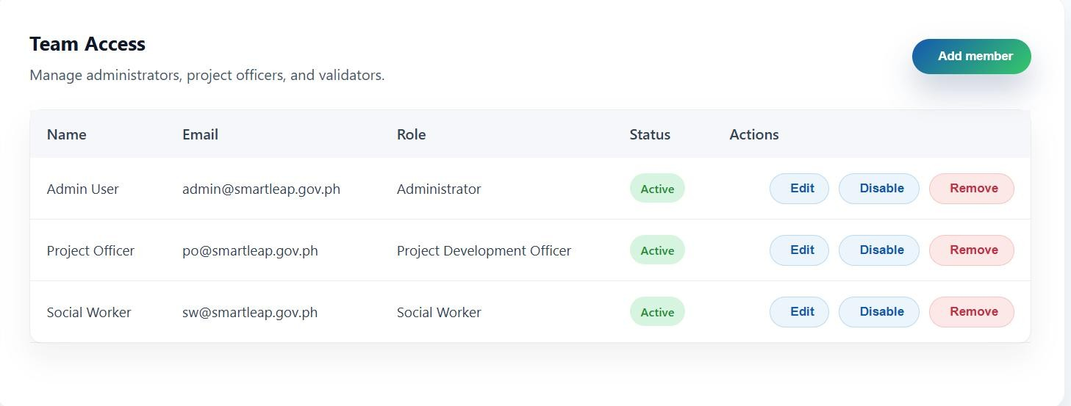
METHODOLOGY
RESEARCH DESIGN
SOFTWARE DEVELOPMENT LIFE CYCLE
SYSTEM ARCHITECTURE
CONCEPTUAL FRAMEWORK USED
USER INTERFACE DESIGN (PROTOTYPE)
ALGORITHMS/FRAMEWORK USED
SOFTWARE PLATFORMS, DEVELOPMENT,ENVIRONMENTS & TOOLS
HARDWARE TOOLS
RESEARCH ETHICAL STANDARDS
USE CASE DIAGRAM
ACTIVITY DIAGRAM
SEQUENCE DIAGRAM
ERD(DATABASE DESIGN)
SYSTEM EVALUATION
Figure 20. User Management (Admin)
RESEARCH AND INSTRUCTIONAL INNOVATION DEPARTMENT

Slide 33
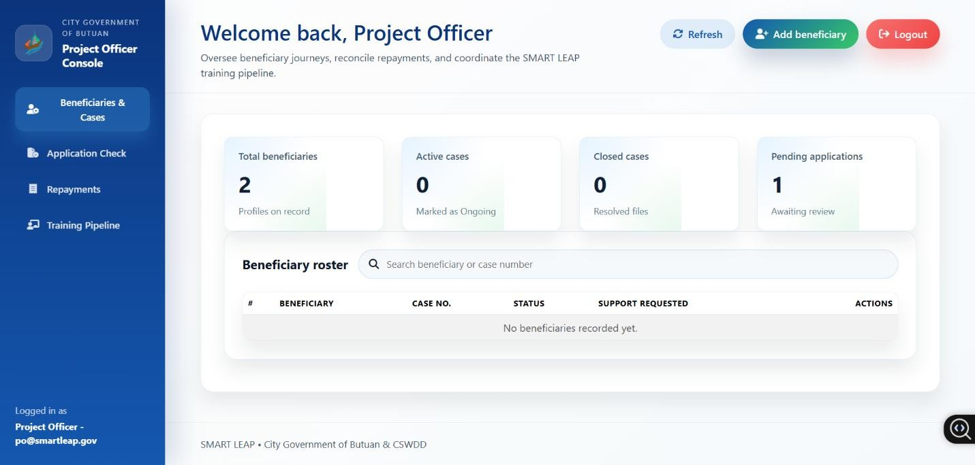
METHODOLOGY
RESEARCH DESIGN
SOFTWARE DEVELOPMENT LIFE CYCLE
SYSTEM ARCHITECTURE
CONCEPTUAL FRAMEWORK USED
USER INTERFACE DESIGN (PROTOTYPE)
ALGORITHMS/FRAMEWORK USED
SOFTWARE PLATFORMS, DEVELOPMENT,ENVIRONMENTS & TOOLS
HARDWARE TOOLS
RESEARCH ETHICAL STANDARDS
USE CASE DIAGRAM
ACTIVITY DIAGRAM
SEQUENCE DIAGRAM
ERD(DATABASE DESIGN)
SYSTEM EVALUATION
Figure 21. PDO Dashboard
RESEARCH AND INSTRUCTIONAL INNOVATION DEPARTMENT

Slide 34
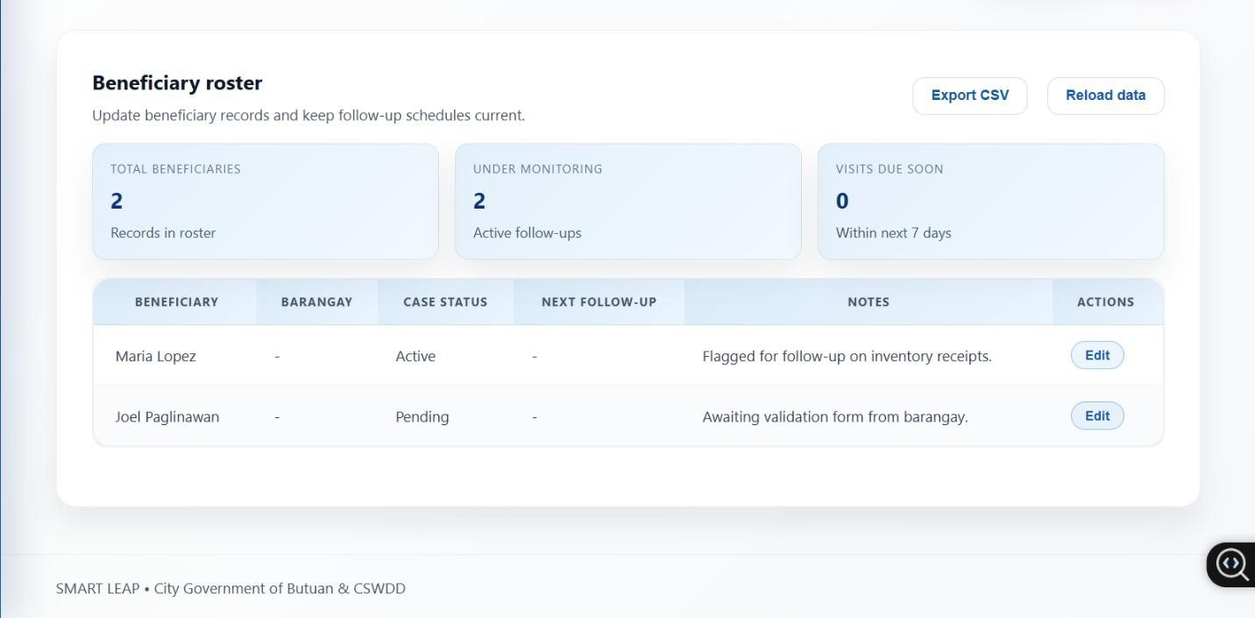
METHODOLOGY
RESEARCH DESIGN
SOFTWARE DEVELOPMENT LIFE CYCLE
SYSTEM ARCHITECTURE
CONCEPTUAL FRAMEWORK USED
USER INTERFACE DESIGN (PROTOTYPE)
ALGORITHMS/FRAMEWORK USED
SOFTWARE PLATFORMS, DEVELOPMENT,ENVIRONMENTS & TOOLS
HARDWARE TOOLS
RESEARCH ETHICAL STANDARDS
USE CASE DIAGRAM
ACTIVITY DIAGRAM
SEQUENCE DIAGRAM
ERD(DATABASE DESIGN)
SYSTEM EVALUATION
Figure 22. Social Worker Dashboard
RESEARCH AND INSTRUCTIONAL INNOVATION DEPARTMENT

Slide 35
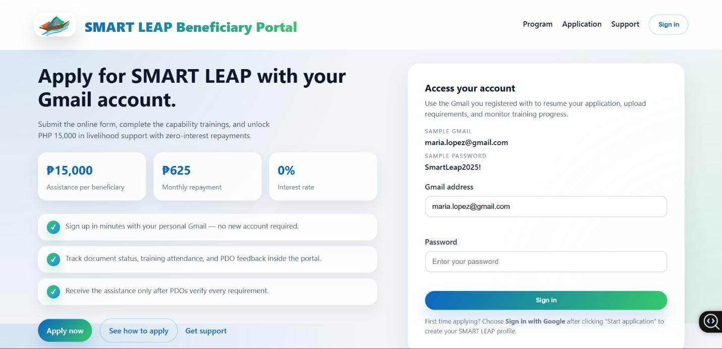
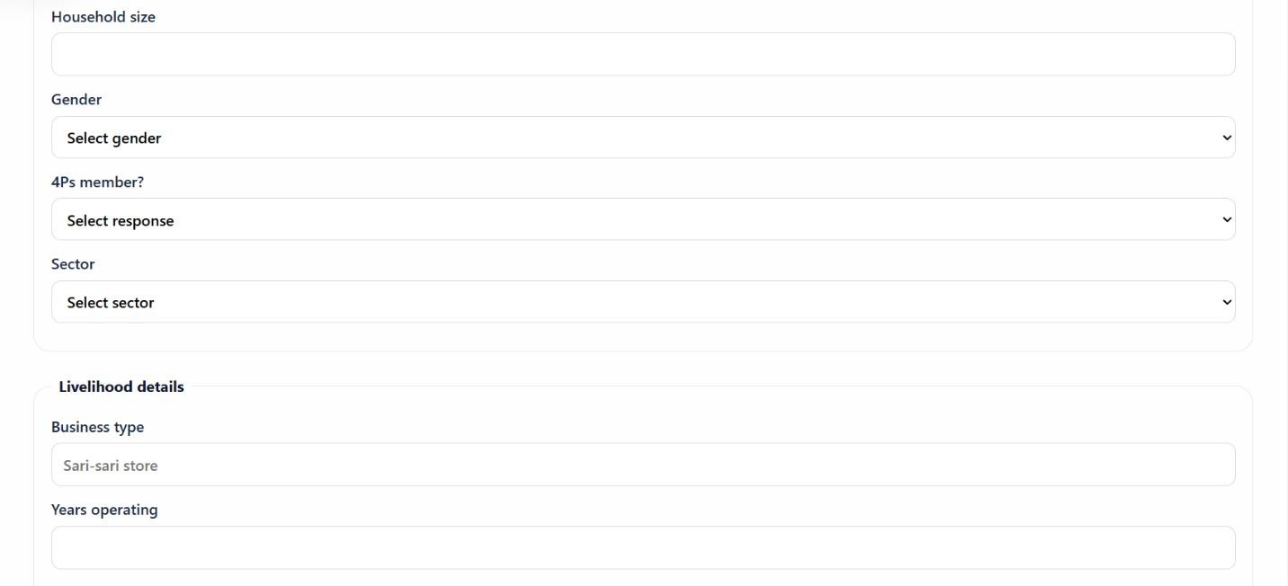
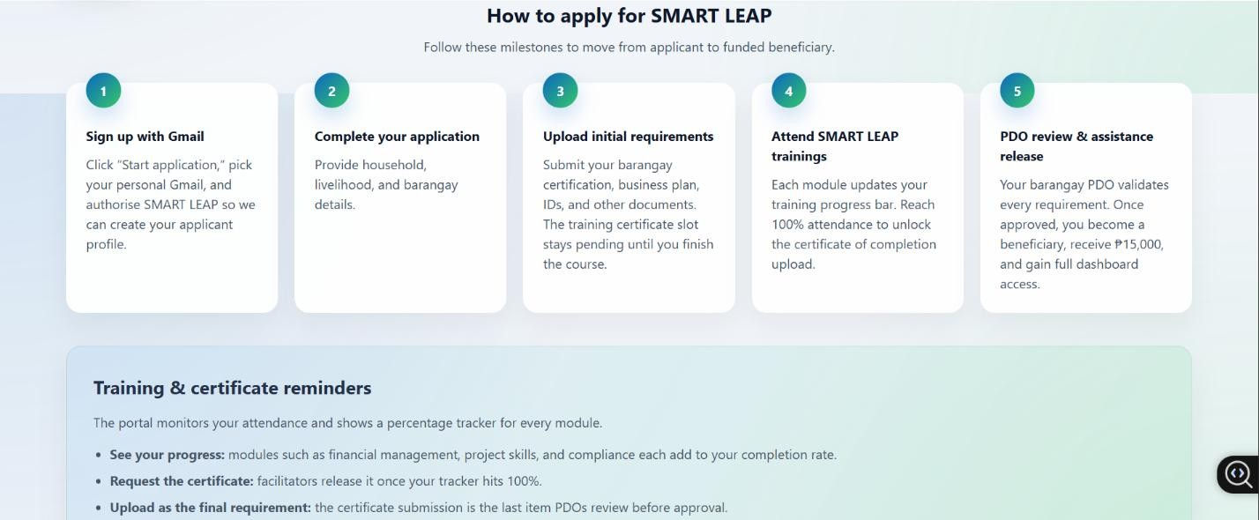
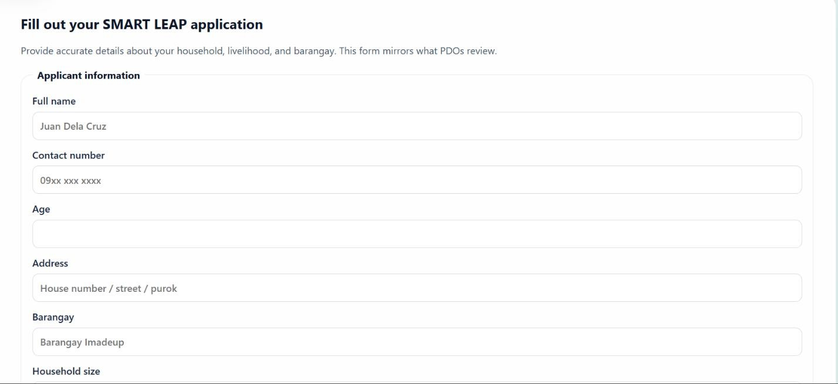
METHODOLOGY
RESEARCH DESIGN
SOFTWARE DEVELOPMENT LIFE CYCLE
SYSTEM ARCHITECTURE
CONCEPTUAL FRAMEWORK USED
USER INTERFACE DESIGN (PROTOTYPE)
ALGORITHMS/FRAMEWORK USED
SOFTWARE PLATFORMS, DEVELOPMENT,ENVIRONMENTS & TOOLS
HARDWARE TOOLS
RESEARCH ETHICAL STANDARDS
USE CASE DIAGRAM
ACTIVITY DIAGRAM
SEQUENCE DIAGRAM
ERD(DATABASE DESIGN)
SYSTEM EVALUATION
Figure 23. Beneficiary Portal
RESEARCH AND INSTRUCTIONAL INNOVATION DEPARTMENT

Slide 36
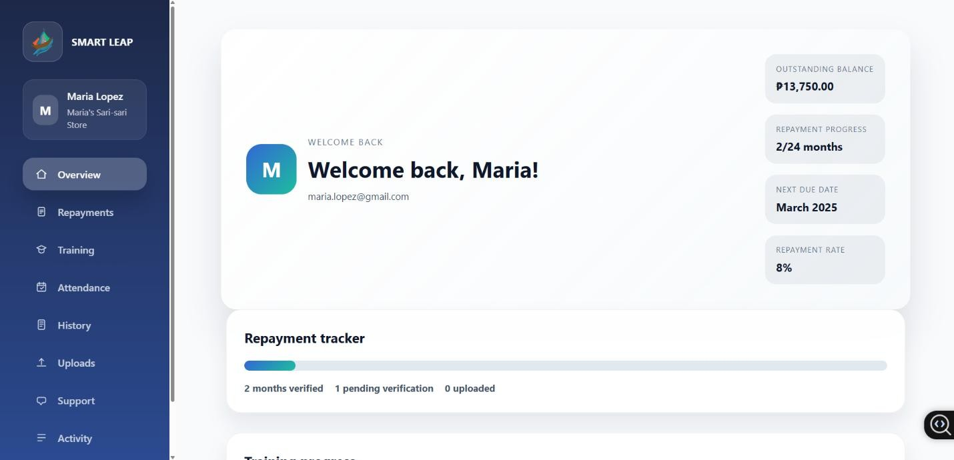
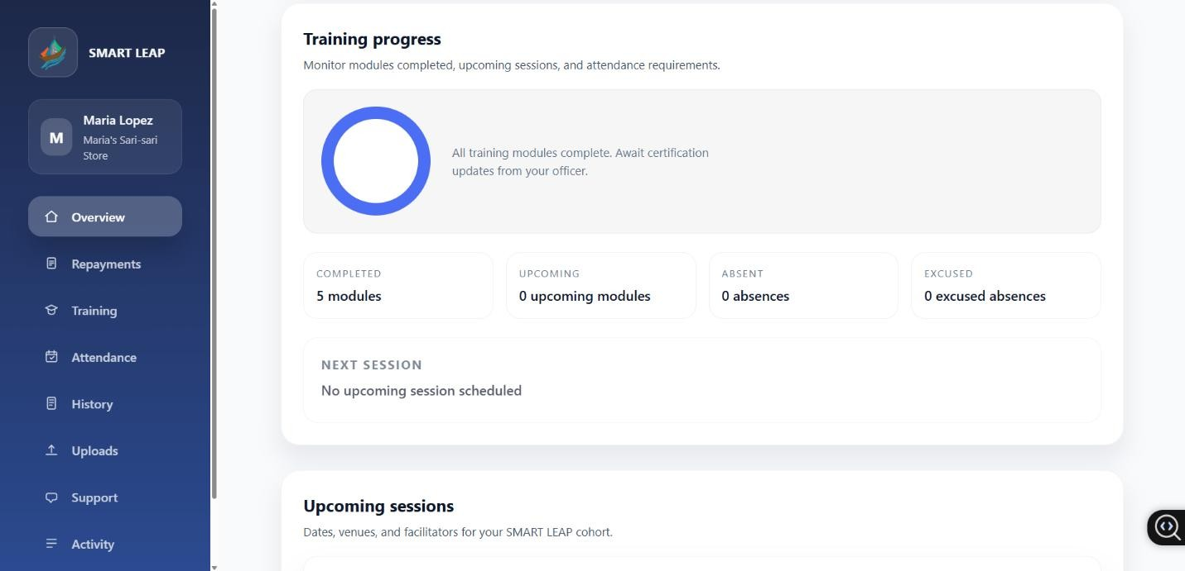
METHODOLOGY
RESEARCH DESIGN
SOFTWARE DEVELOPMENT LIFE CYCLE
SYSTEM ARCHITECTURE
CONCEPTUAL FRAMEWORK USED
USER INTERFACE DESIGN (PROTOTYPE)
ALGORITHMS/FRAMEWORK USED
SOFTWARE PLATFORMS, DEVELOPMENT,ENVIRONMENTS & TOOLS
HARDWARE TOOLS
RESEARCH ETHICAL STANDARDS
USE CASE DIAGRAM
ACTIVITY DIAGRAM
SEQUENCE DIAGRAM
ERD(DATABASE DESIGN)
SYSTEM EVALUATION
Figure 24. Beneficiary Dashboard
RESEARCH AND INSTRUCTIONAL INNOVATION DEPARTMENT

Slide 37
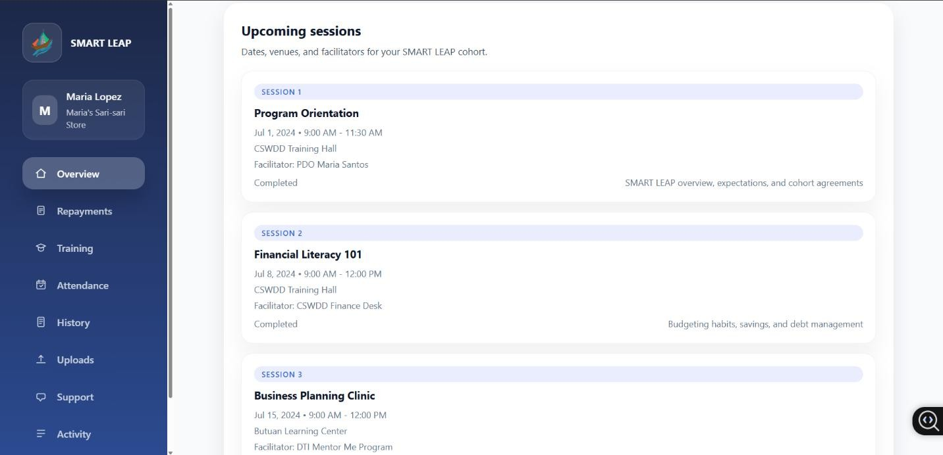
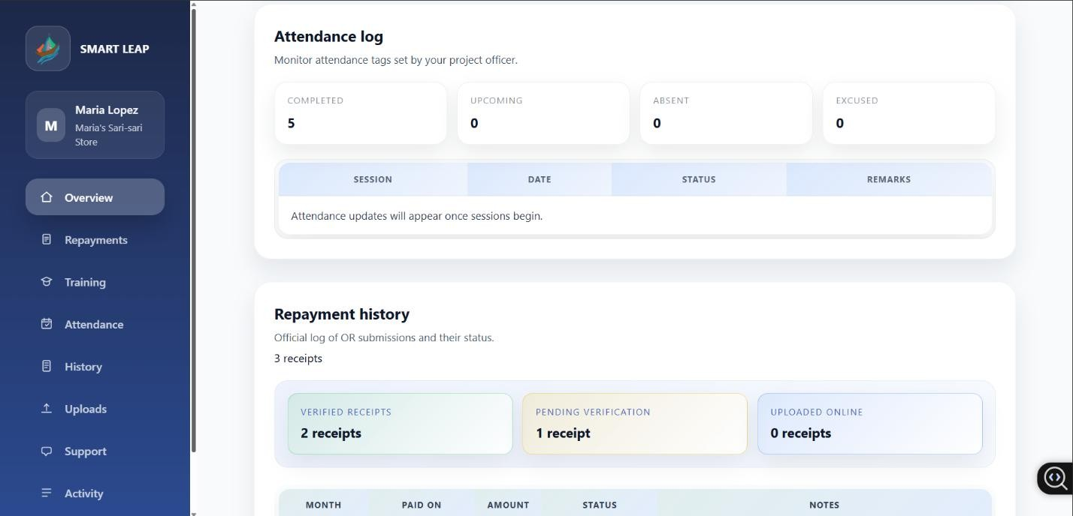
METHODOLOGY
RESEARCH DESIGN
SOFTWARE DEVELOPMENT LIFE CYCLE
SYSTEM ARCHITECTURE
CONCEPTUAL FRAMEWORK USED
USER INTERFACE DESIGN (PROTOTYPE)
ALGORITHMS/FRAMEWORK USED
SOFTWARE PLATFORMS, DEVELOPMENT,ENVIRONMENTS & TOOLS
HARDWARE TOOLS
RESEARCH ETHICAL STANDARDS
USE CASE DIAGRAM
ACTIVITY DIAGRAM
SEQUENCE DIAGRAM
ERD(DATABASE DESIGN)
SYSTEM EVALUATION
Figure 24. Beneficiary Dashboard
RESEARCH AND INSTRUCTIONAL INNOVATION DEPARTMENT

Slide 38
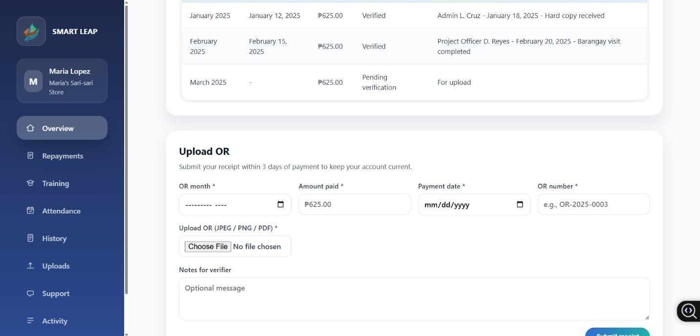
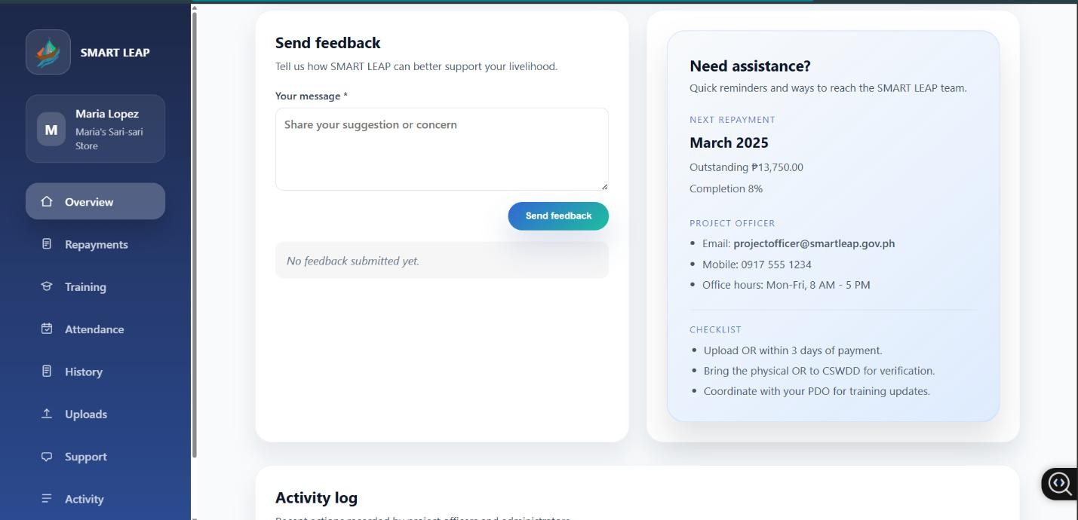
METHODOLOGY
RESEARCH DESIGN
SOFTWARE DEVELOPMENT LIFE CYCLE
SYSTEM ARCHITECTURE
CONCEPTUAL FRAMEWORK USED
USER INTERFACE DESIGN (PROTOTYPE)
ALGORITHMS/FRAMEWORK USED
SOFTWARE PLATFORMS, DEVELOPMENT,ENVIRONMENTS & TOOLS
HARDWARE TOOLS
RESEARCH ETHICAL STANDARDS
USE CASE DIAGRAM
ACTIVITY DIAGRAM
SEQUENCE DIAGRAM
ERD(DATABASE DESIGN)
SYSTEM EVALUATION
Figure 24. Beneficiary Dashboard
RESEARCH AND INSTRUCTIONAL INNOVATION DEPARTMENT

Slide 39
METHODOLOGY
RESEARCH DESIGN
SOFTWARE DEVELOPMENT LIFE CYCLE
SYSTEM ARCHITECTURE
CONCEPTUAL FRAMEWORK USED
SOFTWARE PLATFORMS,DEVELOPMENT,ENVIRONMENTS & TOOLS
ALGORITHMS/
FRAMEWORK USED
HARDWARE REQUIREMENTS
RESEARCH ETHICAL STANDARDS
USE CASE DIAGRAM
ACTIVITY DIAGRAM
SEQUENCE DIAGRAM
ERD(DATABASE DESIGN)
USER INTERFACE DESIGN(PROTOTYPE)
SYSTEM EVALUATION
RESEARCH AND INSTRUCTIONAL INNOVATION DEPARTMENT

Slide 40
METHODOLOGY
RESEARCH DESIGN
SOFTWARE DEVELOPMENT LIFE CYCLE
SYSTEM ARCHITECTURE
CONCEPTUAL FRAMEWORK USED
HARDWARE REQUIREMENTS
ALGORITHMS/FRAMEWORK USED
RESEARCH ETHICAL STANDARDS
USE CASE DIAGRAM
ACTIVITY DIAGRAM
SEQUENCE DIAGRAM
ERD(DATABASE DESIGN)
USER INTERFACE DESIGN(PROTOTYPE)
SOFTWARE PLATFORMS,DEVELOPMENT, ENVIRONMENTS & TOOLS
SYSTEM EVALUATION
RESEARCH AND INSTRUCTIONAL INNOVATION DEPARTMENT

Slide 41
METHODOLOGY
RESEARCH DESIGN
SOFTWARE DEVELOPMENT LIFE CYCLE
SYSTEM ARCHITECTURE
CONCEPTUAL FRAMEWORK USED
SYSTEM EVALUATION
ALGORITHMS/FRAMEWORK USED
USE CASE DIAGRAM
ACTIVITY DIAGRAM
SEQUENCE DIAGRAM
ERD(DATABASE DESIGN)
USER INTERFACE DESIGN(PROTOTYPE)
SOFTWARE PLATFORMS,DEVELOPMENT, ENVIRONMENTS & TOOLS
RESEARCH ETHICAL STANDARDS
HARDWARE REQUIREMENTS
RESEARCH AND INSTRUCTIONAL INNOVATION DEPARTMENT

Slide 42
METHODOLOGY
RESEARCH DESIGN
SOFTWARE DEVELOPMENT LIFE CYCLE
SYSTEM ARCHITECTURE
CONCEPTUAL FRAMEWORK USED
SYSTEM EVALUATION
ALGORITHMS/FRAMEWORK USED
USE CASE DIAGRAM
ACTIVITY DIAGRAM
SEQUENCE DIAGRAM
ERD(DATABASE DESIGN)
USER INTERFACE DESIGN(PROTOTYPE)
SOFTWARE PLATFORMS,DEVELOPMENT, ENVIRONMENTS & TOOLS
RESEARCH ETHICAL STANDARDS
HARDWARE REQUIREMENTS
TIP CORNER
(Delete this after reading)
Just provide the information briefly
ETHICAL CONSIDERATIONS (A-M)
RESEARCH AND INSTRUCTIONAL INNOVATION DEPARTMENT

Slide 43
REFERENCES
RESEARCH AND INSTRUCTIONAL INNOVATION DEPARTMENT

