Slide 1
AI Tax Planner
Shaik Teeb Hussain
21011101115
Samanthu Abhay Reddy
21011101110
Shaik Mohammad Noor
21011101114
Dhayal Kumar
Shiv Nadar University Chennai

Slide 2
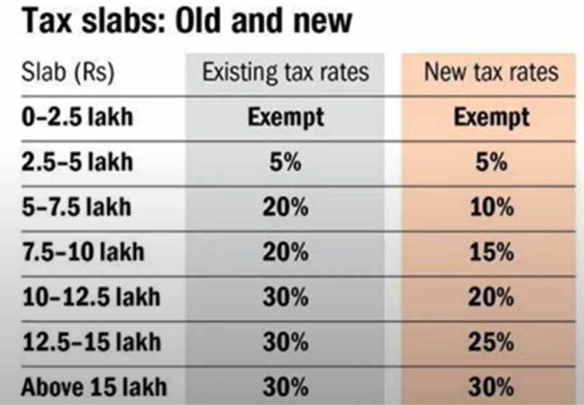
INCOME TAX
Income tax is a tax imposed by the government on income earned by individuals and businesses during a financial year. It serves as a key source of funds for the government to finance its activities its activities and provide public services

Slide 3
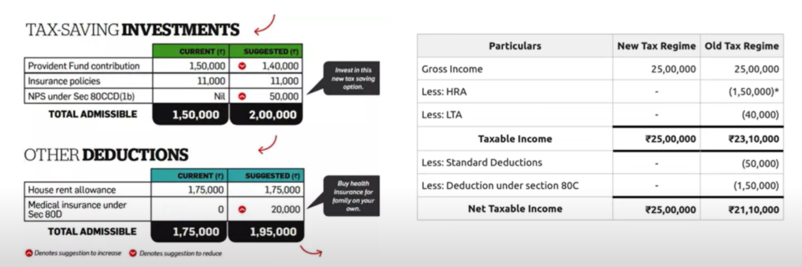
Income tax planner involves leveraging strategies such as tax-efficient investments, deductions, and credits to minimize your tax liability.

Slide 4
Problem Statement -
Develop an intelligent tax planner using Generative AI technologies to provide personalized tax saving recommendations, strategies and Automating compliance checks based on user financial data and up to date tax regulations.

Slide 5
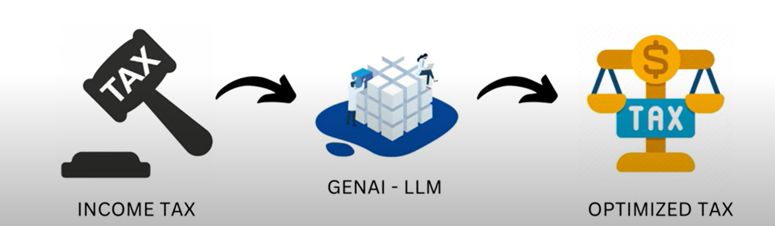

Slide 6
Project Methodology -
Conducting an in-depth analysis of India's financial and taxation legislation.
Gather user financial data including income, expenses, deductions, and previous tax returns. Ensure this data is structured and anonymized.
Clean and normalize user financial data to ensure consistency. Extract key features relevant to tax optimization, and Store in Vector DB (Chroma DB).
Integrate RAG to combine the LLM’s capabilities with a retrieval system to pull relevant information from the vector database.
The RAG framework will help in tailoring these recommendations by retrieving specific tax-saving tips and regulations relevant to each user’s financial situation.
Monitor and measure the performance of the system, including response time, accuracy of recommendations, and user satisfaction.

