Slide 1
Handwritten Signature Verification using Local Binary Pattern features and KNN
Tejas Jadhav - B002
Under the guidance of Mentor Prof. Abhay Kolhe

Slide 2
Contents
Problem definition
Literature Review
Proposed Work
Implementation tool & setup
Dataset
Implementation Work done
Comparative study
References

Slide 3
Problem definition
Signature Verification is the procedure of determining to whether a particular signature is genuine or forged.
System would take as input author ID and signature images and tell us, If the signature ,ust be ‘Accepted’ or ‘Rejected’

Slide 4
Literature Review
An excel sheet of all the Literature Review has been prepared and is been attached with this slide.
The literature review contains total of 40 research papers based on the topic Signature Recognition
Most of the papers make use of 3 stages:
Preprocessing stage
Feature extraction stage
Classification stage

Slide 5
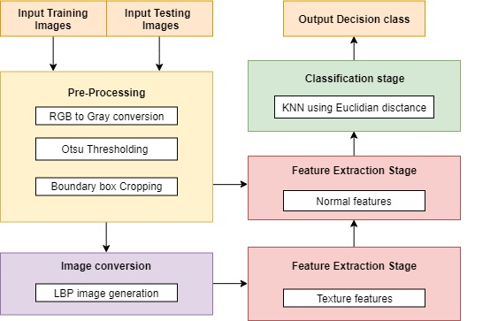
Proposed Work

Slide 6
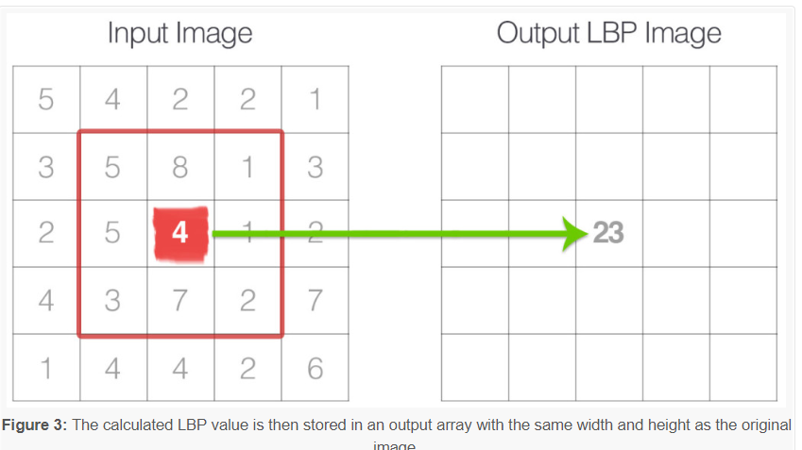
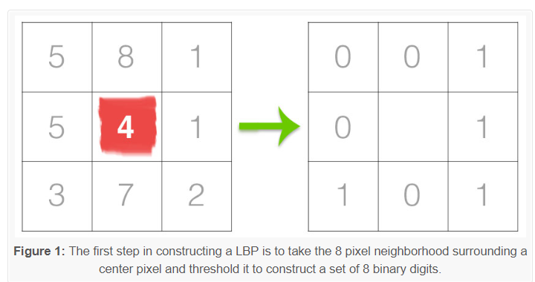
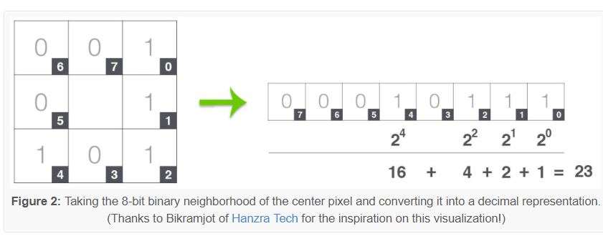
Local Binary Pattern
Proposed Work

Slide 7




Implementation tool & setup
Python using PyCharm
Python is a popular programming language used in web & software development, mathematics, system scripting
PyCharm is a python editor and compiler allows intelligent code completion, on-the-fly error checking and quick-fixes, easy project navigation, and much more.
SQL using MySQL
SQL is a standard language for storing, manipulating and retrieving data in databases.
MySQL is an open source relational database management system, very easy to establish, use and manage

Slide 8
Implementation tool & setup
Python libraries
Using number of libraries, which are easy to install & import..
Package | Description
OpenCV | Computer vision and machine learning software library.
NumPy | Scientific computing & array-processing
Imutils | Functions to make basic image processing functions easier
Math | Provides access to the mathematical functions
MatplotLib | Python 2D plotting library
Pymysql | A simple database interface for Python
OS | allows easy file handling
Scipy | Provides many user-friendly and efficient numerical routines
PySimpleGUI | User interface renderer

Slide 9
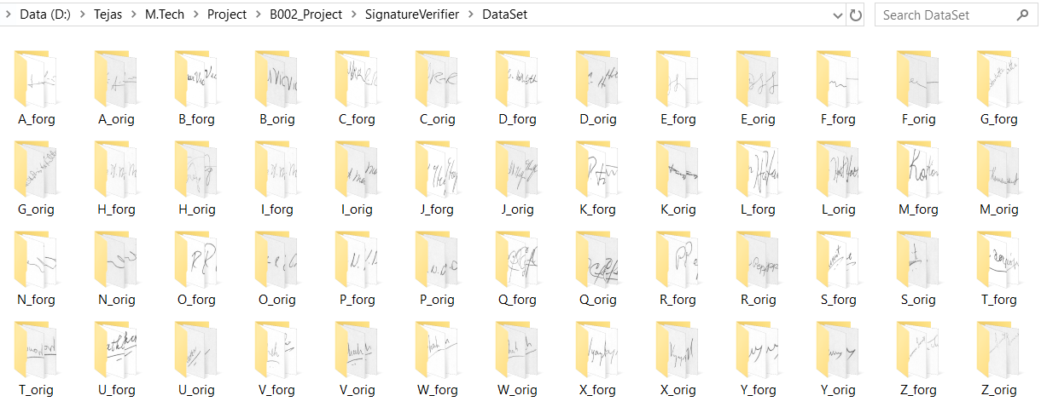

Dataset

Slide 10
Implementation Work done

Slide 11
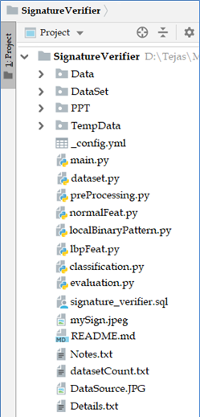
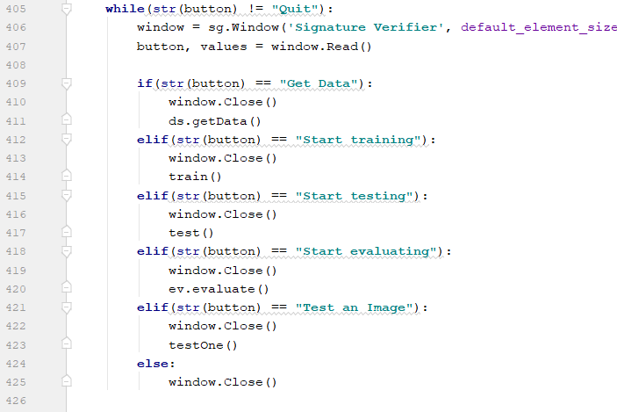
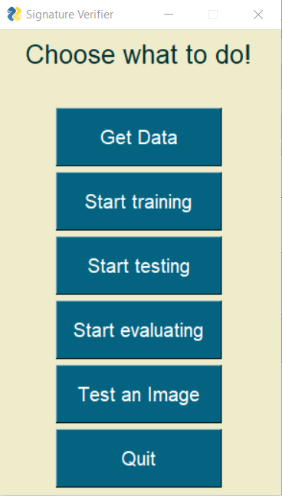
Implementation
Main.py
This is the main python file where the system working starts, calls the other functions, gives the appropriate results and ends.

Slide 12
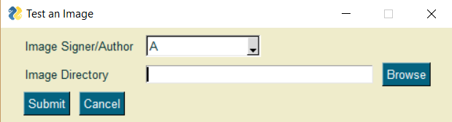
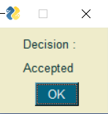
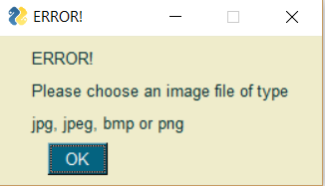
Implementation
Main.py
Test an Image: Clicking on this button will display a popup form and allow user to browse through his computer and perform testing over a single image.

Slide 13
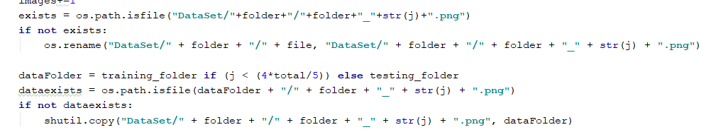
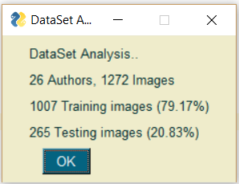
Implementation
Dataset.py
Our dataset is read, renamed, copied and organized in the correct naming convention to a different folder, from where our system will use
xyz.png A_orig_17.png
Also gives an analysis of the count of dataset

Slide 14
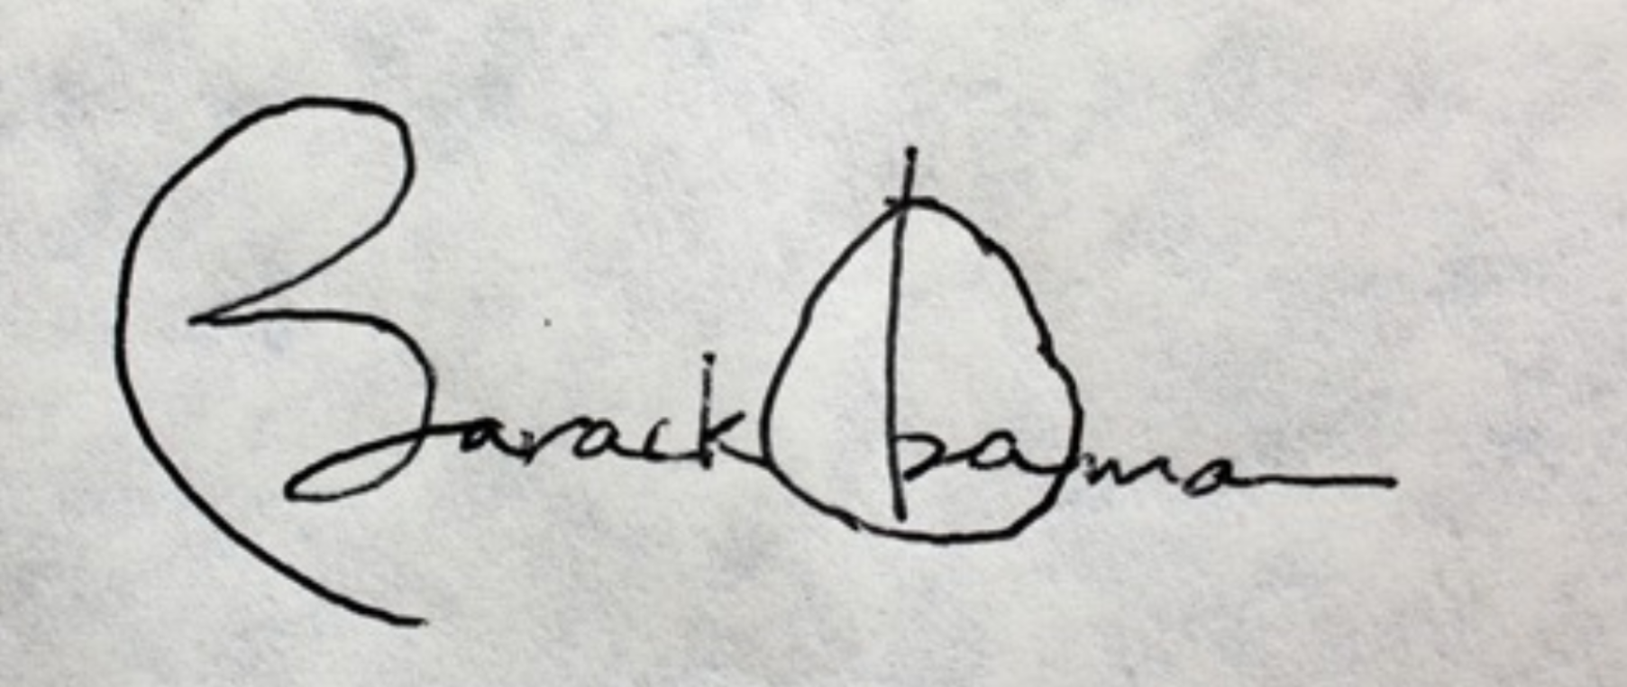
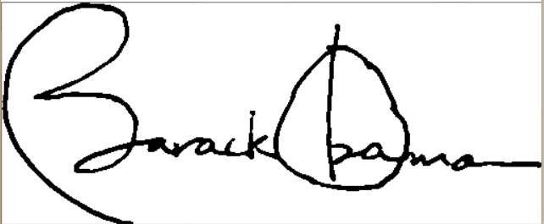
Implementation
Preprocessing.py
This function takes the image in the raw format and converts into a pre-processed format.
Resize ,
RGB to Grey ,
Otsu thresholding,
Boundary Box cropping

Slide 15
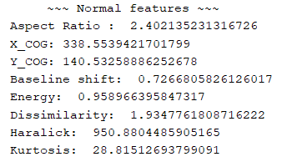
Implementation
NormalFeat.py
This function extracts features of the signature from the pre-processed images.
Aspect Ratio
Center of Gravity - X
Center of Gravity - Y
Baseline Shift
Energy: local difference in brightness, or square of brightness
Dissimilarity: the weights with which instensities move linearly away from the diagonal
Haralick: quantify an image based on texture
Kurtosis: Kurtosis is a measure of the combined weight of a distribution's tails relative to the center of the distribution

Slide 16
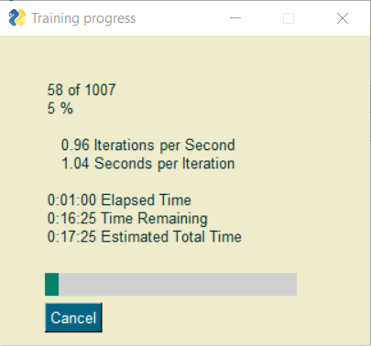
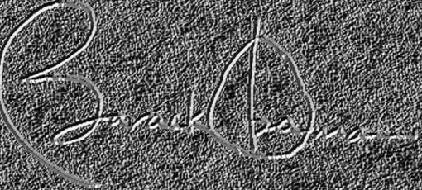
Implementation
LocalBinaryPattern.py
This python file contains function that converts the image into LBP image
LBP image is darker and shows off the textures of the image to help us extract them

Slide 17
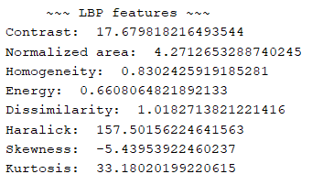
Implementation
LbpFeat.py
This function extracts texture based features of the signature from the LBP images.
Contrast:
Normalized Area
Energy
Dissimilarity
Haralick
Kurtosis
Skewness: asymmetry in a statistical distribution, in which the curve appears distorted or skewed either to the left or to the right
Homogeneity: value that calculates the tightness of distribution of the elements in the GLCM to the GLCM diagonal

Slide 18
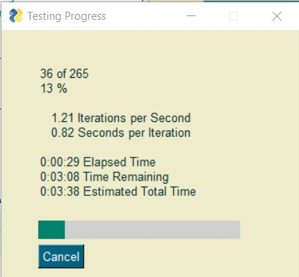
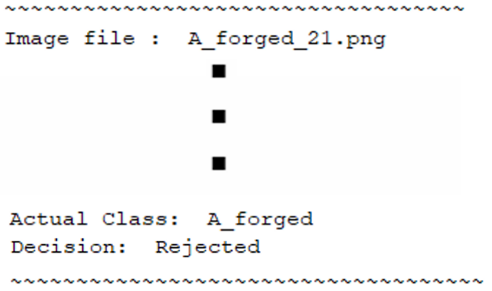
Implementation
Classification.py
This python file contains KNN classification function which classifies the given test data to a class.
KNN algorithm works on the Euclidian distance based approach where the classes of the K nearest neighbours is given to the test data vector.

Slide 19
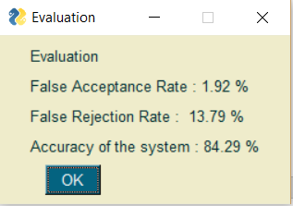
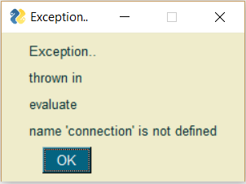
Implementation
Evaluation.py
The evaluation parameter used for measuring accuracy of the system is recognition rate. We find the FAR and FRR which stand for False Acceptance Rate and False Rejection Rate. The number of falsely accepted images over the total images is FAR and the number of falsely rejected images over the total images is FRR
In our experimentation, we find our accuracy to be highest with 84.29% at K = 22 in our KNN classifier. The table below shows the different recognition rates for different values for K.

Slide 20
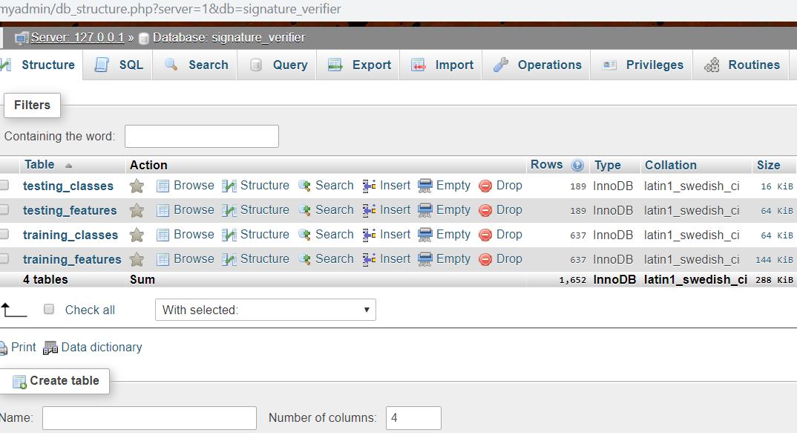
Implementation
Signature_verifier.sql
This has SQL queries for creating database, creating tables, inserting entries into the tables.
Main.py also inserts and reads data into the database one row at a time

Slide 21
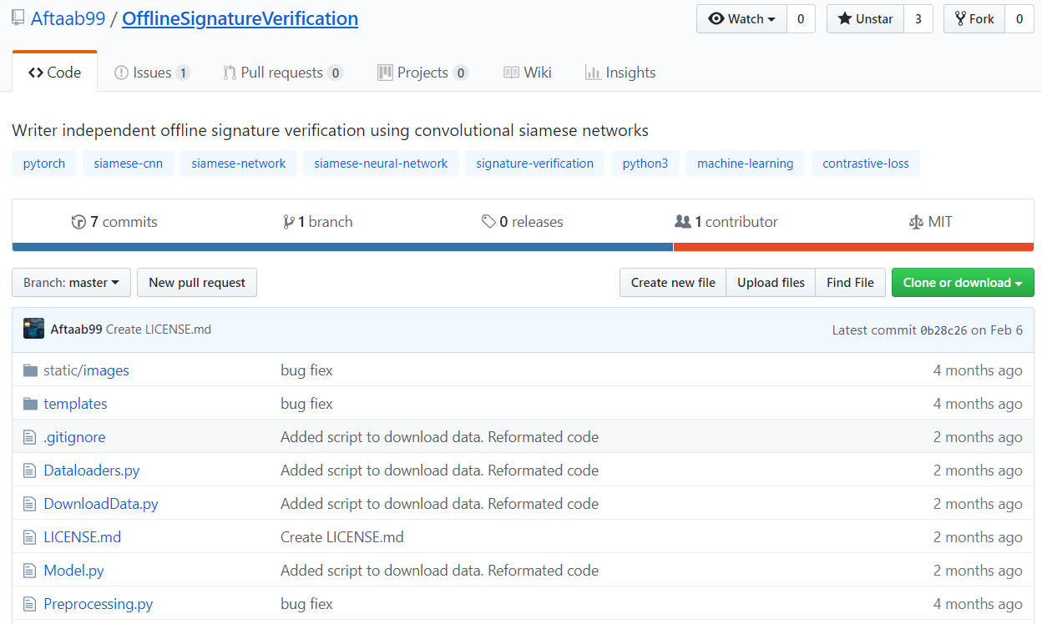
Comparative study

Slide 22
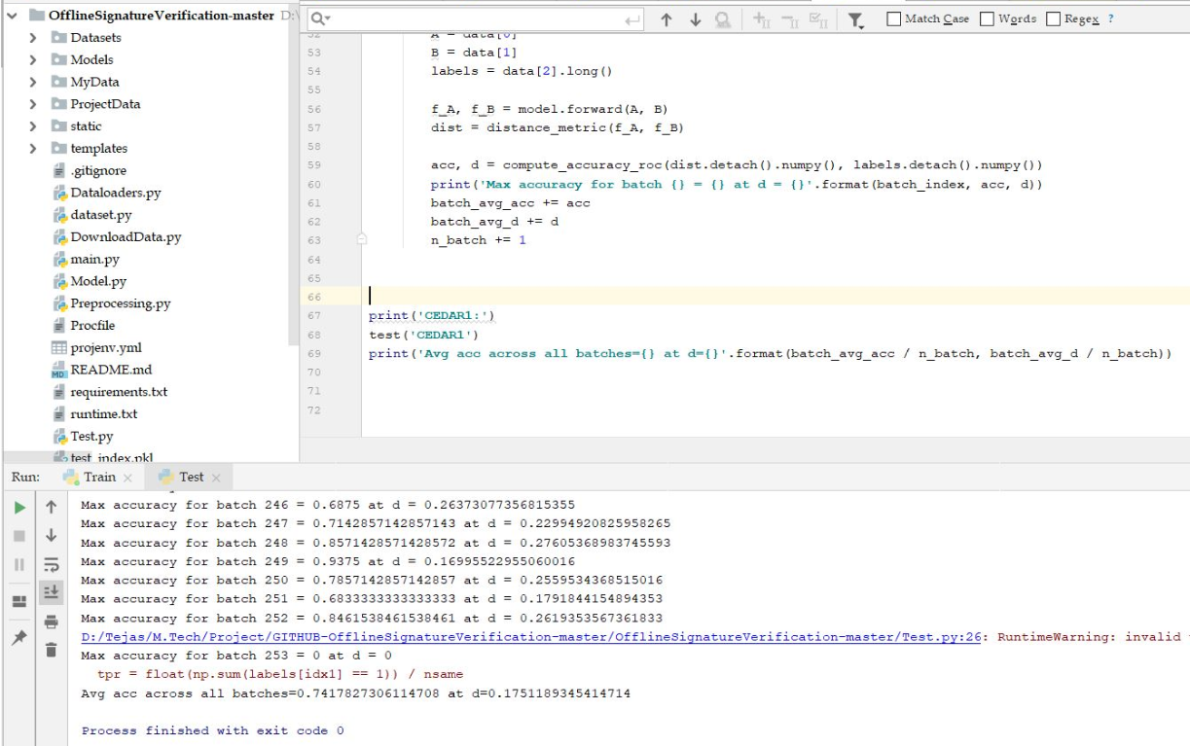
Comparative study
Preprocessing
Grayscale, invertion and scaled down to 0 or up to Images were grouped in pairs of genuine and forged images, where the label was 1 if both were genuine and of the same writer and 0 otherwise.
Model used
Convolutional Siamese network. Siamese neural network is a class of neural network architectures that contain two or more identical subnetworks along with Constrastive loss function.
This network uses Euclidian distance as the distance metric for comparing the output feature vectors, similar to how we used it in our K nearest neighbor classification algorithm.
Evaluation
The model acheived an accuracy of 73.34% on the CEDAR signature dataset

Slide 23
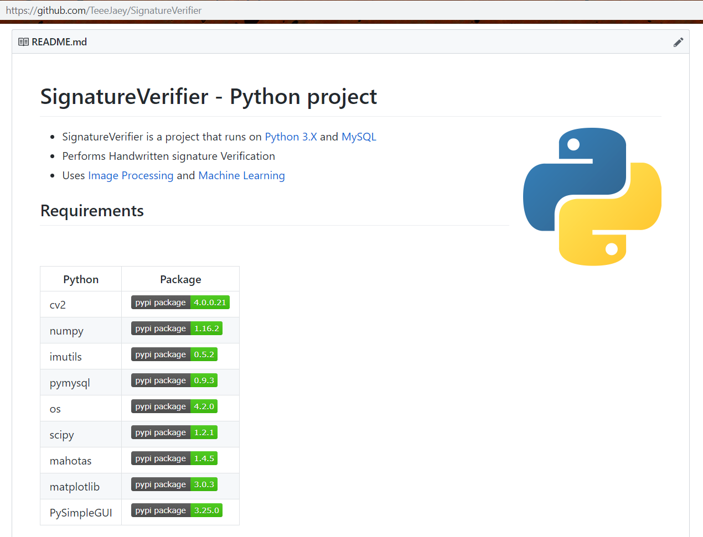

Slide 24
References
[1] S. F. A. Zaidi and S. Mohammed, “Biometric Handwritten Signature Recognition,” 2007.
[2] D. Morocho, A. Morales, J. Fierrez, and R. Vera-Rodriguez, “Towards human-assisted signature recognition: Improving biometric systems through attribute-based recognition,” ISBA 2016 - IEEE Int. Conf. Identity, Secur. Behav. Anal., 2016.
[3] S. A. Angadi, S. Gour, and G. Bhajantri, “Offline Signature Recognition System Using Radon Transform,” 2014 Fifth Int. Conf. Signal Image Process., pp. 56–61, 2014.
[4] S. Hangai, S. Yamanaka, and T. Hammamoto, “ON-LINE SIGNATURE VERIFICATION BASED ON ALTITUDE AND DIRECTION OF PEN MOVEMENT,” Proc. 15th Int. Conf. Pattern Recognition. ICPR-2000, vol. 3, no. l, pp. 479–482, 2000.
[5] I. V Anikin and E. S. Anisimova, “Handwritten signature recognition method based on fuzzy logic,” 2016 Dyn. Syst. Mech. Mach., 2016.
[6] E. Ozgunduz, T. Senturk, and M. E. Karsligil, “Off-line signature verification and recognition by support vector machine,” 13th Eur. Signal Process. Conf., no. 90, pp. 1–4, 2005.
[7] S. A. Angadi and S. Gour, “Euclidean Distance Based Offline Signature Recognition System Using Global and Local Wavelet Features,” 2014 Fifth Int. Conf. Signal Image Process., pp. 87–91, 2014.
[8] Ruangroj Sa-Ardship and K. Woraratpanya, “Offline Handwritten Signature Recognition Using Adaptive Variance Reduction,” 7th Int. Conf. Inf. Technol. Electr. Eng. (ICITEE), Chiang Mai, Thail. Offline, pp. 258–262, 2015.
[9] M. A. Djoudjai, Y. Chibani, and N. Abbas, “Offline signature identification using the histogram of symbolic representation,” 5th Int. Conf. Electr. Eng. - Boumerdes, pp. 1–5, 2017.
[10] A. B. Jagtap and R. S. Hegadi, “Offline Handwritten Signature Recognition Based on Upper and Lower Envelope Using Eigen Values,” Proc. - 2nd World Congr. Comput. Commun. Technol. WCCCT 2017, pp. 223–226, 2017.

Slide 25
References
[11] T. Marušić, Ž. Marušić, and Ž. Šeremet, “Identification of authors of documents based on offline signature recognition,” MIPRO, no. May, pp. 25–29, 2015.
[12] S. L. Karanjkar and P. N. Vasambekar, “Signature Recognition on Bank cheques using ANN,” IEEE Int. WIE Conf. Electr. Comput. Eng., no. December, 2016.
[13] G. S. Prakash and S. Sharma, “Computer Vision & Fuzzy Logic based Offline Signature Verification and Forgery Detection,” IEEE Int. Conf. Comput. Intell. Comput. Res., 2014.
[14] M. S. Shirdhonkar and M. B. Kokare, “Document image retrieval using signature as query,” 2011 2nd Int. Conf. Comput. Commun. Technol. ICCCT-2011, pp. 66–70, 2011.
[15] R. Sa-Ardship and K. Woraratpanya, “Offline Handwritten Signature Recognition Using Polar-Scale Normalization,” 8th Int. Conf. Inf. Technol. Electr. Eng. (ICITEE), Yogyakarta, Indones., pp. 3–7, 2016.
[16] A. Piyush Shanker and A. N. Rajagopalan, “Off-line signature verification using DTW,” Pattern Recognit. Lett., vol. 28, no. 12, pp. 1407–1414, 2007.
[17] Nancy and P. G. Goyal, “Signature Processing in Handwritten Bank Cheque Images,” Int. J. Recent Innov. Trends Comput. Commun., vol. 2, no. 5, pp. 1239–1243, 2014.
[18] A. T. Nasser and N. Dogru, “Signature recognition by using SIFT and SURF with SVM basic on RBF for voting online,” Proc. 2017 Int. Conf. Eng. Technol. ICET 2017, vol. 2018–Janua, pp. 1–5, 2017.
[19] A. Kumar and K. Bhatia, “A Robust Offline Handwritten Signature Verification System Using Writer Independent Approach,” 3rd Int. Conf. Adv. Comput. Autom., 2017.
[20] H. Anand, “Enhanced Signature Verification and RECOGNITION USING MATLAB,” Int. J. Innov. Res. Adv. Eng., vol. 1, no. 4, pp. 88–94, 2014.
[21] B. H. Shekar and R. K. Bharathi, “Eigen-signature: A robust and an efficient offline signature verification algorithm,” Int. Conf. Recent Trends Inf. Technol. ICRTIT 2011, pp. 134–138, 2011.
[22] A. R. Rahardika, “Global Features Selection for Dynamic Signature Verification,” Int. Conf. Inf. Commun. Technol. Glob., pp. 348–354, 2018.
[23] T. Handhayani, A. R. Yohannis, and Lely Hiryanto, “Hand Signature and Handwriting Recognition as Identification of the Writer using Gray Level Co- Occurrence Matrix and Bootstrap,” Intell. Syst. Conf., no. September, pp. 1103–1110, 2017.

Slide 26
References
[24] A. Beresneva, A. Epishkina, and D. Shingalova, “Handwritten Signature Attributes for its Verification,” pp. 1477–1480, 2018.
[25] M. P. Patil, Bryan Almeida, Niketa Chettiar, and Joyal Babu, “Offline Signature Recognition System using Histogram of Oriented Gradients,” Int. Conf. Adv. Comput. Commun. Control, 2017.
[26] M. M. Kumar and N. B. Puhan, “Offline signature verification using the trace transform,” 2014 IEEE Int. Adv. Comput. Conf., pp. 1066–1070, 2014.
[27] O. Miguel-Hurtado, L. Mengibar-Pozo, M. G. Lorenz, and J. Liu-Jimenez, “On-Line Signature Verification by Dynamic Time Warping and Gaussian Mixture Models,” 2007 41st Annu. IEEE Int. Carnahan Conf. Secur. Technol., pp. 23–29, 2007.
[28] M. Ferrer and J. Vargas, “Robustness of offline signature verification based on gray level features,” IEEE Trans. Inf. FORENSICS Secur., vol. 7, no. 3, pp. 966–977, 2012.
[29] B. Erkmen, N. Kahraman, R. A. Vural, and T. Yildirim, “Conic section function neural network circuitry for offline signature recognition,” IEEE Trans. Neural Networks, vol. 21, no. 4, pp. 667–672, 2010.
[30] M. A. Ferrer, A. Morales, and J. F. Vargas, “Off-line signature verification using local patterns,” 2nd Natl. Conf. Telecommun., pp. 1–6, 2011.
[31] M. Tahir and M. U. Akram, “Online Signature Verification using Hybrid Features,” Conf. Inf. Commun. Technol. Soc. Online, pp. 11–16, 2018.
[32] M. Pal, S. Bhattacharyya, and T. Sarkar, “Euler number based feature extraction technique for Gender Discrimination from offline Hindi signature using SVM & BPNN classifier,” 2018 Emerg. Trends Electron. Devices Comput. Tech., pp. 1–6, 2004.
[33] W. Pan and G. Chen, “A Method of Off-line Signature Verification for Digital Forensics,” 12th Int. Conf. Nat. Comput. Fuzzy Syst. Knowl. Discov., pp. 488–493, 2016.

Slide 27
References
[34] M. A. Ferrer, J. B. Alonso, and C. M. Travieso, “Offline geometric parameters for automatic signature verification using fixed-point arithmetic,” IEEE Trans. Pattern Anal. Mach. Intell., vol. 27, no. 6, pp. 993–997, 2005.
[35] S. A. Farimani and M. V. Jahan, “An HMM for Online Signature Verification Based on Velocity and Hand Movement Directions,” Iran. Jt. Congr. Fuzzy Intell. Syst., pp. 205–209, 2018.
[36] G. Pirlo and D. Impedovo, “Verification of static signatures by optical flow analysis,” IEEE Trans. Human-Machine Syst., vol. 43, no. 5, pp. 499–505, 2013.
[37] A. Alaei, S. Pal, U. Pal, and M. Blumenstein, “An Efficient Signature Verification Method Based on an Interval Symbolic Representation and a Fuzzy Similarity Measure,” IEEE Trans. Inf. Forensics Secur., vol. 12, no. 10, pp. 2360–2372, 2017.
[38] D. S. Guru and H. N. Prakash, “Online Signature Verification and Recognition: An Approach based on Symbolic Representation.,” IEEE Trans. Pattern Anal. Mach. Intell., vol. 31, no. 6, pp. 1059–73, 2009.
[39] A. Sharma and S. Sundaram, “On the Exploration of Information from the DTW Cost Matrix for Online Signature Verification,” IEEE Trans. Cybern., vol. 48, no. 2, pp. 611–624, 2018.
[40] G. Pirlo, V. Cuccovillo, M. Diaz-Cabrera, D. Impedovo, and P. Mignone, “Multidomain Verification of Dynamic Signatures Using Local Stability Analysis,” IEEE Trans. Human-Machine Syst., vol. 45, no. 6, pp. 805–810, 2015.
[41] Python : https://www.python.org/
[42] Dataset source :- http://www.iapr-tc11.org/mediawiki/index.php?title=Datasets_List#Handwritten%20Documents
[45] Github's existing system used for comparison https://github.com/Aftaab99/OfflineSignatureVerification

Slide 28
Thank You ☺
Any Questions?

