Slide 1
Handwritten Signature Verifier using Image Processing
Tejas Jadhav - B002
Under the guidance of Mentor Prof. Abhay Kolhe

Slide 2
Contents
Problem definition
Literature Review
Proposed Work
Implementation tool & setup
Implementation Work done
Gantt chart
References

Slide 3
Problem definition
Signature Verification is the procedure of determining to whom a particular signature belongs to.
System would take as input signature images and tell us
To whom the signature belongs to (Author Identification)
If the signature is forged or genuine (Signature Verification)

Slide 4
Literature Review
An excel sheet of all the Literature Review has been prepared and is been attached with this slide.
The literature review contains total of 40 research papers based on the topic Signature Recognition
Most of the papers make use of 3 stages:
Preprocessing stage
Feature extraction stage
Classification stage

Slide 5
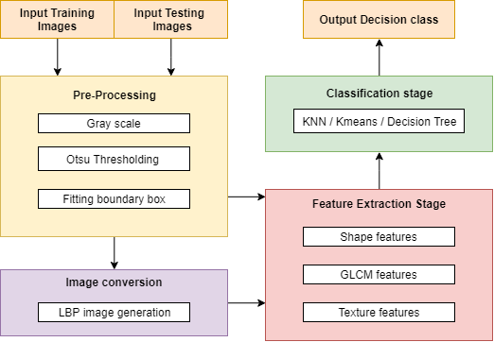
Proposed Work

Slide 6
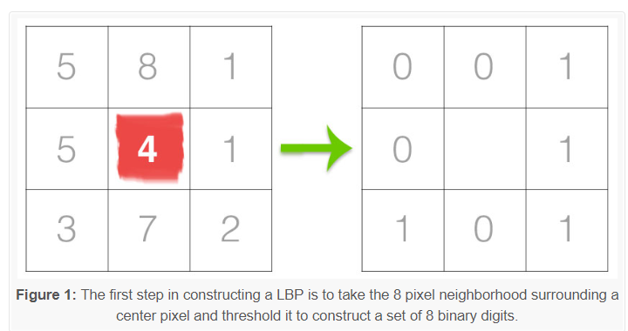
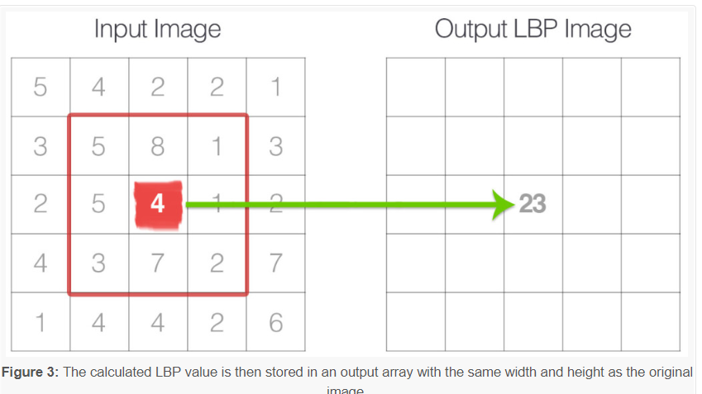
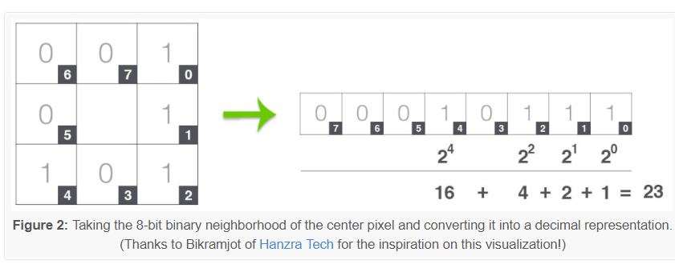
Local Binary Pattern
Proposed Work

Slide 7




Implementation tool & setup
Python using PyCharm
Python is a popular programming language used in web & software development, mathematics, system scripting
PyCharm is a python editor and compiler allows intelligent code completion, on-the-fly error checking and quick-fixes, easy project navigation, and much more.
SQL using MySQL
SQL is a standard language for storing, manipulating and retrieving data in databases.
MySQL is an open source relational database management system, very easy to establish, use and manage

Slide 8
Implementation tool & setup
Python libraries
Using number of libraries, which are easy to install & import..
OpenCV : Computer vision and machine learning software library.
NumPy : Scientific computing & array-processing
Imutils : Functions to make basic image processing functions easier
Math : Provides access to the mathematical functions
MatplotLib : Python 2D plotting library
Pymysql : A simple database interface for Python
OS : allows easy file handling
Scipy : Provides many user-friendly and efficient numerical routines

Slide 9
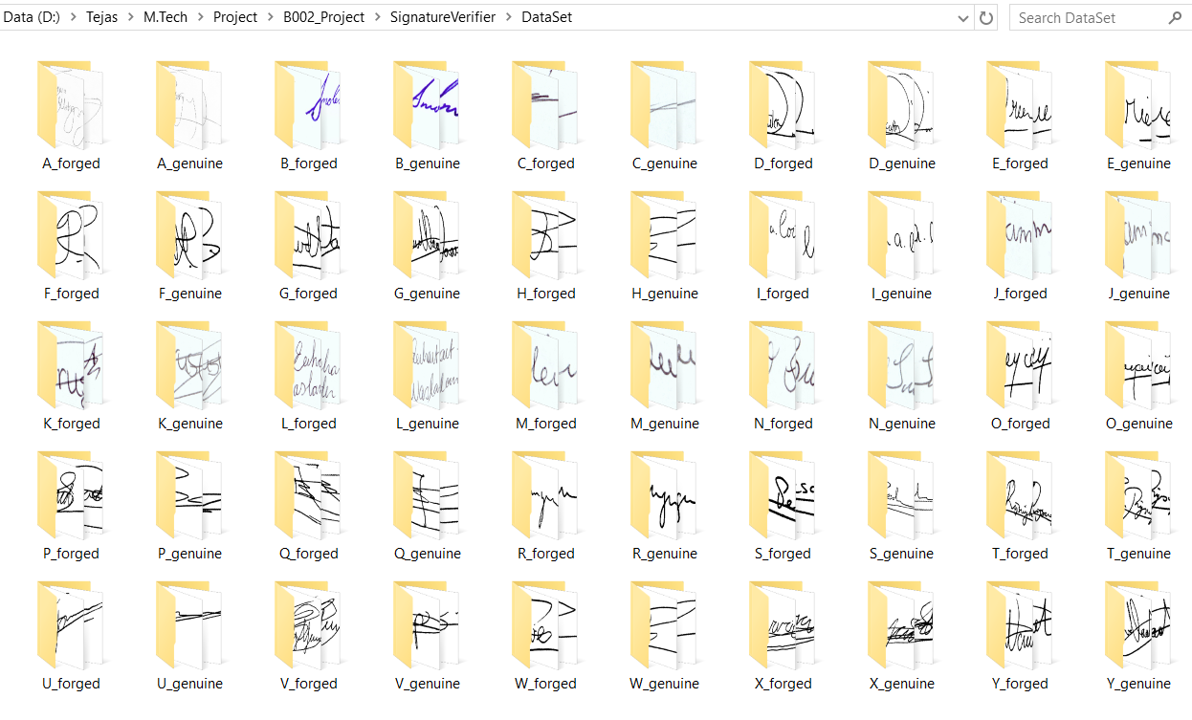
Dataset
25 Authors, 50 Classes, 826 Images
637 Training images (77.12%)
189 Testing images (22.88%)

Slide 10
Implementation Work done

Slide 11
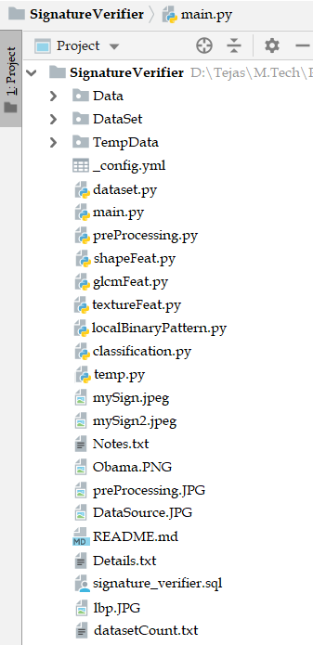

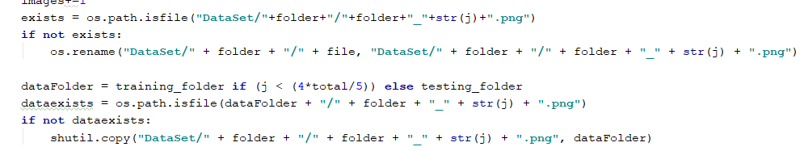
Implementation
Dataset.py
Our dataset is read, renamed, copied and organized in the correct naming convention to a different folder, from where our system will use
xyz.png A_genuine_7.png
Also gives an analysis of the count of dataset

Slide 12
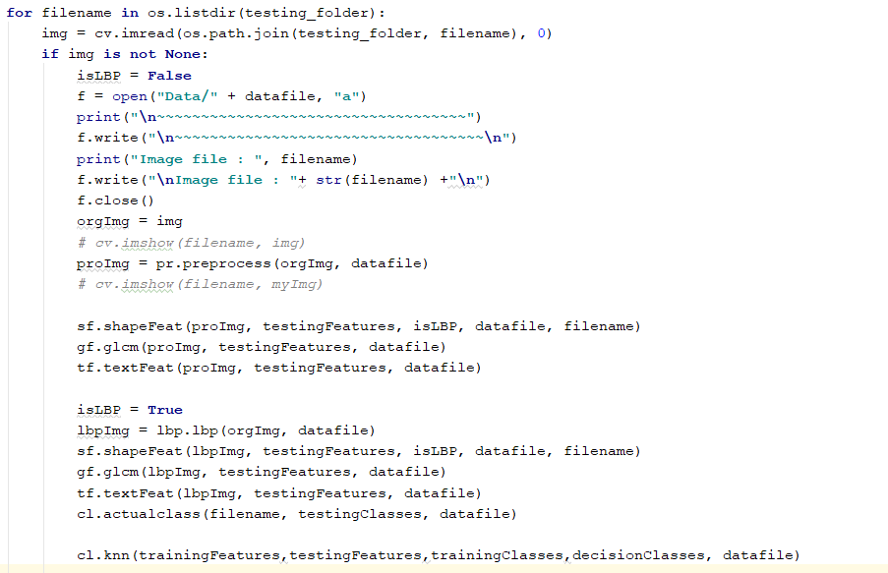
Implementation
Main.py
This is the main python file where the system working starts, calls the other functions, gives the appropriate results and ends.

Slide 13
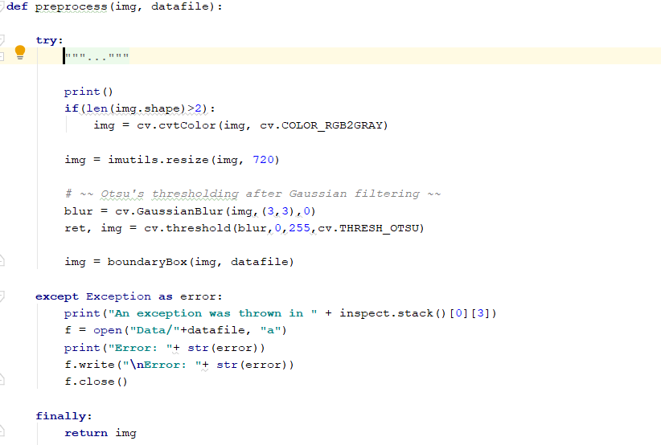
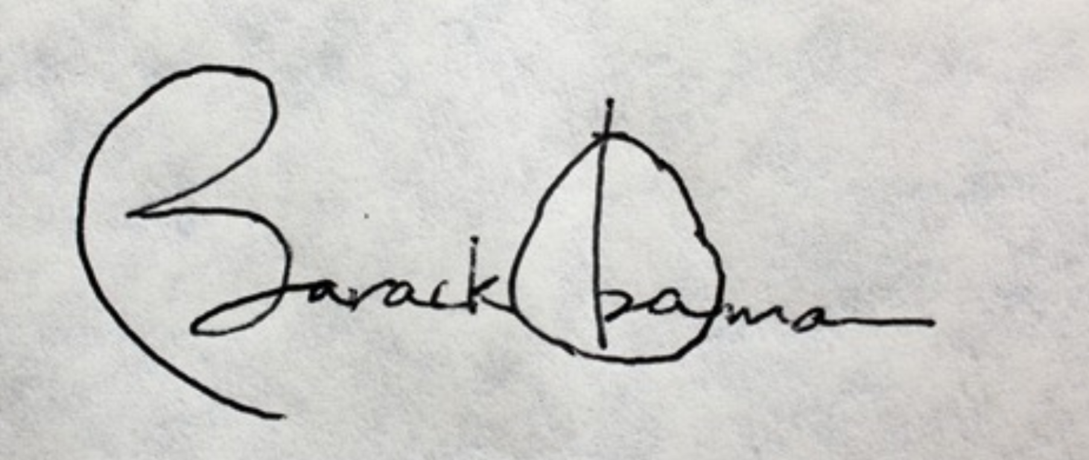
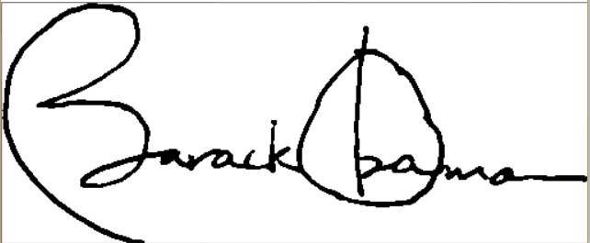
Implementation
Preprocessing.py
This function takes the image in the raw format and converts into a pre-processed format.
Resize, RGB to Grey , Otsu thresholding, boundary Box cropping

Slide 14
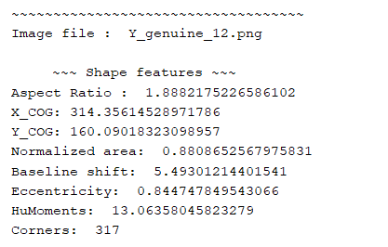
Implementation
shapeFeat.py
This function extracts shape based features of the signature from the images.
These includes:
Aspect Ratio
Center of Gravity
Normalized Area
Baseline Shift
Eccentricity
HuMoments
No of Corners

Slide 15
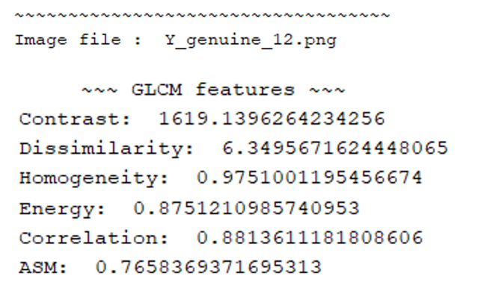
Implementation
glcmFeat.py
This function extracts glcm based features of the signature from the images.
Gray Level Coherence Matrix
These includes:
Contrast
Dissimilarity
Homogeneity
Energy
Correlation
ASM

Slide 16
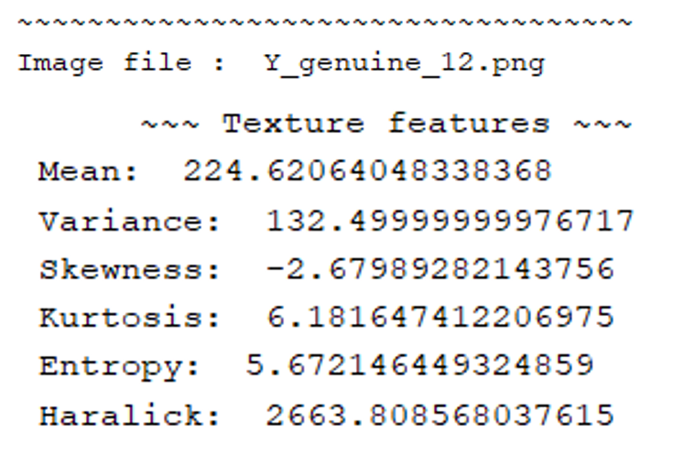
Implementation
textureFeat.py
This function extracts texture based features of the signature from the images.
These includes:
Mean
Variance
Skewness
Kurtosis
Energy
Haralick

Slide 17
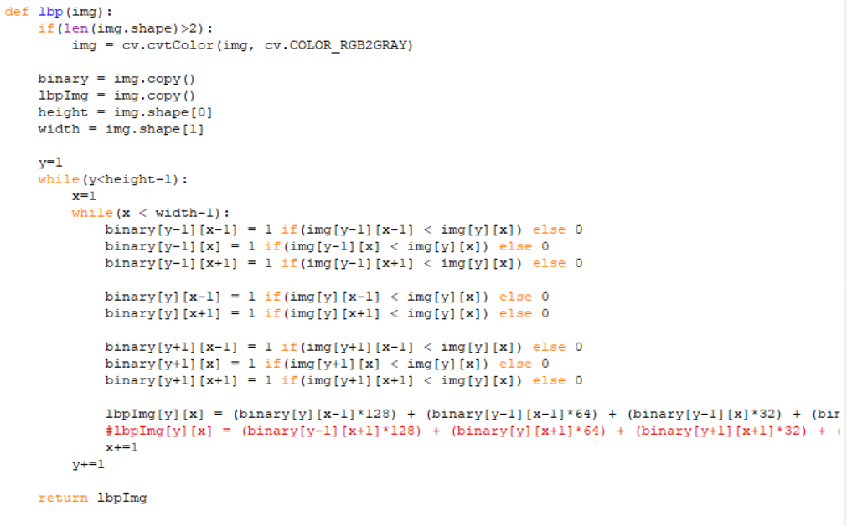
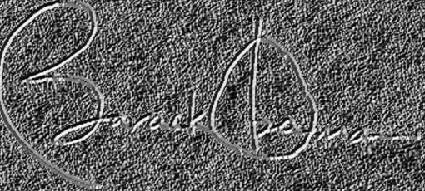
Implementation
localBinaryPattern.py
This python file contains function that converts the image to an LBP image.
Local Binary Pattern

Slide 18
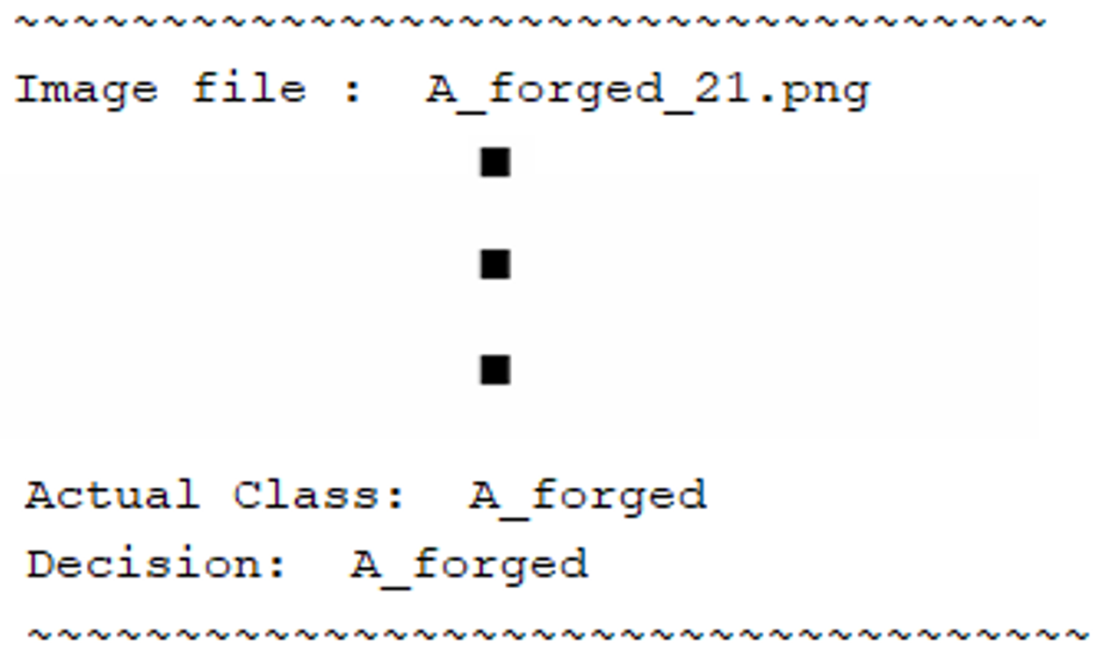
Implementation
classification.py
This python file contains KNN classification function which classifies the given test data to a particular class.
There are two functions one that gets the actual class of the function by merely the name of the file and other is the KNN classifier.

Slide 19
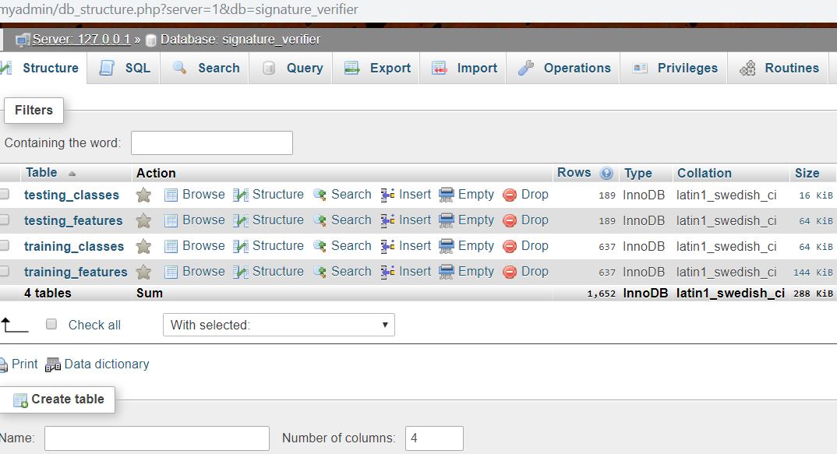
Implementation
signature_verifier.sql
This has SQL queries for creating database, creating tables, inserting entries into the tables.
Main.py also inserts and reads data into the database one row at a time

Slide 20

Gantt Chart

Slide 21
References
[1] S. F. A. Zaidi and S. Mohammed, “Biometric Handwritten Signature Recognition,” 2007.
[2] D. Morocho, A. Morales, J. Fierrez, and R. Vera-Rodriguez, “Towards human-assisted signature recognition: Improving biometric systems through attribute-based recognition,” ISBA 2016 - IEEE Int. Conf. Identity, Secur. Behav. Anal., 2016.
[3] S. A. Angadi, S. Gour, and G. Bhajantri, “Offline Signature Recognition System Using Radon Transform,” 2014 Fifth Int. Conf. Signal Image Process., pp. 56–61, 2014.
[4] S. Hangai, S. Yamanaka, and T. Hammamoto, “ON-LINE SIGNATURE VERIFICATION BASED ON ALTITUDE AND DIRECTION OF PEN MOVEMENT,” Proc. 15th Int. Conf. Pattern Recognition. ICPR-2000, vol. 3, no. l, pp. 479–482, 2000.
[5] I. V Anikin and E. S. Anisimova, “Handwritten signature recognition method based on fuzzy logic,” 2016 Dyn. Syst. Mech. Mach., 2016.
[6] E. Ozgunduz, T. Senturk, and M. E. Karsligil, “Off-line signature verification and recognition by support vector machine,” 13th Eur. Signal Process. Conf., no. 90, pp. 1–4, 2005.
[7] S. A. Angadi and S. Gour, “Euclidean Distance Based Offline Signature Recognition System Using Global and Local Wavelet Features,” 2014 Fifth Int. Conf. Signal Image Process., pp. 87–91, 2014.
[8] Ruangroj Sa-Ardship and K. Woraratpanya, “Offline Handwritten Signature Recognition Using Adaptive Variance Reduction,” 7th Int. Conf. Inf. Technol. Electr. Eng. (ICITEE), Chiang Mai, Thail. Offline, pp. 258–262, 2015.
[9] M. A. Djoudjai, Y. Chibani, and N. Abbas, “Offline signature identification using the histogram of symbolic representation,” 5th Int. Conf. Electr. Eng. - Boumerdes, pp. 1–5, 2017.
[10] A. B. Jagtap and R. S. Hegadi, “Offline Handwritten Signature Recognition Based on Upper and Lower Envelope Using Eigen Values,” Proc. - 2nd World Congr. Comput. Commun. Technol. WCCCT 2017, pp. 223–226, 2017.

Slide 22
References
[11] T. Marušić, Ž. Marušić, and Ž. Šeremet, “Identification of authors of documents based on offline signature recognition,” MIPRO, no. May, pp. 25–29, 2015.
[12] S. L. Karanjkar and P. N. Vasambekar, “Signature Recognition on Bank cheques using ANN,” IEEE Int. WIE Conf. Electr. Comput. Eng., no. December, 2016.
[13] G. S. Prakash and S. Sharma, “Computer Vision & Fuzzy Logic based Offline Signature Verification and Forgery Detection,” IEEE Int. Conf. Comput. Intell. Comput. Res., 2014.
[14] M. S. Shirdhonkar and M. B. Kokare, “Document image retrieval using signature as query,” 2011 2nd Int. Conf. Comput. Commun. Technol. ICCCT-2011, pp. 66–70, 2011.
[15] R. Sa-Ardship and K. Woraratpanya, “Offline Handwritten Signature Recognition Using Polar-Scale Normalization,” 8th Int. Conf. Inf. Technol. Electr. Eng. (ICITEE), Yogyakarta, Indones., pp. 3–7, 2016.
[16] A. Piyush Shanker and A. N. Rajagopalan, “Off-line signature verification using DTW,” Pattern Recognit. Lett., vol. 28, no. 12, pp. 1407–1414, 2007.
[17] Nancy and P. G. Goyal, “Signature Processing in Handwritten Bank Cheque Images,” Int. J. Recent Innov. Trends Comput. Commun., vol. 2, no. 5, pp. 1239–1243, 2014.
[18] A. T. Nasser and N. Dogru, “Signature recognition by using SIFT and SURF with SVM basic on RBF for voting online,” Proc. 2017 Int. Conf. Eng. Technol. ICET 2017, vol. 2018–Janua, pp. 1–5, 2017.
[19] A. Kumar and K. Bhatia, “A Robust Offline Handwritten Signature Verification System Using Writer Independent Approach,” 3rd Int. Conf. Adv. Comput. Autom., 2017.
[20] H. Anand, “Enhanced Signature Verification and RECOGNITION USING MATLAB,” Int. J. Innov. Res. Adv. Eng., vol. 1, no. 4, pp. 88–94, 2014.
[21] B. H. Shekar and R. K. Bharathi, “Eigen-signature: A robust and an efficient offline signature verification algorithm,” Int. Conf. Recent Trends Inf. Technol. ICRTIT 2011, pp. 134–138, 2011.
[22] A. R. Rahardika, “Global Features Selection for Dynamic Signature Verification,” Int. Conf. Inf. Commun. Technol. Glob., pp. 348–354, 2018.
[23] T. Handhayani, A. R. Yohannis, and Lely Hiryanto, “Hand Signature and Handwriting Recognition as Identification of the Writer using Gray Level Co- Occurrence Matrix and Bootstrap,” Intell. Syst. Conf., no. September, pp. 1103–1110, 2017.

Slide 23
References
[24] A. Beresneva, A. Epishkina, and D. Shingalova, “Handwritten Signature Attributes for its Verification,” pp. 1477–1480, 2018.
[25] M. P. Patil, Bryan Almeida, Niketa Chettiar, and Joyal Babu, “Offline Signature Recognition System using Histogram of Oriented Gradients,” Int. Conf. Adv. Comput. Commun. Control, 2017.
[26] M. M. Kumar and N. B. Puhan, “Offline signature verification using the trace transform,” 2014 IEEE Int. Adv. Comput. Conf., pp. 1066–1070, 2014.
[27] O. Miguel-Hurtado, L. Mengibar-Pozo, M. G. Lorenz, and J. Liu-Jimenez, “On-Line Signature Verification by Dynamic Time Warping and Gaussian Mixture Models,” 2007 41st Annu. IEEE Int. Carnahan Conf. Secur. Technol., pp. 23–29, 2007.
[28] M. Ferrer and J. Vargas, “Robustness of offline signature verification based on gray level features,” IEEE Trans. Inf. FORENSICS Secur., vol. 7, no. 3, pp. 966–977, 2012.
[29] B. Erkmen, N. Kahraman, R. A. Vural, and T. Yildirim, “Conic section function neural network circuitry for offline signature recognition,” IEEE Trans. Neural Networks, vol. 21, no. 4, pp. 667–672, 2010.
[30] M. A. Ferrer, A. Morales, and J. F. Vargas, “Off-line signature verification using local patterns,” 2nd Natl. Conf. Telecommun., pp. 1–6, 2011.
[31] M. Tahir and M. U. Akram, “Online Signature Verification using Hybrid Features,” Conf. Inf. Commun. Technol. Soc. Online, pp. 11–16, 2018.
[32] M. Pal, S. Bhattacharyya, and T. Sarkar, “Euler number based feature extraction technique for Gender Discrimination from offline Hindi signature using SVM & BPNN classifier,” 2018 Emerg. Trends Electron. Devices Comput. Tech., pp. 1–6, 2004.
[33] W. Pan and G. Chen, “A Method of Off-line Signature Verification for Digital Forensics,” 12th Int. Conf. Nat. Comput. Fuzzy Syst. Knowl. Discov., pp. 488–493, 2016.

Slide 24
References
[34] M. A. Ferrer, J. B. Alonso, and C. M. Travieso, “Offline geometric parameters for automatic signature verification using fixed-point arithmetic,” IEEE Trans. Pattern Anal. Mach. Intell., vol. 27, no. 6, pp. 993–997, 2005.
[35] S. A. Farimani and M. V. Jahan, “An HMM for Online Signature Verification Based on Velocity and Hand Movement Directions,” Iran. Jt. Congr. Fuzzy Intell. Syst., pp. 205–209, 2018.
[36] G. Pirlo and D. Impedovo, “Verification of static signatures by optical flow analysis,” IEEE Trans. Human-Machine Syst., vol. 43, no. 5, pp. 499–505, 2013.
[37] A. Alaei, S. Pal, U. Pal, and M. Blumenstein, “An Efficient Signature Verification Method Based on an Interval Symbolic Representation and a Fuzzy Similarity Measure,” IEEE Trans. Inf. Forensics Secur., vol. 12, no. 10, pp. 2360–2372, 2017.
[38] D. S. Guru and H. N. Prakash, “Online Signature Verification and Recognition: An Approach based on Symbolic Representation.,” IEEE Trans. Pattern Anal. Mach. Intell., vol. 31, no. 6, pp. 1059–73, 2009.
[39] A. Sharma and S. Sundaram, “On the Exploration of Information from the DTW Cost Matrix for Online Signature Verification,” IEEE Trans. Cybern., vol. 48, no. 2, pp. 611–624, 2018.
[40] G. Pirlo, V. Cuccovillo, M. Diaz-Cabrera, D. Impedovo, and P. Mignone, “Multidomain Verification of Dynamic Signatures Using Local Stability Analysis,” IEEE Trans. Human-Machine Syst., vol. 45, no. 6, pp. 805–810, 2015.
[41] Python : https://www.python.org/
[42] Dataset source :- http://www.iapr-tc11.org/mediawiki/index.php?title=Datasets_List#Handwritten%20Documents

Slide 25
Thank You ☺
Any Questions?

