Slide 1
Overview :- BBMS is a management system that is developed to manage blood bank . This is to make sure that the management of the blood stock became effective, systematic and meeting user requirements, the BBMS is to simplify and automate the process of searching for blood in case of emergency and maintain the records of blood donors, recipients, blood donation programs and blood stocks in the bank.

Slide 2
Problem Definition In some hospitals, especially in the emergency department, we need a lot of blood for operations that require blood transfusion or for people who have lost a lot of blood, so there may be a shortage in the blood stock in the hospital, or it is difficult to find blood donors whose blood type matches that of the recipients, which leads to the death of some people, so we designed this system.

Slide 3
Description of Proposed System
This SRS describes the functional and nonfunctional requirements for software release of the Blood Donation Management System (BDMS). This document is intended to be used by the end users organization administration and members of the project team who will implement and verify the correct functioning of the system. Unless otherwise noted, all requirements specified here are committed for release.
Scope of the System
The BDMS provide short way to find blood quickly. The system is web-based system which will connect the patients and donors in one virtual place. So, a hospital -where the patient in- can search for a blood group in the web site then request the quantity needed. Any hospital can fill emergent request in emergent situations, the system send messages to all donors by SMS to donate as a response of the emergent request.

Slide 4
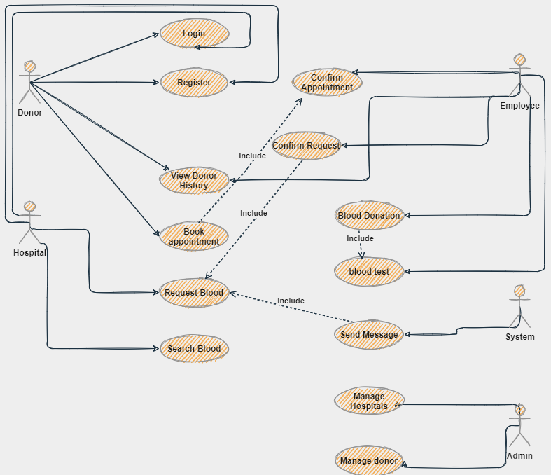
2.5.2Use Case Diagram

Slide 5


2.5.3 Use Case Descriptions
UC ID | 1 | Created date | DD/MM/YYYY
UC Name | Search Blood | Updated Date | DD/MM/YYYY
Actor |  | Hospital Staff
Description |  | Allow hospital staff to search for a blood.
Preconditions |  | Staff is logged in to the system
postconditions |  | Result is displayed
Normal Flow |  | the staff navigate to the search page . staff type the information he search for e.g blood group the staff click the search button.E1 The system should return the search results if, there is a corresponding in the database. The system then should provide filtering options e.g (blood group, address, donation date..etc). The system should filter the results upon the selected options from the staff.
Alternative flow
Exceptions |  | E1 If the staff doesn’t type words in the search field 1.1 the system should ask from him to insert search data. 1.2 Go to step 2 in normal flow.

Slide 6
UC ID | 2 | Created date | DD/MM/YYYY
UC Name | Request Blood | Updated Date | DD/MM/YYYY
Actor |  | Hospital Staff
Description |  | Allow hospital staff to request a blood.
Preconditions |  | Log in
postconditions |  | New request is created and saved to the database.
Normal Flow |  | The staff go to request page . The system display the form of requesting blood. The staff fill out all the needed data (blood group, quantity, patient diagnostic ).E1 The staff click save button to save request. The system should automatically send massages to the donors who has the sane blood group of the request.
Alternative flow
Exceptions |  | E1
 |  | If the staff doesn’t fill all needed data 2.1 the system should ask from him to insert required data. 2.2 Go to step 3 in normal flow.

Slide 7
UC ID | 3 | Created date | DD/MM/YYYY
UC Name | Blood donation | Updated Date | DD/MM/YYYY
Actor |  | Employee
Description |  | To allow employee to create donation for a donor
Preconditions |  | Log in
postconditions |  | Donor has been donated.
Normal Flow |  | the employee check if the donor has appointment or not. If he has, the employee must check the blood test for the donor. If tests success the employee enter the donation details (donor number, date, number of bags…). After that the system should print confirmation of the donor to donate.
Alternative flow
Exceptions

Slide 8
UC ID | 4 | Created date | DD/MM/YYYY
UC Name | Book appointment | Updated Date | DD/MM/YYYY
Actor |  | Donor
Description |  | Allow donor to book appointment to donate
Preconditions |  | Log in
postconditions |  | Donor has an appointment
Normal Flow |  | The donor navigates to the booking page. Then he fills the required details such as date and time. The system should check if the date is available or not. If it available the system must send notification to the bank employee to confirm the appointment. If confirmation done the system inform donor that his booking is success and ask him to come two hours earlier in the bank before the donation time to make the blood test and finish the donation procedures.
Alternative flow
Exceptions

Slide 9
2.5.4 Functional Requirements
The system should allow user to register and create account.
Any user should log in to the system to use system services.
The system should allow hospital staff to request blood.
The doner should be able to make appointment to donate.
The employee should be able to confirm all appointments and requested
2.5.5 Non-Functional Requirements
Usability Requirements:
1-the users should use the BDMS after watching video of who to use it
.2- all hospitals’ staff should be able to request blood from the first time.
Performance Requirements:
1-the BDMS should be able to perform 100 – 400 requests from users in the peak time which from the 10:00 Am to 12:00Pm.

Slide 10
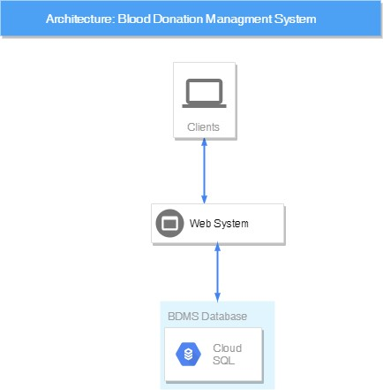

3.1 System Architecture

Slide 11
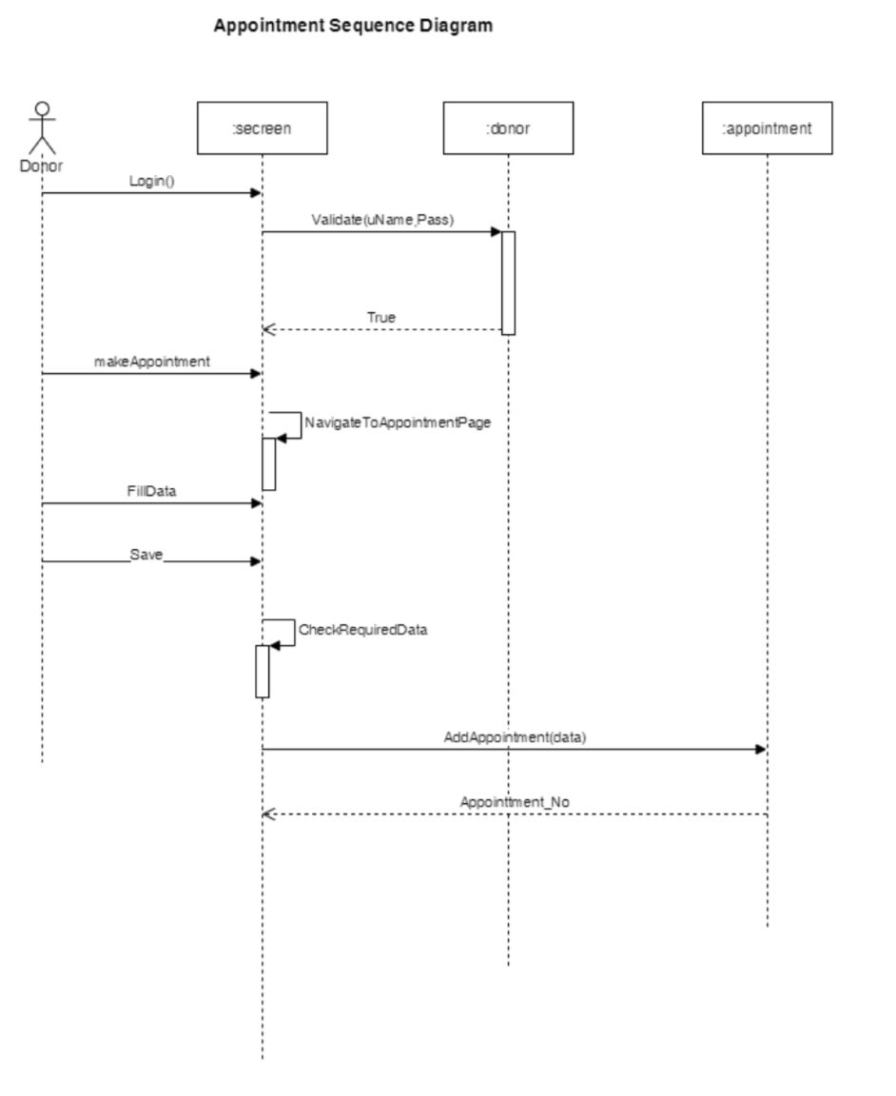
3.2 Sequence Diagrams

Slide 12
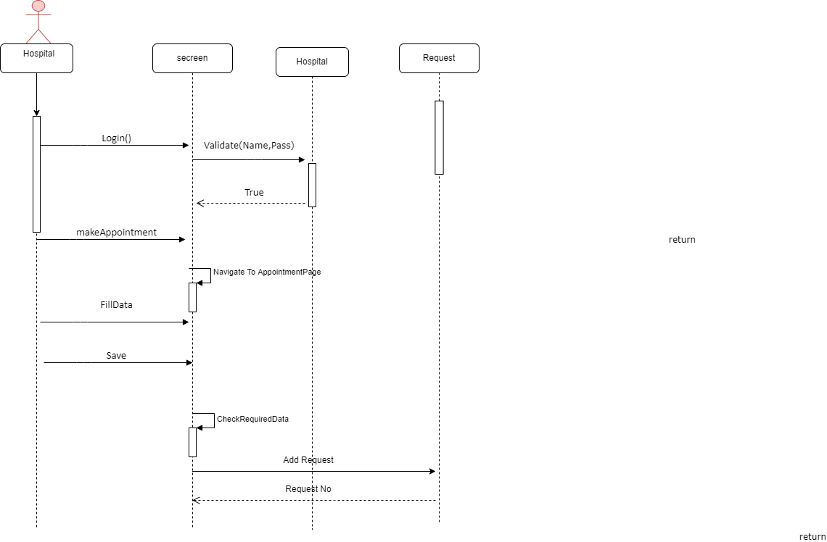

Slide 13
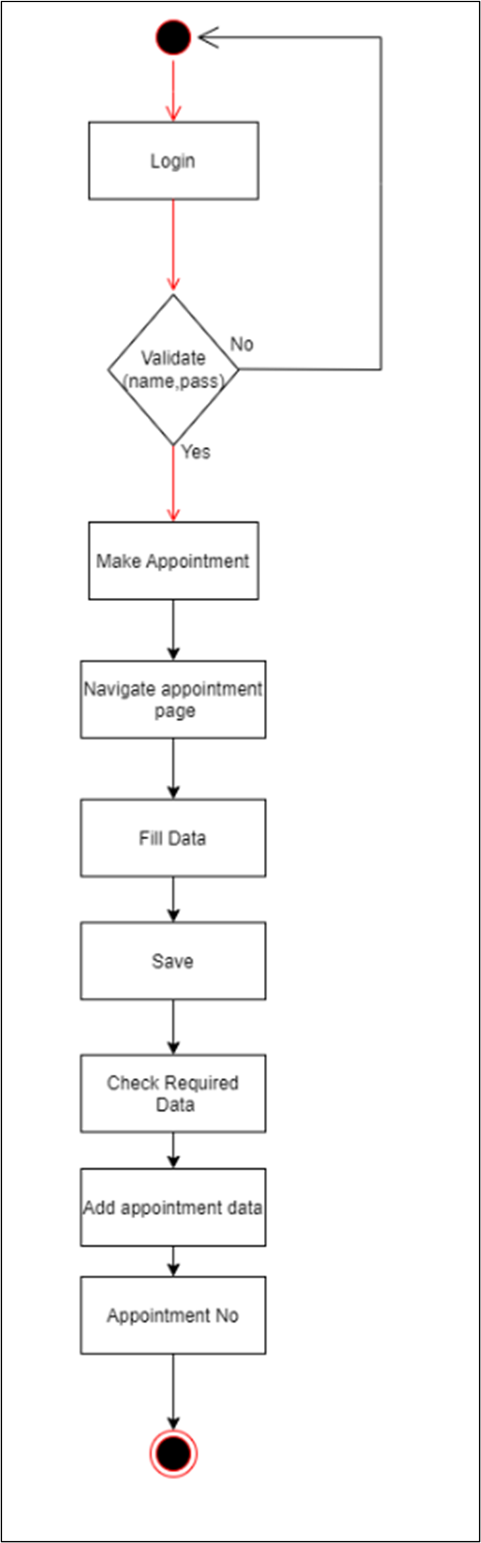
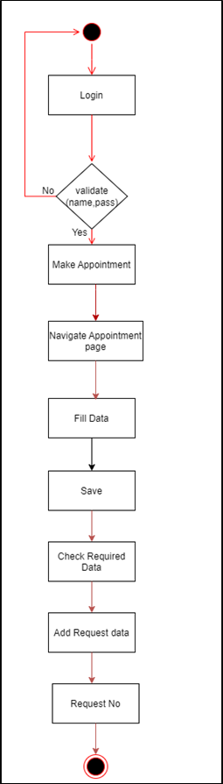
3.3 Activity Diagrams

Slide 14
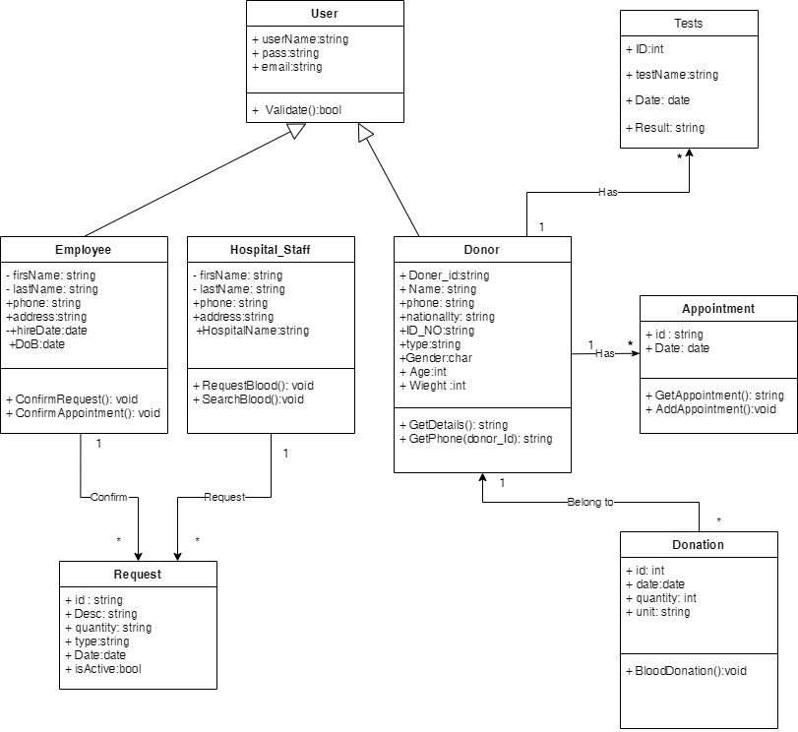
3.4 Class Diagram

Slide 15
6.1 Summary
Benefits of donating blood: Increasing the activity of the bone marrow to produce new blood cells (red cells, white blood cells, and platelets).
Increase the activity of blood circulation.
Donating blood helps reduce iron in the blood because it is one of the causes of heart disease and arterial blockage.
The best features offered by this system:
Facilitate obtaining blood for emergency or other cases as soon as possible.
Ease of donating blood.
Preserve the information of the donor previously, in order to facilitate the donation later.

