Slide 1
Token Cost Analyzer
Tommy Hall

Slide 2
Motivation
Local AI use is becoming more popular with things like Ollama becoming popular. This system is a way to . . .
Calculate estimated cost of input tokens from the user
Process tokens using different token algorithms
Wire input to Ollama for planning output tokens

Slide 3
High Level Design
There are 3 parts
  Token parser
  Model parameters
  Calculate from token count and model parameters cost
  Token parser have a Tokenize method to get output tokens from input
  Model parameters is an over-rideable class which all other model parameters inherit from
  Cost calculator will have multiple calculate methods
  Main is the factory for all these methods creating them depending on the user’s choice in the console

Slide 4
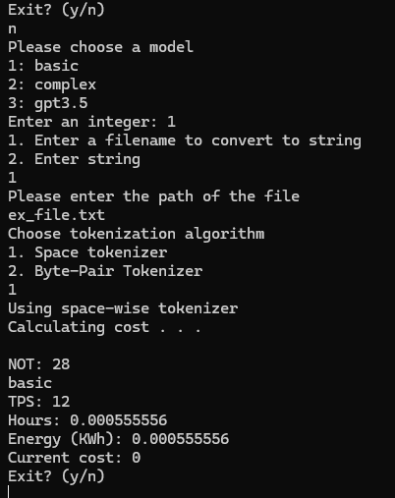
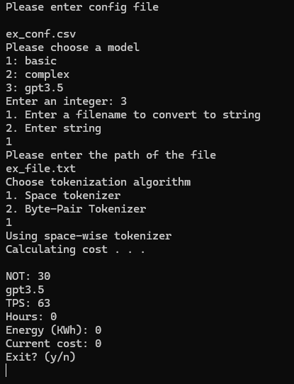
Demo Example

Slide 5
Increase Robustness
Implement more token algorithms
Increase the correctness of the calculator currently precision is up to the compiler
Add unit converter for calculator ease of use

