Slide 1
Oauth Database
Tommy Hall, Lance Diakite

Slide 2
Choice of Topic
Business and Personal Use Case
Flexible in Implementation
Aligned with Team Focuses
Easy to Design, Hard to Implement

Slide 3
Use Case
Business | Community (Personal)
Managing Secure Access of Endpoints | Securing Software for Singular or Distributed Use
Managing Roles Through Secure Practices | Managing Different Permissions of System
Built in Action Monitoring for Log Auditing | Allows Secure Remote Connection with Security
Easy Scaling of Access for Different Departments

Slide 4
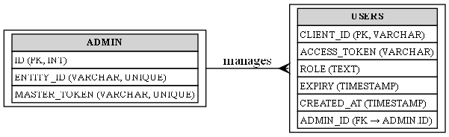
E-R Model

Slide 5
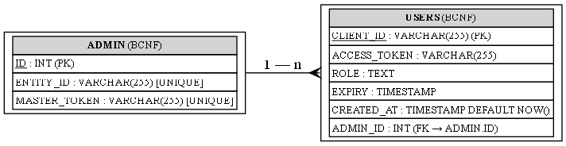
Logical Design

Slide 6


Database Schema and Data
ID’s: Each admin has a unique primary key ID which each user references. Users have a unique string ID (Username). The Entity ID is used to link a master token to a specific admin entity for logging.
Tokens: Used to manage access to credentials and are set up by the implementer of the database. Master tokens do not have a time to live (TTL) access tokens are used for the client and have a TTL.
Role: Used for access portability, different users can all have the same access token but with different access roles.
Timestamps: Every-time a user is created it is logged when they are created and an expiry is generated a day after its creation meaning users can only stay authenticated for a day before having to be redistributed a new credential set in the system.

Slide 7
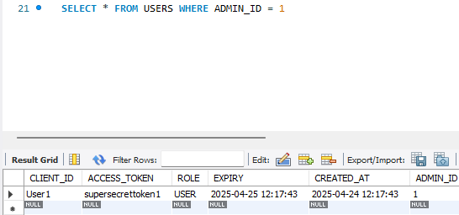
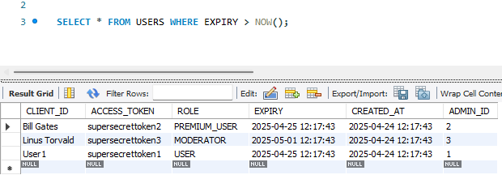
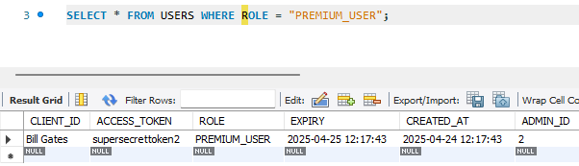
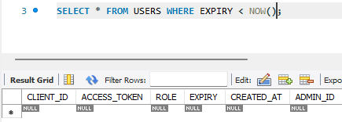
SQL

Slide 8
Future Features

