Slide 1
UI Datathon Project
Devika Bhatt, Ken Huang, Roger Ho, Tong Liu

Slide 2
Business Question
What will be the impact on home improvement spending when the Fed increases interest rates?

Slide 3
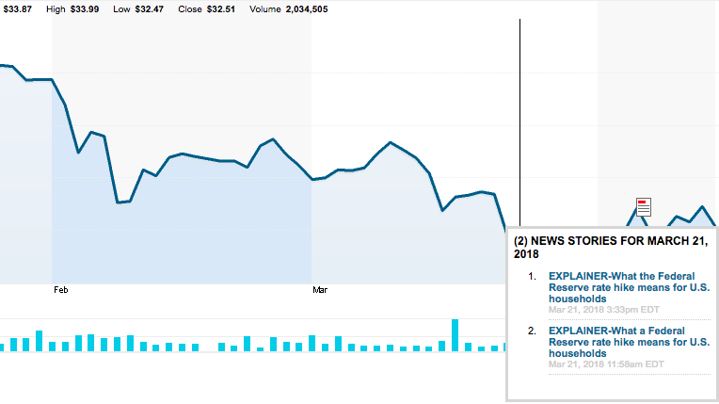
Background Information
The Federal Reserve interest rate hiked in March 2018, which will extend beyond corporate America to household budgets.
The U.S. central bank forecast at least two more hikes for 2018.
According to data from the New York Fed, American households owed a record high total of $13.15 trillion at the end of 2017.
Source: https://www.reuters.com/article/us-usa-fed-households-explainer/what-the-federal-reserve-rate-hike-means-for-u-s-households

Slide 4
Steps
Data Preparation
Internal and External Data
Feature Engineering
Create Features
Model Fitting
Model Selection (Subsequence algorithm to get the best combination)
Explanation vs Accuracy & RMSE

Slide 5
Public Data Sources
Federal reserve: https://fred.stlouisfed.org/
Home Price Index: https://fred.stlouisfed.org/series/CSUSHPINSA
Consumer Price Index: https://fred.stlouisfed.org/series/USACPIHOUMINMEI
Real Disposable Personal Income: https://fred.stlouisfed.org/series/DSPIC96
Sales Price for New Houses Sold: https://fred.stlouisfed.org/series/ASPNHSUS

Slide 6
Features to Explore
Average Sales Price for New Home Sold | New Home Sales Completed
Unemployment Rate | New Home Sales Not Started
CPI: Housing Index | New Home Sales
Home Price Index | New Home Sold
Median Sales Price for New Home Sold | Real Disposable Personal Income (DPI)
Number of Months Home Supply Available | Vehicle Sales
30 Year Fixed Mortgage Rate | PCE: Financial Services and Insurance
New Home Sales Under Construction | Saving and Investment: Disaster Losses
Notes:
Other potential features that we considered: PCE: Pets and Related Products & Services, Household Debt, etc.

Slide 7
ML Models
Support Vector Machine (SVM)
Random Forests
Bayesian Classifiers
Decision Tree Regressor
Gradient Boosting Regressor

Slide 8
Significant Features & Accuracy Rate
SVM 86%
Federal Funds Rate
New Home Sales
Vehicle Sales
Saving and Investment: Disaster Losses

Slide 9
Significant Features & Accuracy Rate
Random Forests 87.23%
30 Year Fixed Mortgage Rate
New Home Sales
Vehicle Sales
Saving and Investment: Disaster Losses

Slide 10
Significant Features & Accuracy Rate
Bayesian Classifiers 84.7%
Real Disposable Personal Income (DPI)
PCE: Financial Services and Insurance
Saving and Investment: Disaster Losses

Slide 11
Significant Features & Accuracy Rate
Decision Tree Regressor 85.22%
30 Year Fixed Mortgage Rate
New Home Sales
Vehicle Sales
PCE: Financial Services and Insurance

Slide 12
Significant Features & Accuracy Rate
Gradient Boosting Regressor 86.5%
30 Year Fixed Mortgage Rate
New Home Sales
Real Disposable Personal Income (DPI)
PCE: Financial Services and Insurance
Saving and Investment: Disaster Losses
CPI: Housing Index

Slide 13
Conclusion
Best ML Model
Random Forests
Potential Attributes
30 Year Fixed Mortgage Rate
New Home Sales
Vehicle Sales
Saving and Investment: Disaster Losses
From our best model, The Fed interest rates might not be significant to the impact on home improvement spending. However, in our SVM model, the Fed interest rates is an attribute but it might not affect that much. The above four are more relevant to household sales.

Slide 14
References
REUTERS: https://www.reuters.com/article/us-usa-fed-households-explainer/what-the-federal-reserve-rate-hike-means-for-u-s-households
2. Federal reserve: https://fred.stlouisfed.org/

