Slide 1
Teen Turn Introduction to Coding in Python
Summer 2023

Slide 2
Agenda
What is Python?
Python Code:
Printing & Input
Variables
if, elif, else
Loops
Functions
Task
Other:
Lists

Slide 3
What is Python?

Slide 4
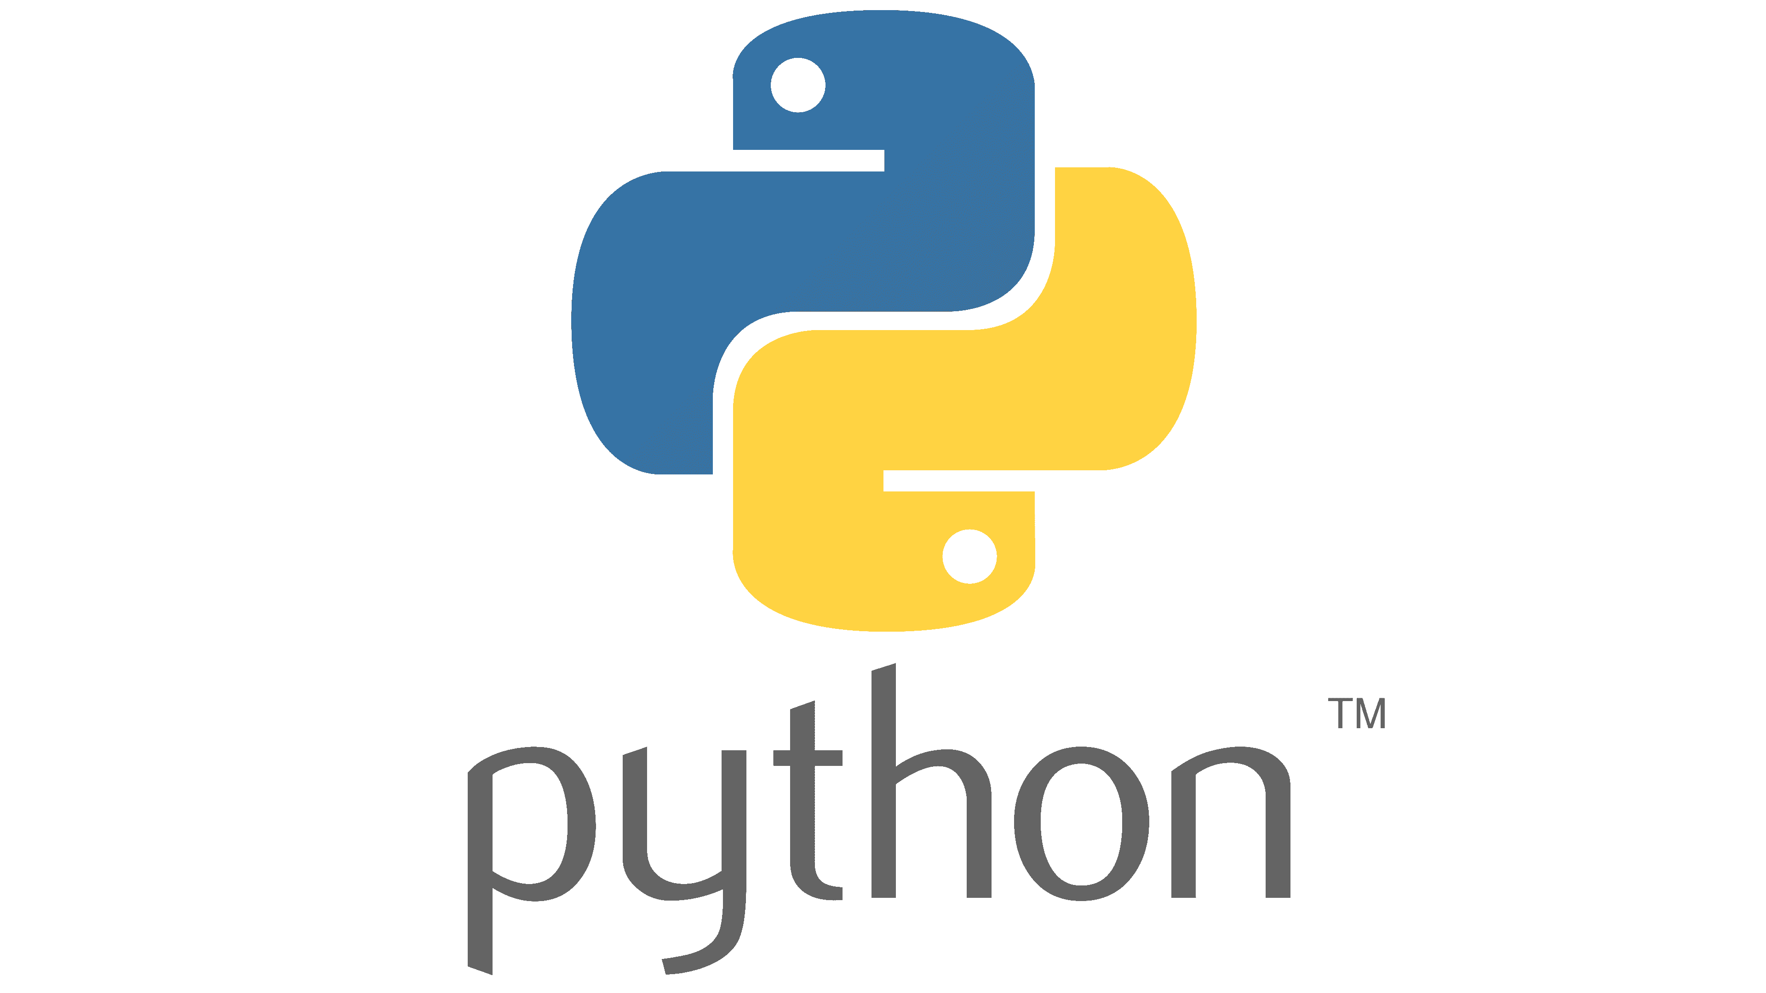
What is Python?
A readable computer programming language
Data science and machine learning
Automation (think factory robots!)
Web development (Netflix, Spotify etc)
etc

Slide 5
Python Code

Slide 6
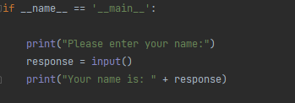

Printing & Input
Printing is your friend and can really help you when you are writing python code
You can print almost anything to the console in python
Input from you (e.g. typing something, clicking a button etc) is also sometimes a feature of a program
Exercise:
Print the following to the console:
“Would you like to try again? (Yes/No)”
Get the input from the user
Print the user input:
“You answered: user input”

Slide 7
Congratulations! You ran your first Python program!

Slide 8
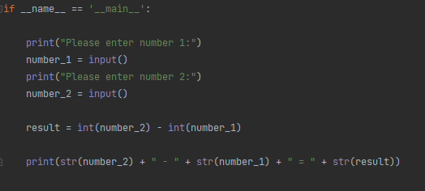
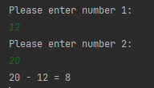
Variables
Numbers
With/without decimal
Maths:
Addition: +
Subtraction: -
Multiplication: *
Division: /
Strings
Add strings to make sentences
Exercise:
Get 2 numbers from the user and print the sum of them

Slide 9
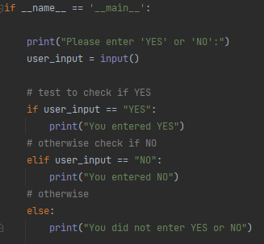

if, elif, else
A simple way to control what parts of your get run is by using what are called if, elif and else conditions
To control the “flow” of your code, you can check conditions respond to them
Exercise:
Ask the user to enter “+”, “-”, “/”, “*”
Test the user input and print:
“You selected: user input”

Slide 10
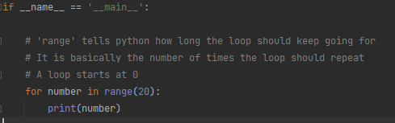
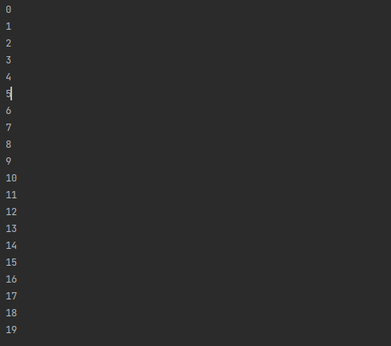
Loops – ‘for’ loop
Loops are used to do repetitive tasks
Examples:
Do something with each item in a sequence of items
Ask a user for input repeatedly
Print something repeatedly
for loops are one way to implement a loop in Python
Exercise:
Print the numbers 0-9 with each on a new line using a for loop

Slide 11
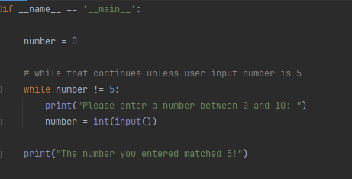
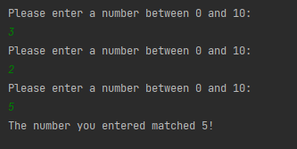
Loops – ‘while’ loop
while loops are another way to implement loops in Python
Exercise:
Implement a while loop that asks the user if they would like to continue (i.e. “Would you like to continue? (Yes/No)
Exit the loop if “No”

Slide 12
Functions
A function is a block of code that only runs when its called
Data/values passed into functions are known as inputs
In programming terms they are known as arguments
If the function gives something back, this something is known as the output
In programming terms this is the returned value
Input(s)
Function
Output(s)

Slide 13
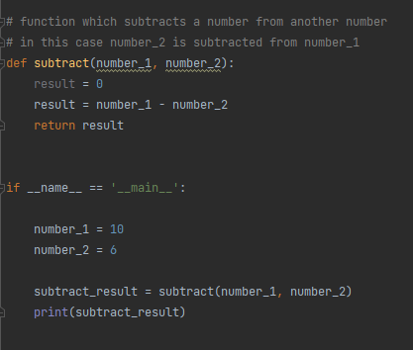
Functions continued.
Functions should be simple and only do one thing
Examples:
Perform basic maths operations on inputs
Print a string input
If you find yourself repeating pieces of code in your program – try put it in a function
Exercise:
Write a function that takes 2 numbers as inputs and returns the sum of the 2 numbers

Slide 14
Task

Slide 15
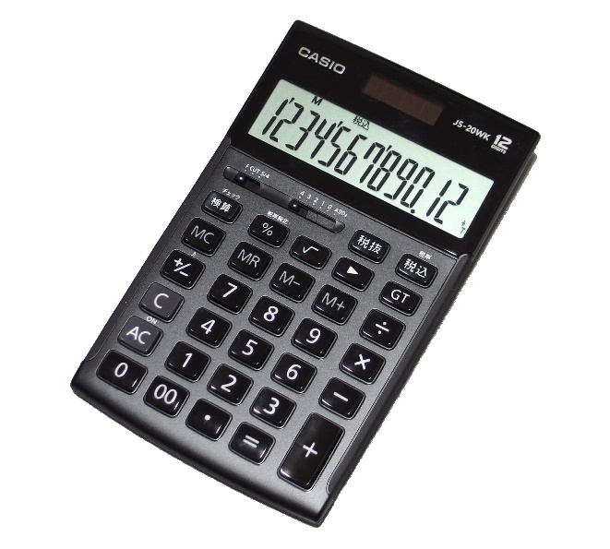
Calculator
Implement a basic calculator
The user should be asked to input 2 numbers:
The user should be asked to input the operation:
Addition (+)
Subtraction (-) (subtract the 2nd number from the 1st)
Division (/) (divide the 2nd number by the 1st)
Multiplication (*)
Your program should perform the chosen operation on the 2 numbers
Show the result to the user (print the result)
Bonus:
Implement a loop that asks the user if they would like to try again
If yes repeat the above, if no end the program

Slide 16
Calculator – continued.
Everything you need is in the examples shown, or in the short exercises
And of course, if you have any questions please don’t hesitate to ask Fiachra or Gus

Slide 17
Other

Slide 18
Calculator extra task
Add a square root operation (for example sqrt(4) = 2)
You must add this line to your file
import math
Add a power operation (for example 2^3 = 8)
Add a ANS operation (remember the previous calculation)

Slide 19
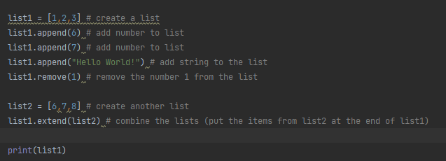
Lists
Lists are used to group data and store them together in a single variable
Items can be added and removed from lists easily
Lists can be added together to create one long list
Exercise:
Create a list of 5 numbers and print it

