Slide 1
ABC Corporation - Weekly Performance Report
Reporting Period: 2025-11-24 to 2025-11-30
Generated by Automated Insight Engine

Slide 2
Executive Summary
The marketing account delivered strong performance this week, generating over 1.25 million impressions and securing 11,846 total conversions. The overall efficiency was high, with a strong conversion rate of 11.60 percent and an average cost per acquisition stabilizing at an efficient $2.21.
Campaign APP01 was the strongest performer, driving the highest volume of conversions at 6,210 while maintaining the most efficient cost per acquisition of $2.04. Campaign BA01 also showed excellent engagement, achieving the highest click-through rate at 10.20 percent and a very strong CPA of $2.13. Conversely, Campaign WS01 requires immediate attention as it demonstrated the lowest click-through rate at 5.10 percent and the highest cost per conversion, reaching $3.86. Campaign RT01 performed adequately with a CPA of $2.43 but showed lower engagement than the top two campaigns.
We recommend increasing the budget allocation for Campaigns APP01 and BA01 to maximize volume while efficiency is high. We should simultaneously reduce or pause spending on Campaign WS01 while the team investigates why its cost per conversion is significantly higher than the account average. We will also analyze the ad creatives used in Campaign RT01 to identify opportunities for improving its click-through rate.

Slide 3
Key Highlights
1,250,000 impressions, 102,080 clicks and 11,846 conversions this week.
CTR held at 8.17% with an average CPC of 0.26 and CPA of 2.21.
APP01 was the strongest driver of conversions with 6,210 conversions.
WS01 shows the highest CPA at 3.86, indicating a focus area for optimization.

Slide 4
KPI Dashboard
Impressions: 1,250,000
Clicks: 102,080
Conversions: 11,846
Spend: 26190.00
CTR: 8.17%
CPC: 0.26
CVR: 11.60%
CPA: 2.21

Slide 5
Top Campaigns (by Spend)
Campaign | Impr. | Clicks | Conv. | Spend | CTR | CPC | CPA
APP01 | 419,500 | 41,700 | 6,210 | 12650.00 | 9.94% | 0.30 | 2.04
BA01 | 324,000 | 33,050 | 3,420 | 7280.00 | 10.20% | 0.22 | 2.13
RT01 | 302,000 | 16,900 | 1,610 | 3920.00 | 5.60% | 0.23 | 2.43
WS01 | 204,500 | 10,430 | 606 | 2340.00 | 5.10% | 0.22 | 3.86

Slide 6
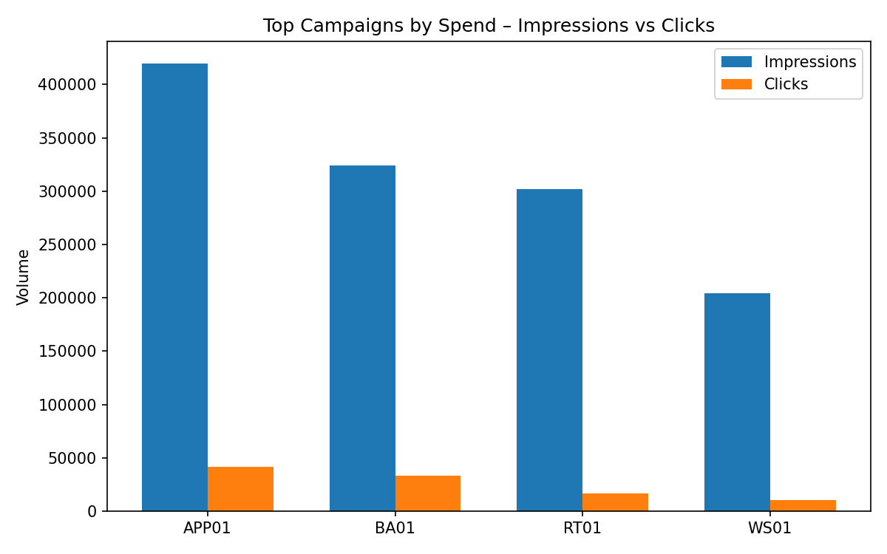
Top Campaigns – Impressions vs Clicks

Slide 7
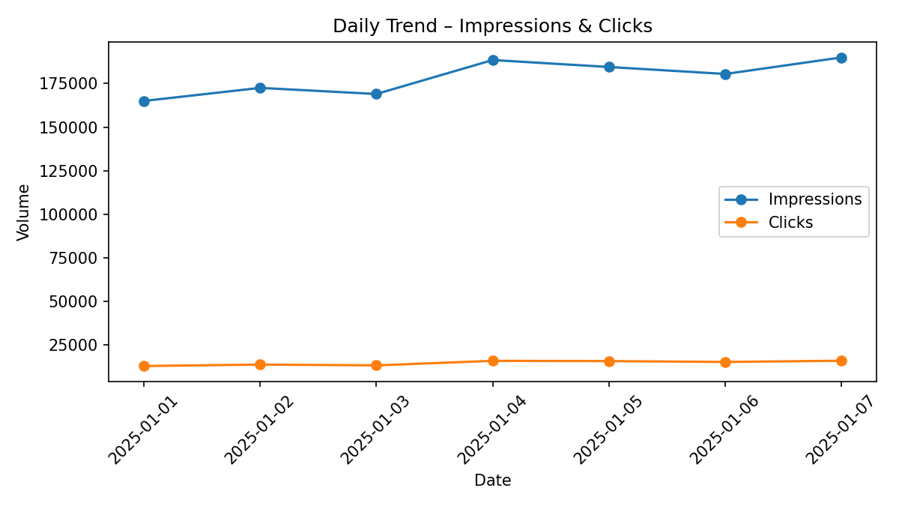
Daily Trend – Impressions & Clicks

Slide 8
Optimization Plan
Prioritize budget allocation towards high-CVR campaigns (APP01, BA01) and low-CPA campaigns (APP01, BA01).
Review targeting, creatives and landing pages for higher-CPA campaigns (WS01, RT01) to improve efficiency.
Plan structured A/B tests for creative and audience combinations and consolidate learnings weekly.

Slide 9
Glossary
CTR (Click-Through Rate): Percentage of impressions that resulted in clicks.
CVR (Conversion Rate): Percentage of clicks that resulted in conversions.
CPA (Cost Per Acquisition): Average cost required to generate a single conversion.

Slide 10
Thank You
Report generated by the Automated Insight Engine for ABC Corporation.
For questions or further deep dives, please reach out to your account team.

