Slide 1
Personalized Federated Learning for Explainable and Privacy-Preserving Disease Risk Prediction in Heterogeneous Healthcare Systems
Course Code: PBL-3 (CSP-391) | Zeroth Evaluation | Sharda University
Project Team Members:
1. Teena Kalia (System ID: 2024318098) - Data & FL Engineer (Role A & B)
2. Muntaha Malik (System ID: 2024344225) - ML & Full-Stack/XAI Developer (Role C & D)

Slide 2
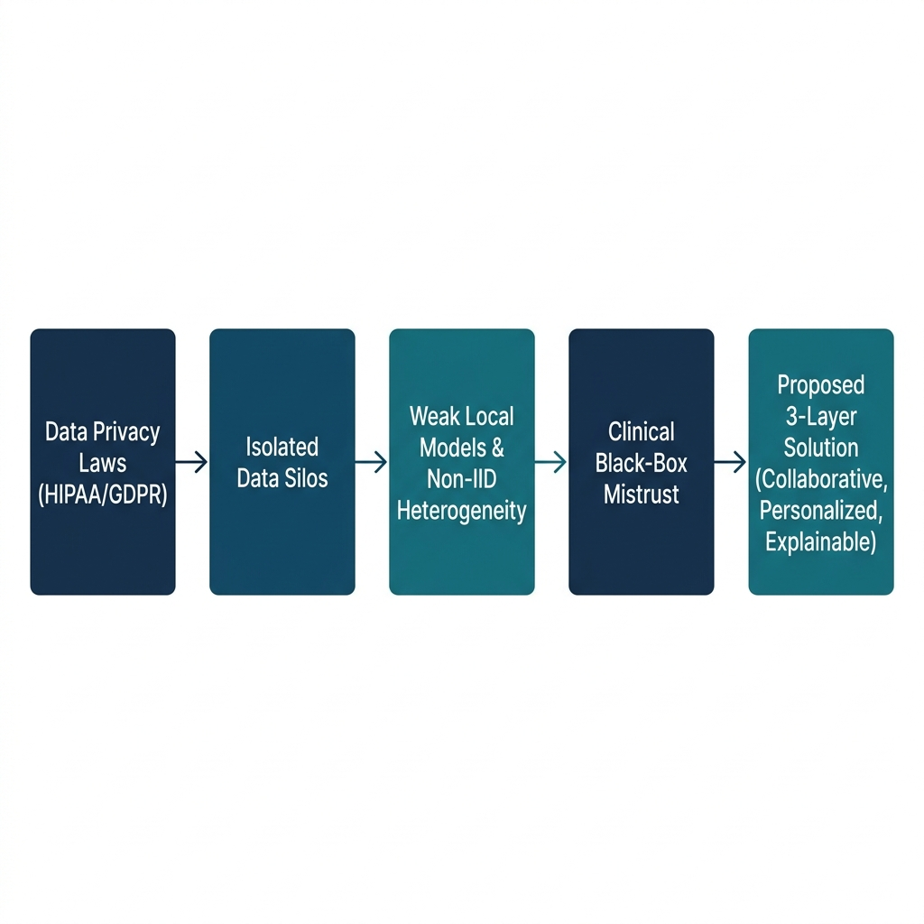
The Core Problem: Healthcare AI Barriers
Siloed Institutional Data:
• Strict privacy laws (HIPAA/GDPR) prevent centralizing patient records.
Statistical Population Skew:
• Standard global FL (FedAvg) fails to generalize to non-IID clinical distributions.
Clinical Black-Box Trust Barrier:
• Clinicians reject unexplained model predictions carrying malpractice liabilities.
Formal Goal: min_{θ_1...θ_K} ∑ p_k L_k(θ_k) collaboratively and adaptively without sharing raw records.

Slide 3
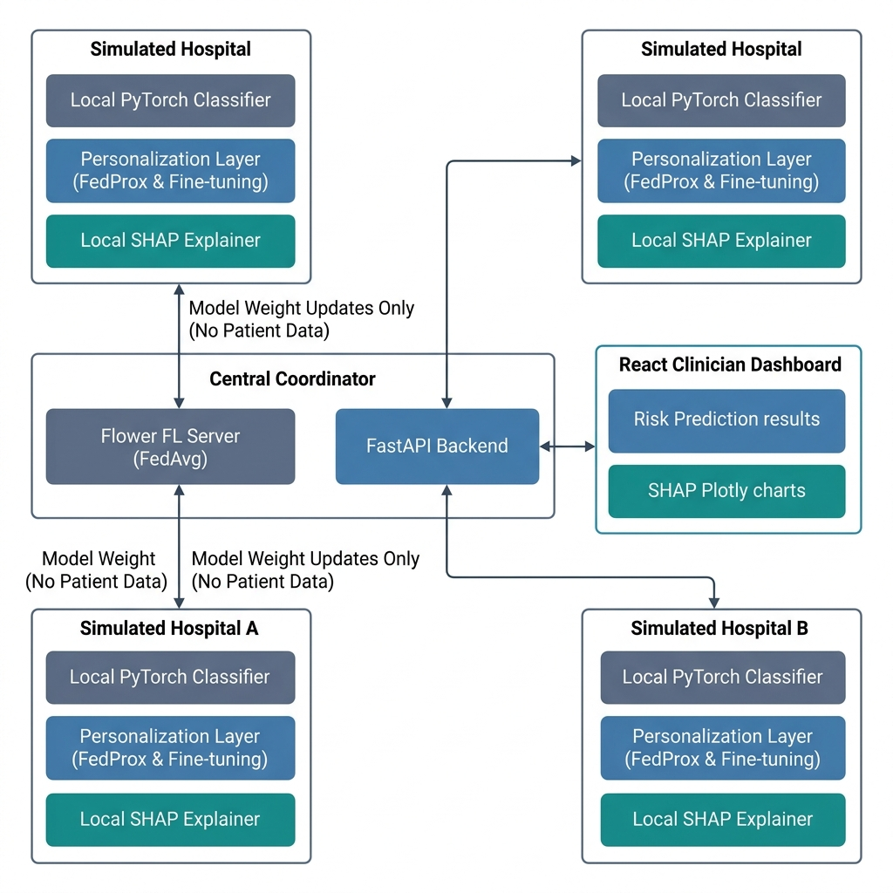
Our Solution: The 3-Layer Approach
Layer 1: Collaborative Federated Learning
• Coordinates parameter updates using Flower server; raw records never leave clients. Solves Data Silos.
Layer 2: Statistical Personalization
• Applies FedProx optimizer to regularize local updates, followed by final-layer fine-tuning. Solves non-IID Skew.
Layer 3: Post-Hoc Explainability
• Instantiates SHAP engine locally inside client nodes to map patient feature attributions. Solves Black-Box Barrier.

Slide 4
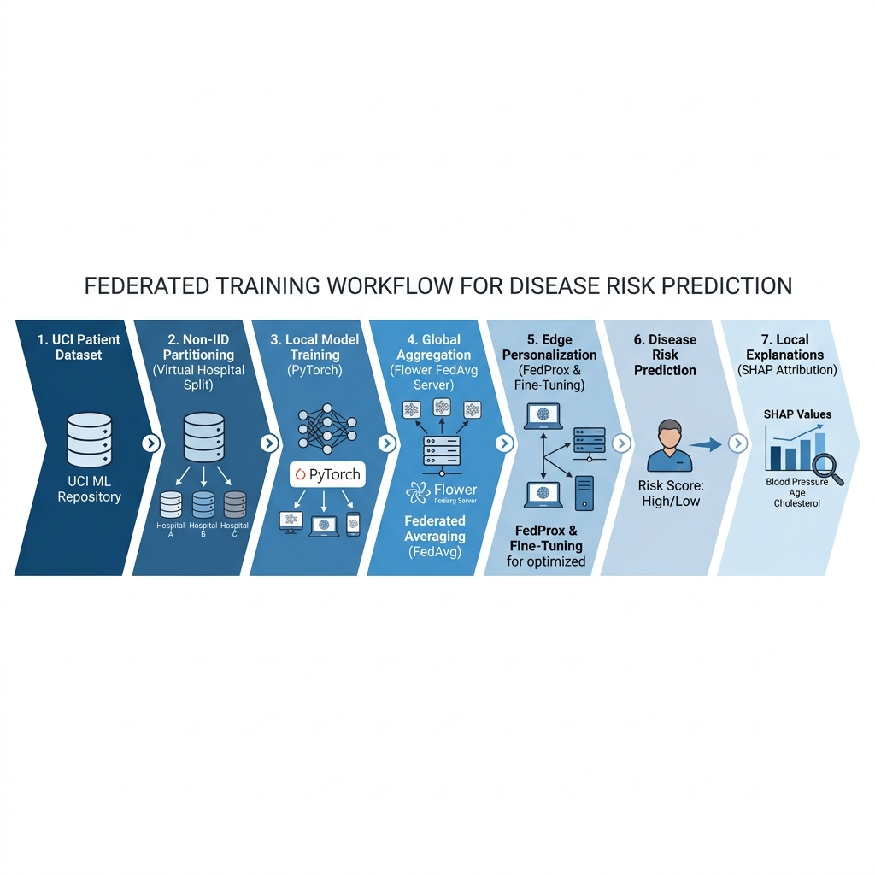
End-to-End Pipeline & Workflow
• Data Partitioning: UCI dataset split into non-IID clinical client partitions (representing hospitals).
• Collaborative Learning: Local PyTorch loops coordinate parameter training; weights aggregated globally.
• Local Adaptation: FedProx proximal term regulates updates, specialized post-FL via final-layer fine-tuning.
• Point-of-Care Trust: Clinician dashboard queries FastAPI to render risk probabilities and SHAP Plotly charts.

Slide 5
Research Foundation & Identified Gap
Literature Survey Foundation:
• Evaluated 49 entries (48 unique papers) across 4 thematic areas:
1. FL Fundamentals 2. FL in Healthcare 3. Personalized FL 4. Clinical XAI
Identified Academic Research Gap:
• No existing clinical framework combines collaborative model training, local personalization (FedProx), and local-only, edge-decoupled SHAP attributions for tabular risk prediction tasks.
• Existing clinical XAI literature is biased toward centralized imaging and lacks decentralized explanations generated at the client boundary without exposing patient cohorts.
Research Question: Can a personalized federated approach match centralized diagnostic performance under privacy constraints, while delivering consistent, clinician-grounded trust?

Slide 6
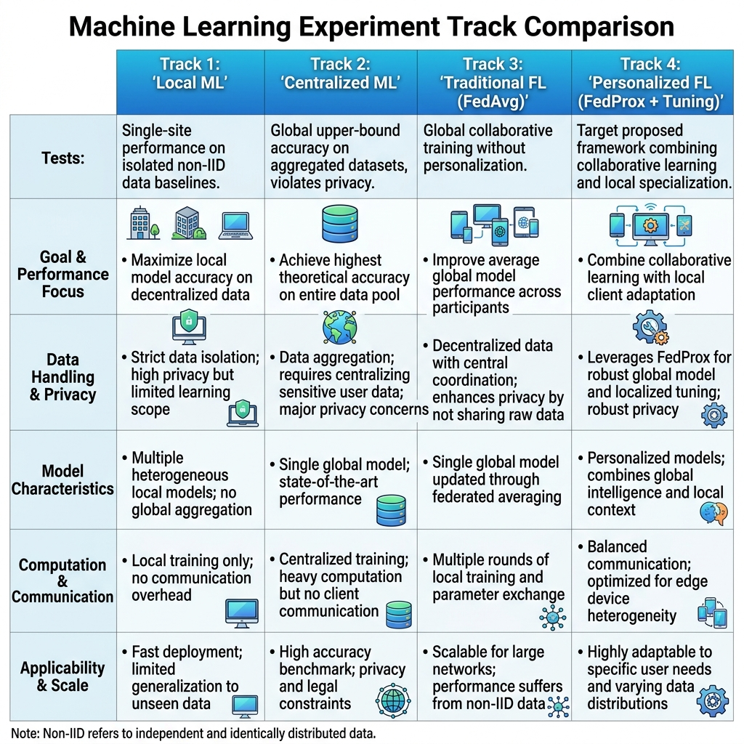
Experimental Plan & Success Condition
Four-Track Comparative Evaluation:
• Tracks: Local ML (Siloed baseline), Centralized ML (Upper bound), FedAvg (Standard FL), Personalized FL (FedProx + tuning).
Evaluation Metrics:
• Utility: Accuracy, Precision, Recall, F1-Score, and AUC-ROC.
• Efficiency: Communication rounds, total bytes sent, wall-clock time.
• XAI: SHAP explanation ranking stability across client nodes.
Project Success Definition:
• Personalized FL outperforms plain FedAvg on hospital-specific test accuracy, while local SHAP values consistently highlight clinical features.

Slide 7
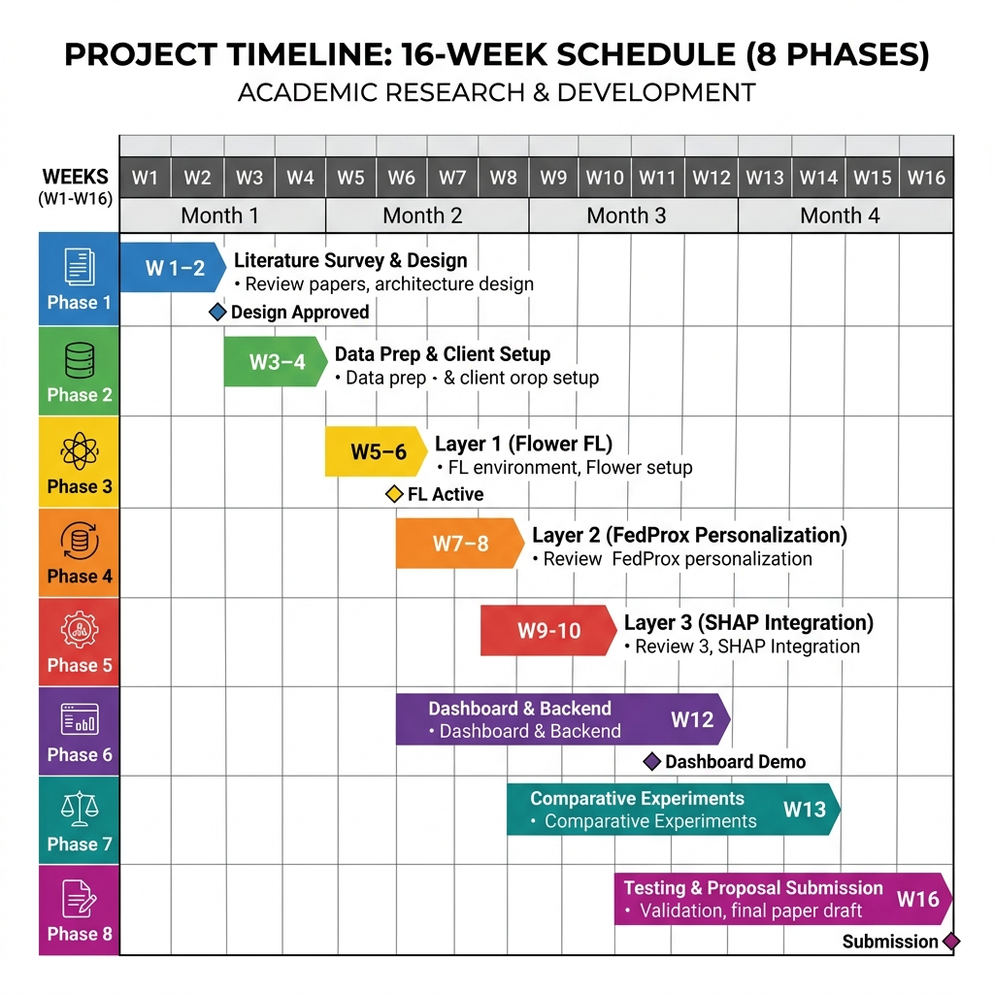
Roadmap, Technology Stack, & Closing
Technology Stack:
• ML & FL: PyTorch, Flower FL, SHAP
• Product: FastAPI (Backend), React (UI), Supabase (Log Database)
Core Project Value:
• Unifies collaborative learning, statistical customization, and point-of-care interpretability in a zero-budget, open-source stack.
• Demonstrates equitable diagnostic care across medical networks, protecting patient privacy while enabling clinician validation.

