Slide 1


Aum Amriteshwaryai Namaha !
Miniaturized Power Divider With Triple-Band Filtering Response Using Coupled Line
IEEE Access, vol. 11, pp. 27602-27608, 2023.
Group No : B15
Student Names: TEENA.S ,MADDU SIRI VARSHINI, MANASA MURALI, KANIMOZHI HARSHINI.M
Roll No.s: AM.EN.U4ECE22144, AM.EN.U4ECE22150,AM.EN.U4ECE22152, AM.EN.U4ECE22157
19 ECE 381 RF & Simulation Lab

Slide 2
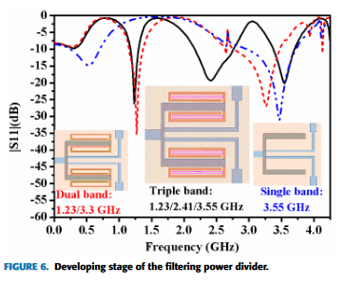


Abstract
This paper introduces a miniaturized power divider that uses coupled lines to achieve a triple-band filtering response.
The design integrates Wilkinson power divider principles with bandpass filters using coupled-line resonators.
The setup includes an isolation resistor and micro strip resonators, producing passbands at 1.23 GHz, 2.41 GHz, and 3.55 GHz. By adjusting structural parameters, the resonance frequencies can be controlled.
This compact design is suited for L-band, WLAN, and sub-6 GHz 5G applications.
Results
Operating frequencies: 1.23 GHz, 2.41 GHz, 3.55 GHz
Bandwidth:
20% (1.1-1.35 GHz)
37% (2.0-2.9 GHz)
15% (3.25-3.8 GHz)
Insertion Loss:
1.0 dB, 0.2 dB, and 0.2 dB across the three passbands.
Compact Design:
Size reduced to 25 mm × 30 mm
(0.10λg × 0.12λg).

Slide 3
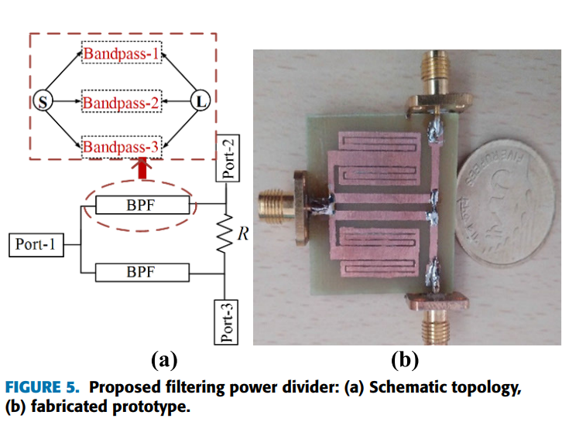
Context of the paper
Basic Theory of the Device:
A power divider splits input power into multiple outputs. Unlike traditional Wilkinson Power Dividers (WPD), which use quarter-wave transmission lines, this design employs coupled-line microstrip resonators for multi-band filtering at specific frequencies. Key features include:
Coupled-Line Resonators: Generate inductance and capacitance for resonance, enabling triple-band filtering.
Triple-Band Filtering: Supports 3 pass-bands, enhancing versatility.
Isolation Resistor: Enhances signal isolation between output ports.
Application Domain:
Designed for wireless communication systems, including:
L-band: Satellite systems (1.23 GHz).
WLAN: Wi-Fi networks (2.41 GHz).
5G Sub-6 GHz: Mobile and 5G infrastructure (3.55 GHz).
(Dilip Kumar Choudhary et al., IEEE Access, Vol. 11, 2023, pp. 27602-27608)

Slide 4
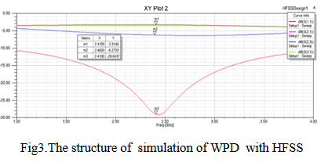
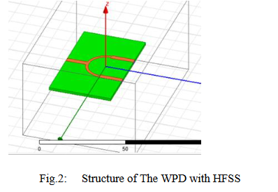
Objectives of the paper
Old system
Key parameters of the old system are:-
Insertion Loss: Limited performance at approximately -3dB.
Return Loss: Moderate levels, unspecified but not optimized for WLAN
Isolation: Restricted bandwidth and isolation performance.
The paper highlights that the traditional WPD, despite its simplicity, has restricted bandwidth and requires improvement in isolation and insertion loss.

Slide 5
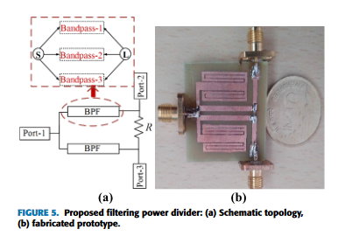
Objectives of the paper
New system
Integrated triple-band filtering using coupled-line resonators.
Improvements:
Size reduction by replacing quarter-wave transformers with coupled-line sections.
Multi-band operation with improved isolation and selectivity.
Performance Parameters of the New System/Device
Operating Frequencies: 1.23 GHz (L-band) ,2.41 GHz (WLAN) and 3.55 GHz (5G sub-6 GHz)
Size: 0.10λg × 0.12λg (25 mm × 30 mm)

Slide 6
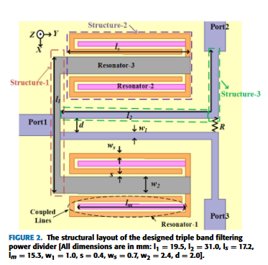
Methodology
Proposed Device Structure Taken from the Paper
The proposed device is a miniaturized triple-band filtering power divider (FPD) using coupled-line microstrip resonators. The structure includes:
Three resonators: Resonator-1, Resonator-2, and Resonator-3 for generating triple-band responses.
Isolation resistor: Enhances isolation between output ports.
Compact size: 0.10λg × 0.12λg (25 mm × 30 mm).
Citation:(Dilip Kumar Choudhary et al., "Miniaturized Power Divider With Triple-Band Filtering Response Using Coupled Line," IEEE Access*, vol. 11, pp. 27602-27608, March 2023)*.

Slide 7
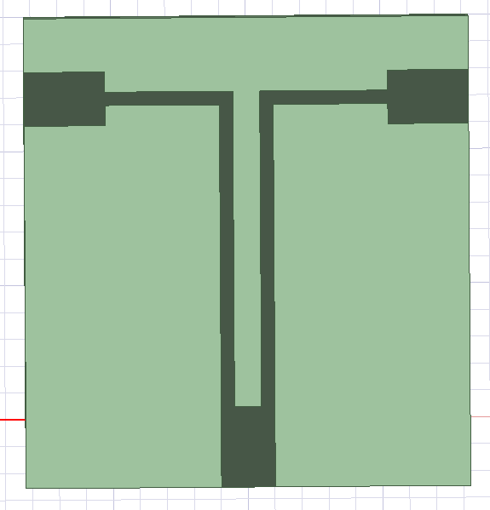
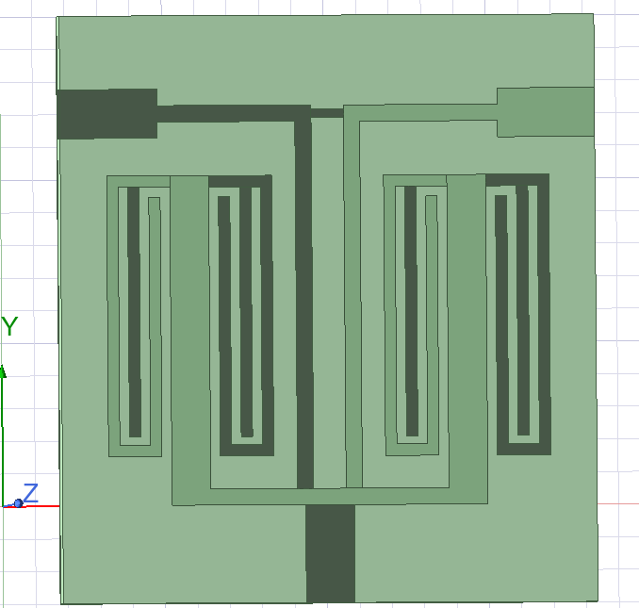
Methodology
Wilkinson power divider
Power Divider With Triple-Band Filtering Response

Slide 8
Results
Resonant Frequencies:
1.23 GHz (L-band)
2.41 GHz (WLAN)
3.55 GHz (5G Sub-6 GHz)
Insertion Loss:
1st Band (1.23 GHz): 1.0 dB
2nd Band (2.41 GHz): 0.2 dB
3rd Band (3.55 GHz): 0.2 dB
Isolation:
Above 18 dB for all passbands.
Fractional Bandwidths:
20% (1.1 GHz to 1.35 GHz)
37% (2.0 GHz to 2.9 GHz)
15% (3.25 GHz to 3.8 GHz)
Compact Design:
The power divider’s dimensions: 25 mm × 30 mm
Simulation Results:
Resonant Frequencies:
1.2275 GHz , 2.1812 GHz ,3.4937 GHz
Insertion Loss:
1st Band (1.2275 GHz): 0.7dB
2nd Band (2.1812 GHz): 0.6dB
3rd Band (3.4937 GHz): 0.5dB
Isolation: >18 dB for all passbands
Fractional Bandwidths:
22.1%(1.0875GHz to 1.3587GHz)
35%(1.91GHz to 2.6625GHz)
13%(3.2662GHz to 3.72037GHz)
Compact Design:
The power divider’s dimensions: 33 mm × 36 mm

Slide 9
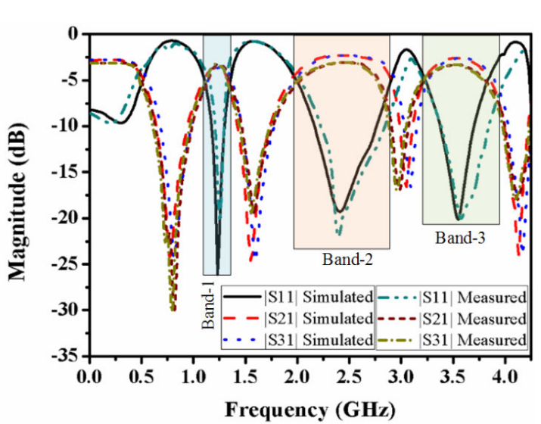
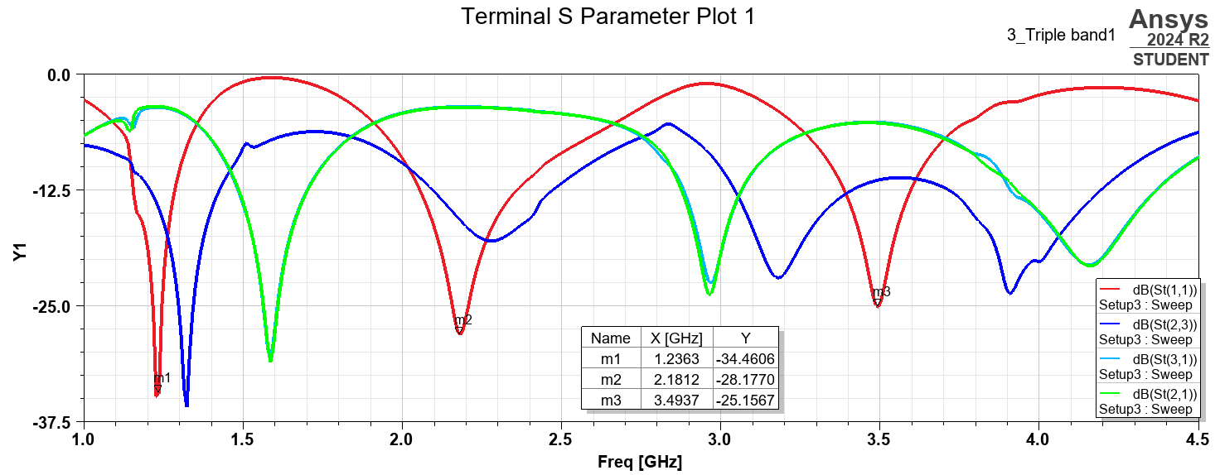
Results
S-parameter plot shown in paper,
vol. 11, pp. 27602-27608, March 2023
Simulated S-parameter plot

Slide 10
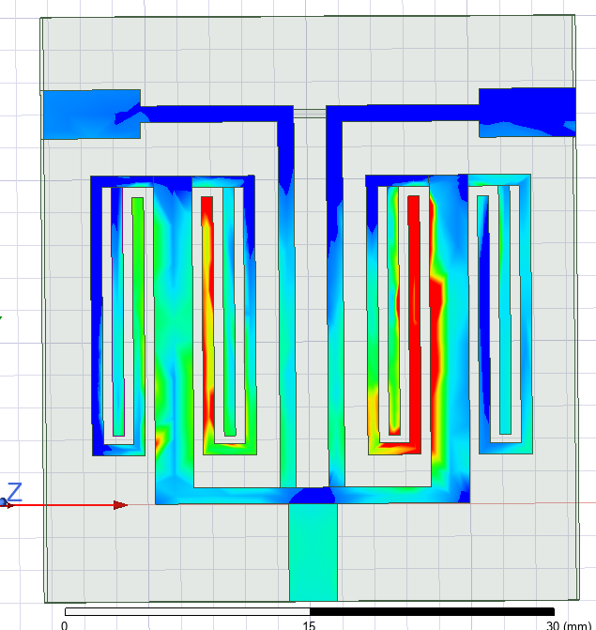
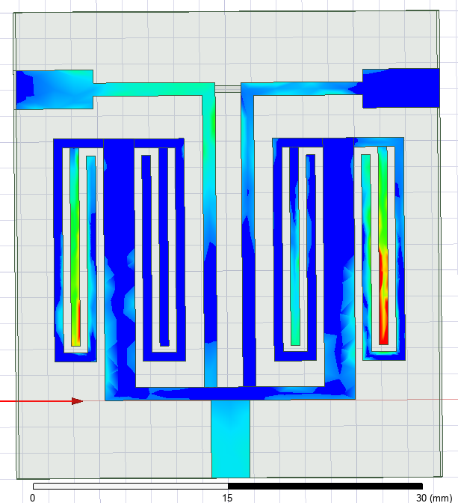
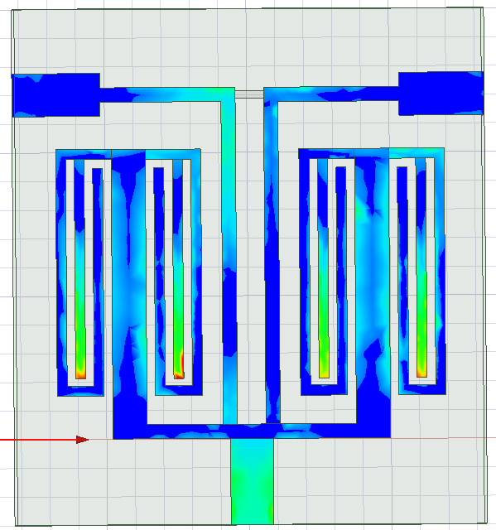
Results
E-field distribution of presented tri-band FPD:
1.23GHz
2.41GHz
3.55GHz

Slide 11
Contribution from each member
TEENA .S - AM.EN.U4ECE22144 – SINGLE BAND
MADDU SIRI VARSHINI - AM.EN.U4ECE22150 –TRIPLE BAND
MANASA MURALI - AM.EN.U4ECE22152 – DOUBLE BAND
KANIMOZHI HARSHINI .M - AM.EN.U4ECE22137 –WILKINSON POWER DIVIDER

