Slide 1
Lending Club Case Study
-Teenu Francis

Slide 2
Problem Statement:
Lending Club Case Study involves the identification of the methods to minimize the risk of financial loss incurred by the Banking and Financial institutions post loan acceptance, using the techniques of EDA and the understanding of Risk Analytics.

Slide 3
Steps in the Analysis:
Understanding the requirement
Understanding the Risk analysis domain
Understanding the data
Identifying the key factors
Cleansing the data
Identifying the techniques of EDA
Applying the EDA concepts in the python program

Slide 4
Key Variables considered :
loan_status: Loan Status
annual_inc: Annual Income
home_ownership: Home Ownership
pub_rec_bankruptcies: Public Record of Bankruptcies
funded_amnt : Funded/Loan Amount
int_rate :Interest Rate of the Loan
Purpose: Purpose of the Loan
delinq_2yrs: No. of days past due
pub_rec : Derogatory Public Records

Slide 5
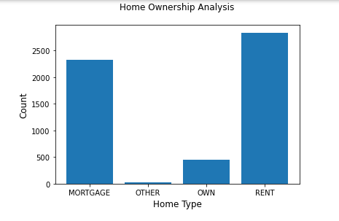
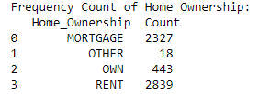
Univariate Analysis: Home Ownership field Analysis
The higher number of individuals with Charged Off loans have Home Ownership as 'MORTGAGE' and 'RENT' so they are likely to default the payment.

Slide 6
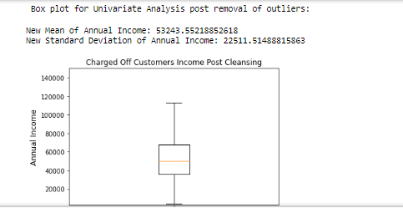
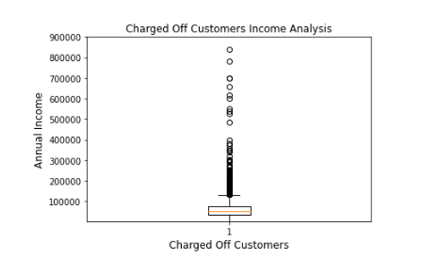
Univariate Analysis: Annual Income field
Box plot is used for the analysis before and post removal of outliers. The low Annual Income of the customers is a cause for the defaulting of loans.
Box plot post removal of outliers:

Slide 7
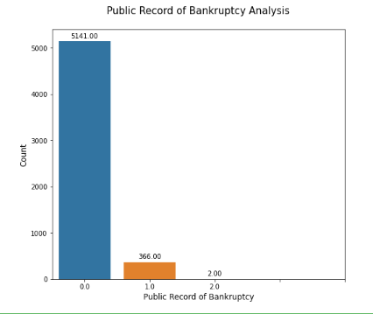

Univariate Analysis: Public Record of Bankruptcy Analysis
Individuals who are listed as bankrupt are less likely to pay the loan.

Slide 8

Bivariate Analysis :Finding the Correlation Coefficient
The Funded Amount and the Interest Rate have a positive correlation, as the Funded Amount increase, the Interest Rate also increases and hence difficulty of repayment of the loan increases.

Slide 9
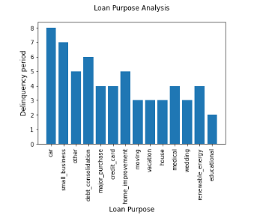
Bivariate Analysis: Purpose of Loan verses Delinquency
The loan taken for the purpose of Car and Small business have higher delinquency as when compared to the other types of loans, hence there are more number defaulters for those who have taken Car and Small business loans.

Slide 10
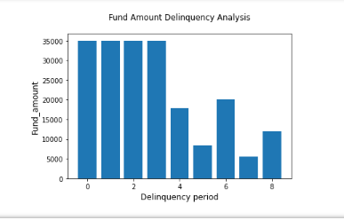
Bivariate Analysis :Fund Amount Delinquency Analysis:
Graph shows the maximum Fund Amounts for which the Delinquency is observed.

Slide 11
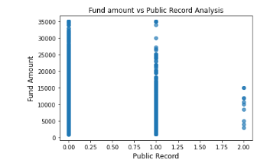
Bivariate Analysis :Fund amount verses Public Record Analysis
Graphs shows that there are many individuals who have been listed on derogatory Public records, those with one or more than 1 public records are likely to default the loan.

Slide 12
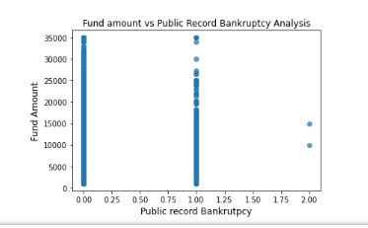
Bivariate Analysis: Fund amount verses Public Record Bankruptcy Analysis
Graphs shows that there are many individuals who have been listed on Public record Bankruptcies, those with one or more than 1 public record bankruptcies are likely to default the loan.

Slide 13
Thank you!

