Slide 1
Server
Cloud(AWS) vs Server
Server | Cloud(AWS) | Computer Server
Price start | ~2k/mo Total =2k | OS (30k) Computer (20k-30k ) Electric bill (150/mo) Total =60.1k
Price per year | Total =24k | -Maintenance (might be) 10k Electric bill 1.8k/year Total = 60.1k + 12k =>72k
Price paid in 10 years | 240k | Total = 60.1k + 120k =>180k
Maintenance | No need | Have to
** I suggest to start with AWS for fast production and switch to computer server when production become larger scale
Notes:
https://aws.amazon.com/lightsail/pricing/

Slide 2
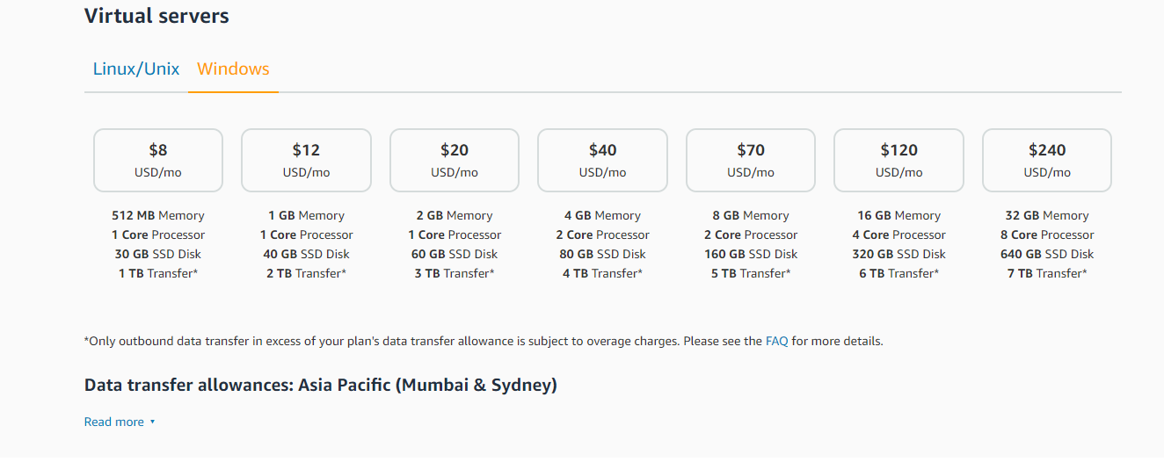
AWS

Slide 3
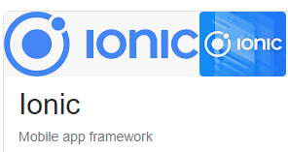
Plan for technology
Start with Cross platform (base on web)
Pros : starting with WebApp ,no cost for deployment
Android: 25 USD, IOS : 99 USD/year
Can be convert to android or ios whenever with one source code
Hence, in single dev output is Web, android and IOS
Cons : not native application so some of feature is not support
e.g., shaking
App is slower than native 20% because web view.
There is not okay when render thousand of item List

Slide 4
Features
Users Master
Users
Points ,Lotto
Store location Suggestion
Ads / Events/ Promotion
Wongnai POS
Interface data from back office

