Slide 1
Features
User Profile Master
List Products
Get Points/Lotto
Check Status Lotto
Give reward to user
Show List of store in map (Optional)

Slide 2
User Profile Master
Login by using Google+,Facebook or UsernamePassword(Email)
Change profile
Change Password (in case binding with Email)

Slide 3
List Products
Show list all products
Show ads (Banner)
Update news with push notification

Slide 4
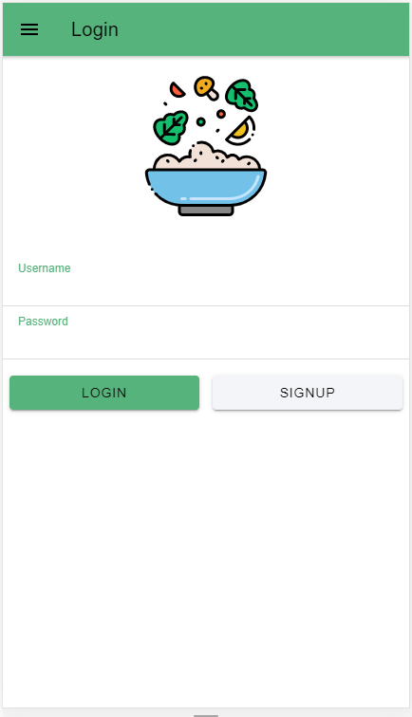
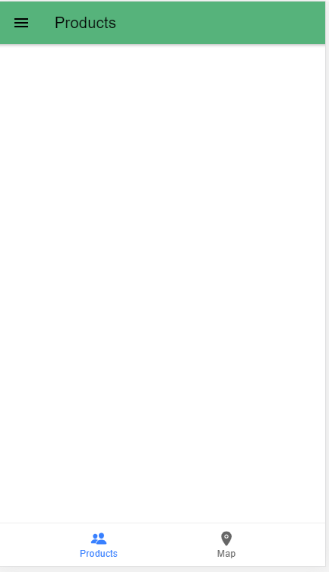
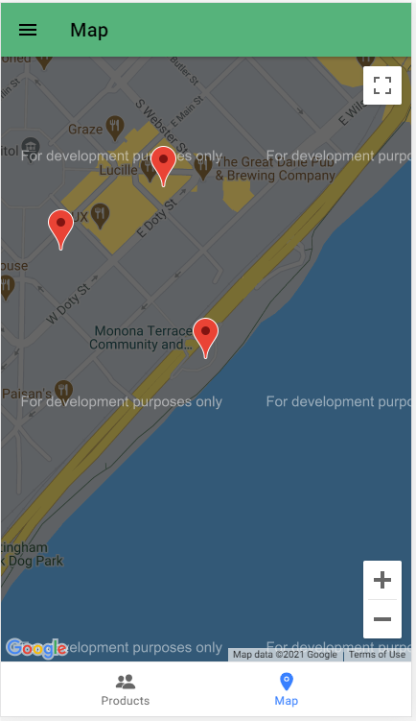


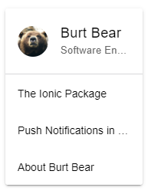




Slide 5
Get Points/Lotto
Scan barcode to get point
Scan barcode to get rights of lotto
Passing token from barcode and fire to API

Slide 6
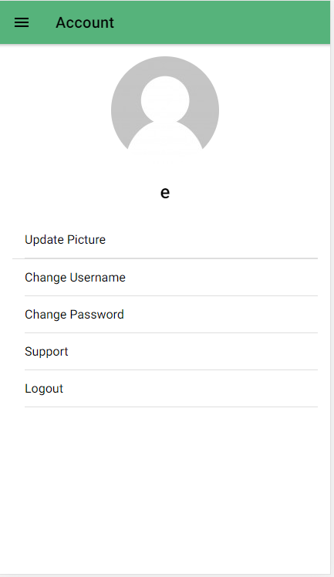
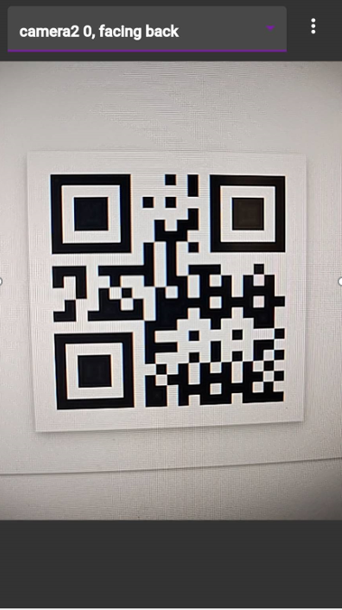
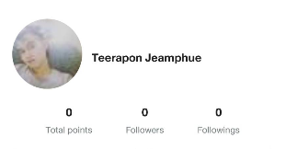
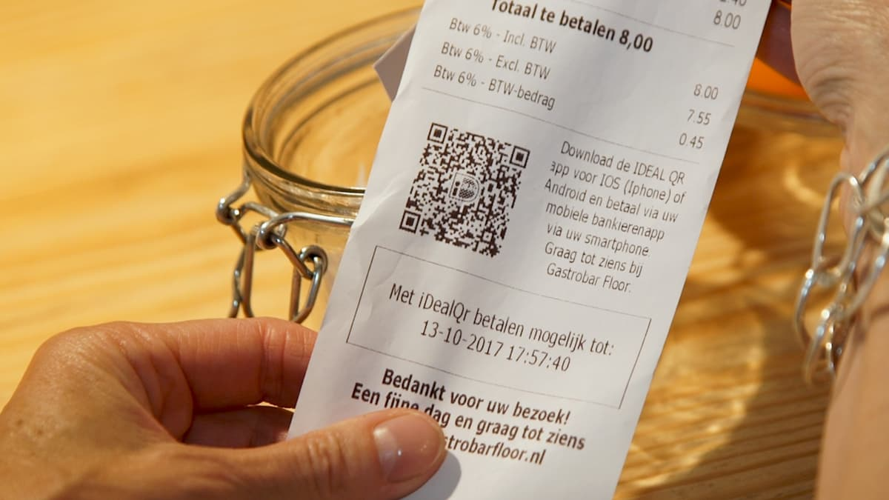



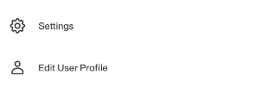

Slide 7
Check Status Lotto
Show status of lotto
Define period of lotto (daily/monthly/yearly)

Slide 8




Lotto
502,677 บาท
27 March 2021
08:08:08
รายชื่อผู้โชคดี

Slide 9
Give reward to user
Admin can check data of lucky user ‘s profile (Phone_no)
Manual give reward to user from calculated data.
System update data after rewards are given.

Slide 10
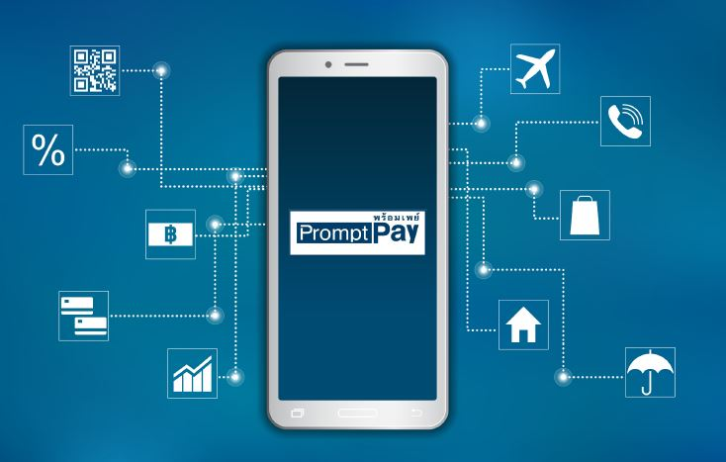
Back Office show User Profile,
Admin Validate Name before transfer

Slide 11
Show List of store in map (Optional)
Show and mark all store in map

Slide 12
POS
Feature
Registration stores
BranchName,owner_name,location,trasactionData
TransactionData
Stock management
Invoice
Generate token barcode
Refer from Loyverse

Slide 13
Registration stores
Registration state
Approve state
Refill stock

Slide 14
Transaction Data
Orders
Lotto ID
Calculate remain stock

Slide 15
POS BackOffice(Web)
Create Product
Manage Sellers/Customers
Show transactions
Show Lotto userProfile to confirm give reward

Slide 16
POS Client
Create invoice
Show list of transactions
Print invoice

Slide 17
Flow TaYou
Customers*
Store
Back Office
Order
Create Invoice
Insert Transaction
Paid
Scan Lotto
Generate Lotto
Get Lucky
Random Lucky
Give Reward
* Customers must validate Phone_no( and Name) in PromtPay

Slide 18
Require Items
 | Unit(s) | Price
Server AWS | 1 | 4,200฿(120$) per month
Printer | 100 | 105,900฿ (1,059฿)
GoogleAPI | 1 | 10,500฿(300$) (Only pay for what you use)
Google Store Account | 1 | 875฿(25$)
Apple Store Account | 1 | 3,465฿(99$) per year
Summary |  | 125,040฿
Software
 | TimeSpend | Price
TaYou App | 2.5 + 1 Months (12months) | 130,000฿
TaYou POS Client | 4 + 1.5 Months (12months) | 150,000฿
TaYou BackOffice | 2 + 1 Months | 650,000฿
Summary |  | 1,030,000฿*
*Software advance 50%

