Slide 1
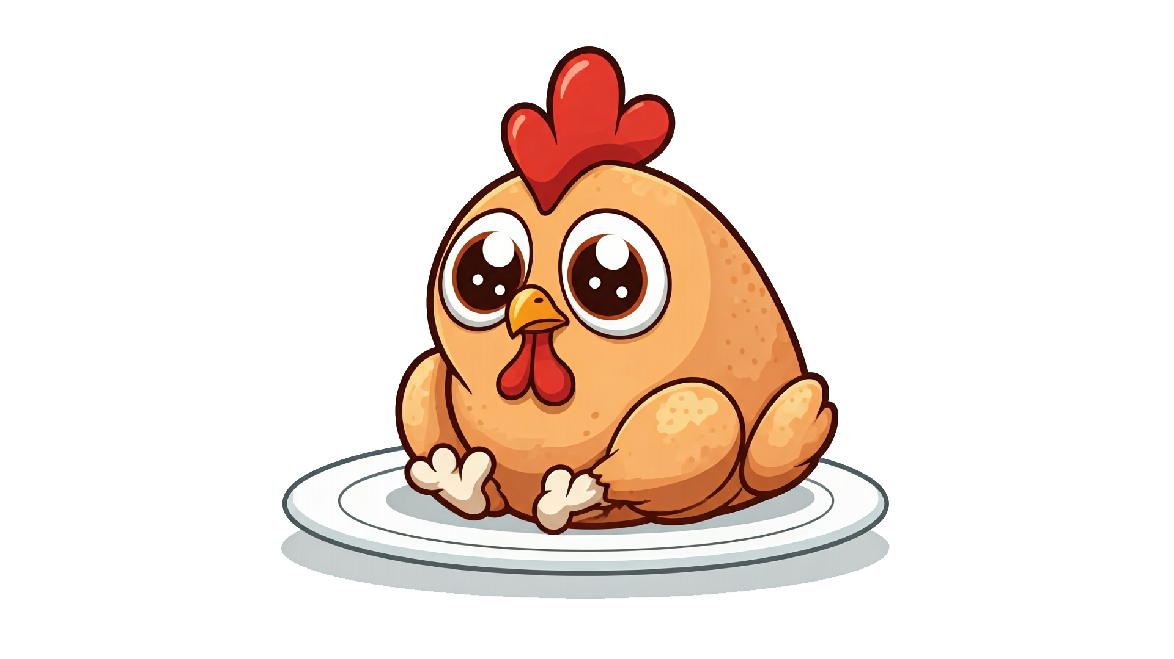


Chicken Boneless
Teerapath Keawratana
Notes:
Greeting audience

Slide 2
Over view
concept: the chicken has to escape from the enemy and shoot an enemy with the bone to collect more score.
Genre: Arcade, Shooting
Target audience: casual gamers, competitive players
Notes:
Story: ck run away from kitchen, but still in dining room

Slide 3
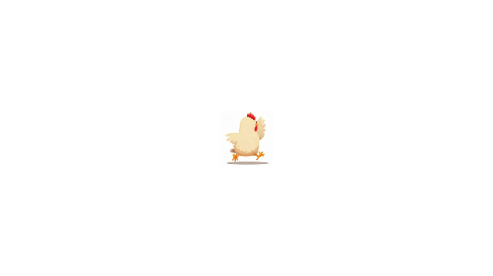

Player control
W
Left Click
A
D
S
Notes:
Chicken movement

Slide 4
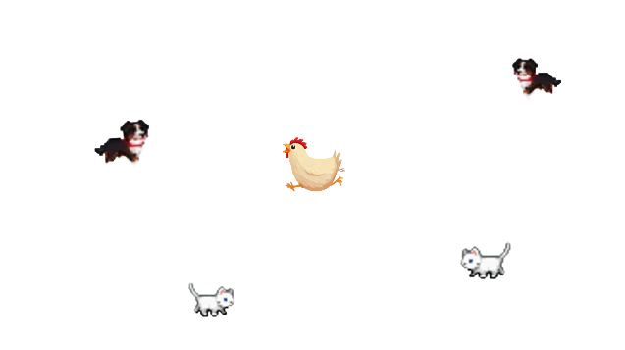
enemy

Slide 5
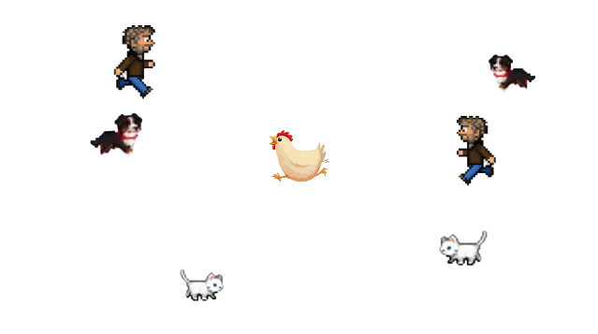
enemy

Slide 6
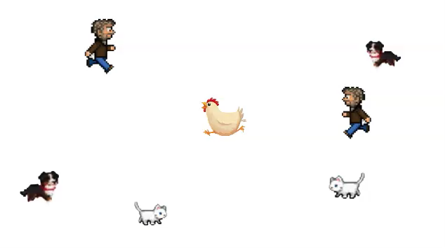
Game flow

Slide 7
Screen flow
Main Menu Screen
High Score Screen
No
Game Screen
High Score Input Screen
High Score?
Yes

Slide 8
Thank you

