Slide 1



Chicken Boneless
Teerapath Keawratana
Notes:
Greeting audience

Slide 2
Over view
concept: the chicken has to escape from the enemy and shoot an enemy with the bone to collect more score.
Genre: Arcade, Shooting
Target audience: casual gamers, competitive players
Notes:
Story: ck run away from kitchen, but still in dining room

Slide 3
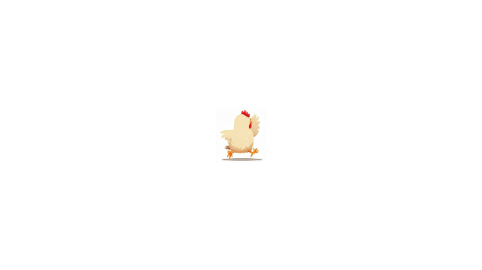


Player control
W
Left Click
A
D
S
Notes:
Chicken movement

Slide 4
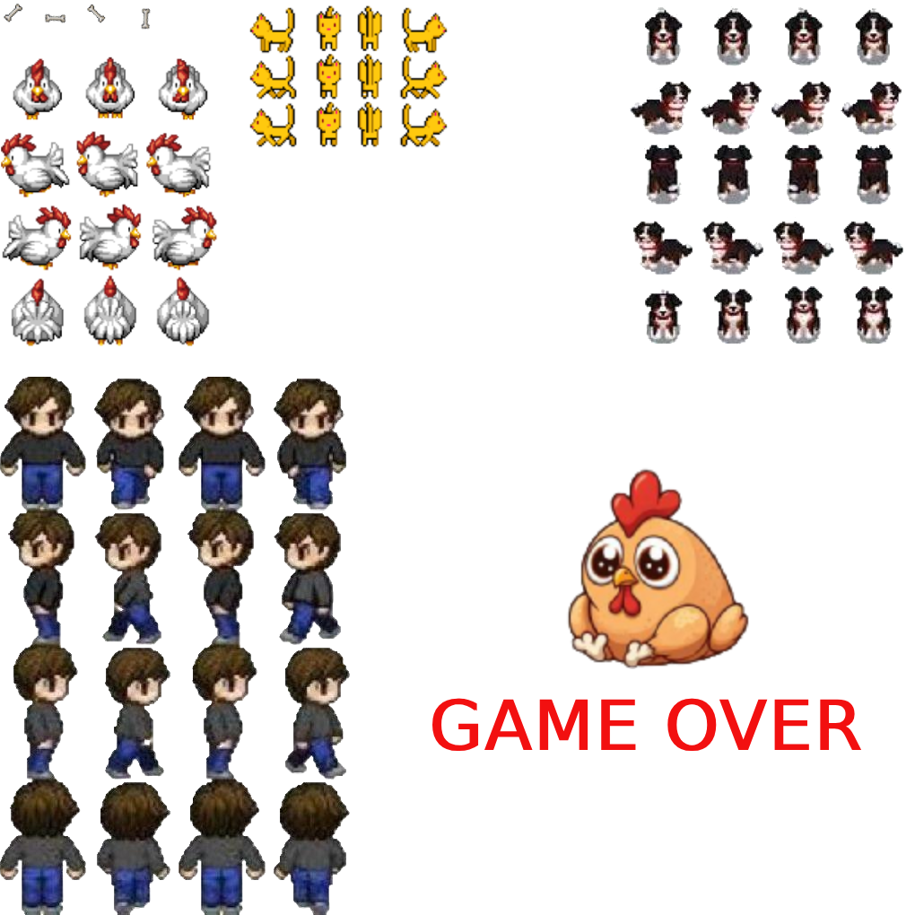
Sprite sheet
www.gameart2d.com

Slide 5
Spawn Enemy

Slide 6
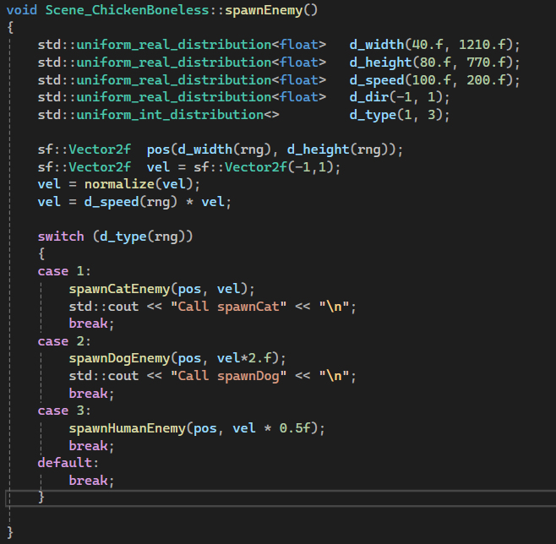

Slide 7
scollision

Slide 8
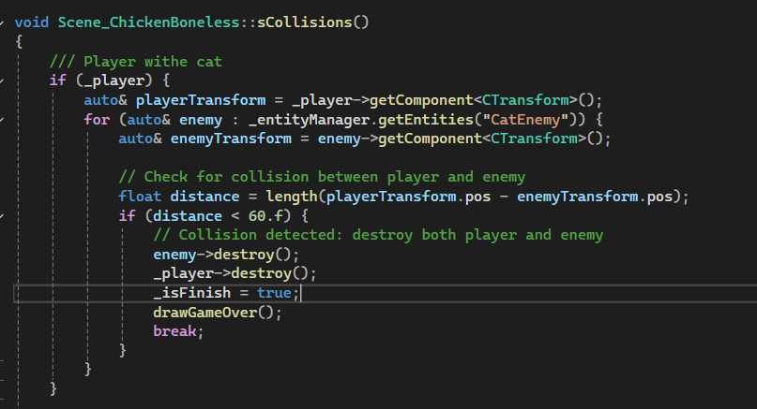

Slide 9
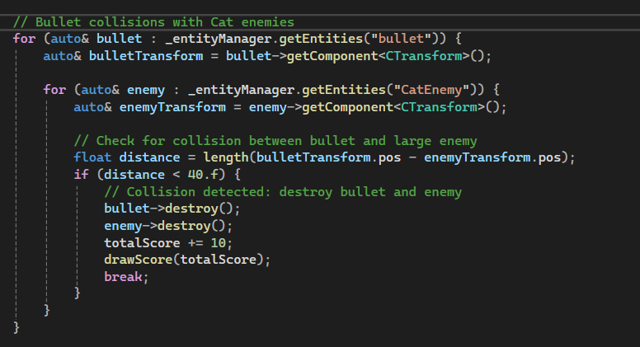

Slide 10
Animation for keepinbound function

Slide 11
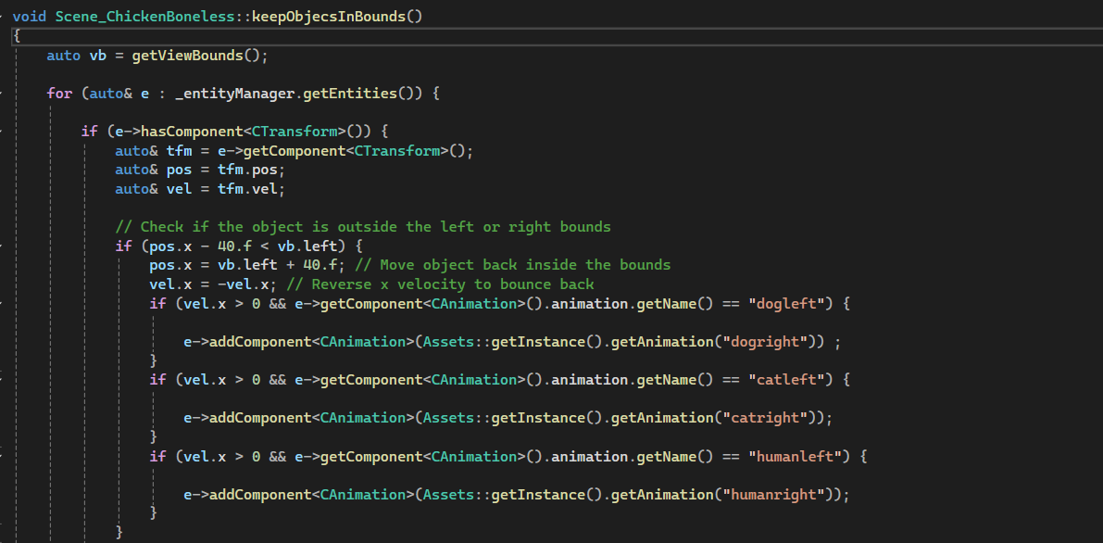

Slide 12
Thank you

