Slide 1

Customer Shopping Behavior Analysis
Uncovering insights from 3,900 purchases to guide strategic business decisions through data-driven analysis of spending patterns, customer segments, and product preferences.

Slide 2
DATASET OVERVIEW
The Foundation: Our Data
3,900
18
37
Total Purchases
Data Columns
Missing Values
Transactions analyzed
Feature dimensions
In Review Rating only
Dataset captures customer demographics, purchase details, and shopping behavior including age, gender, location, subscription status, product categories, discounts, and review ratings.

Slide 3

Data Preparation in Python
01
Data Loading & Exploration
Imported dataset using pandas, examined structure with df.info() and summary statistics
02
Missing Data Handling
Imputed Review Rating nulls using median rating per product category
03
Feature Engineering
Created age_group bins and purchase_frequency_days columns for deeper analysis
04
Database Integration
Connected to PostgreSQL and loaded cleaned data for SQL analysis

Slide 4


SQL ANALYSIS
Key Business Questions
Revenue Analysis
Gender comparison and age group contributions
Customer Behavior
Discount usage patterns and spending habits
Product Performance
Top-rated items and category leaders
Segmentation
New, Returning, and Loyal customer classification

Slide 5
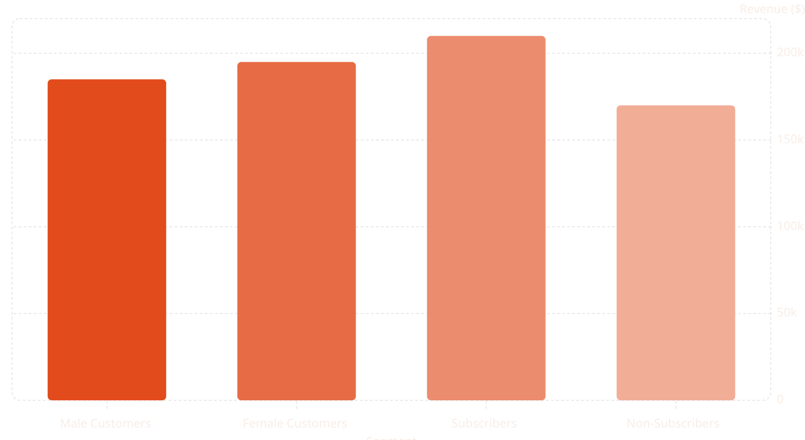
Revenue Insights
Gender & Subscription Impact
Female customers generate slightly higher revenue. Subscribers show significantly higher total revenue and average spend compared to non-subscribers.
Express shipping users also demonstrate higher average purchase amounts than standard shipping customers.

Slide 6




Customer Segmentation
New Customers
First-time buyers exploring the catalog
Returning Customers
2-5 purchases showing growing engagement
Loyal Customers
5+ purchases, high subscription rate
Customers with more than 5 purchases show significantly higher subscription rates, indicating strong correlation between repeat buying and subscription adoption.

Slide 7
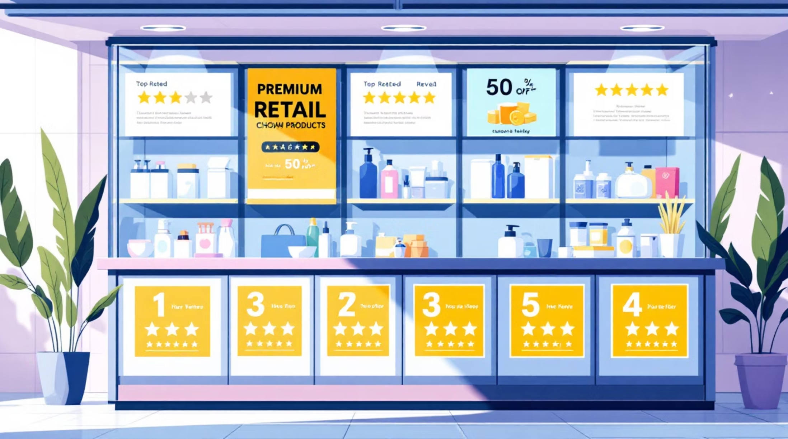
Product Performance Leaders
Top 5 Products by Rating
Highest-rated items show consistent quality and customer satisfaction across categories.
Category Champions
Identified top 3 most-purchased products within each category, revealing clear customer preferences and bestsellers.
Discount Dependency
Five products show highest percentage of discounted purchases, indicating price sensitivity in specific segments.

Slide 8
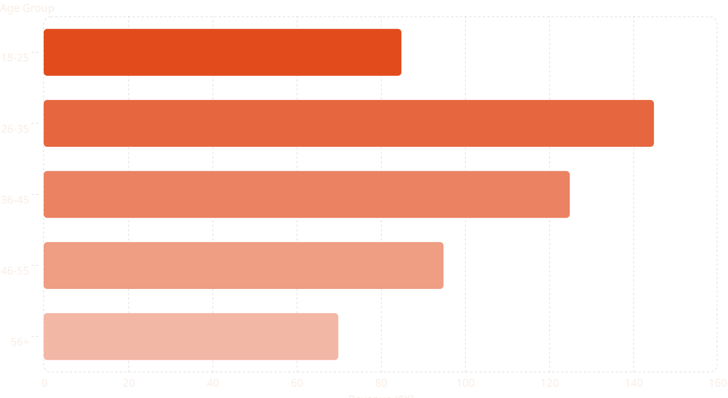
Age Group Revenue Distribution
The 26-35 age group contributes the highest revenue, followed by 36-45. These demographics represent prime targets for marketing campaigns and product positioning strategies.

Slide 9

POWER BI DASHBOARD
Interactive Visual Analytics
Comprehensive Power BI dashboard presents all insights visually with interactive filters for real-time exploration of customer segments, product performance, and revenue trends.

Slide 10


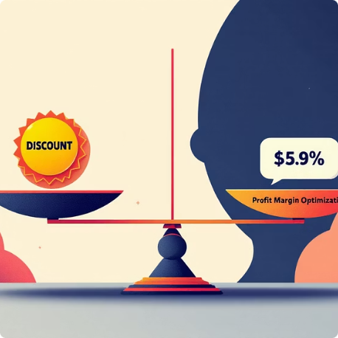

Strategic Recommendations
Boost Subscriptions
Loyalty Programs
Review Discount Policy
Targeted Marketing
Promote exclusive benefits to convert high-frequency buyers into subscribers
Reward repeat buyers to accelerate movement into Loyal segment
Balance promotional sales boosts with healthy margin control
Focus on high-revenue age groups (26-45) and express-shipping users

