Slide 1
MediHealth Clinic:
Cybersecurity Strategy
Protecting Patient Information and Supporting Reliable Care
Titilayo Yusuf
Fictional educational case study
Notes:
This presentation is for clinic management and cybersecurity project judges. MediHealth Clinic is fictional. The assessment is scenario-based, not a technical audit. Controls and targets are proposals, ratings require verification, and costs are unknown. Imagery is illustrative, not evidence of an actual clinic.

Slide 2

A 50-person clinic, assessed from a supplied scenario
50
Employees at a fictional Nigerian primary healthcare provider
EHR processes patient identification details, medical histories, and insurance information
Supplied scenario only: no interviews, system inspection, or technical testing occurred
Notes:
The clinic size and EHR data categories come from the supplied scenario. No interviews, inspection, or testing occurred, so this is not evidence of verified system conditions. Recommendations remain proposed, costs are unknown, and risk ratings require verification. The clinic image is illustrative.

Slide 3
Assessment scope and current weaknesses
EHR server failure disrupted access.
Weak passwords, shared accounts, and no MFA.
Outdated software and unencrypted EHR communications.
Inadequate access controls and physical security.
Limited recurring awareness training.
No documented recovery or incident response policies.
Assessment based on the supplied scenario; no live testing performed.
Notes:
The clinic size and EHR data categories come from the supplied scenario. No interviews, inspection, or testing occurred, so this is not evidence of verified system conditions. Recommendations remain proposed, costs are unknown, and risk ratings require verification. The clinic image is illustrative.

Slide 4
Risk Assessment and Priorities
Risk score=Likelihood x Impact, using a 1-5 scale
Risk | Score | Priority
Outdated Software exploitation | 20 | Critical
Phishing –related account compromise | 16 | High
Weak or shared credential misuse | 16 | High
Unencrypted communication | 12 | High
Extended EHR outage and recovery difficulties | 15 | High
Unauthorised physical access | 12 | High
Ratings need verification. Backup verification is urgent despite its lower score because an outage has already occurred.
Notes:
All six scores are scenario-based estimates and require verification. Backup verification is immediately important because an outage already occurred, even though the outage/recovery score is below the Critical software score. The table does not confirm that phishing compromise or interception occurred. Controls are proposed and costs are unknown.

Slide 5

Phishing Awareness Campaign
Healthcare-specific email examples and staff training.
Pause, Check, Verify, Report.
Verify unexpected requests through trusted contacts.
Authentication results support checking; PASS does not guarantee safety.
Proposed evaluation: reporting rate, confirmed clicks, reporting time, and knowledge checks.

Slide 6
Password Security and MFA
Minimum 15 characters
User passwords should be unique; use long passphrases.
Unique Passwords and compromised-password screening.
Changes following suspected compromise.
Individual accounts and no credential sharing
Proposed controls
MFA
Change after suspected compromise, not routine expiration
Evaluate Bitwarden Business before adoption
Priorities administrator, Email, remote access, and supported EHR access.
Prefer FIDO2/WebAuthn with user verification.
Pilot enrolment, recovery, and clinical workflows
Current NIST guidance informs the password-change approach, an explained departure from the older brief.
Notes:
These are proposed controls, not implemented practices. The minimum 15-character user password policy and compromise-triggered changes reflect current NIST guidance; the change approach is an explained departure from the older brief. NIST does not mandate the Bitwarden Business product recommendation. Evaluate it before adoption. Compatibility and costs are unknown, and scenario ratings require verification.
Reference: https://pages.nist.gov/800-63-4/sp800-63b.html

Slide 7

Technical and Physical Protection
Inventory software and verify vendor support.
Prioritise updates and test critical changes.
Enable supported EHR transport encryption.
Review data locations and role-based access
Introduce staff identification and visitor procedures.
Restrict sensitive areas and secure unattended devices.
Possible consequences include delayed access to histories, errors from inaccurate records, and disrupted appointments.
These are risks only; no patient harm is claimed.
Notes:
The three objectives connect information security to clinical access and reliable records. Consequences are possible risks, not observed patient outcomes. No patient harm is claimed. This is a scenario-based assessment; ratings require verification, controls are proposed, and costs are unknown. The care image is illustrative.

Slide 8

Backup, Recovery and Clinical Continuity
Verify backup coverage and restoration capability.
Protect EHR records, attachments, and configuration.
Maintain protected off-site and isolated recovery copies.
Test restoration and clinical workflows.
Securely document and reconcile work completed during outages.
Service | Proposed RTO | Proposed RPO
EHR | 4 hours | 1 hour
Administrative documents | 1 working day | 24 hours
No training or simulation has occurred.
Notes:
The phishing email and training materials are prepared educational artifacts. Training and simulation have not occurred, and the listed metrics are proposed rather than results. SPF, DKIM, and DMARC PASS results do not establish that an email is safe. The assessment remains scenario-based, ratings require verification, and costs are unknown.

Slide 9
Baseline weaknesses leave records and access exposed
Access and software
Continuity and safeguards
Weak passwords and shared credentials; no MFA
Outdated EHR and device software
Unencrypted EHR communications
EHR server hardware failure disrupted access
Inadequate storage access arrangements and physical security
Limited recurring awareness training
No documented backup/recovery or incident response policies
Unknown: whether backups exist, and whether phishing has compromised anyone.
Notes:
These weaknesses are reported in the scenario, not established by inspection. The hardware failure and disruption are supplied facts; phishing compromise is unknown. An absence of documented backup policy does not establish that backups do not exist. Ratings need verification, all controls are proposed, and costs are unknown.

Slide 10
Incidence Response
Record lessons and corrective actions.
Establish reporting routes, roles, and deputies.
Assess scope, severity, and effects on patient care.
Contain threats and preserve evidence.
Investigate and address the cause.
Validate recovery and monitor for recurrence.
Record lessons and corrective action

Slide 11
Government and Implementation Roadmap
Period Main actions
Day 1-7 Verify backups, software exposure, accounts, and reporting
Day 8-30 Begin training, improve accounts, pilot MFA, plan remediation
Day 31-60 Extend controls and test recovery and response
Day 61-90 Review risks, effectiveness, exceptions, and remaining upgrades
Assign accountable owners. Assess applicable data protection obligations. Verify HIPAA applicability separately. Prepare a costed proposal.
Notes:
All six scores are scenario-based estimates and require verification. Backup verification is immediately important because an outage already occurred, even though the outage/recovery score is below the Critical software score. The table does not confirm that phishing compromise or interception occurred. Controls are proposed and costs are unknown.

Slide 12
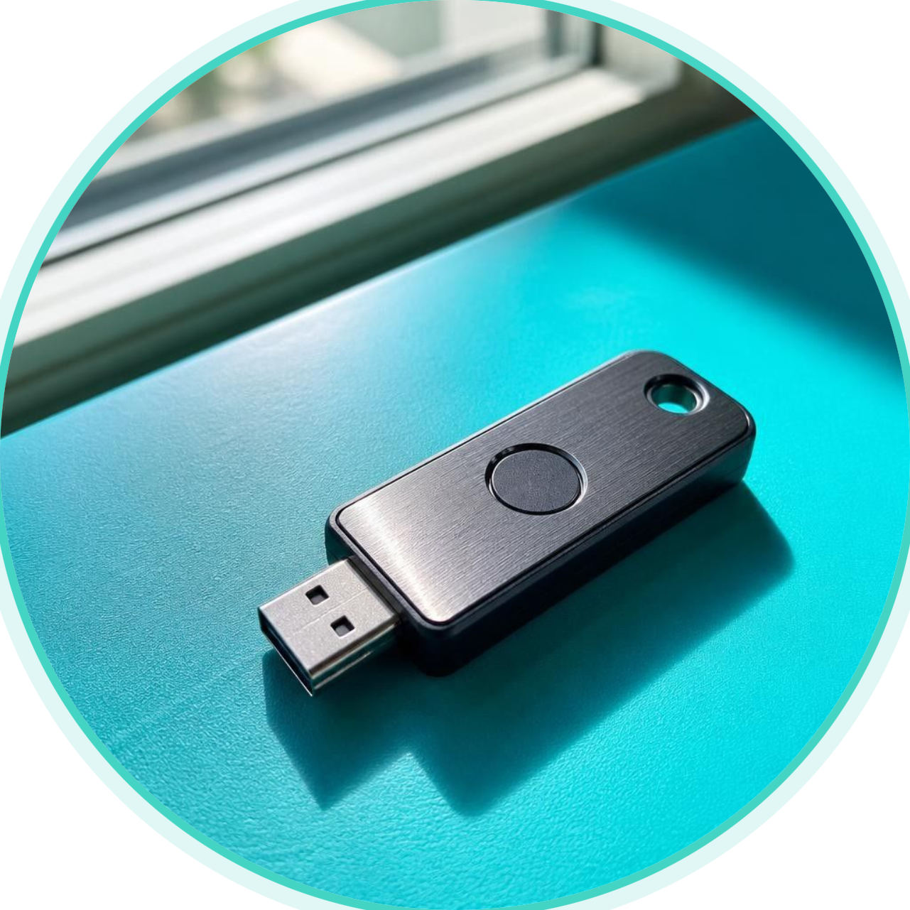
Management Decision and Success Measures
Decisions Requested
Measures
Approve discovery and assign owners.
Agree clinical priorities and recovery targets.
Fund a phased implementation proposal.
Authorise pilots and regular reviews.
MFA enforcement and individual-account coverage.
Awareness outcomes.
Software support and remediation progress.
Tested recovery performance.
Corrective action completion.
Documentation prepared. Implementation and effectiveness remain unverified..
Notes:
MFA deployment is proposed. Remote access is conditional on its presence, and EHR MFA depends on support. Prefer phishing-resistant FIDO2/WebAuthn with user verification; interim codes and number-matched push remain phishing-susceptible. The 5–8-person pilot and six-week rollout are project proposals subject to discovery, not source-mandated targets. Confirm recovery, emergency access, compatibility, and bypass protection. Costs are unknown; ratings require verification.
References: https://www.cisa.gov/sites/default/files/publications/fact-sheet-implementing-phishing-resistant-mfa-508c.pdf and https://pages.nist.gov/800-63-4/sp800-63b.html

