Slide 1
Fall 2019 CSE 140L
Lab 2 Assignment
Alarm Clock
2019.10.06

Slide 2
Part 1: Basic Alarm Clock
Behavioral Description
  User can adjust the clock time and the alarm time.
  A set of LCDs that display:
    The alarm time when the user is setting the alarm;
    The current time in all other cases.
  User can turn the alarm on or off.
  If the alarm is on, the buzzer goes high when
    clock hour = alarm hour, and
    clock minutes = alarm minutes.
-- Alarm works on weekdays only
-- For an A: add date and month calendar (365-day year only)

Slide 3
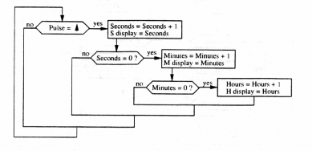
Clock Behavioral Diagram
Student to add day-of-wk cntr

Slide 4
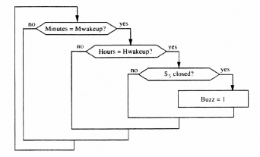
Alarm Behavioral Diagram
Student to add day-of-week
alarm control.

Slide 5
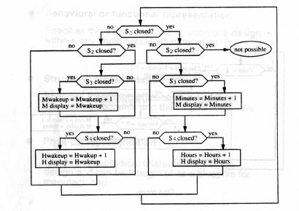
Combined Behavioral Diagram

Slide 6
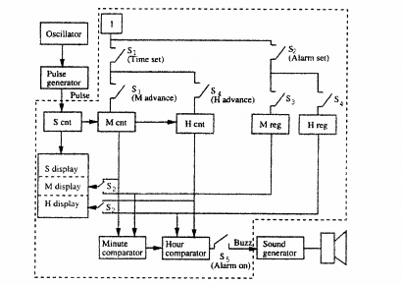
Structural Diagram

Slide 7
Components Provided for Part 1
ClockDev:
  Seconds are incremented at each CLK cycle as in a regular clock. When its Set input is set, clock time can be adjusted by incrementing hours and minutes using SM (Set Minute) and SH (Set Hour) inputs.
AlarmDev:
  Very similar to ClockDev except that this block has neither a CLK input nor seconds output.
LCD Interface:
  Takes a 7-bit input number (0 to 127) and displays it on 7-segment displays as two decimal digits. In this part, only 6 bits will be used.
7Comp:
  7-bit comparator that gives a ‘1’ output if the two inputs are the same.
MUX-2x7:
  7-bit 2-to-1 multiplexer that selects one of the two 7-bit inputs and directs it to its output.
Decoder-4 (LogicWorks library component):
  If En == 1, all output = 1
  If En == 0, For i = 0 to 3, Qi = 0 if S1S0 == i
En
S1
S0
Q3
Q2
Q1
Q0

Slide 8
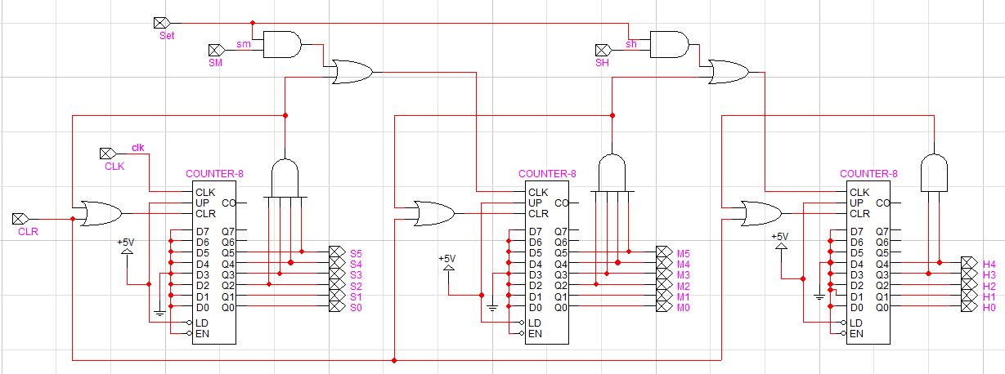
Implementation of ClockDev
Above is the implementation of the ClockDev component,
which demonstrates using a counter with appropriate rollover
logic via a simple AND gate.

Slide 9
Part 2: Days of the Week
Behavioral Description
  The alarm clock keeps track of the day of the week and displays it on a 7-seg LCD Display.
    Counts from 0 to 6 (each number represents a different day of the week, starting with 0 for the 7th day and going to 6 for the 6th day)
  Requires a new counter for tracking the day of the week for the current time.
  The day of the week for the alarm to go off can also be set.
    The alarm will now buzz when current hour = alarm hour, current minute = alarm minute, and current day !=0, 6.
    Requires another counter for the day of the week of the alarm time.
    The alarm time’s day of the week counter will count from 0 to 6. If it is set to 7, then the alarm will ignore the day of the week when evaluating whether to buzz.
    While in the set alarm mode, the LCD Display will show the alarm time’s day of the week.

Slide 10
Part 3 (for an A)
Add a 4-digit calendar display (date and month) to the test bench and a date/month counter to the design
365-day years only – no need to worry about 29 Feb
Figure out how to map 365 consecutive days to date/month format or how to create a 28-30-31 day counter that responds to the month.
Tricky part: involves two interlocked counters

Slide 11
Components for Part 3
MonthofYear
Counts 1 through 12
Set/increment via SPDT pushbutton or rollover from DayOfMonth
DayOfMonth – Represents day of month
– Base on Counter-8
– Months 1, 3, 5, 7, 8, 10, 12: count 1 to 31
– Months 4, 6, 9, 11: count 1 to 30
– Month 2: count from 1 to 28
– Can be incremented via SPDT Pushbutton (independently of DayOfWeek) or through a rollover of the hours (in parallel with DayOfWeek).
– Should always count from 0 to 31 when being set

