Slide 1
Labs 4 and 5
Encryption/Decryption
CSE140L
Spring 2020

Slide 2
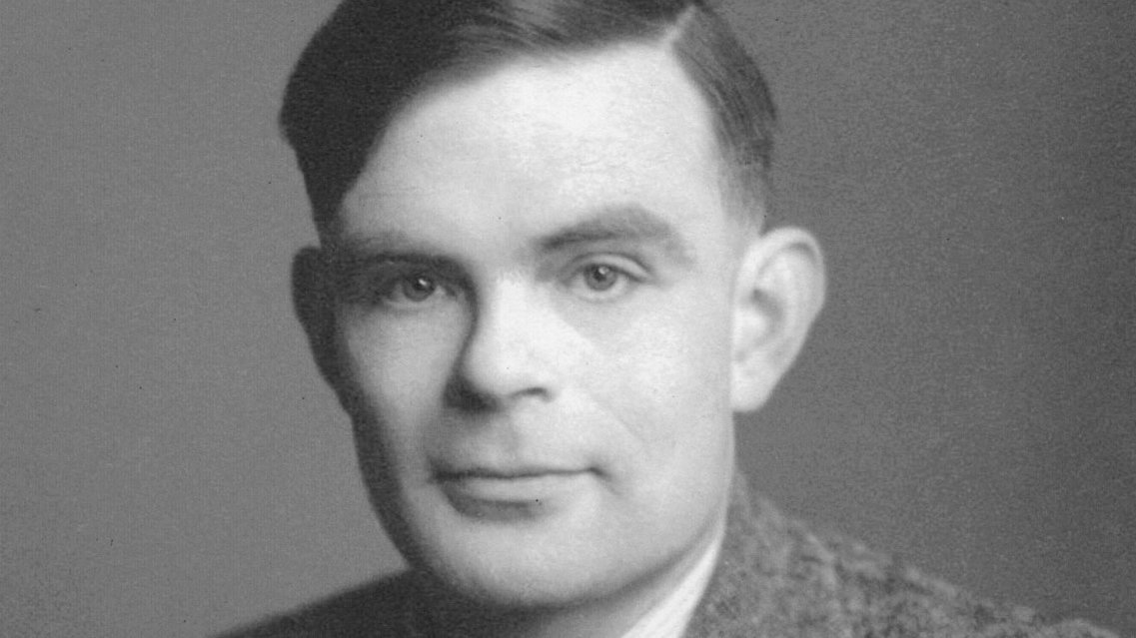
Who Was This Man?
Alan Turing
shortened WWII by 2 years, saved 14M lives
crucial role in cracking intercepted coded German messages, enabling the Allies to defeat the Nazis in many crucial engagements

Slide 3
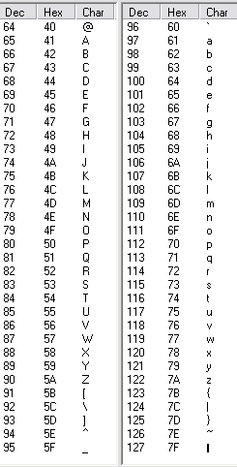
ASCII Table
We shall restrict ourselves to values 0x40 to 0x7F so that our encrypted message will be printable.
My testbench will read in an ASCII character string, cast as binary equivalents, and your module will flip various combinations of bits to encrypt the message.
My testbench will then display the encrypted message.

Slide 4
Our set of values
We are going to encrypt a message to make it unreadable, by taking the binary equivalent of each ASCII character in an incoming message and bitwise XORing it against a 6-bit linear feedback shift register / pseudorandom/pseudonoise code.
We shall restrict ourselves to ASCII codes 64 through 127, all of which have the format 8’b01______. This way, our encrypted message will appear as printable characters.

Slide 5
Preamble / Prefix
We are going to scramble/encrypt the data using a rolling code generated by an 6-tap linear feedback shift register (LFSR).
The LFSR can start in any of 63 possible states (everything except all 0s – why?)
A maximal length 6-tap LFSR, one that hits all 2⁶-1 nonzero states, can be built using any of six different sets of taps.
If we provide a known sequence of data (we’ll use ASCII space characters) that has been encrypted with the LFSR, the receiver can figure out our starting state (easy) and which of the 6 possible LFSR tap patterns we used, in no more than 6 transitions (7 clock cycles).

Slide 6
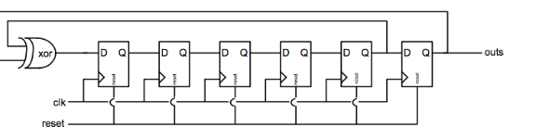
One possible 6-tap LFSR
bit 0 is on the left; bit 5 is on the right
polynomial = 6’b110000 = 0x30
Note: reset should force anything other than 6’b000000 (why)?
Our output will be all 6 bits inside the shift register, rather than just the MSB.

Slide 7
LFSR parallel, not serial, output
We are going to port all 6 internal LFSR state bits to an array of 6 data strings.
On each clock cycle we shall bitwise XOR the current data value with the current state of the LFSR to generate our encrypted output.
This is a rolling code.

Slide 8
Example
first preamble data value = ASCII underline = 8’b(01) 011111;
initial LFSR state = 8’h11 = 6’b010001
encrypted data value = 8’b(01)001110
second preamble value also = ASCII _ = 8’b(01)011111
if taps = 6’h30, second LFSR state = 6’b100011
encrypted data value = 8’h(01)111100;

Slide 9
6 candidate LFSR feedback patterns
0: r1 = 6'h21; // tap positions 50
1: r1 = 6'h2D; // tap positions 5310
2: r1 = 6'h30; // tap positions 54
3: r1 = 6'h33; // tap positions 5410
4: r1 = 6'h36; // tap positions 5421
5: r1 = 6'h39; // tap positions 5430
These are called maximal length patterns.
Any other pattern will not hit all 63 states. (Try it. :) )

Slide 10
Implementation
data memory – testbench will store raw data into addresses 0-50
testbench will provide instructions in addresses 61-63
student DUT will store preamble-padded, encrypted data stream into addresses 64-125
DUT will comprise:
  this two-port data memory (reg. file)
  controller (state machine)
  data path (connects to both)
    LFSR (encryption pattern generator) included in data path
  starter code will be provided

Slide 11
Deliverables
working Verilog model
  state machine for control/sequencing
  data path comprising a data register file / memory and arithmetic/logic circuitry.
Screenshots
  waveform viewer (from ModelSim)
  transcript (from ModelSim)
  top-level block diagram (from Quartus)
  control unit block diagram
  data path diagram
Readme.txt
  help graders wade through your code
  alert us regarding what worked and what didn’t.

Slide 12
Lab 5
Given an encrypted data sequence with a preamble of known (encrypted space) characters:
  train & synchronize the receiver/decrypter’s internal LFSR
  what starting LFSR state was used during encryption?
  what combination of feedback taps was used during encryption?
  continue to run the internal LFSR to decode/decrypt the message
  how long was the message?
    it will have space characters up front and perhaps also at the end
    we want the length of just the message itself, with the front and back padding removed

